Slide 1
The Careers Impact System:
Driving internal insight, external challenge, system-wide impact.
Notes:
The Careers Impact System has always been about more than careers provision.
It’s about strengthening sustainable and strategic careers leadership leadership and improving institutions and learner outcomes.
The Careers Impact System is:
Moving careers into strategic leadership
Embedding evidence and peer challenge
Creating a repeatable, high-quality improvement model

Slide 2
To appreciate how engaging with the Careers Impact System can support continuous improvement.
To understand the value & purpose of engaging with a Careers Impact peer-to-peer review.
To understand the process and commitment to engage in a Careers Impact peer-to-peer review.
Session Aims

Slide 3
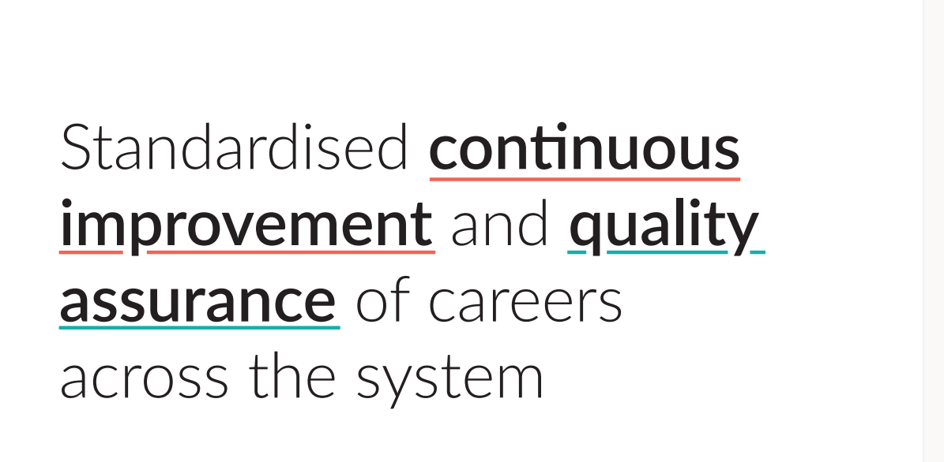
Notes:
This is the overarching ambition for the Careers Impact System.
Rooted in the Gatsby Benchmarks and other evidence about best practice in careers, the Careers Impact System aims to:
Provide assurance of quality of careers provision
Improve careers provision across the country
Elevate the status of Careers Leadership
Support leaders to feel confident in a quality careers education programme that is actually designed to support whole school improvement.

Slide 4
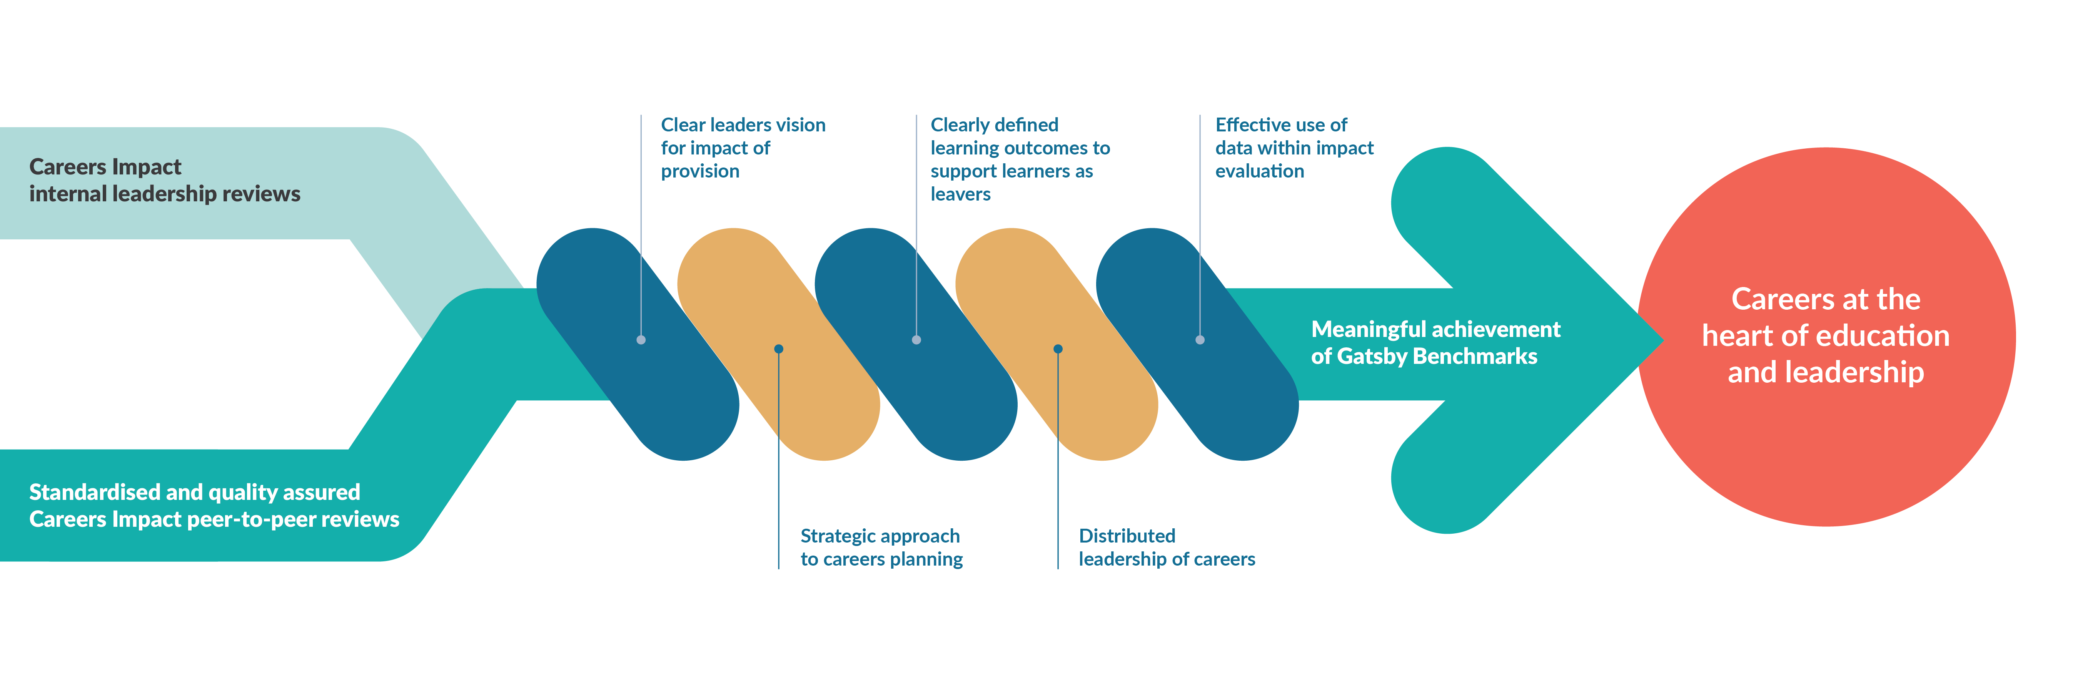
The Careers Impact Model
A structured, evidence-led improvement cycle that makes careers a strategic driver of outcomes across institutions
Notes:
The Careers Impact System is made up of two key parts, both of which I will outline today
Careers Impact internal leadership reviews and peer-to-peer reviews, both of which are based in the five conditions for success that were identified as the elements that need to be in place in order to ensure a sustainable and strategic approach to careers leadership and the meaningful achievement of the Gatsby Benchmarks.
The five conditions for success are embedded within the Careers Impact System and help leaders to focus time and effort in the places that will make the biggest difference.
These are ensuring a clear, well-articulated leaders' vision for the impact of the provision, a strategic approach to careers planning, aligning with wider school improvement priorities, clearly defined learning outcomes to support learners as leavers, a distributed approach to careers leadership and the effective use of data within impact evaluation.

Slide 5
What does the Careers Impact System give us?
“A different way of talking about careers and careers leadership: in the realm of overall improvement.”
“An opportunity to identify the actions that will create a more sustainable and embedded approach where leadership is distributed, and careers is considered to be everyone’s responsibility.”
“A strategic focus on the impact and outcomes of careers provision, when the temptation can be to focus on the operational inputs and activities.”
Notes:
The system overall provides us with a different way of talking about careers and careers leadership, specifically through the lens of wider school, special school and college improvement
The reviews within the system allow us all to reflect on practice and to identify actions that will create a more sustainable and strategic approach to careers leadership
The reviews give you a safe space to focus on the strategic leadership of careers and to step back from the to-do list to re-calibrate, focusing time and effort on the things that will make the biggest difference in your setting,

Slide 6
Why engage in a Careers Impact internal leadership review?
Builds shared understanding, aligns careers to priorities, and identifies clear, evidence-based actions.

Slide 7
The internal leadership review is a collaborative, evidence-informed self-evaluation process based on the Careers Impact Maturity Model.
It brings together those responsible for the distributed leadership of careers to:
Assess current practice across key themes.
Agree a shared view of strengths and priorities.
Align careers with wider improvement goals.
What is a Careers impact internal leadership review?

Slide 8
Internal leadership reviews:
Process
Convene
All those involved in the distributed leadership of careers should be involved in the review process.
Agree
The review involves colleagues reflecting on which statements in the Maturity Model best describe the practice their institution.
Record
The digital feature allows institutions to record the responses collaboratively agreed during an institution’s internal review. Colleagues will have access to a summary of institution's insights, showing a snapshot of indicated areas of strength and priority action areas.
Act
Institution identification of highest leverage actions to drive school, special school or college improvement and to support improved student outcomes.
Careers Impact
Self-evaluation tool
Notes:
Ambition that every school, special school and college undertakes a careers impact internal leadership review annually within their impact evaluation process
The key steps to a review are highlighted on this slide
All those involved in distributed leadership of careers within an institution should convene in the review process
Those convened then consider the maturity model and agree the best ft statements on each line that describes practice in their institutions
We then encourage colleagues to return to the digital tool to record their responses – crucial that this lands as an offline review/discussion process where responses are recorded online through compass/Compass+
The digital functionality allows institutions to see data visualisations of their strengths and areas for focus and recommendations for improvement
The data that institutions see will inform next steps and action planning and will likely inform your ways of working as a Hub…this is straying into value and purpose to Hubs so let’s go back to a focus on value and purpose to schools, special schools and colleges!

Slide 9
Careers Impact internal leadership review: IMPACT
94% report a more strategic view of careers.
92% report stronger alignment with whole-institution priorities.
4 in 5 report increased senior leader engagement.
Notes:
As of participant feedback data May 2026

Slide 10
“We strongly recommend the use of the Careers Impact System which supports a quality assured, sustainable and strategic approach to careers leadership and establishes a shared and standardised language of quality improvement for careers, aligned to school and college improvement.”
Department for Education Statutory Guidance: Careers guidance and access for education and training providers June 2026
Notes:
It is recommended in Statutory Guidance, that institutions undertake a Careers Impact internal leadership review. This process involves key senior staff and will support you in understanding what embedded good practice looks like and how to recognise it.
Engagement with this process also enables you more confidently articulate the intent, design and impact of your careers provision whether for internal reflection, external validation, during an Ofsted inspection or within stakeholder engagement.
Through this process, leaders gain:
a clear understanding of strengths and areas for development within their careers provision.
evidence-based insights to inform inspection discussions and stakeholder engagement.
increased confidence across leadership and staff in articulating impact and strategic direction.
a demonstration of a culture of continuous improvement and strategic oversight.
strengthened collaboration across departments, fostering shared ownership of careers education.
development of robust impact measures aligned with institutional priorities.
the ability to monitor progress over time and adapt strategies responsively.

Slide 11
“The Careers Impact internal leadership review sets clearly defined standards on what good careers leadership looks like: it is directly linked to wider school and college improvement.”
Department for Education Statutory Guidance: Careers guidance and access for education and training providers June 2026
Notes:
It is recommended in Statutory Guidance, that institutions undertake a Careers Impact internal leadership review. This process involves key senior staff and will support you in understanding what embedded good practice looks like and how to recognise it.
Engagement with this process also enables you more confidently articulate the intent, design and impact of your careers provision whether for internal reflection, external validation, during an Ofsted inspection or within stakeholder engagement.
Through this process, leaders gain:
a clear understanding of strengths and areas for development within their careers provision.
evidence-based insights to inform inspection discussions and stakeholder engagement.
increased confidence across leadership and staff in articulating impact and strategic direction.
a demonstration of a culture of continuous improvement and strategic oversight.
strengthened collaboration across departments, fostering shared ownership of careers education.
development of robust impact measures aligned with institutional priorities.
the ability to monitor progress over time and adapt strategies responsively.

Slide 12
Confident articulation of impact across new
Ofsted Evaluation areas
Evaluation Area | Questions to consider
Leadership and Governance | How well do leaders understand learners’ needs, and how has this shaped the careers provision? Has careers provision been used to address key institutional challenges?
Curriculum and teaching / Curriculum teaching and training | Is the curriculum designed to build knowledge and skills for future education, training, or employment? How does the strategic careers plan influence curriculum intent and planning? How is destination data used to shape curriculum decisions? Does the curriculum reflect local labour market needs? What support is available to help staff understand labour market information and transition pathways? How are staff supported to highlight the relevance of their subject to careers, pathways, & essential skills? How are staff supported to make links from the curriculum to careers, pathways, and essential skills?
Attendance and behaviour / Participation and Development | Does the strategic careers plan help build cultural capital, especially for disadvantaged learners and those with SEND? Does the strategic careers plan support positive attitudes to learning and improved engagement? Do employer and education encounters inspire learners and improve attendance?
Inclusion | How is data on vulnerable groups used to plan targeted careers provision? How do you ensure all learners including those absent or in alternative provision access careers provision? What evidence shows the impact of differentiated careers provision for vulnerable learners?
Notes:
The NEW Ofsted guide coming out in the next few weeks will dig deeper into how to confidently articulate impact to Ofsted.
The process of undertaking a Careers Leadership internal leadership review is not only recommended in Statutory Guidance, it also can help strengthen your confidence in effectively articulating how careers provision contributes to other Ofsted evaluation areas. You can see some examples of the types of reflective questions and conversations that will arise through the process of collective self-evaluation.
Senior leader participation in a Careers Impact internal leadership review or their strategic and responsive involvement in a peer-to-peer review, provides a strong indication of effective leadership. Participation not only supports informed decision-making but also demonstrates a commitment to inclusive, high-quality provision. The peer-to-peer review adds further rigour, and the resulting impact-evaluated strategic action planning can serve as potential evidence of ‘strong’ or even ‘exemplary’ practice under the new framework.

Slide 13
Scale and impact of Careers Impact internal leadership review
Almost 4,000 institutions nationally have undertaken an internal leadership review since pilot with over 2000 in 2025/6.
94% report a more strategic view of careers.
92% report stronger alignment with whole-institution priorities.
4 in 5 report increased senior leader engagement.
100% report clarity on priority areas for development.
61% report increased use of evidence (e.g. FSQ).
👉 Careers is now:
Part of SLT conversations.
Aligned to school improvement planning.
Informing resource and curriculum decision SLT strengthens quality and accountability.
👉 This leads to:
Better targeting of resources.
Stronger evaluation and accountability.
Clearer evidence of impact.
Notes:
May feedback data

Slide 14

Why undertake an internal leadership review?

Slide 15

  “Careers is the cornerstone of education, and the internal leadership review showed us how much we haven’t thought about yet.
  The maturity model takes a lot of that thinking work away – it enables us to work out where we are and what we need to do next because it’s written down for us – so we can focus on strategy and implementation.”
  Senior Leader (2024)
  Following involvement in an internal leadership review

Slide 16
Why engage in a Careers Impact
peer-to-peer review?
Expert-facilitated, whole-setting challenge that strengthens leadership decisions and drives consistent, high-quality careers leadership and careers provision across the system.

Slide 17
Peer-to-peer review is an expertly facilitated, collaborative leadership process where institutions engage with trained peers to:
• Explore their internal leadership review.
• Test assumptions and challenge thinking.
• Strengthen and refine improvement plans.
Over 1200 schools, specialist settings and colleges have engaged in peer review to date.
What is a Careers impact peer-to-peer review?

Slide 18
Peer-to-peer review process
Internal leadership review
Convene
Agree
Record
Trio formation, preparation and commitment
Connect
Support
Prepare
Review
Standardised methodology
Lines of enquiry
Agreed priorities and actions
Act
Highest Leverage Actions
Action planning
Present to SLT & Governors
Reconvening
Careers Impact
Self-evaluation tool
Notes:
Internal leadership review
Institutions begin by bringing together the right colleagues (internal to their institution) to complete an internal leadership review, reflecting on strengths and areas for development in relation to Careers Leadership Maturity.
Forming trios and preparation for review
Institutions are grouped into trios for the review day. Groupings may be based on setting type (e.g. special schools, colleges), similar /different benchmarks or priorities, geographical location, or Trust membership. Sharing the rationale for groupings with leaders helps reinforce the value of the collaborative approach. Colleagues will need to prepare for the review which will be covered in the next section on commitment.
Review day participation
Each institution commits up to two staff members to attend the full review day, one of whom must be the senior leader responsible for careers. Full engagement is essential for meaningful peer learning and reflection.
Post-review – Summary and action planning
Following the review, the facilitator provides a summary of review document. Each institution then completes an action plan within the same document. This is designed to support strategic conversations with wider leadership teams and governors, promoting distributed leadership of careers. There is finally the option to reconvene as a trio to share progress and maintain momentum.

Slide 19

  This opportunity has allowed us the time but more importantly the constructive challenge to reflect on what we do. The Maturity Model has done the thinking, giving our team the space to focus on the strategy to ensure effective implementation.
  Headteacher (2026)
  Careers Impact peer-to-peer review

Slide 20
Careers Impact peer-to-peer review: IMPACT
100% report relevance to leadership roles across the setting.
97% report confidence that actions will be implemented.
100% agreed the review was helpful to address their school's/college's specific challenges and priorities.
Notes:
Survey data May 2026

Slide 21
Scale and impact of Careers Impact peer-to-peer reviews
Over 1,200 institutions nationally have undertaken a peer-to-peer review
300+ expert facilitators trained 2025/26
100% agreed the review was helpful to address their school's/college's specific challenges and priorities.
100% report relevance to leadership roles across the setting.
97% report confidence that actions will be implemented.
Driving quality, accountability, and impact across the system.
Improves quality and consistency through shared learning, collaboration, and alignment to best practice.
Builds trust and accountability by ensuring honest reflection, reliable insight, and strong quality assurance.
Strengthens system impact by enabling collective solutions for engagement, NEET risk, and equity.
Notes:
May feedback data

Slide 22
From activity to strategy
Careers is increasingly being positioned as a whole-setting priority
Survey findings
  95% viewed careers more strategically.
  93% strengthened links to institutional improvement.
  88% developed a shared language for careers leadership.
Quality Review (12+ months on)
  Careers embedded within improvement planning.
  Greater involvement from senior leaders, governors and trusts.
  More distributed careers leadership.
  Stronger governance and strategic structures.
Insight: Careers is moving from a standalone programme to a strategic whole-setting priority.
Notes:
This finding is particularly important because it suggests careers is increasingly being seen as a strategic lever for whole-establishment improvement rather than a standalone programme.
Looking first at the survey evidence, the impact is clear. 95%of respondents said the internal leadership review helped them view careers more strategically, while 93% reported stronger links between careers and wider institutional improvement priorities. In addition, 88% said the process helped create a shared language for careers leadership, and 78% reported a better understanding of how careers can contribute to wider priorities such as attendance, engagement and learner outcomes.
These findings indicate that the Careers Impact System is helping establishments move beyond a focus on individual careers activities and towards a more strategic view of careers as part of organisational improvement.
What is particularly encouraging is that the Quality Review evidence suggests these changes are being sustained over time.
More than 12 months after participating in a peer-to-peer review, institutions described careers priorities being incorporated into school improvement plans and strategic careers plans. They reported stronger involvement from senior leaders, governors and trust leaders, demonstrating that responsibility for careers was becoming more widely shared.
The Quality Review also found evidence that careers leadership was becoming more distributed, reducing reliance on individual Careers Leaders and embedding careers more firmly within leadership structures. Several institutions had introduced new policies, governance arrangements and trust-level approaches, demonstrating that the review process had influenced not only thinking but also organisational practice.
Taken together, the survey and Quality Review findings tell a consistent story. The immediate impact of the Careers Impact System is helping institutions think more strategically about careers, while the longer-term evidence suggests this is translating into sustained organisational change, with careers increasingly embedded within leadership, governance and whole-establishment improvement planning.
Provide your feedback on BizChat

Slide 23
Strengthening
leadership engagement
Reviews are broadening ownership of careers leadership
Survey findings and data insight:
  63% involved senior leaders in internal leadership reviews.
  85% reported increased SLT engagement following peer-to-peer review.
Quality Review (12+ months on)
  Careers is featuring more prominently in leadership and governance.
  Careers Leaders report greater influence and organisational backing.
  Careers priorities are increasingly reflected in school and trust-level planning.
Careers is becoming a shared leadership responsibility,
not solely the remit of the Careers Leader.

Slide 24
From reflection to action
Reviews are translating reflection into action
Survey findings
  100% reported greater clarity about strengths and development priorities.
  93% expected improved careers provision.
  88% expected improved learner outcomes.
  85% anticipated more empowered careers leadership.
Quality Review (12+ months on)
  Evidence of changes to plans, policies and provision.
  Follow-up activity helped sustain momentum and accountability.
  Review findings continued to inform decision-making over time.
Insight: The process combines reflection, challenge and practical action planning, helping settings convert insight into sustained improvement.
Notes:
The Quality Review helps us understand why these changes appear to endure.
Participants consistently highlighted the value of having dedicated time to reflect, constructive challenge from peers, and practical next steps that could be implemented immediately.
Reviews were described as reflective, supportive and non-judgemental, creating an environment where institutions could recognise strengths, identify priorities and, most importantly, turn those priorities into action.
This suggests the greatest value of the Careers Impact System is not simply diagnosis. It's creating the conditions for meaningful action and sustained improvement."

Slide 25

Why undertake a peer-to-peer review?

Slide 26
Cumulative Added Value of Careers Impact Reviews
Internal Leadership
Review
Broadening understanding through wider SLT engagement in Careers.
Collaborative awareness of current positioning of careers.
Peer-to-Peer Review
Support and challenge from peers with a focus on impact and quality of provision.
Expert guidance from a trained facilitator using standardised methodology.
Summary of Review,
Action Planning and Post-Review Stages
A summary of identified strengths and agreed highest leverage actions to inform SLT and Governors.
Collaborative action planning to ensure sustainable, strategic, impact-driven improvement.
Stimulates initial thoughts around how to achieve progress through the Maturity Model.
Collaboratively agreed highest leverage actions prompted by the Maturity Model language.
Ongoing support to enable long-term impact where careers is leveraged as a vehicle for overall improvement.
Notes:
Following an internal leadership review, you may decide that engaging in a peer-to-peer review is the natural progression. It adds value through:
Expert guidance and constructive challenge.
Supportive collaboration with peers, enabling shared learning and best practice exchange.
The collective identification and lasting impact of highest leverage actions.
It builds on the strengths and areas for development surfaced through the internal leadership review and senior leaders and practitioners work together and share best practice examples and engage in reflective dialogue, to identify highest leverage actions in a fraction of the time.
The process results in a clear, prioritised direction of travel, documented in a summary report which includes a collaborative action plan to drive improvement.

Slide 27

Careers Impact System engagement
The expectation is that each setting:
Completes an internal leadership review annually, to track and measure progress.
Engages in a peer-to-peer review every three years (with every institution to have taken part by 2028/29).
Notes:
The expectation is that each institution:
Completes an internal leadership review annually, to track and measure progress.
Engages in a peer-to-peer review every three years.
This will ensure the ongoing internal reflection and external support and challenge continues to drive improvement and benefit each and every learner.

Slide 28
Without strategic reflection,
careers provision risks remaining fragmented, reactive, and disconnected from wider improvement efforts,
ultimately limiting its impact on learners.
Notes:
Not engaging risks careers provision that is not providing for our learners, particularly impacting those who are at disadvantage. Without reflection and continuous improvement driven by school, special school and college leaders, careers provision risks remaining fragmented, reactive, and disconnected from wider improvement efforts, ultimately limiting its impact on learner outcomes.

Slide 29
Q&A

