Slide 1
Guidance for Governors
Updated July 2026

Slide 2
This guidance is designed to ensure all governors and trustees:
1
Have a good understanding of the Careers Strategy.
4
Appreciate the role of the governor in supporting the Careers Strategy.
2
Are fully aware of the setting’s statutory duties.
5
Feel supported in challenging school or college leaders.
3
Explore how careers could be allowed to be a driver for improvement.
6
Are aware of the range of support available from The Careers & Enterprise Company.

Slide 3
What is careers?
Careers is everything young people need to know, understand and be able to do in order to:
Make aspirational and informed decisions.
Make effective and sustained transitions.
Develop career readiness/
prepare for adulthood.

Slide 4
High quality careers education & guidance:
Drives learner outcomes.
Reduces NEET figures (young people not in Education, Employment or Training).
Increases young people’s skills knowledge and behaviours to inform their next steps.
Impact of the work of the CEC
Evidence shows that:

Slide 5
The Gatsby Benchmarks
All education settings are expected to take a strategic approach to the development of their careers provision, through:
The appointment of a named Careers Leader.
Using the Gatsby Benchmark Framework.
Find out more about the development of the Benchmarks here ‘Good Career Guidance – The Next 10 Years’
From September 2025, DfE expects all settings to use the updated Gatsby Benchmarks.

Slide 6








The Gatsby Benchmarks
1. A stable careers programme.
5. Encounters with employers and employees.
2. Learning from careers and labour market information.
6. Experiences of workplaces.
3. Addressing the needs of each young person.
7. Encounters with further and higher education.
4. Linking curriculum learning to careers.
8. Personal guidance.

Slide 7
The core of the eight Gatsby Benchmarks remains the same, but some important changes include:
  Careers at the heart of education and leadership.
  Inclusion and impact for every young person.
  Meaningful and caried encounters and experiences.
  Focusing on the use of information and data.
  Engagement of parents and carers.

Slide 8

Understanding the Gatsby Benchmark updates

Slide 9
Statutory Duties:
Schools and Special Schools
For further information, access our ‘At a Glance Checklist and Guide for School Leaders.’
The Governing Body should ensure that the school complies with its statutory responsibilities:
The appointment of a Careers Leader.
2. Compliance with the provider access legislation.
3. The publishing of policy statements on the school’s website.
4. Commitment to the delivery of independent and impartial careers guidance.
5. A strategic approach to meeting legal and statutory requirements with a commitment to quality assurance and continuous improvement.
Notes:
Provide at least six encounters with approved providers of apprenticeships and technical education, for all students:
Two encounters for pupils during the ‘first key phase’ (year 8 or 9) that are mandatory for all pupils to attend
Two encounters for pupils during the ‘second key phase’ (year 10 or 11) that are mandatory for all pupils to attend
Two encounters for pupils during the ‘third key phase’ (year 12 or 13) that are mandatory for the school to put on but optional for pupils to attend

Slide 10
Statutory Duties: Colleges and Training Providers
The Governing Body should ensure that the college is following the DfEs expectations to:
Use the updated Gatsby Benchmarks to improve careers provision.
Offer every learner at least two meaningful encounters with an employer each year, at least one of which should be related to the learner’s field of study.
Undertake an Internal Leadership Review to ensure stability and sustainability within careers leadership and lead to college improvement.
Appoint a named person to the role of Careers Leader to lead the careers programme.
Publish details of the careers programme on the college’s website in a way that enables learners, parents, college staff and employers to access and understand it.
Collect and maintain accurate data for each learner on their education, training or employment destinations.
Ensure that all young people with an EHC plan are provided with independent careers guidance and secure access for all learners.
Hold the matrix Standard if they are in receipt of funding from the DfE adult skills budget.
For further information, access our ‘At a Glance Checklist and Guide for College and ITP Leaders.’

Slide 11


More detailed support and guidance on Statutory requirements and Ofsted expectations, can be found here:
Careers Education: A Guide for college governors
Careers Education: A Guide for secondary and special school governors

Slide 12
Reforming work experience
From September 2026, all schools should be reforming their work experience programmes providing a minimum of two weeks’ worth of work experience by Year 11 (during Key Stages 3 and 4), made up of:
At least one week of work experience activities in Years 7–9.
At least one week of placements in Years 10–11.
This ambition will ensure access for all young people, enable flexibility for schools, learners, and employers to design experiences that meet local and individual needs.
For further insight and support, please visit The CEC website pages on Modern Work Experience

Slide 13

How can careers be a driver for school, special school or college improvement?

Slide 14
Conditions for Success:
Careers Leadership as a driver for school, special school and college improvement
Impact evaluation with robust and regular monitoring (by SLT and governance) and celebration of success.
Allocating relevant resource and distributed leadership of careers (inc. SLT).
Strategic approach to planning of careers provision with clearly articulated vision and priorities (link to overall development planning).
Intentionally planned student career learning journeys that are responsive to need and that include clear measurable milestones.
Clear vision from leaders with definition of intended impact and identification of relevant success criteria shared with SLT and governance.

Slide 15
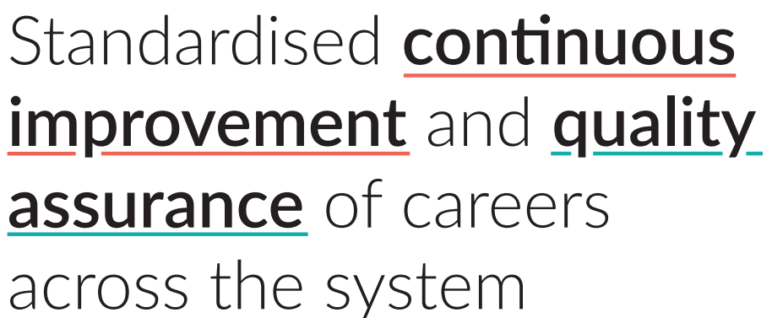

Slide 16
Undertaking an internal leadership review will:
Support leaders to identify areas for development and a clear strategic action plan.
Offer a measurement of the ability and capacity for continuous improvement.
Help leaders to assess the current effectiveness of a setting or programme.
Access information about the Careers Impact internal leadership reviews here.

Slide 17
Key strategic questions to support and challenge leaders
For further questions to support conversations with Careers Leaders, please access the Guides for school, special school and college Governors.

Slide 18
Legal requirements and other expectations
Have the school leaders or college executives informed the Governing Body of its legal and other requirements with regard to career guidance, and the expectations in the DfE’s latest guidance?
Does the setting comply with its legal requirements and other responsibilities for career guidance, and are these reflected in the careers policy?
Do all learners have the opportunity to engage with further and higher education, apprenticeships and other routes to employment?

Slide 19
Strategic oversight
Is the Governing Body fully aware of the careers provision and it is engaged in the evaluation of the careers provision?
Is there a strategic careers plan?
Is it aligned with the setting’s strategic priorities?
How frequently is it discussed at Governing Body meetings?
Have leaders taken part in a Careers Impact internal leadership review?

Slide 20
Leadership of Careers
Who in the senior leadership team is responsible for careers, and which staff members have defined roles in this area?
Is the Careers Leader adequately trained, resourced, and are their details and the careers programme information accessible and up-to-date on the website?
How often does the Careers Leader report to the senior leadership team and Governing Body, and is there a Link Governor for careers who meets regularly with the Careers Leader?

Slide 21
Quality assurance
How is the effectiveness of the setting’s careers provision evaluated, and what evidence supports this?
Does the careers provision meet the needs of all learners, including vulnerable or disadvantaged learners, and how does it compare to national and regional standards?
Is sufficient time allocated to whole-staff CPD to support them to link curriculum learning to careers and to have effective careers conversations with learners, parents and carers.

Slide 22
Support from the Careers & Enterprise Company
The Careers & Enterprise Company provide both local and national support for Governors, including:
We have a range of training and support available, including a dedicated Governor Page on our Resource Directory with training and resources.
There is a free online training module on the Careers & Enterprise Academy, designed to support you in your role as Governor.
Register here to receive latest policy updates and support via our Governor Newsletter.
Access our Careers Hub network. Careers Hubs are partnerships between The Careers & Enterprise Company and Combined and Local Authorities and Local Enterprise Partnerships.
For support to understand the work experience guarantee, visit the CEC website here.

Slide 23
Any questions?

