Slide 1
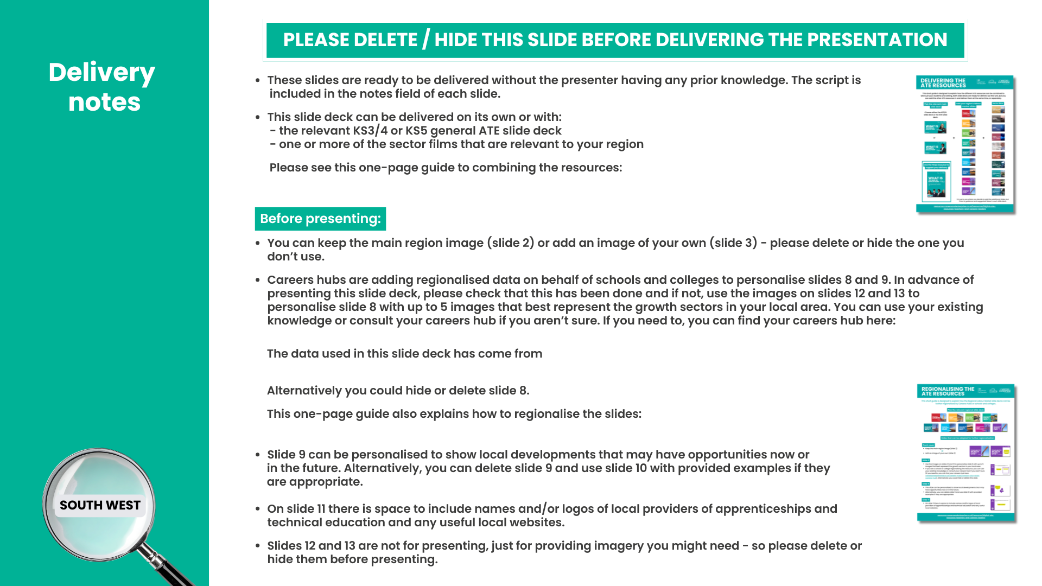
resources.careersandenterprise.co.uk/sites/default/files/2026-03/Combining%20the%20ATE%20Resources.pdf
careersandenterprise.co.uk/careers-hubs/contact-your-local-careers-hub
gov.uk/government/publications/labour-market-and-skills projections-2020-to-2035
resources.careersandenterprise.co.uk/sites/default/files/2026-03/Regionalising%20the%20ATE%20Resources.pdf
Notes:
Speaker note: please ensure you have followed the instructions on this slide and then delete or hide it before presenting.
Links from the slide:
One-page guide to combining the resources: https://resources.careersandenterprise.co.uk/sites/default/files/2026-03/Combining%20the%20ATE%20Resources.pdf
Finding a careers hub: https://www.careersandenterprise.co.uk/careers-hubs/contact-your-local-careers-hub
Data used in the slide deck: www.gov.uk/government/publications/labour-market-and-skills-projections-2020-to-2035
One-page guide to regionalising slides: https://resources.careersandenterprise.co.uk/sites/default/files/2026-03/Regionalising%20the%20ATE%20Resources.pdf

Slide 2

Notes:
Today / Now (if you have added this slide deck to the general ATE slide deck) we are going to have a look at the South West more specifically and what the labour market is like here.
Optional audience question:
Does anyone know what the term ‘labour market’ means or describes? Or know anything about it?
We could also call the labour market the ‘job market’ and it describes the current employment situation in a whole country or in a more specific area, and we’re going to look at both of those today.

Slide 3

If you would like to use a different image to represent your region, please do so here and delete the previous slide.
If you want to use the previous slide, please delete this one before presenting.
Notes:
Speaker note: If you would like to use a different image to represent your region, please ensure you have done so by adding an image to this slide before presenting. If not, please delete this slide and use the previous slide instead.
Today / Now (if you have added this slide deck to the general ATE slide deck) we are going to have a look at the South West more specifically and what the labour market is like here.
Optional audience question:
Does anyone know what the term ‘labour market’ means or describes? Or know anything about it?
We could also call the labour market the ‘job market’ and it describes the current employment situation in a whole country or in a more specific area, and we’re going to look at both of those today.

Slide 4
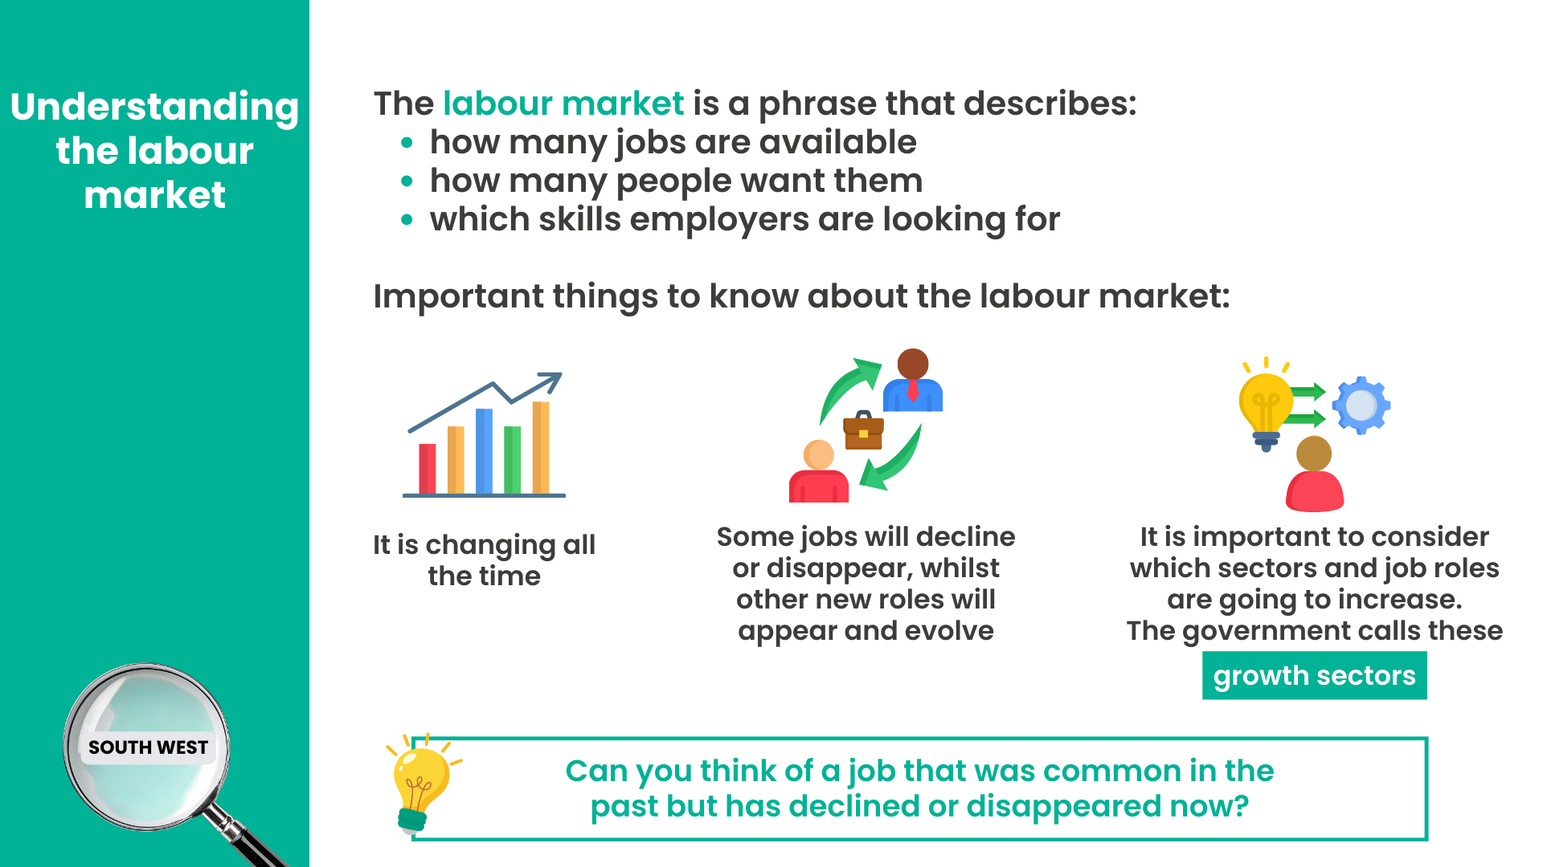
Notes:
The labour market is a phrase that describes how many jobs are available, how many people want them and which skills employers are looking for.
It’s important to know that the labour market changes all the time. Some jobs will decline or disappear, whilst other new roles will appear and evolve. When we’re thinking about careers and future options, we should also consider which sectors and job roles are going to increase. The government calls these growth sectors.
Optional audience interaction:
Can you think of a job that was common in the past but has declined or disappeared now?
Example answers:
Video rental shop assistant - shops like Blockbuster employed staff to manage physical tapes and DVDs – now we have streaming platforms and automated digital libraries.
Typist / word‑processing operator - offices once relied on dedicated staff to type letters, reports and forms for colleagues and then to post or fax them. This would’ve been the case in our school / college, but now everyone has personal computers and office software documents are sent via email.
Directory enquiries operator - people phoned a number to ask for someone’s telephone number, but now we have online search engines and digital contact directories.
Paste‑up artist (newspaper and magazine layout) - before digital publishing, staff physically cut and arranged content on boards but now it is digital.
Traditional travel agent (walk‑in model) - booking holidays with in‑person agents haw decreased with online booking platforms and comparison sites.

Slide 5
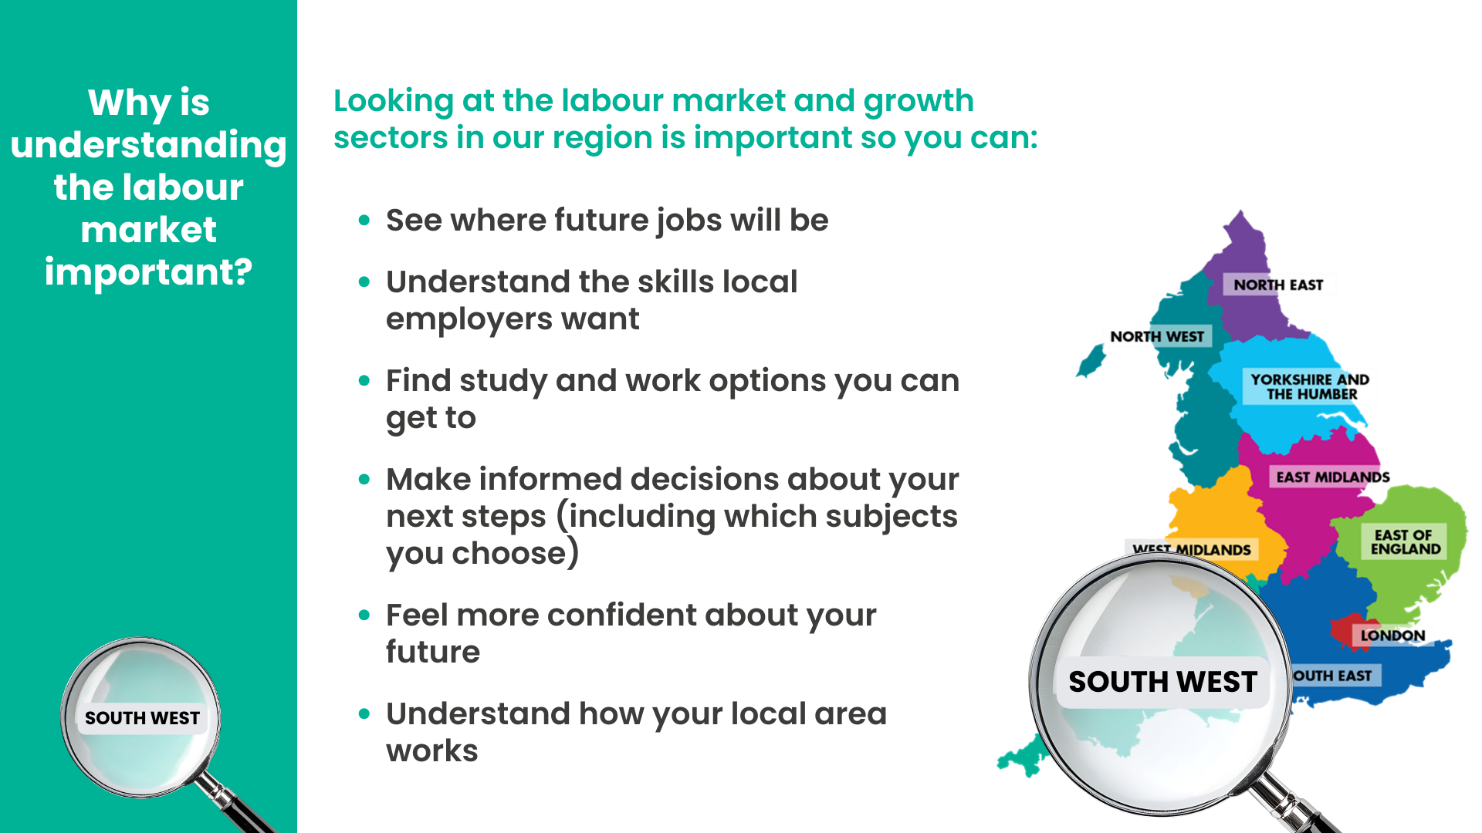
Notes:
Understanding the labour market and growth sectors is important for lots of reasons and it’s something you may not have thought about before. But if you’re starting to think about jobs you want to do in the future, it’s a really good idea to think about which jobs are available and if there will be opportunities in the area you live or want to live.
On the screen you can see some of the reasons why it’s important to understand the labour market:
See where future jobs will be – this is fundamental to helping you consider what your options are.
Understand the skills local employers want – if you know which jobs are going to be available, you can make sure you work on developing relevant skills.
Find study and work options you can get to – if you want to stay living where you are now, understanding what employers and jobs there are that you could actually travel to is really important.
Make informed decisions about your next steps (including which subjects you choose) – Speaker note: this will depend on which year group you are delivering to and when during the academic year – for example if it’s to year 9, they might have already chosen their GCSE options – if you know there are going to be lots of jobs in a particular area that you would like to do, it may be that you consider this when you are considering your next steps in education.
Feel more confident about your future - if you don’t know what you want to do, understanding what jobs are going to be out there can give you some inspiration and confidence, as well as help you know what you could do to work towards them.
Understand how your local area works – knowing what your local area is like and what employers and roles there are and might be is really important.

Slide 6
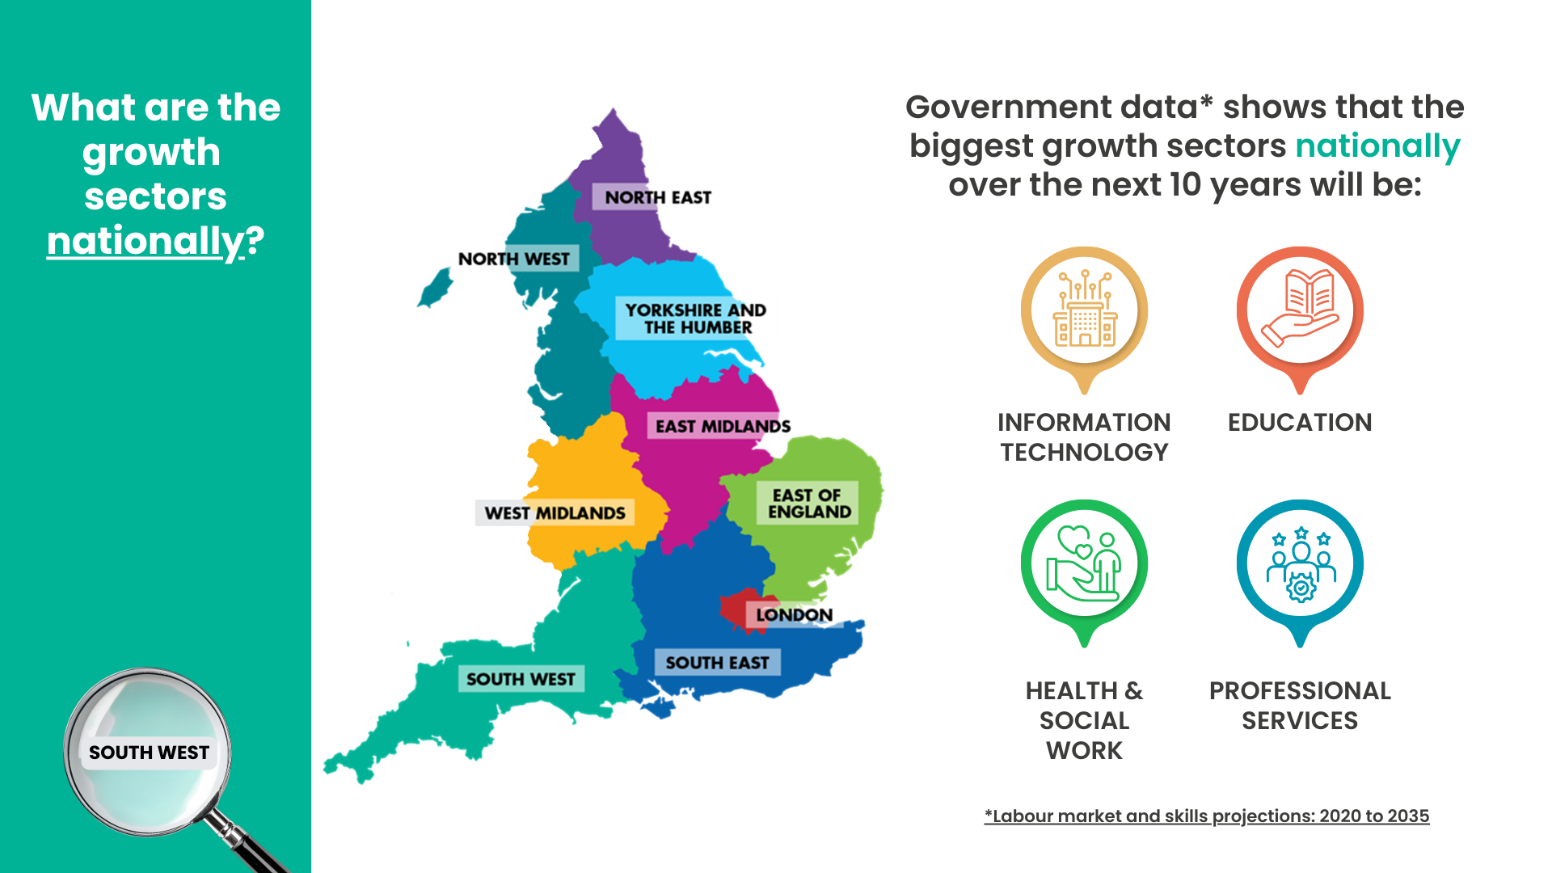
Notes:
The government looks at the labour market and which areas are ‘growth sectors’, because they need a clear picture of what kinds of jobs the country will need in the future and what skills people will need to do them.
A study called ‘Labour market and skills projections: 2020-2035’ shows which sectors are likely to expand. This helps the government understand where future workers will be needed and adjust funding, apprenticeships and qualifications so young people can train for those roles.
They have found that nationally the biggest growth sectors will be Information Technology, Education, Health & Social Work and Professional Services (this includes roles in the legal sector, finance and accounting, business and management consultation, marketing, HR and many more).
Speaker note: At this point, you could share one or more of the sector films, for example: Digital, Health & Adult Social Care or Professional Business Services. You could also share the films relevant to your region in the next slide or slide 8.
You can find all the films here: https://resources.careersandenterprise.co.uk/resources/growth-sector-videos

Slide 7
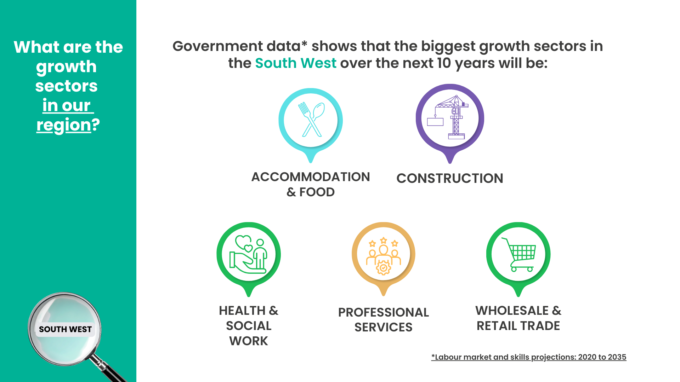
Notes:
As well as looking nationally, it is also important to look locally, as we discussed earlier. Different regions grow in different ways. Projections help local leaders understand which jobs are coming to their area so they can shape local training, colleges and employer partnerships. The government study publishes regional and local breakdowns for this reason.
The labour market study showed that in the South West, the biggest growth sectors will be Accommodation & Food, Construction, Health & Social Work, Professional Services (this includes roles in the legal sector, finance and accounting, business and management consultation, marketing, HR and many more) and Wholesale & Retail Trade (which includes a huge range of roles linked to moving and supplying goods, selling goods and supporting the whole operation of wholesale and retail).
This doesn’t mean there aren’t lots of roles in other areas too, but it is really worth looking into growth sectors carefully and thinking about which roles might interest you – you will probably be really surprised at the wide range of interesting roles you may not have considered or even heard of!
Speaker note: At this point, you could share one or more of the sector films, for example: Construction, Health & Adult Social Care or Professional Business Services.
You can find all the films here: https://resources.careersandenterprise.co.uk/resources/growth-sector-videos

Slide 8
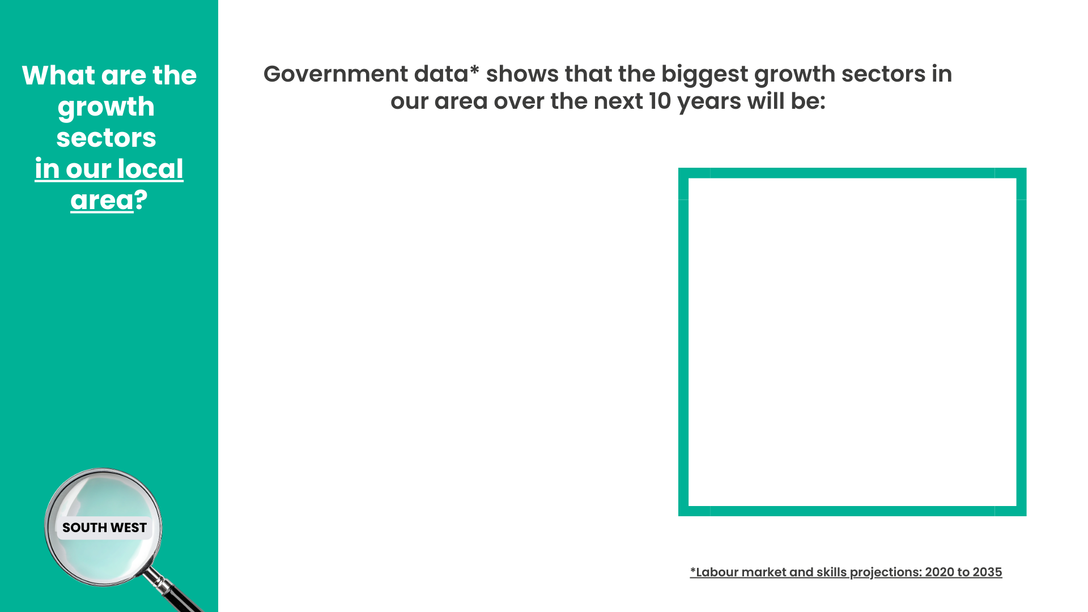
We suggest you select up to 5 images from the graphics at the end of this presentation
We suggest you add an image of or from your region here
Notes:
Speaker note: please see the first slide for instructions on how to add relevant information to this slide before presenting.
The South West is a big region, so it is also a good idea to look more closely at our local area and the growth sectors. You can see that…

Slide 9
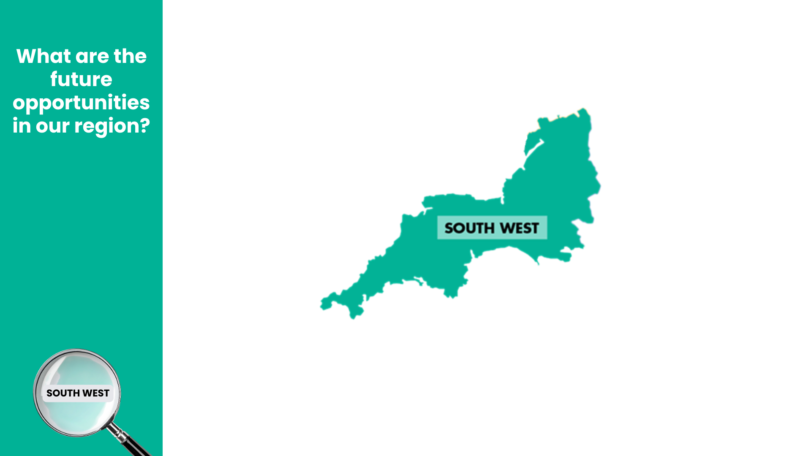
We suggest you add any local developments that may have opportunities now or in the future. Alternatively, you can delete this slide and use the next slide with provided examples.
Notes:
Speaker note: please see the first slide for instructions on how to add relevant information to this slide before presenting.
When a region gets major new developments like new business parks, transport links, science hubs, logistics centres, hospitals, green‑energy sites or digital campuses, it can bring in new employers, new investment and new types of work. For you, this could mean more pathways opening up close to home.
You can see some new developments in our region here, that are going to bring in new businesses, new industries and new opportunities. That means more jobs, more apprenticeships and more career paths opening up right here on our doorstep.
The roles you’ll step into in the next few years might not even exist yet, but the skills you build now will prepare you for them.
These developments aren’t just about buildings or companies; they’re about your future and the chance to shape the place you live.

Slide 10
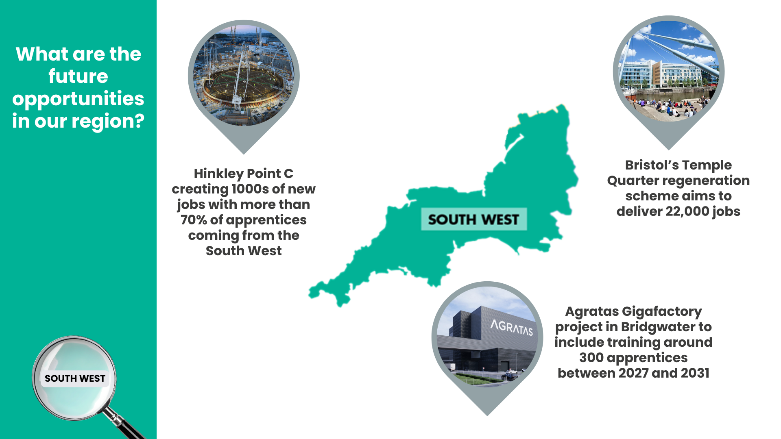
Notes:
Speaker note: please only use this slide if you haven’t personalised the previous slide (slide 9).
When a region gets major new developments like new business parks, transport links, science hubs, logistics centres, hospitals, green‑energy sites or digital campuses, it can bring in new employers, new investment and new types of work. For you, this could mean more pathways opening up close to home.
You can see some new developments in our region here, that are going to bring in new businesses, new industries and new opportunities. That means more jobs, more apprenticeships and more career paths opening up right here on our doorstep. The roles you’ll step into in the next few years might not even exist yet, but the skills you build now will prepare you for them. These developments aren’t just about buildings or companies; they’re about your future and the chance to shape the place you live.

Slide 11
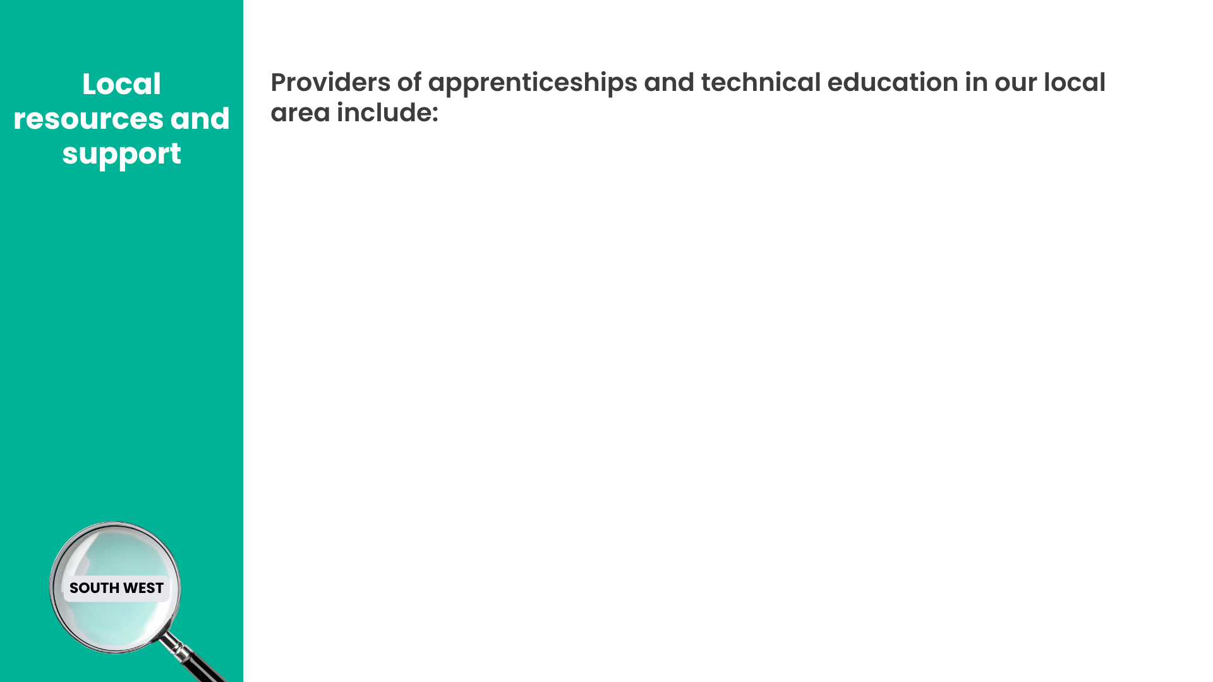
We suggest you add logos and / or names of providers here
Notes:
A brilliant way into roles in the growth sectors we’ve discussed today is technical education – for example T Levels, apprenticeships, Higher Technical Qualifications (HTQs). On the screen now you can see some of the providers of apprenticeships and technical education in our area, and where you can find out more about careers locally.
Speaker note: at this point, you may wish to show any websites about careers in your local area.

Slide 12

This slide is not part of the presentation – please copy and paste the imagery to adapt slide 6
ACCOMMODATION & FOOD
AGRICULTURE
ARTS &
ENTERTAINMENT
CONSTRUCTION
EDUCATION
ELECTRICITY & GAS
ENGINEERING
FINANCE & INSURANCE
FOOD, DRINK & TOBACCO
HEALTH & SOCIAL WORK
INFORMATION TECHNOLOGY
MEDIA
Notes:
Speaker note: this slide is not part of the presentation – please copy and paste the imagery to adapt slide 6

Slide 13

This slide is not part of the presentation – please copy and paste the imagery to adapt slide 6
MINING & QUARRYING
OTHER SERVICES
PROFESSIONAL SERVICES
PUBLIC ADMIN & DEFENCE
REAL ESTATE
REST OF MANUFACTURING
SUPPORT SERVICES
TRANSPORT & STORAGE
WATER & SEWERAGE
WHOLESALE & RETAIL TRADE
Notes:
Speaker note: this slide is not part of the presentation – please copy and paste the imagery to adapt slide 6

Slide 14

Blank slide if there is anything else you would like to add

