Slide 1
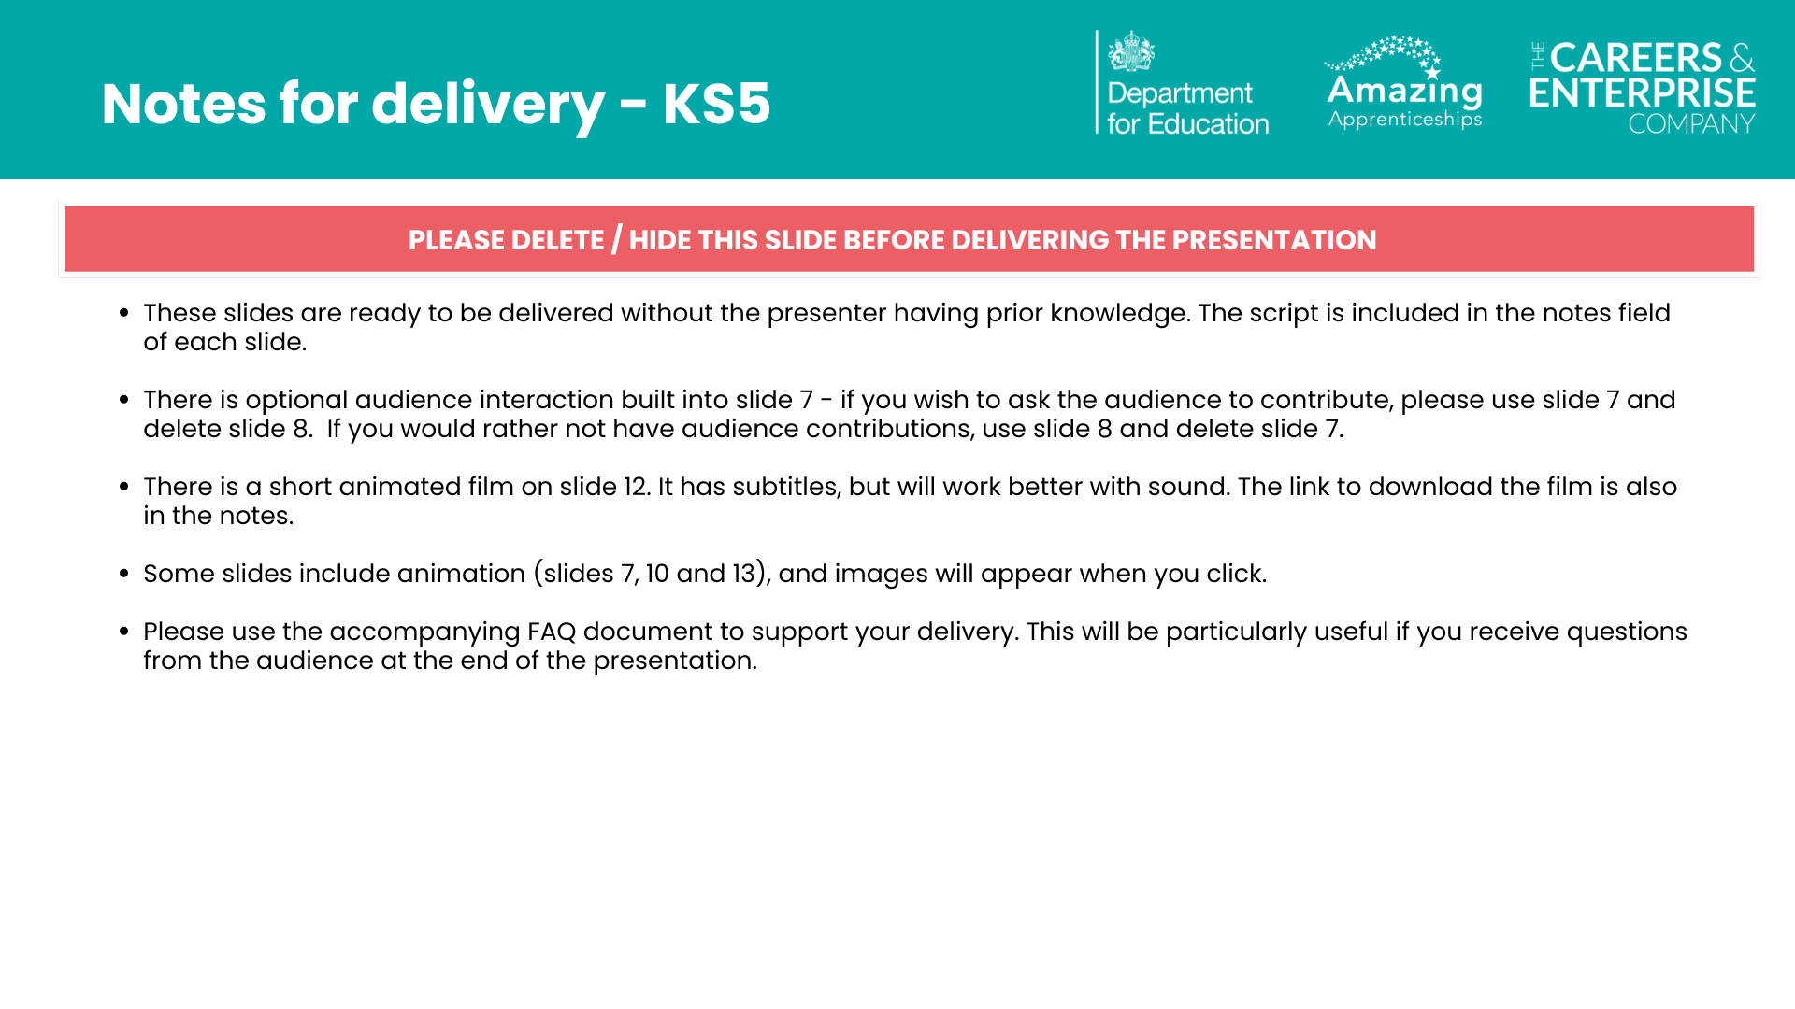

Slide 2

Notes:
What is technical education?
Welcome to today’s session.
Today we are going to be exploring technical education:
- What it is
- The different options and how they work,
- Who technical education can suit, and
- What you could do next if you’re interested.
Even if you don’t think technical education is for you, please listen carefully, because you may be surprised at some of the new opportunities that it can offer you.
It’s always important to have an open mind and not limit your options.

Slide 3
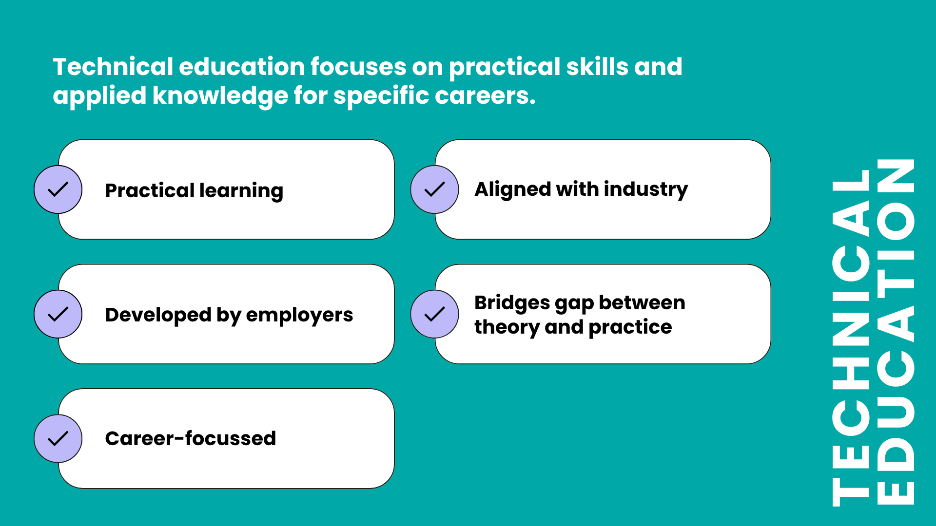
Notes:
What do we mean by technical education?
Technical education can be described as “education that focuses on practical skills and applied knowledge for specific careers”.
Here’s what makes technical education different:
- Practical learning - You’ll learn by doing, not just by listening.
- Built with employers - Courses are designed with businesses, so you gain the skills they’re looking for.
- Career-focussed - Everything you learn helps you move towards the job you want.
- Industry-ready - What you study matches what’s happening in the real world.
- Bridges the gap - It connects classroom learning with actual work experience

Slide 4
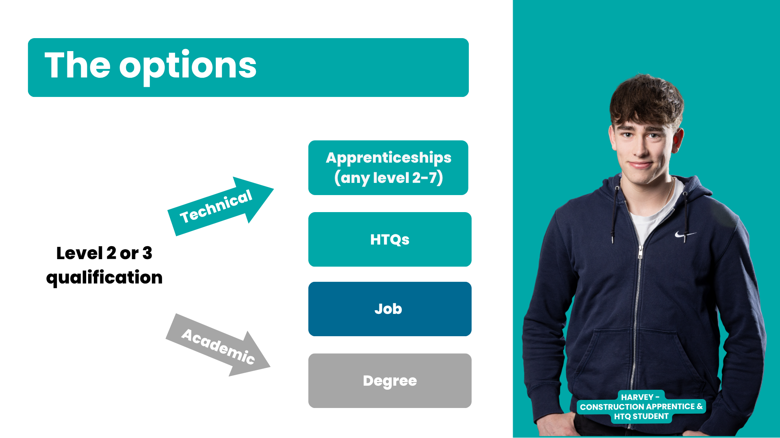
Notes:
Once you are 18, you have a range of options available to you, which you can see on the screen. We are going to talk about two of the main technical education options today, apprenticeships and HTQs.
Apprenticeships can be undertaken once you are 16 and have left full-time education and there is no upper age limit for doing an apprenticeship. As well as being a great option for those leaving school or college, lots of adults will undertake apprenticeships too, so even if you don’t want to do an apprenticeship now, it could be something you look at in the future.
Higher Technical Qualifications (HTQs) are level 4 and 5 qualifications for people aged 18+. Like apprenticeships, HTQs can be undertaken during your career to upskill or retrain so could be something you consider when you’re older too.

Slide 5
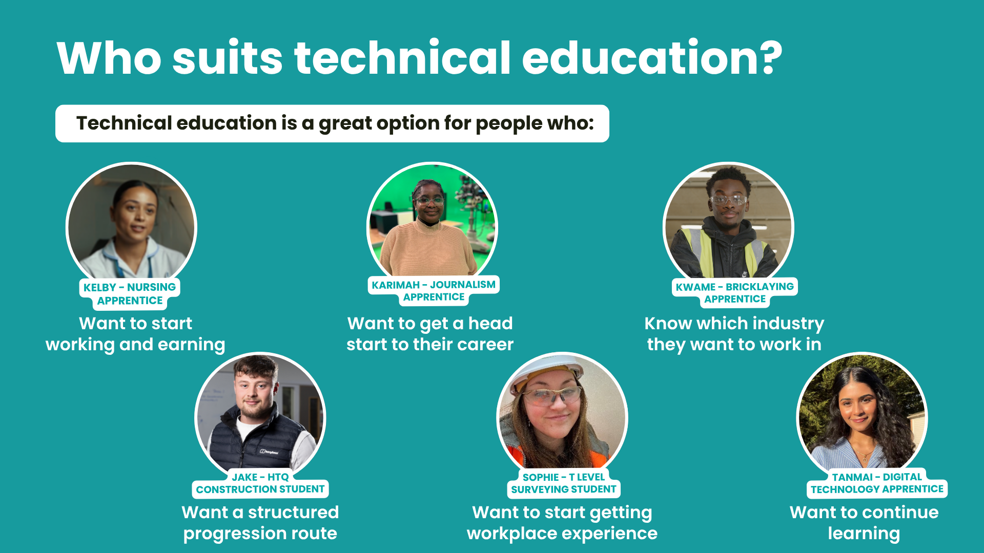
Notes:
Before we get into the detail of the different options, I want to explore who technical education might be best suited to.
Technical education could be a great option for you…
- If you want to start working and earning money
- You want to get a head start to your career
- You know which industry you want to work in
- You want a structured route with clear progression
- You want to start getting valuable workplace experience and
- You want to continue learning and gaining new skills, just not necessarily not in a classroom the whole time…
If this sounds like you, then one of the technical education options we’re going to discuss could be the right choice for you.
Even if none of these apply to you right now, please listen carefully because you never know what might change and how you might feel in the future.
AND you might be surprised once you’ve heard about the options!

Slide 6

Notes:
The first option we are going to discuss today is apprenticeships.

Slide 7


You go through an application process
You have real responsibilities and tasks
You are an employee with a contract
You are paid a salary
You
learn by doing your job and from colleagues
You get experience
of the
workplace
You are part of a team
Everything you’ve suggested about real jobs is also true about apprenticeships.
Notes:
*OPTIONAL INTERACTIVE SLIDE*
(Speaker note: If you are not using interaction, please delete / hide this slide, and use the next slide)
You can see on the screen the statement ‘An apprenticeship is a real job’.
What do you know about ‘real jobs’? What do they involve? (Students suggest ideas)
Great ideas, thank you.
(Speaker note: Please click for animation – circles will appear individually)
On the screen you can now see some of the things a ‘real job’ involves (go over any that you haven’t discussed following the students’ suggestions):
- You’re paid a salary
- You have real responsibilities and tasks to do
- You have a contract of employment and are an employee just like anyone else
- There are application processes that vary from employer to employer
- You learn by doing your job and from your colleagues
- You get valuable experience of the workplace
- You are part of a team
and you thought of lots more too!
Everything you’ve suggested about real jobs is also true about apprenticeships!
But does anyone know how an apprenticeship is DIFFERENT to a real job?

Slide 8
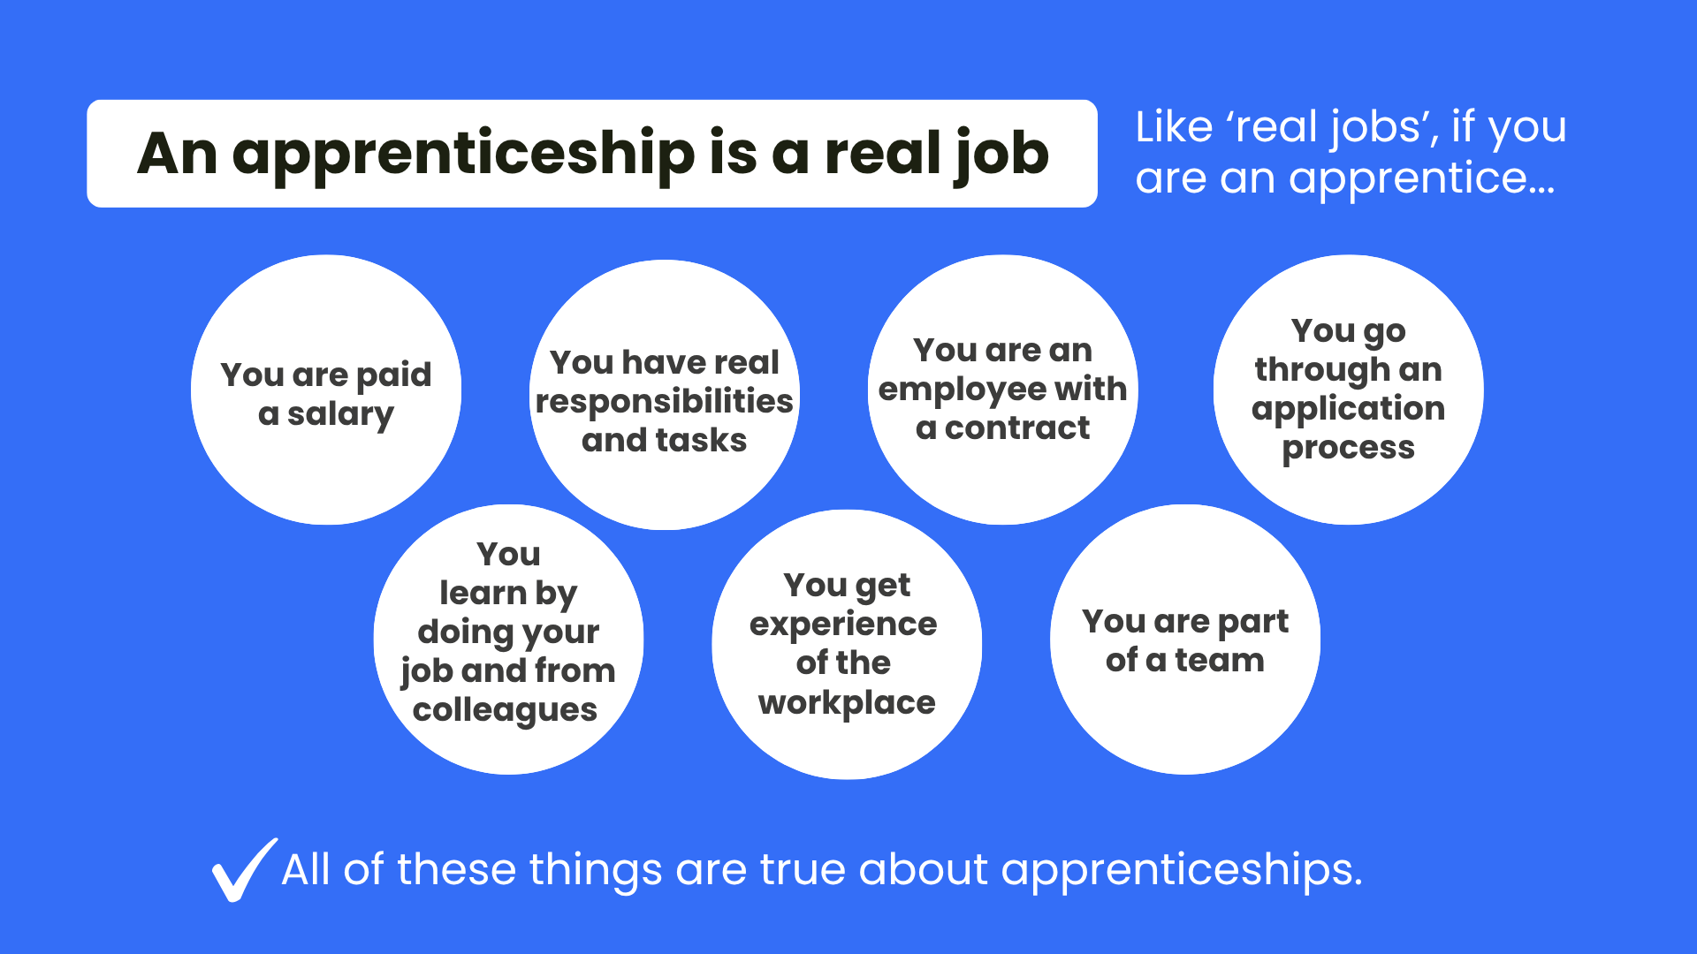
Notes:
You can see on the screen the statement ‘An apprenticeship is a real job’.
On the screen you can see some of the things a ‘real job’ involves
- You’re paid a salary
- You have real responsibilities and tasks to do
- You have a contract of employment and are an employee just like anyone else
- There are application processes that vary from employer to employer
- You learn by doing your job and from your colleagues
- You get valuable experience of the workplace
- You are part of a team
All of these things are also true about apprenticeships!
But does anyone know how an apprenticeship is DIFFERENT to a real job?

Slide 9
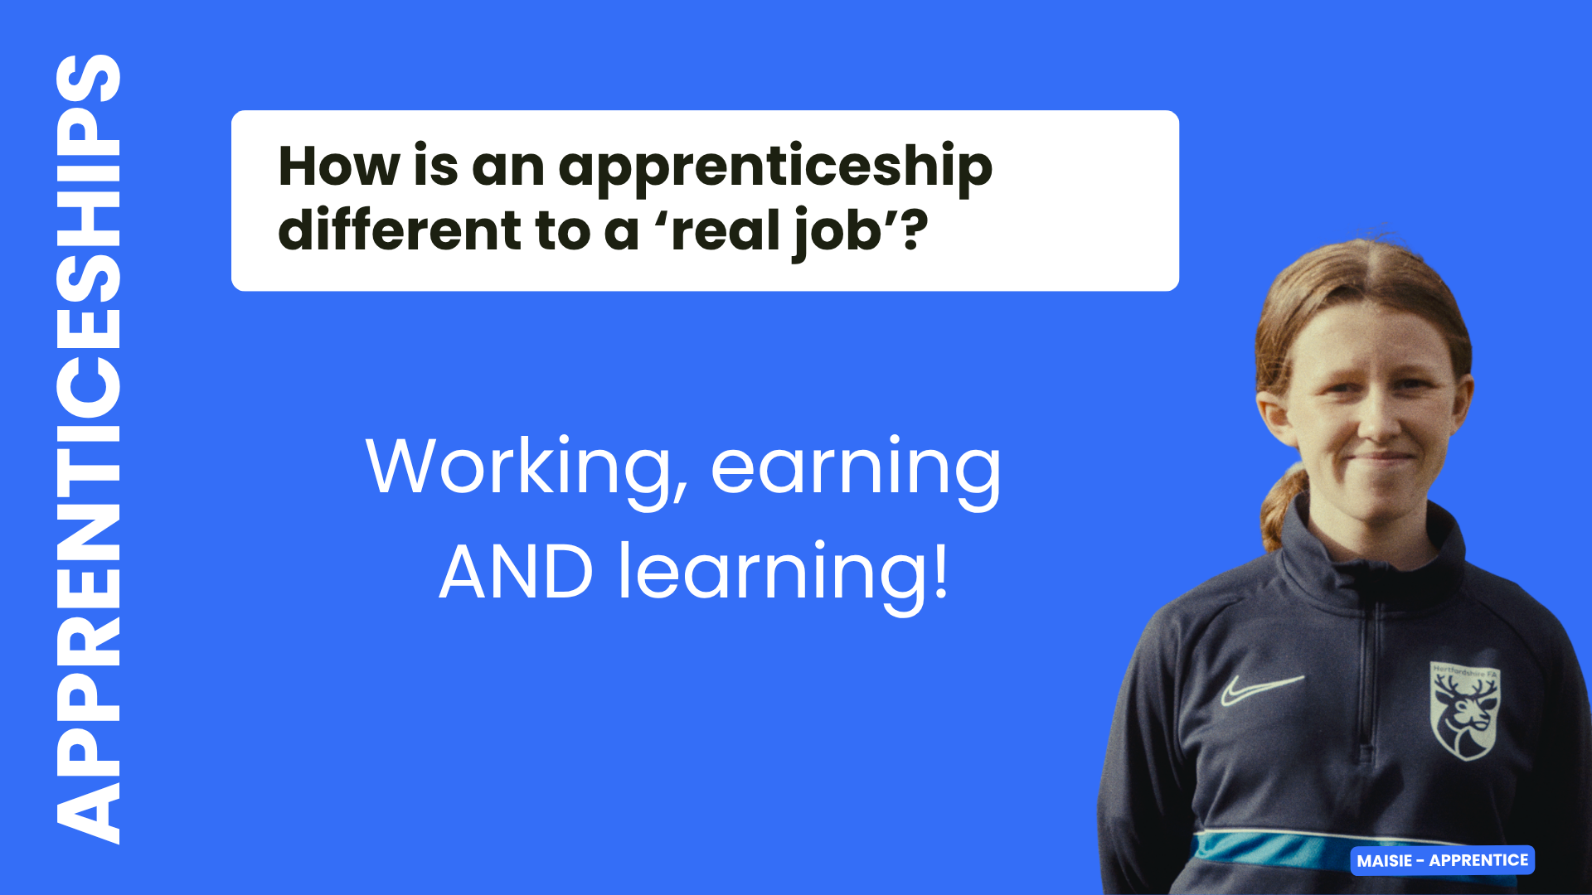
Notes:
If you’re doing an apprenticeship, as well as all the ‘real job’ things we’ve just covered, you also LEARN and gain new skills at the same time.
But how does this work and what else is important to know about apprenticeships?

Slide 10



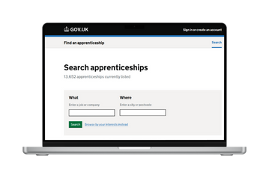
650+
standards -
70%
occupations
Foundation
- degree
level
Typically
1-6 years
Off-the-job training
Entry requirements
Progression
Finding an apprenticeship
findapprenticeship.service.gov.uk
Notes:
(Speaker note: Please click for animation – circles will appear individually)
Apprenticeships are available from level 2 (foundation and intermediate level) (for context, GCSEs are level 2 qualifications), all the way up to level 7 (again, for context, a university bachelor’s degree is a level 6 and a master’s degree is level 7). Apprenticeships have levels to give an idea of the level of knowledge, skills and behaviours needed for a particular role, as well as to align with the level of the qualification that is built into the apprenticeship.
What is important to know about apprenticeship levels is that say you’ve done A-levels, which are a level 3 qualification, it doesn’t mean you can’t or shouldn’t do a level 3 apprenticeship. If the job you want to do is accessible via a level 3 apprenticeship – go for it!
There are more than 650 apprenticeship standards. A standard sets out all the details about the apprenticeship. The range is huge, from accountant to zookeeper, and you can access nearly 70% of the occupations available in England via an apprenticeship.
Apprenticeships typically take between one and six years to complete, depending on the level and the role. There are some apprenticeships that are now a minimum of 8 months, if they are foundation apprenticeships or if the apprentice has prior experience that can shorten it.
Now we’re coming to that BIG difference between apprenticeships and ‘real jobs’ – off-the-job training. What is really special about it is that you are paid to take regular, scheduled time away from your workplace tasks and duties, to spend time learning and working towards any qualifications that are part of your apprenticeship.
This learning is provided by a college, university, independent training provider or even the employer themselves if they are set up to do so.
You also don’t pay any fees – so if you’re doing a degree apprenticeship for example, you wouldn’t pay the university fees (unless you’re over 21 and doing a level 7 apprenticeship).
Entry requirements for apprenticeships really vary and will depend on the level, the role, the employer and the training provider. For example, some level 2 apprenticeships don’t have specific entry requirements, although lots will, but degree apprenticeships will almost always require GCSEs and a level 3 qualification like A-levels or T Levels (more on those in a bit!), and at certain grades too.
Finding an apprenticeship can be confusing because sometimes people think you apply through a college for example. But you actually find an apprenticeship in the same way you would with any other job – looking for an employer with a vacancy and applying to them.
You find apprenticeships in all the places you’d find other jobs, as well as on a special government website called Find an apprenticeship, which we can give you some support to use.
Progression is an important part of apprenticeships, because they are designed to support your career development, meaning that many individuals will undertake more than 1 apprenticeship, moving through different levels as they progress their career and need to learn new skills.

Slide 11

Notes:
The next option we are going to discuss today is Higher Technical Qualifications – also known as HTQs for short
If you are considering higher education, which is education after secondary school leading to level 4 qualifications and above, but aren’t sure if a full bachelor’s degree is right for you and you’re interested in the idea of technical education, HTQs could be the perfect next step!
Watch this short film about HTQs and then we’ll go over the key facts.

Slide 12


Notes:
(Speaker note: Play this short film – the link is here if you need it)
https://vimeo.com/1120766498

Slide 13


They are for people aged 18+ who have a level 3 qualification like A levels or a T Level
Taught in further education colleges, universities and Institutes of Technology
HTQs are level 4 and 5 qualifications
An HTQ will usually take 1-2 years to complete
HTQS
HTQs
Key
Facts
HTQs are typically delivered in classroom settings
Students are able to access the same student finance as a degree
HTQs could
lead into an apprenticeship,
full degree or employment
HTQs are flexible and can be studied full time or part time
Notes:
(Speaker note: Please click for animation – circles will appear individually)
Let’s look at some of the key facts.
HTQs are level 4 and 5 qualifications and to give that some context like we did for apprenticeships, A-levels and T Levels are level 3 and a full bachelor's degree is level 6.
So HTQs sit just between those.
You do need to be 18+ and have a level 3 qualification to be eligible for an HTQ.
They are taught in colleges, universities and Institutes of Technology.
Level 4 HTQs take one year and level 5 HTQs take two years.
HTQs are really flexible and can be studied full or part time, which means you can do them alongside a job.
They are typically delivered in a classroom setting, with practical elements depending on the course.
You can access the same student finance as for a full degree.
After an HTQ, you can top it up to a full degree, go on to an apprenticeship or into employment.

Slide 14
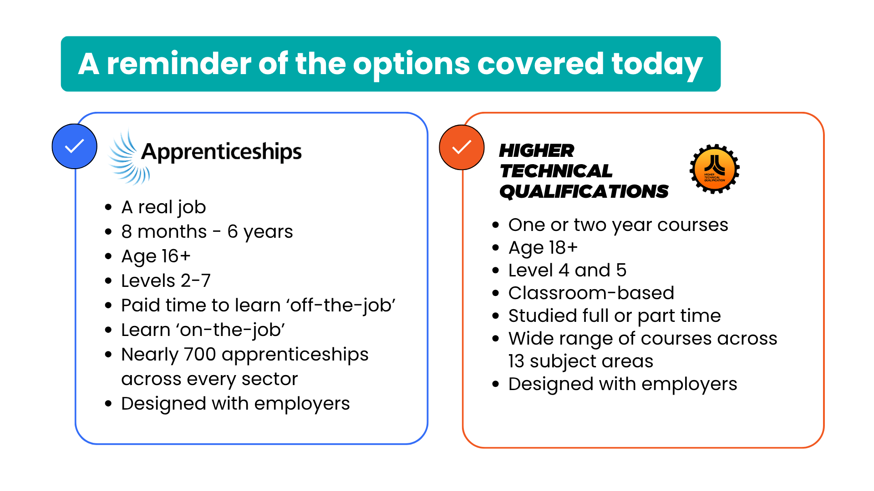
Notes:
(Speaker note: This slide has been included so you can summarise the two technical education options we have discussed today. This slide could also be shared with students, colleagues or parents after the session to summarise what has been discussed.)

Slide 15

apprenticeships.gov.uk
findapprenticeship.service.gov.uk
htqtoolkit.co.uk
skillsforcareers.education.gov.uk/pages/training-choice/htq-higher-technical-qualification
Notes:
There are lots of places that you can find out more about the different options we’ve discussed today, and you can see some of these on the screen now.
On the top row you can see the Government apprenticeships website and Find an apprenticeship, which we spoke about earlier.
On the bottom row, you can see the HTQ Toolkit page, which has a section called ‘For potential learners’ with resources you can explore, and the Government HTQs page.
(Speaker note: You could offer to share the links)
https://www.apprenticeships.gov.uk/
https://www.findapprenticeship.service.gov.uk/
https://www.htqtoolkit.co.uk/
https://www.skillsforcareers.education.gov.uk/pages/training-choice/htq-higher-technical-qualification

Slide 16

skillsforcareers.education.gov.uk
Notes:
There is also a website where you can explore other options that we haven’t discussed in detail today, which you can see on the screen now.
www.skillsforcareers.education.gov.uk

Slide 17
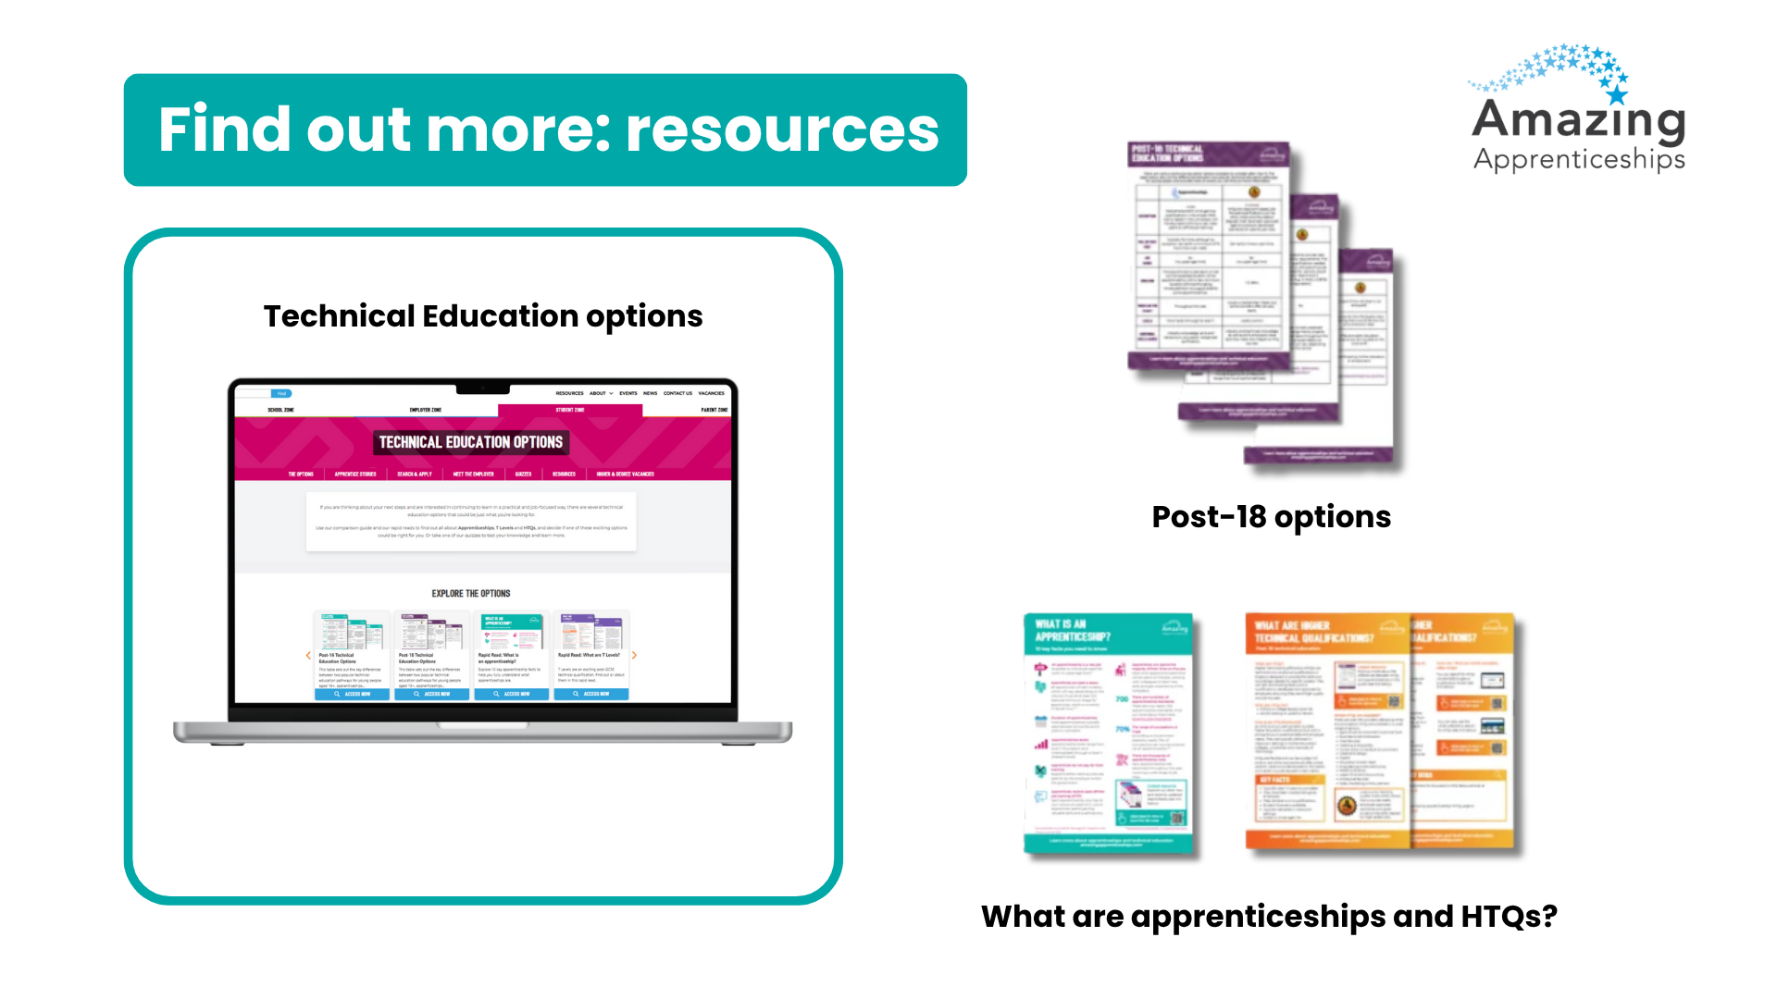
amazingapprenticeships.com/the-options
Notes:
Amazing Apprenticeships also has a page on their website called ‘The Options’ where you can explore different resources to help you understand them.
www.amazingapprenticeships.com/the-options/

