Slide 1
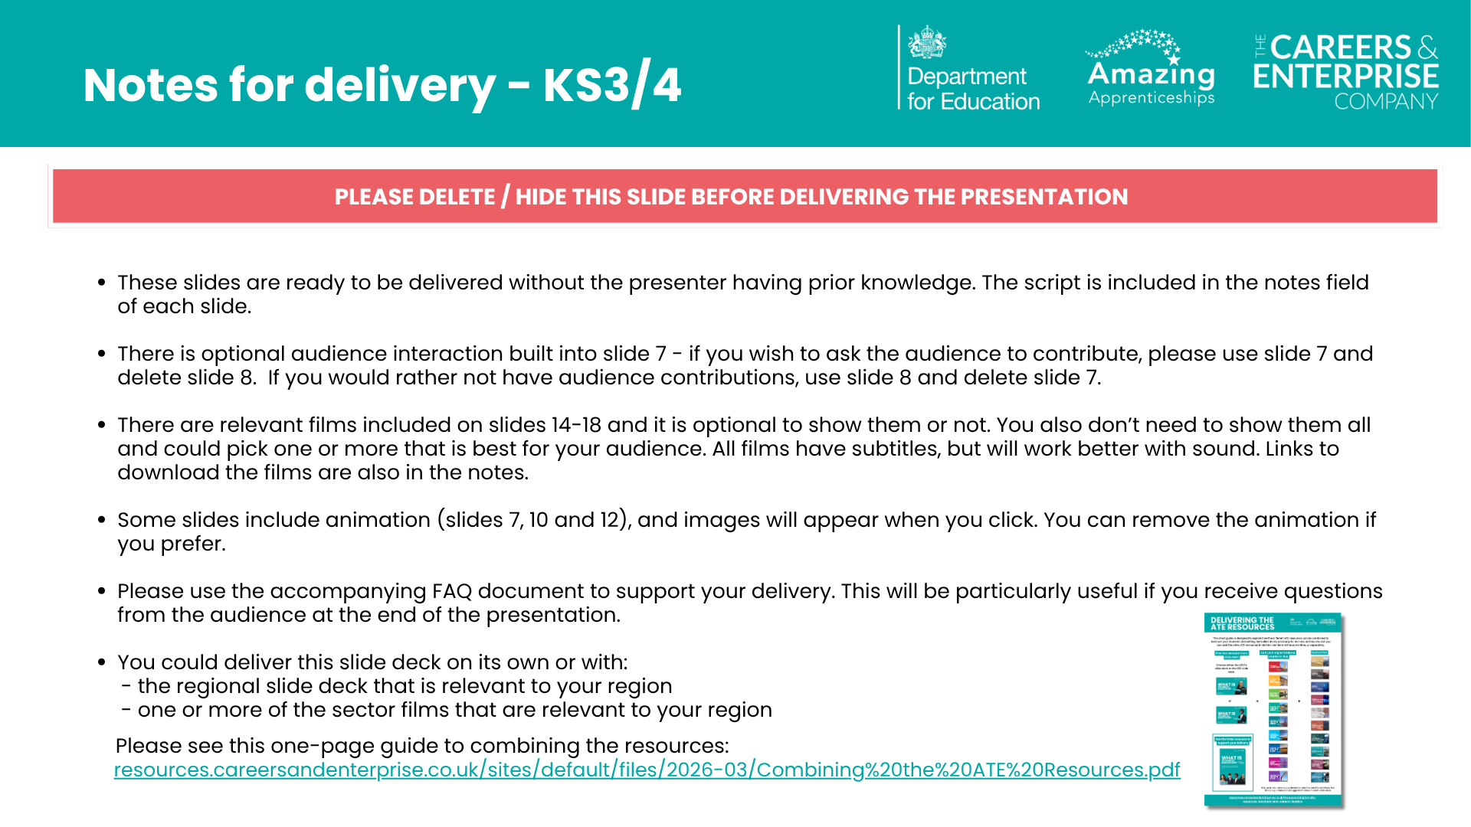
Notes:
Guide to combining the resources: https://resources.careersandenterprise.co.uk/sites/default/files/2026-03/Combining%20the%20ATE%20Resources.pdf

Slide 2

Notes:
What is technical education?
Welcome to today’s session.
Today we are going to be exploring technical education: - What it is - The different options there are and how they work - Who technical education can suit, and - What you could do next if you’re interested.
Even if you don’t think technical education is for you, please listen carefully, because you may be surprised at some of the new opportunities that it can offer you.
It’s always important to have an open mind and not limit your options.

Slide 3
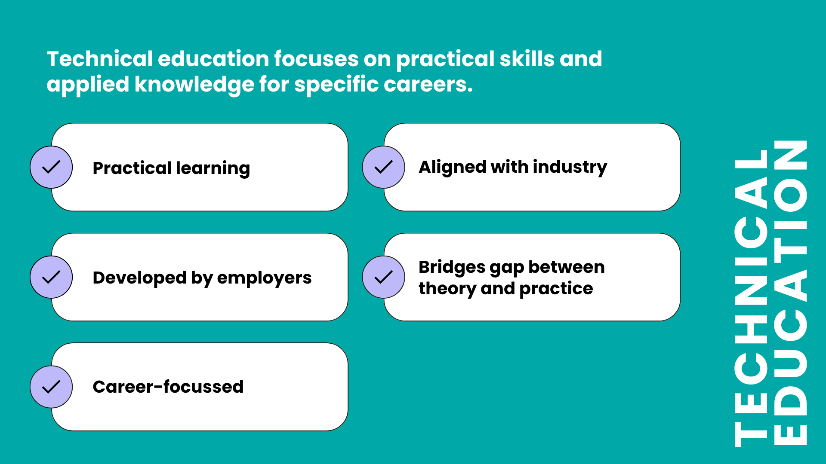
Notes:
What do we mean by technical education?
Technical education can be described as “education that focuses on practical skills and applied knowledge for specific careers”.
Here’s what makes technical education different: - Practical learning - You’ll learn by doing, not just by listening. - Built with employers - Courses are designed with businesses, so you gain the skills they’re looking for. - Career-focussed - Everything you learn helps you move towards the job you want. - Industry-ready - What you study matches what’s happening in the real world. - Bridges the gap - It connects classroom learning with actual work experience.

Slide 4
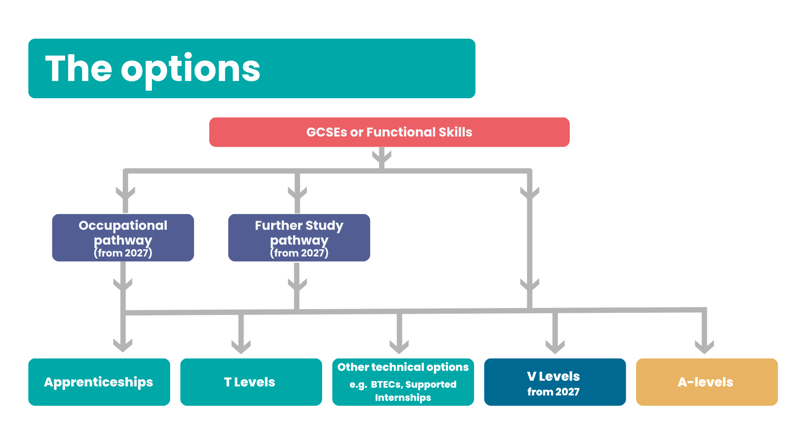
Notes:
In England, you can leave school on the last Friday in June if you’ll be 16 by the end of the summer holidays, BUT, you must then do one of the following until you’re 18:
stay in full-time education (at school or college)
start an apprenticeship
spend 20 hours or more a week working or volunteering, while in part-time education or training
We are going to talk about two of the main technical education options available to 16-19 year olds today: apprenticeships and T Levels, although there are other technical education options you may have heard of.
After GCSEs or Functional Skills, you can see on the screen that you can go straight on to an apprenticeship (at level 2 or 3), a T Level, another technical option such as a BTEC or a Supported Internship, or A-levels.
Apprenticeships can be undertaken once you are 16 and have left full-time education. There is no upper age limit for doing an apprenticeship, and as well as being a great option for those leaving school or college, lots of adults will undertake apprenticeships too.
T Levels are for 16-19 year olds.
Other technical options you may have heard of are:
- Qualifications grouped under the name Vocational Technical Qualifications (VTQs), which currently include BTECs, Cambridge Nationals and Cambridge Technicals.
There are also other options like supported internships and vocational study programmes that could be of interest to you too.
In addition, the Government recently shared more information about new qualifications called V Levels, which are new level 3 vocational qualifications available in some subjects from 2027 with more rolling out over the next few years. One V Level will be the same ‘size’ as an A-level and students will be able to mix and match V Levels and A-levels.
You can also see on the screen that there are two new level 2 options that have recently been announced by the Government that you can take after GCSEs or Functional Skills. The Further Study pathway will provide a year of study to students who want to go on to do V Levels, A-levels or T Levels but who aren’t ready to go straight to one of those options. There is also the occupational pathway, which is a two-year programme designed to support students to progress to a skilled job or apprenticeship.
At the end of this presentation I will share some useful links where you can learn more about all these different options.
There are technical education options after the age of 18, in particular Higher Technical Qualifications (HTQs), which are for people aged 18+. We aren’t going to focus on HTQs today, but please ask at the end if you’d like more information.

Slide 5
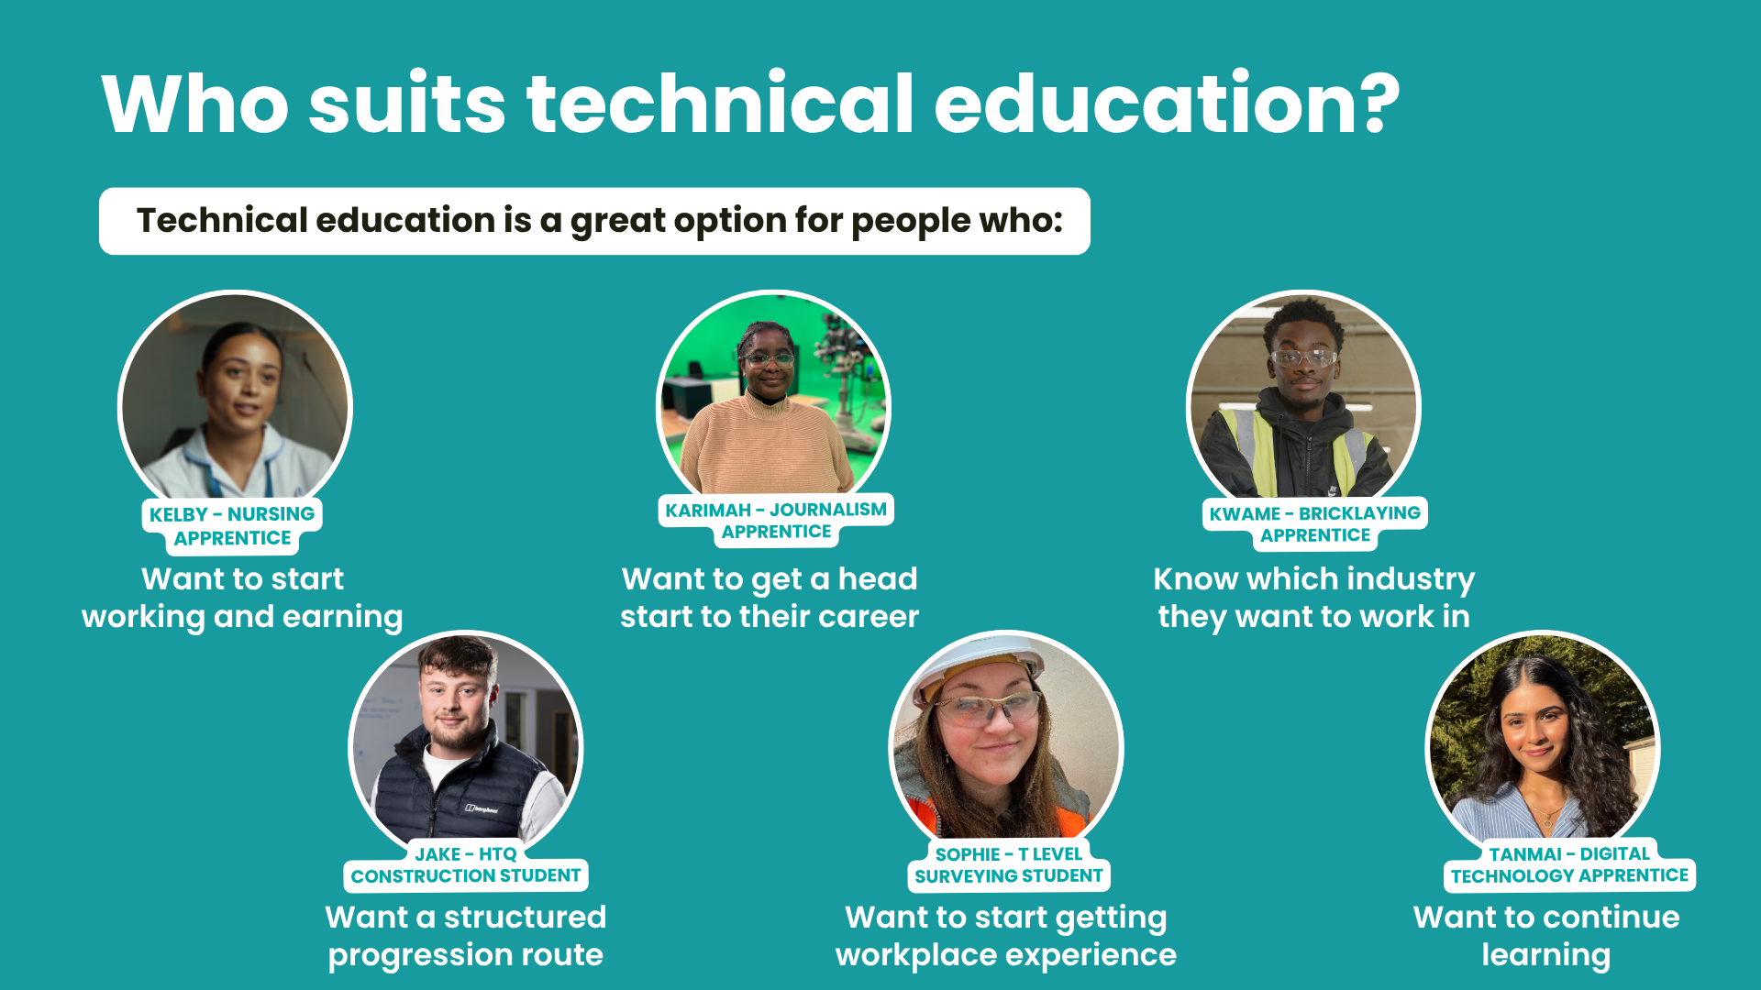
Notes:
Before we get into the detail of the different options, I want to explore who technical education might be best suited to.
Technical education could be a great option for you… - If you want to start working and earning money - You want to get a head start to your career - You know which industry you want to work in - You want a structured route with clear progression - You want to start getting valuable workplace experience and - You want to continue learning and gaining new skills, just not necessarily in a classroom the whole time…
If this sounds like you, then one of the technical education options we’re going to discuss could be the right choice for you.
Even if none of these apply to you right now, please listen carefully because you never know what might change and how you might feel in the future. AND you might be surprised once you’ve heard about the options!

Slide 6

Notes:
The first option we are going to discuss today is apprenticeships.

Slide 7

You go through an application process
You have real responsibilities and tasks
You are an employee with a contract
You are paid a salary
You
learn by doing your job and from colleagues
You get experience
of the
workplace
You are part of a team
Everything you’ve suggested about real jobs is also true about apprenticeships.
Notes:
*OPTIONAL INTERACTIVE SLIDE*
(Speaker note: If you are not using interaction, please delete / hide this slide, and use the next slide)
You can see on the screen the statement ‘An apprenticeship is a real job’.
What do you know about ‘real jobs’? What do they involve? (Students suggest ideas)
Great ideas, thank you.
(Speaker note: Please click for animation – circles will appear individually) On the screen you can now see some of the things a ‘real job’ involves (go over any that you haven’t discussed following the students’ suggestions): - You’re paid a salary - You have real responsibilities and tasks to do - You have a contract of employment and are an employee just like anyone else - There are application processes that vary from employer to employer - You learn by doing your job and from your colleagues - You get valuable experience of the workplace - You are part of a team and you thought of lots more too!
Everything you’ve suggested about real jobs is also true about apprenticeships!
But does anyone know how an apprenticeship is DIFFERENT to a real job?

Slide 8
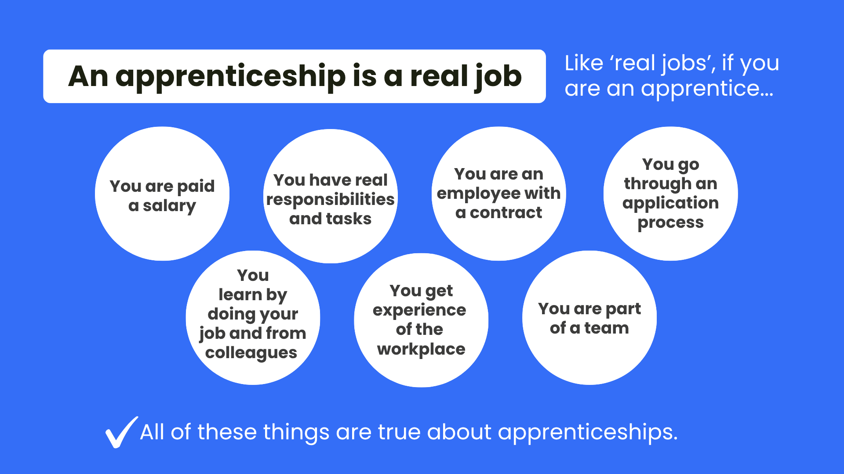
Notes:
You can see on the screen the statement ‘An apprenticeship is a real job’.
On the screen you can see some of the things a ‘real job’ involves - You’re paid a salary - You have real responsibilities and tasks to do - You have a contract of employment and are an employee just like anyone else - There are application processes that vary from employer to employer - You learn by doing your job and from your colleagues - You get valuable experience of the workplace - You are part of a team
All of these things are also true about apprenticeships!
But does anyone know how an apprenticeship is DIFFERENT to a real job?

Slide 9
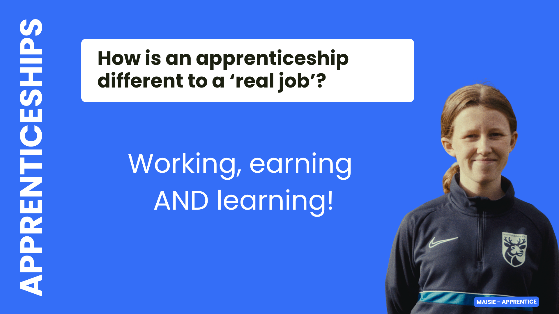
Notes:
If you’re doing an apprenticeship, as well as all the ‘real job’ things we’ve just covered, you also LEARN and gain new skills at the same time.
But how does this work and what else is important to know about apprenticeships?

Slide 10


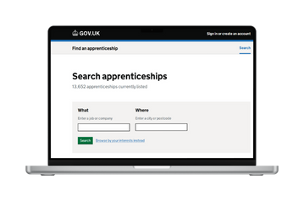
650+
standards -
70%
occupations
Foundation
- degree
level
Typically
1-6 years
Off-the-job training
Entry requirements
Progression
Finding an apprenticeship
findapprenticeship.service.gov.uk
Notes:
(Speaker note: Please click for animation – circles will appear individually)
Apprenticeships are available from level 2 (foundation and intermediate level) (for context, GCSEs are level 2 qualifications), all the way up to level 7 (again, for context, a university bachelor’s degree is a level 6 and a master’s degree is level 7). Apprenticeships have levels to give an idea of the level of knowledge, skills and behaviours needed for a particular role, as well as to align with the level of the qualification that is built into the apprenticeship. What is important to know about apprenticeship levels is that say you’ve done A-levels or a T Level, which are level 3 qualifications, it doesn’t mean you can’t or shouldn’t do a level 3 apprenticeship. If the job you want to do is accessible via a level 3 apprenticeship – go for it!
There are more than 650 apprenticeship standards. A standard sets out all the details about the apprenticeship. The range is huge, from accountant to zookeeper, and you can access nearly 70% of the occupations available in England via an apprenticeship.
Apprenticeships typically take between one and six years to complete, depending on the level and the role. There are some apprenticeships that are now a minimum of 8 months if they are foundation apprenticeships or if the apprentice has prior experience that can shorten it.
Now we’re coming to that BIG difference between apprenticeships and ‘real jobs’ – off-the-job training. What is really special about it is that you are paid to take regular, scheduled time away from your workplace tasks and duties, to spend time learning and working towards any qualifications that are part of your apprenticeship. This learning is provided by a college, university, independent training provider or even the employer themselves if they are set up to do so. You also don’t pay any fees – so if you’re doing a degree apprenticeship for example, you wouldn’t pay the university fees (unless you’re over 21 and doing a level 7 apprenticeship).
Entry requirements for apprenticeships really vary and will depend on the level, the role, the employer and the training provider. For example, some level 2 apprenticeships don’t have specific entry requirements, although lots will, but degree apprenticeships will almost always require GCSEs and a level 3 qualification like A-levels or T Levels (more on those in a bit!), and at certain grades too.
Progression is an important part of apprenticeships, because they are designed to support your career development, meaning that many individuals will undertake more than one apprenticeship, moving through different levels as they progress their career and need to learn new skills.
Finding an apprenticeship can be confusing because sometimes people think you apply through a college for example. But you actually find an apprenticeship in the same way you would with any other job – looking for an employer with a vacancy and applying to them.
You find apprenticeships in all the places you’d find other jobs, as well as on a special government website called Find an apprenticeship, which we can give you some support to use.
(Speaker note: if you would like to share more information on looking for apprenticeships on Find an apprenticeship, you could show or share this 10 minute video created by the DfE: https://www.youtube.com/watch?v=r0NY-VBdkg4 or share this guide to registering on Find an apprenticeship https://www.amazingapprenticeships.com/resources/how-to-register-on-find-an-apprenticeship-guide )

Slide 11

Notes:
The next option we are going to discuss today is T Levels.
You will have almost certainly heard of A-levels, but there is a brilliant technical option you can take after your GCSEs called T Levels.

Slide 12
Key facts about T Levels
Two year
course
Alternative
to
A-levels
80%
study /
20% work
45-day
industry placement
T LEVELS
1 T Level
=
3 A-levels
Designed
by
employers
Get
work
ready
20 subjects
Notes:
(Speaker note: Please click for animation – circles will appear individually)
T Levels are a two-year course for people aged 16-19, designed as a technical alternative to A-levels.
T Levels are really unique compared to other post-16 options, because you spend 80% of your time in the classroom, but 20% of your course is spent on an industry work placement – around 45 days.
You take one T Level, but it’s equivalent in size to 3 A-levels and when you complete it, you get allocated UCAS points in the same way.
T Levels have the real career focus and industry alignment we spoke about earlier because they have been designed with employers from all the relevant industries to ensure they teach students exactly the right skills they need to be work ready. And the industry placement means T Level students gain valuable workplace experience, adding to their employability.
There are currently 20 different T level subjects you can take, and you can see these on the next slide.
After finishing your T Level, you could go straight into a job, start an apprenticeship, go onto an HTQ, or apply to university.

Slide 13
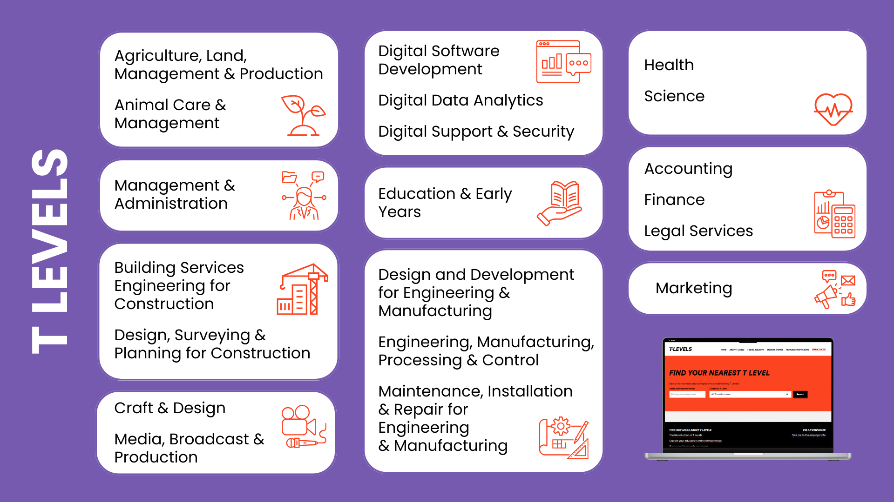
Notes:
There are 20 different T Level subjects you can take and you can see them on the screen.
You can also hopefully see that they span a wide range of subjects and sectors – from animal care and agriculture, through to accounting and marketing.
It is really important to check which are available at providers local to you. T Levels were launched in 2020 so are still rolling out in schools and colleges across the country. You can check by looking on the Find a T Level page on the T Levels website by putting in your postcode.
We’re going to watch a short film(s) now, so you can hear directly from T Level students about their experience.

Slide 14


Notes:
(Speaker note: There are five T Level student films on these slides - select one or more options that best suit your students and learning environment.
These slides could also be left out and the links shared with students to explore independently.
Please note that Joseph’s film also includes an HTQ student, Harrison.)
Sydney (Construction, Design, Planning and Surveying T Level): https://vimeo.com/1123908385
Dawn (Design and Development for Engineering and Manufacturing T Level): https://vimeo.com/1123911126
Katy (Education and Early Years T Level) & Dina (Health T Level): https://vimeo.com/1124852290
Joseph (Digital T Level): https://vimeo.com/1124852577
Fernanda (Digital T Level): https://vimeo.com/1129099098/ee0c031ae6?fl=pl&fe=sh

Slide 15

Notes:
(Speaker note: There are five T Level student films on these slides - select one or more options that best suit your students and learning environment.
These slides could also be left out and the links shared with students to explore independently.
Please note that Joseph’s film also includes an HTQ student, Harrison.)
Sydney (Construction, Design, Planning and Surveying T Level): https://vimeo.com/1123908385
Dawn (Design and Development for Engineering and Manufacturing T Level): https://vimeo.com/1123911126
Katy (Education and Early Years T Level) & Dina (Health T Level): https://vimeo.com/1124852290
Joseph (Digital T Level): https://vimeo.com/1124852577
Fernanda (Digital T Level): https://vimeo.com/1129099098/ee0c031ae6?fl=pl&fe=sh

Slide 16

Notes:
(Speaker note: There are five T Level student films on these slides - select one or more options that best suit your students and learning environment.
These slides could also be left out and the links shared with students to explore independently.
Please note that Joseph’s film also includes an HTQ student, Harrison.)
Sydney (Construction, Design, Planning and Surveying T Level): https://vimeo.com/1123908385
Dawn (Design and Development for Engineering and Manufacturing T Level): https://vimeo.com/1123911126
Katy (Education and Early Years T Level) & Dina (Health T Level): https://vimeo.com/1124852290
Joseph (Digital T Level): https://vimeo.com/1124852577
Fernanda (Digital T Level): https://vimeo.com/1129099098/ee0c031ae6?fl=pl&fe=sh

Slide 17

Notes:
(Speaker note: There are five T Level student films on these slides - select one or more options that best suit your students and learning environment.
These slides could also be left out and the links shared with students to explore independently.
Please note that Joseph’s film also includes an HTQ student, Harrison.)
Sydney (Construction, Design, Planning and Surveying T Level): https://vimeo.com/1123908385
Dawn (Design and Development for Engineering and Manufacturing T Level): https://vimeo.com/1123911126
Katy (Education and Early Years T Level) & Dina (Health T Level): https://vimeo.com/1124852290
Joseph (Digital T Level): https://vimeo.com/1124852577
Fernanda (Digital T Level): https://vimeo.com/1129099098/ee0c031ae6?fl=pl&fe=sh

Slide 18

Notes:
(Speaker note: There are five T Level student films on these slides - select one or more options that best suit your students and learning environment.
These slides could also be left out and the links shared with students to explore independently.
Please note that Joseph’s film also includes an HTQ student, Harrison.)
Sydney (Construction, Design, Planning and Surveying T Level): https://vimeo.com/1123908385
Dawn (Design and Development for Engineering and Manufacturing T Level): https://vimeo.com/1123911126
Katy (Education and Early Years T Level) & Dina (Health T Level): https://vimeo.com/1124852290
Joseph (Digital T Level): https://vimeo.com/1124852577
Fernanda (Digital T Level): https://vimeo.com/1129099098/ee0c031ae6?fl=pl&fe=sh

Slide 19
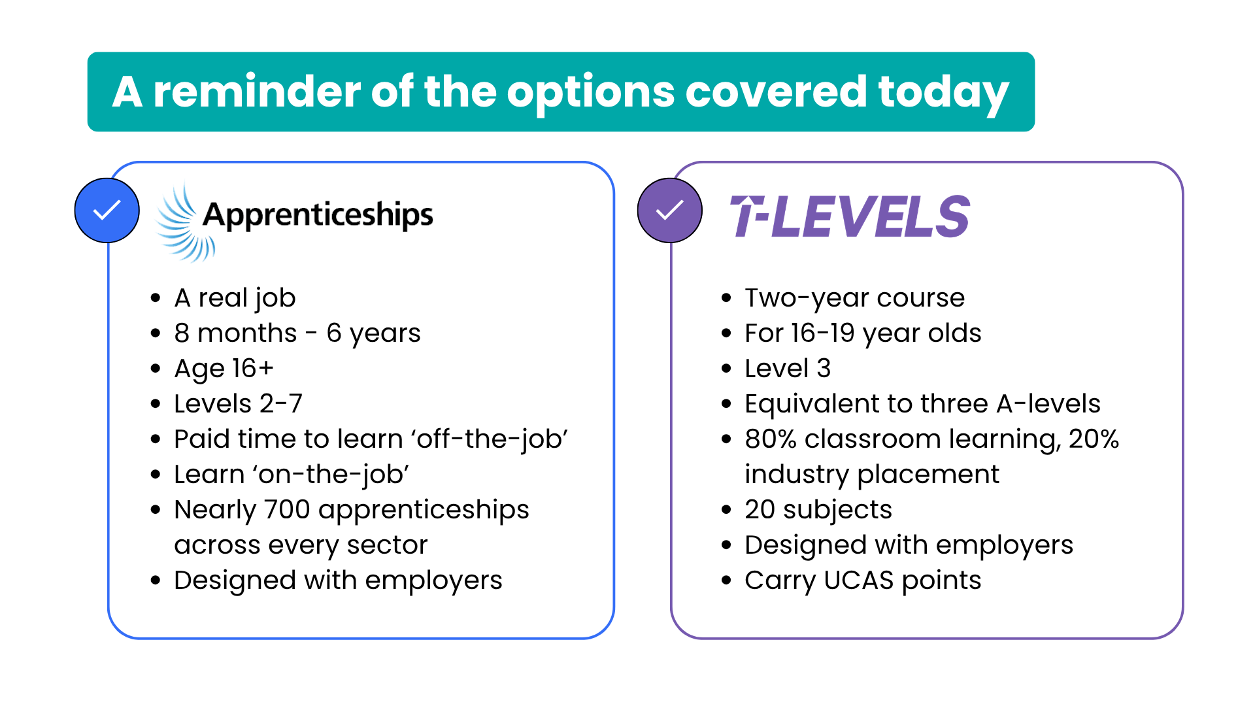
Notes:
(Speaker note: This slide has been included so you can summarise the two technical education options we have discussed today. This slide could also be shared with students, colleagues or parents after the session to summarise what has been discussed.)

Slide 20
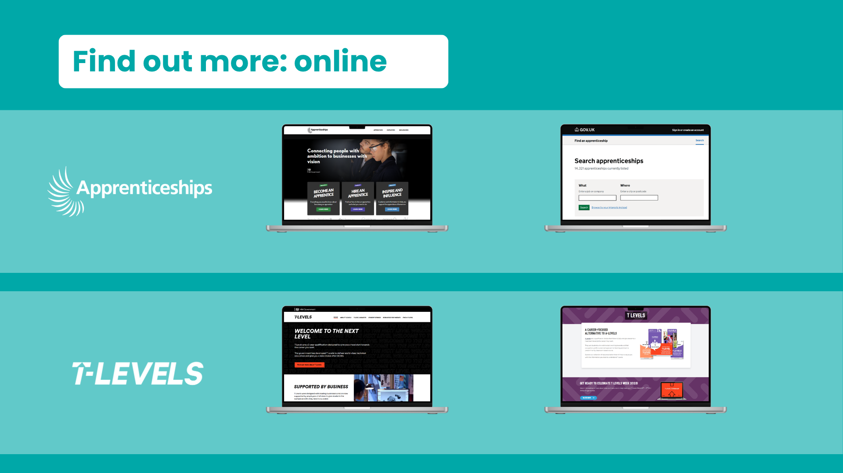
apprenticeships.gov.uk
findapprenticeship.service.gov.uk
tlevels.gov.uk
amazingapprenticeships.com/t-levels
Notes:
There are lots of places that you can find out more about the different options we’ve discussed today, and you can see some of these on the screen now.
On the top row you can see the Government apprenticeships website and Find an apprenticeship, which we spoke about earlier.
On the bottom row, you can see the T Levels website and the Amazing Apprenticeships T Level page.
(Speaker note: You could offer to share the links)
https://www.apprenticeships.gov.uk/
https://www.findapprenticeship.service.gov.uk/
https://www.tlevels.gov.uk/
https://www.amazingapprenticeships.com/t-levels/

Slide 21

skillsforcareers.education.gov.uk
Notes:
There is also a website where you can explore some of the options I mentioned at the start that we haven’t discussed in detail today, which you can see on the screen now.
www.skillsforcareers.education.gov.uk

Slide 22
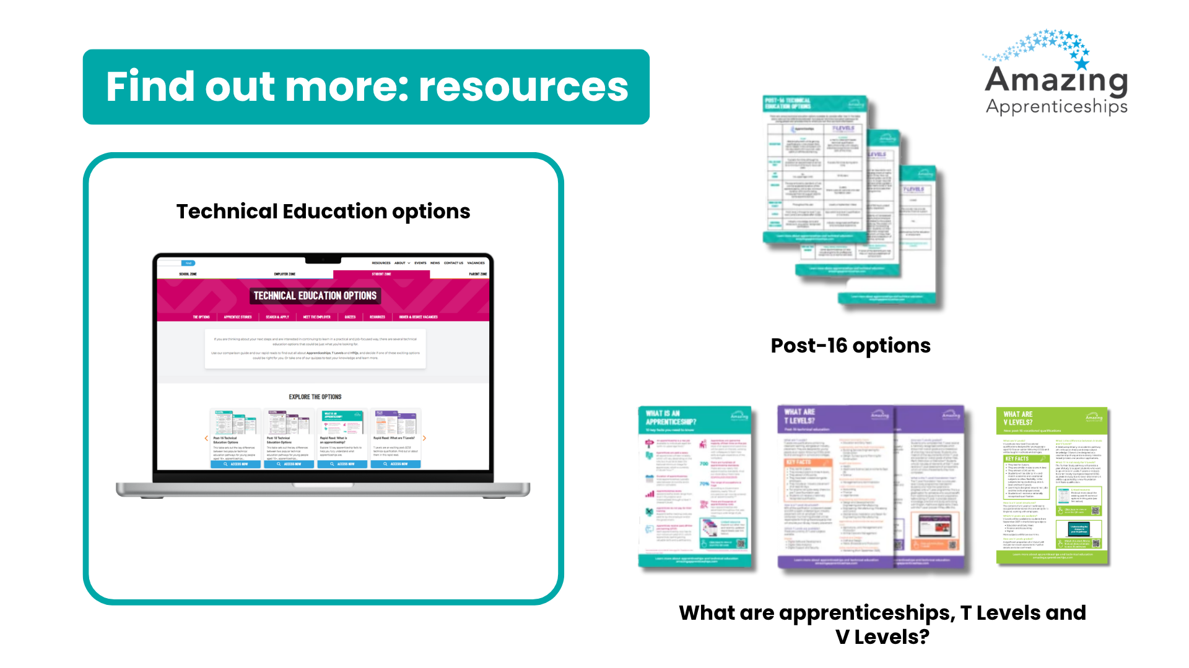
amazingapprenticeships.com/the-options
Notes:
Amazing Apprenticeships also has a page on their website called ‘The Options’ where you can explore different resources to help you understand them.
www.amazingapprenticeships.com/the-options/

