Slide 1


Hair and Beauty
My Learning, My Future
Where can studying Hair and Beauty take you? Highlighting the relevance of Hair and Beauty to future careers and opportunities​

Slide 2
Why study Hair and Beauty?
Opportunities for self-employment
Gain practical skills
Enter a growing industry
Express your creativity
Build confidence in others
Notes:
Why study Hair and Beauty?
Enter a growing industry
The beauty industry is always evolving and in demand, offering a wide range of career paths in salons, fashion, film, TV, and even product development.
Gain practical skills
Working in a career in Hair and Beauty offers opportunities to develop real-world techniques in hair styling, colouring, skincare, and beauty treatment skills you can use in salons, spas, or even your own business.
Express your creativity Hair and Beauty is an artistic field where you can design unique looks, experiment with styles, and express your personal flair through hair, makeup, and skincare.
Opportunities for self-employment With the right skills and experience, you can become your own boss running a salon, working freelance, or offering mobile services.
Build confidence in others
You will learn how to help people feel good about themselves, boosting their confidence and self-esteem through your skills and care.
Reflection:
Is there anything else you would add to this list?
How do you share the importance of studying Hair and Beauty with learners?
How do you communicate the value of studying Hair and Beauty with parents and carers?

Slide 3
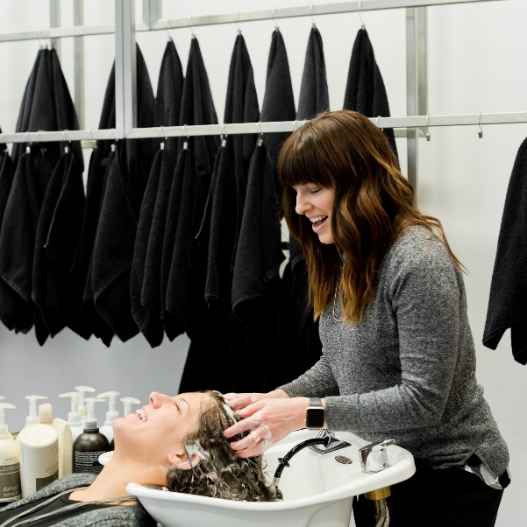

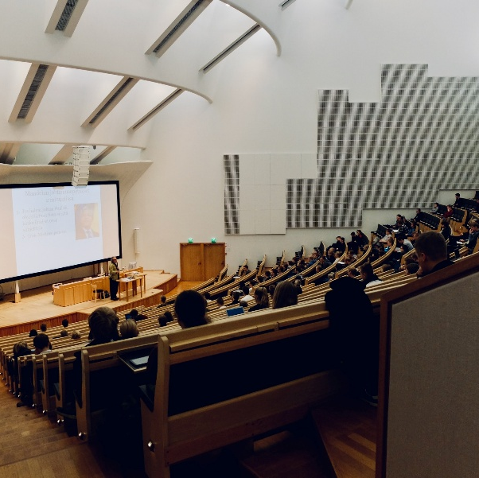

Explore a career as a…
Here are some example roles and careers linked to​ Hair and Beauty
Franchise Owner
Magazine Journalist
Further education Lecturer
BBC Bitesize case study
icould case study
BBC Bitesize case study
icould case study
Notes:
Jobs that use Hair and Beauty iCould: https://icould.com/explore/categories/subject/hair-and-beauty-studies
Activity Ideas:
Ahead of revealing content of slide, encourage students to think about as many roles linked to your subject as they can in pairs/groups.
Encourage students to engage with specific videos/profiles or direct students to specific roles/careers to predict, research and reflect on:
Pathways
Essential Skills
Wages/Work Conditions
Why they, might like/not like in a particular role?

Slide 4
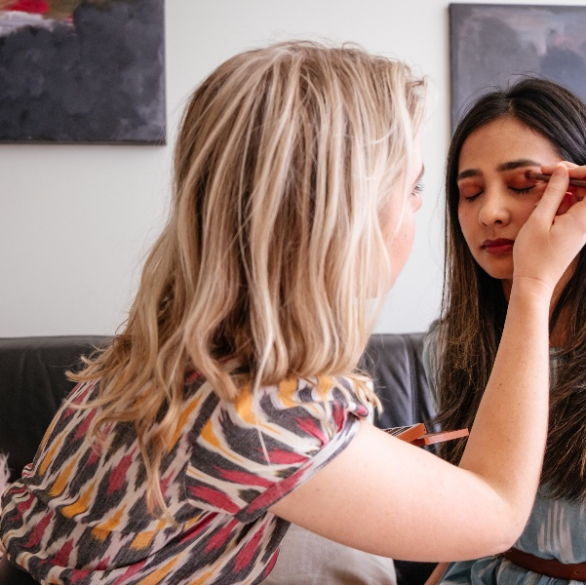
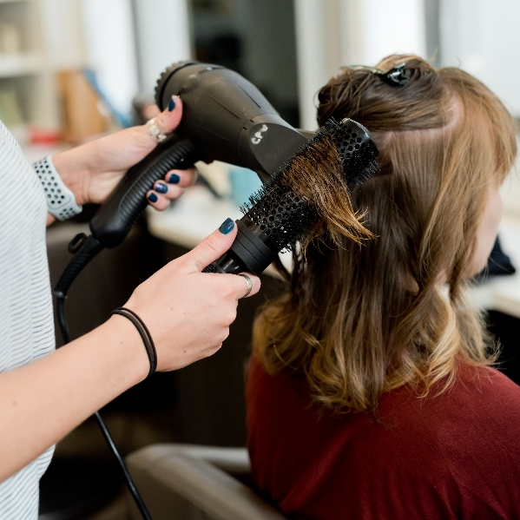
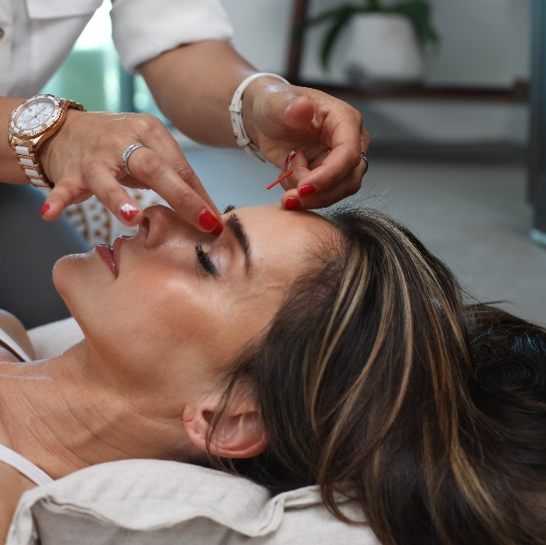
Explore a career as a…
Here are some example roles and careers linked to​ Hair and Beauty
Make Up Artist
Hair Stylist
Beauty Therapist
icould case study
BBC Bitesize case study
icould case study
icould case sudy
Notes:
Jobs that use Hair and Beauty iCould: https://icould.com/explore/categories/subject/hair-and-beauty-studies
Activity Ideas:
Ahead of revealing content of slide, encourage students to think about as many roles linked to your subject as they can in pairs/groups.
Encourage students to engage with specific videos/profiles or direct students to specific roles/careers to predict, research and reflect on:
Pathways
Essential Skills
Wages/Work Conditions
Why they, might like/not like in a particular role?

Slide 5


Not so obvious subjects using Hair and Beauty:
Ever thought about..?
How to become a Hair and Make-up Junior for Small Axe
Aromatherapist | Explore careers | National Careers Service
How to become a Make-up Artist: Amrita's story
Reiki Healer | Explore careers | National Careers Service
How to become a founder of a makeup brand: Jessica's story
Tattooist and Body Piercer | Explore careers | National Careers Service
Notes:
It’s important for students to understand the wide range of possibilities arising from your subject. Here’s some to explore…try and focus on less obvious choices.
To select more yourself:
iCould link:
Hair & Beauty
National Careers Service link:
https://nationalcareers.service.gov.uk/explore-careers

Slide 6

MYPATH Job of the week (Hair and Beauty)
Tattoo Artist
Barber
Beauty Therapist
Notes:
MYPATH are a series of fabulous videos designed to inspire students in a variety of jobs.
https://www.mypathcareersuk.com/other-careers-videos
Inspire students with these clips.

Slide 7

From passion to profession:
Share a role that sparks your interest
Prepare a 3 - 5 minute talk to share with a small group on any role that interests you related to Hair and Beauty
What is the role?
What do you need to do to get this role?
Where do you need to go to carry out this role?
What might a typical day look like?
Why are you interested in this role?

Slide 8
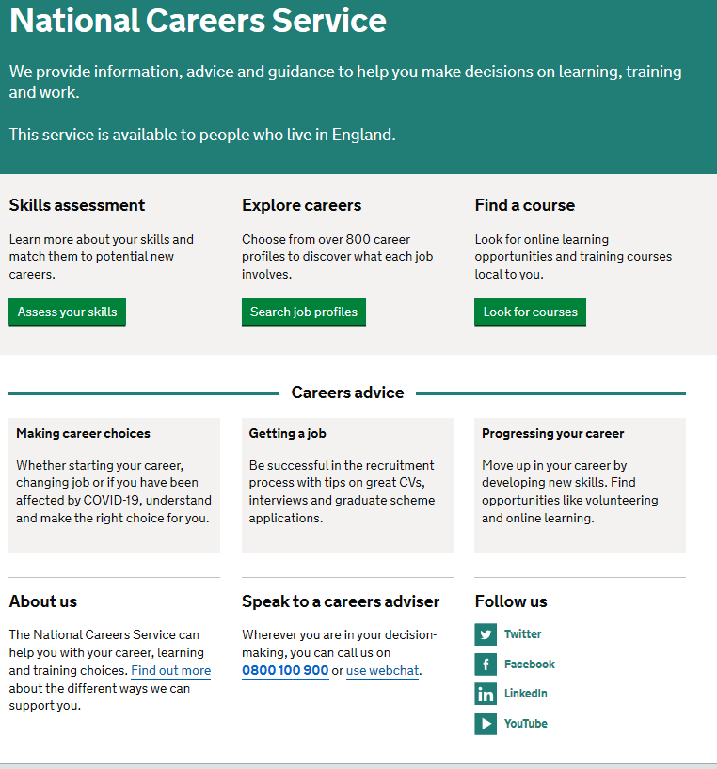
Discover more about the role
Explore careers using National Careers Service and find out about what jobs involve and how they are right for you
Includes:
Average salary
Typical hours
Work patterns
Pathways/How to become
Essential Skills
Daily tasks
Career path and progression
Current opportunities
Research Ideas:
Magazine Journalist
Further education Lecturer
Make Up Artist
Hairdresser
Beauty Therapist
Notes:
https://nationalcareers.service.gov.uk/explore-careers
How to use this slide:
Highlight the National Careers Service: Explore Careers Tool https://nationalcareers.service.gov.uk/explore-careers
Encourage students to access the tool and research general or specific roles linked to your subject.
Set students comparative/reflective tasks about why students may/may not like jobs they research.
Ask if your students have done the Buzz quiz (5mins to complete) – if they haven’t then consider setting this as a pre/post task to allow them to reflect on how these roles may suit them based on their profile. Take the test and find out which animal you are, too!
The Buzz Quiz (Quiz) - North East Ambition

Slide 9


Why not teach Hair and Beauty?
Progress your career into leadership and management
Bring your outside interests into the classroom and your subject
No two days are the same – and neither are the pupils
Once qualified you can teach throughout your life
You could teach abroad
Explore teaching
Daniel’s Story
Jem’s Story
Shaniqua’s Story
What makes a great teacher?
The right skills to teach?
Work well in a team?
Love to nurture imagination?
Love to keep learning?
Notes:
Use the bullets on the slide to discuss benefits of teaching.
Bring through the reasons cited in your guide P5:
Re teaching:
2. Turn your passion into a career
3. The reward is always worth the challenge
4. More time for what you love
5. Start on at least £25k (£32k inner London)
‘Explore teaching’ is a great introduction for your students to consider what it is really like to be on the other side of the desk (you choose the best fit video for your students).
·Daniel is the early stages of his teaching career as a primary teacher and shares his journey, belief, and pride that great teachers make all the difference.
·Jem who always wanted to be a teacher from his time at university, teaches history and politics in an 11-18 secondary school. Filmed in his school, he shares his career progression, along with pupils sharing why they enjoy his lessons.
·Shaniqua is a primary teacher who shares her inspiring and personal journey from having to retake her GCSEs, to working as a Teaching Assistant, alongside studying for a degree. Filmed in her school, which she used to attend, Shaniqua shares her message that there are ‘other ways to become a teacher than doing A Levels and straight to university’.
The right skills to teach?
These three very short films show students those skills they have already gained like teamwork, imagination or a love of learning - could they be more of teacher than they think?
What makes a great teacher?
A short video where secondary pupils share their responses to this question. Try asking your students first and then comparing their answers with the students on film.

Slide 10

GCSE
While there are different routes you can take to be a teacher there are a few essential things that you will need:
• A minimum GCSE Grade 4 or above in English and Maths (plus Science if you want to teach primary)
A degree or equivalent qualification
A-Level
T level
Vocational/Technical Qualification
Apprenticeships
A-Levels are 2 years of study
T levels are nationally recognised, technical qualifications for 16–19-year-olds. Designed by leading employers, one T level is equivalent in size to 3 A-Levels
These include BTEC, Applied General Qualifications (AGQ) and Vocational Technical Qualifications (VTQ) – all at Level 3
Apprenticeships are jobs which combine practical work and study. Intermediate is Level 2, Advanced is Level 3
Degree
Level 4/5 qualifications
Higher apprenticeships
Complete a degree course
It is possible to get QTS as part of an undergraduate degree, for example:
• Bachelor of Arts (BA) with QTS
• Bachelor of Education (BEd) with QTS
• Bachelor of Science (BSc) with QTS
Complete a L4/5 course and top up to a degree – L4/5 includes Certificate of HE, Diploma of HE, Higher Technical Qualification (HTQ), HNC, HND and Foundation degrees
Top up to a degree (Level 6) in a year of full-time study
Higher level apprenticeship (foundation degree / Level 5)
Degree apprenticeships
Degree apprenticeship
(Level 6-7). There is a Level 6 Teaching apprenticeship programme
Initial Teacher Training (ITT) with qualified teacher status (QTS)
Teacher
Notes:
Here is the power point version of the infographic resource showing different options learners could follow to get into teaching.
Go through this with your learners and give examples of different staff in your school, special school or college who followed these paths.

Slide 11



Hair and Beauty pathways
Combine study and work
Study
Work

Slide 12

Combine study and work
Apprenticeships
Hair and Beauty Studies
Beauty Therapy
Nail Technology
Media Make Up
VTQs
Barbering
Advanced and Creative Hair Professionals
Technical Salon Management​
Production Arts​
Complementary Therapies
Beauty and Spa Therapy
Theatrical Effects and Media
Make Up Artistry
Complementary Therapies
Beauty Therapy​
Theatre and Media Make Up
Retail Knowledge​
Beauty Therapy and Nail Services​
Spa and Nails

Slide 13

Study pathways
HTQs (Higher Technical Qualifications)
You will find occupation routes in:
Business and Management
Higher education
You might find courses in:
Acupuncture
Advanced Skin Techniques
Advanced Make Up, Hair and Prosthetics
Theatrical Hair and Media Make Up
Salon and Spa Management
Hair and Make Up for Screen and Film​
Aesthetic Practitioner​
Beauty Therapy ​
Beauty Communication and Promotion ​
Artistic Make Up and Special
Effects​
Fashion and Beauty Media

Slide 14

Work pathways
Supported internships with an education, health and care plan
You might read about:
• Access to Work Funding (if you have a disability or health condition)
• Preparing for Adulthood
School leaver programmes
You might read about:
• How to fill in an application form
• How to write a CV
• Interview help
• Progressing your career (Careers Advice from NCS)

Slide 15


