Slide 1
The business case for modern work experience
Modern work experience.
Let’s make it work.

Slide 2
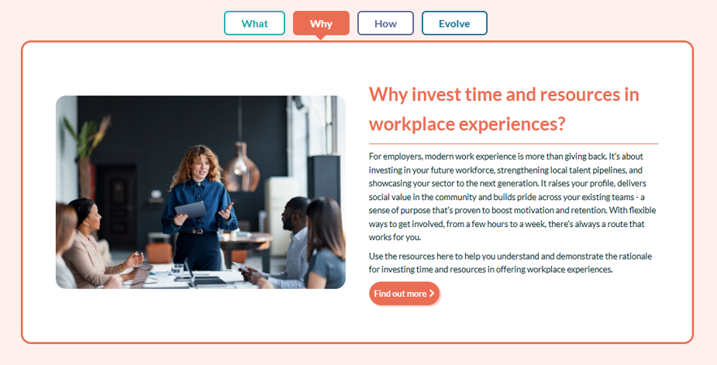
  How to use this document.
This document forms part of a suite of resources to support employers to engage in modern work experience.
This slide deck is part of the ‘WHY’ suite of resources which includes a longer set of business case evidence with detailed citations.
It is available in both PDF and word format so that you can use relevant parts to support your work.
You can select from the following slides to use in presentations to stakeholders to support your business case.
https://www.careersandenterprise.co.uk/employers/engage-with-education/workplace-experiences/
If you have used any evidence not referenced in the business case that may be supportive to other businesses, please do share with us by emailing: employers@careersandenterprise.co.uk

Slide 3
The UK has almost 1 million young people Not in Education Employment or Training (NEET).
However…
A young person who has 4 or more encounters with employers is 86% less likely to be unemployed… and can earn up to 18% more during their career.
Source
x4

Slide 4

  Economic benefits
There is potential to add £69bn to the economy if we matched the lowest NEET rate in the OECD.
Even within the UK, if we improved NEET rates to match those in the best-performing region, it would add £23bn to the economy.
Source:
One in eight young people across the UK not in work or education - Youth Futures Foundation
PwC comments on the latest UK NEET rates among young people

Slide 5

The better the careers provision; the better the outcomes for young people​
(And business!)​
Employers who engage effectively report:
early years recruitment
recruitment costs
workforce diversity
skills gaps
Source: https://www.careersandenterprise.co.uk/media/uh4jebzc/looking-deeper-at-destinations.pdf
Source: https://www.careersandenterprise.co.uk/evidence-and-reports/employer-standards-for-careers-education-one-year-on/ and
https://www.careersandenterprise.co.uk/evidence-and-reports/employer-standards-insight-briefing/

Slide 6
  Economic benefits
The WEF's Future of Jobs report identified the top ten skills for the evolving job market:
Creative thinking
Analytical thinking
Technological literacy
Curiosity and lifelong learning
Resilience, flexibility, and agility
Leadership and social influence
Empathy and active listening
Motivation and self-awareness
Talent management
Service orientation and customer service
The majority of these can be developed and enhanced via work experience. They align well to the Skills Builder framework of essential skills which we recommend embedding in your careers education approach (and forms a key element of our Employer Standards).
Source:
Future of Jobs
and
Skills Builder
See more on the role of essential skills in the AI transition here

Slide 7

  Employer benefits
  Employers delivering the highest quality ‘meaningful opportunities’ (including workplace experiences) are 2x as likely to say their work is helping close skills gaps.
  Employers proactively targeting their activities to under-represented groups are 1/3 more likely to say that their education outreach is helping them to develop new talent pipelines.
  Overall:
  81% of employers say their outreach Is helping to develop new talent pipelines
  67% say it’s helping to improve the diversity of their workforce
  87% say it’s encouraging young people to take up careers in their sector
  Employer Standards for careers education one-year-on

Slide 8



  Employer benefits
  Offering workplace experiences can provide opportunities for staff to engage, supervise and mentor young people, providing opportunities to realise unidentified skills and develop other professional and personal skills.
  According to NCVO, volunteering also drives a more engaged, confident, and mission-focused workforce.
Making a difference: Nine in ten volunteers (89%) agreed that it makes them feel like they are making a difference.
Wellbeing: Three-quarters (75%) reported that volunteering improved their mental health and wellbeing.
Connectivity: Almost nine in ten volunteers (87%) connect to new people.

Slide 9
  Employer benefits
Early talent pipeline development
Work experience can help build awareness of your brand and your sector.
87% of employers say their work in this area is encouraging young people to take up careers in their sector.
Employers delivering the highest quality ‘meaningful opportunities’ (including workplace experiences) are 2x as likely to say their work is helping close skills gaps.
Source: https://www.careersandenterprise.co.uk/media/5jdfj3dg/1958-employer-standards-for-careers-education-one-year-on-v10-non-print.pdf (p.7)

Slide 10
  Employer benefits
Inclusive talent development
By ensuring inclusivity you can break down barriers, challenge stereotypes and broaden your future talent pipeline, which can maximise interest in your organisation.
Employers proactively targeting their activities to under-represented groups are 1.5x more likely to say that their education outreach is helping them to develop new talent pipelines.*
In 2024 Cisco UK & Ireland identified that 50% of their female apprentice cohort came through one of their work experience programmes**.
*based on users of the Employer Standards tool
** Cisco Pathways Social Impact Report 2014-2024 10 years of impact

Slide 11
  Employer benefits
Cost savings
Engaging your prospective talent pipeline can lower the cost per hire of early careers recruitment and reduce onboarding attrition.
Almost 40% of employers say working with schools and colleges has helped them to reduce their recruitment costs. *
*based on users of the Employer Standards tool

Slide 12
  Employer benefits
Social value and community impact
Modern work experience is one of the most practical and measurable ways for employers to create social value. It strengthens local economies, supports business resilience and develops the future talent pipeline employers rely on.
Government reforms now make this even more important.
Under the Procurement Act 2023, the National Procurement Policy Statement, the Social Value Model and the 2025 Public Procurement consultation, suppliers must show how they support skills, opportunity and workforce development, now central priorities for public procurement and local growth.
Work experience delivers exactly this: real opportunities for young people and clear contribution to both local and national priorities.
The Social Value Impact of Work Experience
Visible commitment to local communities, including opportunity to target opportunities to cohorts missing out
Stronger bid performance with clear, measurable, robust and reportable social value outcomes
Flexible and achievable for any business, from SMEs to major contractors
High impact which builds confidence in young people now and strengthens talent pipelines for the future
Modern work experience: good for young people, good for communities, good for business.

Slide 13
  Employer benefits
Supports social mobility
A commitment to social mobility begins with supporting young people without social networks to have their first experience of the workplace.
Children’s aspirations are shaped, moulded and restricted by gender stereotyping, socio-economic background and social networks.
Stereotypes begin to develop as early as seven years old.²
Young people from low socio-economic backgrounds need more support to build their networks, confidence and skills. Their attainment is positively impacted by meeting relatable workplace role models.³
¹https://www.mckinsey.com/industries/social-sector/our-insights/breaking-the-standstill-how-social-mobility-can-boost-europes-economy
² https://www.educationandemployers.org/wp-content/uploads/2018/01/Drawing-the-Future-FINAL-REPORT.pdf
³ https://www.careersandenterprise.co.uk/media/3ogdxqu1/bit67-cec-report_v3.pdf

Slide 14
  Employer benefits
Supports skills development
Following a recent work experience pilot engaging learners from high deprivation schools in a KPMG-led pilot.
92% of students
reported they better understood the skills employers are looking for.
83% of students
in the same pilot also reported greater awareness of their skills and talents.
See the KPMG impact report

Slide 15
  Why work with Careers Hubs?
Employers who work with Careers Hubs provide higher quality outreach and see greater business benefits, both in the short and long term.
Employers delivering high quality opportunities over the long term report the greatest business benefits; and these grow over time, especially when it comes to reduced recruitment costs and closing skills gaps.
Our Hubs help in a range of ways:
  Make it easy and efficient to engage
  Provide data-informed connections to schools & colleges
  Share best practice & access to resources
Contact your local Careers Hub

Slide 16
Thank you for your continued support.
Modern work experience.
Let’s make it work.

