Slide 1


Science
My Learning, My Future
Where can studying Geography take you? Highlighting the relevance of Science to future careers and opportunities​
Notes:
Purpose of slides:
To allow you to highlight the relevance of your subject to future careers and opportunities.
To enable students to explore the full range of options available to them.
Aims:
To engage students in your subject
To highlight pathways and opportunities from your subject
To encourage students to consider your subject at KS4/Post 16
To support work across the school towards Gatsby Benchmark 4
How to use these slides?
These slides can be used at any point during KS3/4 or post 16 to engage students in learning and to highlight the relevance of your subject to future careers and opportunities.
They will be of most relevance within an option process and can support work you are doing to encourage students to consider their options for KS4/Post 16.

Slide 2
Why study Science?
Understanding the world around us
Informed decision-making
Career opportunities
Developing critical thinking skills
Solving
real-world problems
Notes:
Why study Science?
Career opportunities
Applicants with a background in science or STEM whether through technical education training or a degree are highly valued across industries. These skills can lead to well-paid and exciting opportunities in a wide range of sectors.
Informed decision-making
Helps students understand how and why things work the way they do, enabling them to create and make informed decisions.
Developing critical thinking skills
Science teaches you how to ask questions, gather evidence, analyse data, and draw logical conclusions. These skills are valuable in any career and in everyday decision-making.
Understanding the world around us
Science helps explain natural phenomena from why the sky is blue to how ecosystems function. It gives us a deeper appreciation of the universe and our place in it.
Solving real-world problems
Scientific knowledge drives innovation in medicine, technology, energy, and the environment. Studying science equips you to tackle global challenges like climate change, disease, and food security.
Reflection:
Is there anything else you would add to this list?
How do you share the importance of studying Science with learners?
How do you communicate the value of studying Science with parents and carers?
Reflection:
What else would learners add to this list?

Slide 3
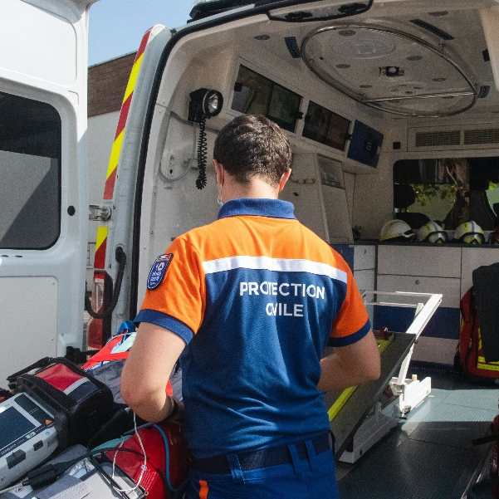


Explore a career as a…
Here are some example roles and careers linked to​ Science
Paramedic
Pharmacist
Critical Care Technologist
BBC Bitesize case study
BBC Bitesize case study
NHS case study
BBC Bitesize case study
Notes:
Jobs that use Science BBC Bitesize Careers: https://www.bbc.co.uk/bitesize/tags/zjb8f4j/jobs-that-use-science/1
Activity Ideas:
Ahead of revealing content of slide, encourage students to think about as many roles linked to your subject as they can in pairs/groups.
Encourage students to engage with specific videos/profiles or direct students to specific roles/careers to predict, research and reflect on:
Pathways
Essential Skills
Wages/Work Conditions
Why they, might like/not like in a particular role?

Slide 4



Explore a career as a…
Here are some example roles and careers linked to​ Science
Research Scientist
Mental Health Nurse
Ecologist
BBC Bitesize case study
BBC Bitesize case study
BBC Bitesize case study
STEM case study
NHS case study
STEM case study
Notes:
Jobs that use Science BBC Bitesize Careers: https://www.bbc.co.uk/bitesize/tags/zjb8f4j/jobs-that-use-science/1
Activity Ideas:
Ahead of revealing content of slide, encourage students to think about as many roles linked to your subject as they can in pairs/groups.
Encourage students to engage with specific videos/profiles or direct students to specific roles/careers to predict, research and reflect on:
Pathways
Essential Skills
Wages/Work Conditions
Why they, might like/not like in a particular role?

Slide 5


Not so obvious subjects using Science:
Ever thought about..?
How to become a zero waste shop owner: Lydia's story - BBC Bitesize
Arboricultural Officer | Explore careers | National Careers Service
How to become a StreetDoctorIntern: Khadija's story
Data Analyst/Statistician | Explore careers | National Careers Service
How to become an Executive Assistant: Emily's story
Garment Technologist | Explore careers | National Careers Service
Notes:
It’s important for students to understand the wide range of possibilities arising from your subject. Here’s some to explore…try and focus on less obvious choices.
To select more yourself:
BBC Bitesize link:
https://www.bbc.co.uk/bitesize/tags/zjb8f4j/jobs-that-use-science/1
National Careers Service link:
https://nationalcareers.service.gov.uk/explore-careers

Slide 6

MYPATH Job of the week (Science)
Geoscientist
Toxicologist
Dentist
Notes:
MYPATH are a series of fabulous videos designed to inspire students in a variety of jobs.
https://www.mypathcareersuk.com/other-careers-videos
Inspire students with these clips.

Slide 7
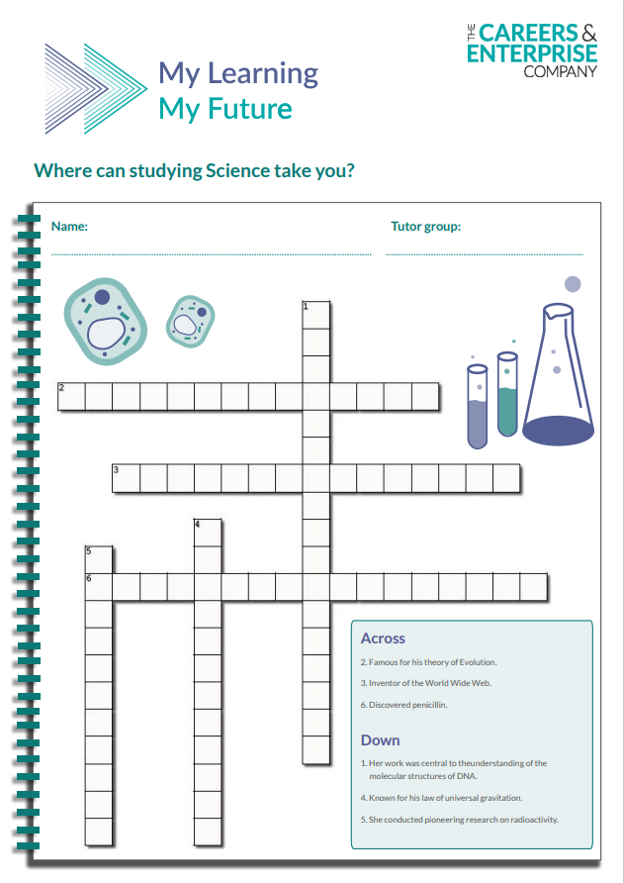
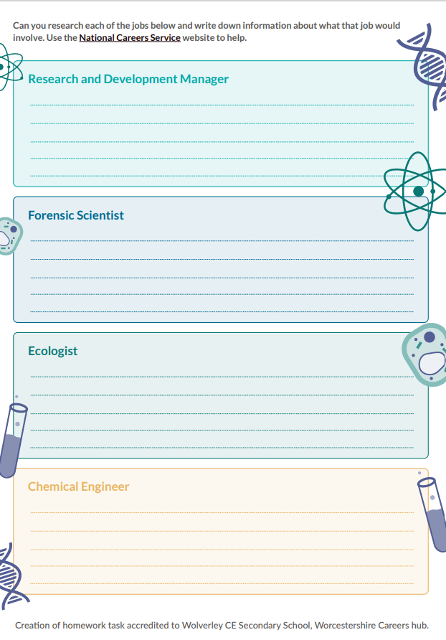
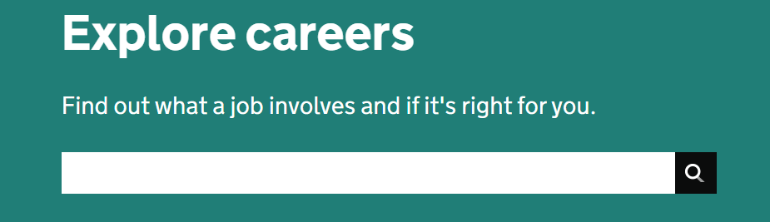
KS3 Home learning task
Use the National Careers Service Explore careers tool to research for this homework
Explore here

Slide 8


From passion to profession:
Share a role that sparks your interest
Prepare a 3 - 5 minute talk to share with a small group on any role that interests you related to Science.
What is the role?
What do you need to do to get this role?
Where do you need to go to carry out this role?
What might a typical day look like?
Why are you interested in this role?

Slide 9
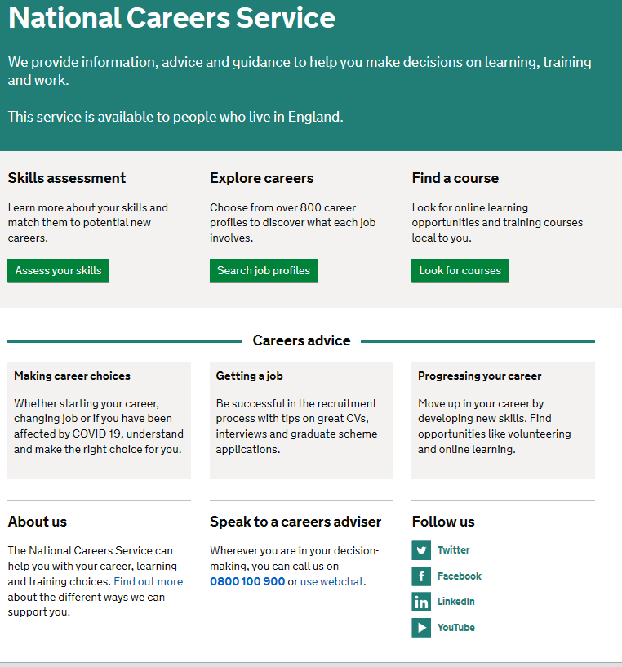
Discover more about the role
Explore careers using National Careers Service and find out about what jobs involve and how they are right for you
Includes:
Average salary
Typical hours
Work patterns
Pathways/How to become
Essential Skills
Daily tasks
Career path and progression
Current opportunities
Research Ideas:
Paramedic
Pharmacist
Critical Care Technologist
Research Scientist
Mental Health Nurse
Ecologist
Notes:
https://nationalcareers.service.gov.uk/explore-careers
How to use this slide:
Highlight the National Careers Service: Explore Careers Tool https://nationalcareers.service.gov.uk/explore-careers
Encourage students to access the tool and research general or specific roles linked to your subject.
Set students comparative/reflective tasks about why students may/may not like jobs they research.
Ask if your students have done the Buzz quiz (5mins to complete) – if they haven’t then consider setting this as a pre/post task to allow them to reflect on how these roles may suit them based on their profile. Take the test and find out which animal you are, too!
The Buzz Quiz - North East Ambition

Slide 10


Why not teach Science?
Progress your career into leadership and management
Bring your outside interests into the classroom and your subject
No two days are the same – and neither are the pupils
Once qualified you can teach throughout your life
You could teach abroad
Explore teaching
Daniel’s Story
Jem’s Story
Shaniqua’s Story
What makes a great teacher?
The right skills to teach?
Work well in a team?
Love to nurture imagination?
Love to keep learning?
Notes:
Use the bullets on the slide to discuss benefits of teaching.
Bring through the reasons cited in your guide P5:
Re teaching:
2. Turn your passion into a career
3. The reward is always worth the challenge
4. More time for what you love
5. Start on at least £25k (£32k inner London)
‘Explore teaching’ is a great introduction for your students to consider what it is really like to be on the other side of the desk (you choose the best fit video for your students).
·Daniel is the early stages of his teaching career as a primary teacher and shares his journey, belief, and pride that great teachers make all the difference.
·Jem who always wanted to be a teacher from his time at university, teaches history and politics in an 11-18 secondary school. Filmed in his school, he shares his career progression, along with pupils sharing why they enjoy his lessons.
·Shaniqua is a primary teacher who shares her inspiring and personal journey from having to retake her GCSEs, to working as a Teaching Assistant, alongside studying for a degree. Filmed in her school, which she used to attend, Shaniqua shares her message that there are ‘other ways to become a teacher than doing A Levels and straight to university’.
The right skills to teach?
These three very short films show students those skills they have already gained like teamwork, imagination or a love of learning - could they be more of teacher than they think?
What makes a great teacher?
A short video where secondary pupils share their responses to this question. Try asking your students first and then comparing their answers with the students on film.

Slide 11

GCSE
While there are different routes you can take to be a teacher there are a few essential things that you will need:
• A minimum GCSE Grade 4 or above in English and Maths (plus Science if you want to teach primary)
A degree or equivalent qualification
A-Level
T level
Vocational/Technical Qualification
Apprenticeships
A-Levels are 2 years of study
T levels are nationally recognised, technical qualifications for 16–19-year-olds. Designed by leading employers, one T level is equivalent in size to 3 A-Levels
These include BTEC, Applied General Qualifications (AGQ) and Vocational Technical Qualifications (VTQ) – all at Level 3
Apprenticeships are jobs which combine practical work and study. Intermediate is Level 2, Advanced is Level 3
Degree
Level 4/5 qualifications
Higher apprenticeships
Complete a degree course
It is possible to get QTS as part of an undergraduate degree, for example:
• Bachelor of Arts (BA) with QTS
• Bachelor of Education (BEd) with QTS
• Bachelor of Science (BSc) with QTS
Complete a L4/5 course and top up to a degree – L4/5 includes Certificate of HE, Diploma of HE, Higher Technical Qualification (HTQ), HNC, HND and Foundation degrees
Top up to a degree (Level 6) in a year of full-time study
Higher level apprenticeship (foundation degree / Level 5)
Degree apprenticeships
Degree apprenticeship
(Level 6-7). There is a Level 6 Teaching apprenticeship programme
Initial Teacher Training (ITT) with qualified teacher status (QTS)
Teacher
Notes:
Here is the power point version of the infographic resource showing different options learners could follow to get into teaching.
Go through this with your learners and give examples of different staff in your school, special school or college who followed these paths.

Slide 12



Science pathways
Combine study
and work
Study
Work

Slide 13

Combine study and work
Apprenticeships
Nuclear Scientist
Laboratory Scientist
Vet Technician
Therapeutic Radiographer
Forensic Practitioner
T Levels
Health
Healthcare Science
Science
Agriculture, Land Management and Production
Animal Care and Management
Education and Early Years
Pharmacy Technician
Environmental Health Practitioner
Dental Technician
Conservation Officer
VTQs
Applied Science
Health and Social Care

Slide 14

Study pathways
HTQs (Higher Technical Qualifications)
Higher technical qualifications (HTQs) | Department for Education
You will find occupation routes in:
Health and Science
Education and Early Years
Engineering and Manufacturing
Construction and the Built Environment
A levels
You might find courses in:
Science (Biology, Chemistry, Physics)
Applied General Science
Statistics
Environmental Science
Higher education
You might find courses in:
Molecular Science
Animal Science
Sensory Science
Research Science
Science, Engineering and Production

Slide 15

Work pathways
Supported internships with an education, health and care plan
You might read about:
Access to Work Funding (if you have a disability or health condition)
Preparing for Adulthood
School leaver programmes
You might read about:
How to fill in an application form
How to write a CV
Interview help
Progressing your career (Careers Advice from NCS)

Slide 16


University league tables
See at a glance the university ranking for various Sciences
Rankings Rankings (the completeuniversityguide.co.uk
Biological Sciences
Biomedical Sciences
Filter by:
Overall score
Entry standards
Student satisfaction
Research quality
Research intensity
Graduate prospects

Slide 17


