Slide 1


Physics
My Learning, My Future
Where can studying History take you? Highlighting the relevance of Physics to future careers and opportunities​
Notes:
Purpose of slides:
To allow you to highlight the relevance of your subject to future careers and opportunities.
To enable students to explore the full range of options available to them.
Aims:
To engage students in your subject
To highlight pathways and opportunities from your subject
To encourage students to consider your subject at KS4/Post 16
To support work across the school towards Gatsby Benchmark 4
How to use these slides?
These slides can be used at any point during KS3/4 or post 16 to engage students in learning and to highlight the relevance of your subject to future careers and opportunities.
They will be of most relevance within an option process and can support work you are doing to encourage students to consider their options for KS4/Post 16.

Slide 2
Why study Physics?
Curiosity and discovery
Technical innovation
Career opportunities
Tackle global challenges
Understanding the universe
Notes:
Why study Physics?
Career opportunities
Whether through academic degrees or technical pathways, physics equips learners with a powerful foundation in analytical thinking, mathematical modelling, and problem-solving. As a result, physics-trained individuals are in high demand across a wide range of sectors including data science, finance, engineering, education, and research, etc.
Technical innovation
Many modern technologies like smartphones, MRI machines, and solar panels are based on principles of physics. Studying physics can lead to breakthroughs in engineering, medicine, and computing.
Tackle global challenges
Physics plays a key role in addressing issues like:
Climate change (energy efficiency, sustainable tech)
Clean water (filtration and desalination technologies)
Space exploration and satellite communication
Understanding the universe
Physics helps explain how the universe works from the tiniest particles to the largest galaxies. It answers fundamental questions about matter, energy, space, and time.
Curiosity and discovery
If you are driven by curiosity about the workings of the world, physics offers a natural and inspiring path. It encourages deep exploration and intellectual discovery, often unlocking surprising insights that challenge assumptions and expand our understanding of the universe.
Reflection:
Is there anything else you would add to this list?
How do you share the importance of studying Physics with learners?
How do you communicate the value of studying Physics with parents and carers?

Slide 3
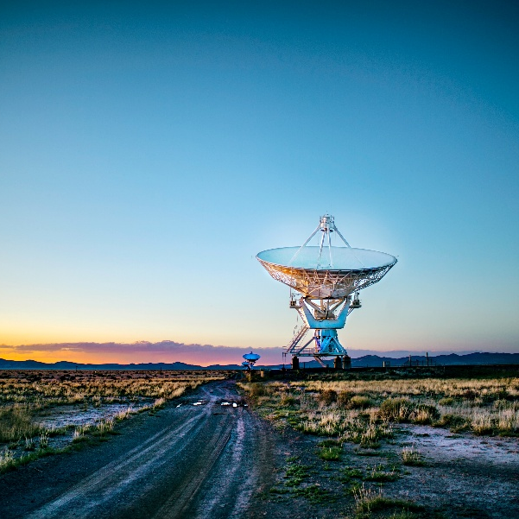

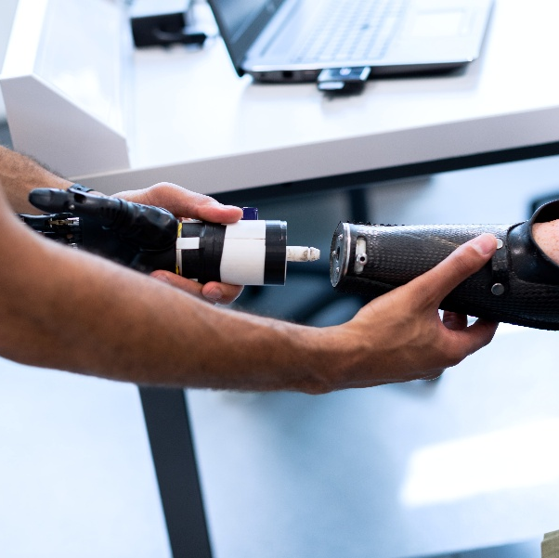
Explore a career as a…
Here are some example roles and careers linked to Physics
Astrophysicist
Naval Architect
Prosthetist/Orthotist
Nasa case study
BBC Bitesize Profile
BBC Bitesize case study
icould case study
STEM case study
Notes:
Jobs that use Science (Physics) BBC Bitesize Careers: https://www.bbc.co.uk/bitesize/tags/z4x3y9q/jobs-that-use-science/1
Activity Ideas:
Ahead of revealing content of slide, encourage students to think about as many roles linked to your subject as they can in pairs/groups.
Encourage students to engage with specific videos/profiles or direct students to specific roles/careers to predict, research and reflect on:
Pathways
Essential Skills
Wages/Work Conditions
Why they, might like/not like in a particular role?

Slide 4



Explore a career as a…
Here are some example roles and careers linked to Physics
Risk Manager
Field Technician (Wind Turbine)
Electrical Engineer
Job case study
BBC Bitesize case study
BBC Bitesize case study
STEM case study
Notes:
Jobs that use Science (Physics) BBC Bitesize Careers: https://www.bbc.co.uk/bitesize/tags/z4x3y9q/jobs-that-use-science/1
Activity Ideas:
Ahead of revealing content of slide, encourage students to think about as many roles linked to your subject as they can in pairs/groups.
Encourage students to engage with specific videos/profiles or direct students to specific roles/careers to predict, research and reflect on:
Pathways
Essential Skills
Wages/Work Conditions
Why they, might like/not like in a particular role?

Slide 5


Not so obvious jobs using Physics:
Ever thought about..?
How to become an Audiologist: Amun's story - BBC Bitesize
Astronaut | Explore careers | National Careers Service
How to become a Field Technician: Harry's story
Energy Engineer | Explore careers | National Careers Service
How to become a Solar Farm Manager: Manish's story
Medical Physicist | Explore careers | National Careers Service
Notes:
It’s important for students to understand the wide range of possibilities arising from your subject. Here’s some to explore…try and focus on less obvious choices.
To select more yourself:
BBC Bitesize link:
https://www.bbc.co.uk/bitesize/tags/zjb8f4j/jobs-that-use-science/1
National Careers Service link:
https://nationalcareers.service.gov.uk/explore-careers

Slide 6

MYPATH Job of the week (Physics)
Neurologist
Nasa Engineer
Mechanical Engineer
Notes:
MYPATH are a series of fabulous videos designed to inspire students in a variety of jobs.
https://www.mypathcareersuk.com/other-careers-videos
Inspire students with these clips.

Slide 7

From passion to profession:
Share a role that sparks your interest
Prepare a 3 - 5 minute talk to share with a small group on any role that interests you related to Physics.
What is the role?
What do you need to do to get this role?
Where do you need to go to carry out this role?
What might a typical day look like?
Why are you interested in this role?

Slide 8
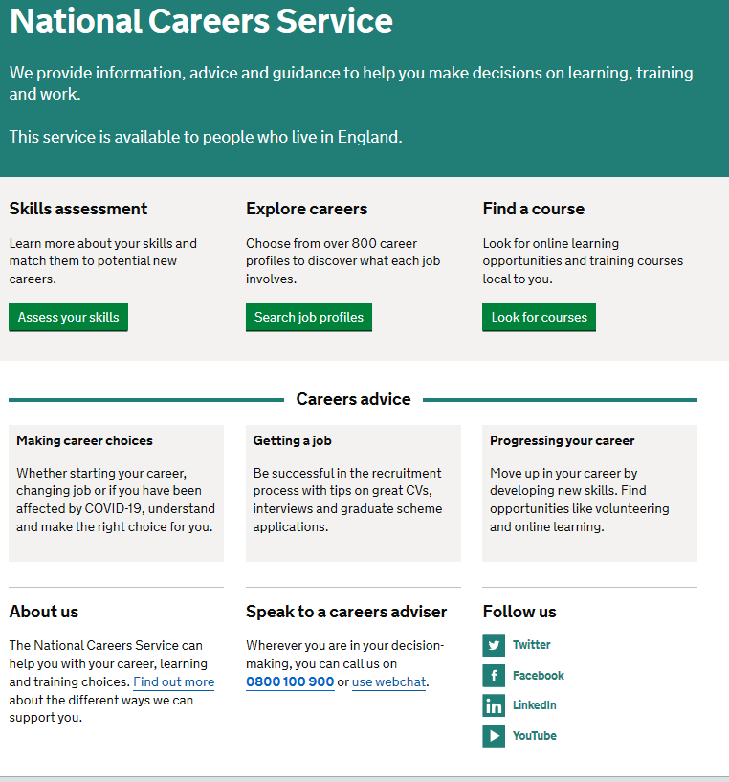
Discover more about the role
Explore careers using National Careers Service and find out about what jobs involve and how they are right for you
Includes:
Average salary
Typical hours
Work patterns
Pathways/How to become
Essential Skills
Daily tasks
Career path and progression
Current opportunities
Research Ideas:
Astronomer
Naval Architect
Prothetist/Orthotist
Risk manager
Wind Turbine Technician
Electrical Engineer
Notes:
https://nationalcareers.service.gov.uk/explore-careers
How to use this slide:
Highlight the National Careers Service: Explore Careers Tool https://nationalcareers.service.gov.uk/explore-careers
Encourage students to access the tool and research general or specific roles linked to your subject.
Set students comparative/reflective tasks about why students may/may not like jobs they research.
Ask if your students have done the Buzz quiz (5mins to complete) – if they haven’t then consider setting this as a pre/post task to allow them to reflect on how these roles may suit them based on their profile. Take the test and find out which animal you are, too!
The Buzz Quiz (Quiz) - North East Ambition

Slide 9


Why not teach Physics?
Progress your career into leadership and management
Bring your outside interests into the classroom and your subject
No two days are the same – and neither are the pupils
Once qualified you can teach throughout your life
You could teach abroad
Explore teaching
Daniel’s Story
Jem’s Story
Shaniqua’s Story
What makes a great teacher?
The right skills to teach?
Work well in a team?
Love to nurture imagination?
Love to keep learning?
Notes:
Use the bullets on the slide to discuss benefits of teaching.
Bring through the reasons cited in your guide P5:
Re teaching:
2. Turn your passion into a career
3. The reward is always worth the challenge
4. More time for what you love
5. Start on at least £25k (£32k inner London)
‘Explore teaching’ is a great introduction for your students to consider what it is really like to be on the other side of the desk (you choose the best fit video for your students).
·Daniel is the early stages of his teaching career as a primary teacher and shares his journey, belief, and pride that great teachers make all the difference.
·Jem who always wanted to be a teacher from his time at university, teaches history and politics in an 11-18 secondary school. Filmed in his school, he shares his career progression, along with pupils sharing why they enjoy his lessons.
·Shaniqua is a primary teacher who shares her inspiring and personal journey from having to retake her GCSEs, to working as a Teaching Assistant, alongside studying for a degree. Filmed in her school, which she used to attend, Shaniqua shares her message that there are ‘other ways to become a teacher than doing A Levels and straight to university’.
The right skills to teach?
These three very short films show students those skills they have already gained like teamwork, imagination or a love of learning - could they be more of teacher than they think?
What makes a great teacher?
A short video where secondary pupils share their responses to this question. Try asking your students first and then comparing their answers with the students on film.

Slide 10

GCSE
While there are different routes you can take to be a teacher there are a few essential things that you will need:
• A minimum GCSE Grade 4 or above in English and Maths (plus Science if you want to teach primary)
A degree or equivalent qualification
A-Level
T level
Vocational/Technical Qualification
Apprenticeships
A-Levels are 2 years of study
T levels are nationally recognised, technical qualifications for 16–19-year-olds. Designed by leading employers, one T level is equivalent in size to 3 A-Levels
These include BTEC, Applied General Qualifications (AGQ) and Vocational Technical Qualifications (VTQ) – all at Level 3
Apprenticeships are jobs which combine practical work and study. Intermediate is Level 2, Advanced is Level 3
Degree
Level 4/5 qualifications
Higher apprenticeships
Complete a degree course
It is possible to get QTS as part of an undergraduate degree, for example:
• Bachelor of Arts (BA) with QTS
• Bachelor of Education (BEd) with QTS
• Bachelor of Science (BSc) with QTS
Complete a L4/5 course and top up to a degree – L4/5 includes Certificate of HE, Diploma of HE, Higher Technical Qualification (HTQ), HNC, HND and Foundation degrees
Top up to a degree (Level 6) in a year of full-time study
Higher level apprenticeship (foundation degree / Level 5)
Degree apprenticeships
Degree apprenticeship
(Level 6-7). There is a Level 6 Teaching apprenticeship programme
Initial Teacher Training (ITT) with qualified teacher status (QTS)
Teacher
Notes:
Here is the power point version of the infographic resource showing different options learners could follow to get into teaching.
Go through this with your learners and give examples of different staff in your school, special school or college who followed these paths.

Slide 11



Physics pathways
Combine study
and work
Study
Work
Notes:
These are the three pathway choices all students have.

Slide 12

Combine study and work
T Levels
Apprenticeships
Nuclear Scientist
Metrology Technician
Laboratory Scientist
Veterinary Scientist
Therapeutic Radiographer
Forensic Practitioner
Acoustics Technician
Aerospace Engineer
Software Developer
Design and Development for Engineering and Manufacturing
Education and Early Years
Health
Healthcare Science
Science
Maintenance, Installation and Repair for Engineering and Manufacturing
VTQs
Applied Science
Engineering
Electrical Electronic Engineering
Operations and Maintenance Engineering​
Aviation Operations​
Forensic and Criminal Investigation

Slide 13

Study pathways
HTQs (Higher Technical Qualifications)
You will find occupation routes in:
Construction and the Built Environment
Engineering and Manufacturing
A levels
You might find courses in:
Physics
Engineering
Statistics
Computer Science
Higher education
You might find courses in:
Aerospace Engineering
Agriculture and related Sciences
Medicine and allied subjects
Electrical and Electronic Engineering
Biophysics
Veterinary Science
Optometry​
Paramedic Science ​
Physical Sciences ​
Pharmacology, Toxicology and Pharmacy​
Radiography and Medical Technology

Slide 14

Work pathways
Supported internships with an education, health and care plan
You might read about:
Access to Work Funding (if you have a disability or health condition)
Preparing for Adulthood
School leaver programmes
You might read about:
How to fill in an application form
How to write a CV
Interview help
Progressing your career (Careers Advice from NCS)

Slide 15


University league tables
See at a glance the university ranking for Physics
Physics and Astonomy Rankings (thecompleteuniversityguide.co.uk)
Filter by:
Overall score
Entry standards
Student satisfaction
Research quality
Research intensity
Graduate prospects
Notes:
Some learners will aspire to go to the top university for their subject. However, this isn't the same for all subjects.
It also depends what aspect of university life young people consider the most important.
Once you have had this discussion with learners, follow the link and filter by different factors to help inform their choices.

Slide 16


