Slide 1


Physical Education
My Learning, My Future
Bringing learning to life: Connecting Physical Education to careers, pathways, and the world beyond the classroom
Notes:
This presentation has been created to allow curriculum teachers to increase learner engagement within meaningful achievement of Gatsby Benchmark 4 by:
highlighting the relevance of their subject and pathways to the world of work and careers
making links to pathways, careers and the world of work from the curriculum
embedding curriculum learning in the context of the world of work
How to use these slides?
These slides can be used at any point during KS3/4 or post 16 to engage learners in curriculum learning and to highlight the relevance of your subject to future careers and opportunities.
They will be of most relevance within an option process and can support work you are doing to encourage learners to consider their options for KS4/Post 16.

Slide 2
Why study Physical Education ?
Discover talents and interests
Develop teamwork and leadership
Pathway to exciting careers
Understand the human body
Learn about healthy lifestyles
Notes:
Why study Physical Education?
Pathway to exciting careers
PE can lead to careers in sports coaching, physiotherapy, teaching, fitness training, nutrition, and more.
Develop teamwork and leadership
Through sports and group activities, you learn how to work with others, lead, communicate, and solve problems effectively.
Understand the human body
PE teaches you about anatomy, physiology, and how the body responds to exercise—great preparation for careers in health, fitness, or sports science.
Learn about healthy lifestyles
PE teaches you about nutrition, fitness, and how to make informed choices that support long-term health and wellbeing.
Discover talents and interests
PE gives you the chance to try a variety of sports and activities, helping you find what you enjoy and where you excel.
Reflection:
Is there anything else you would add to this list?
How do you share the importance of studying Physical Education with learners?
How do you communicate the value of studying Physical Education with parents and carers?

Slide 3
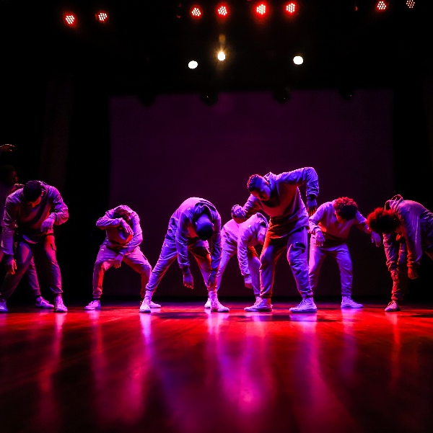
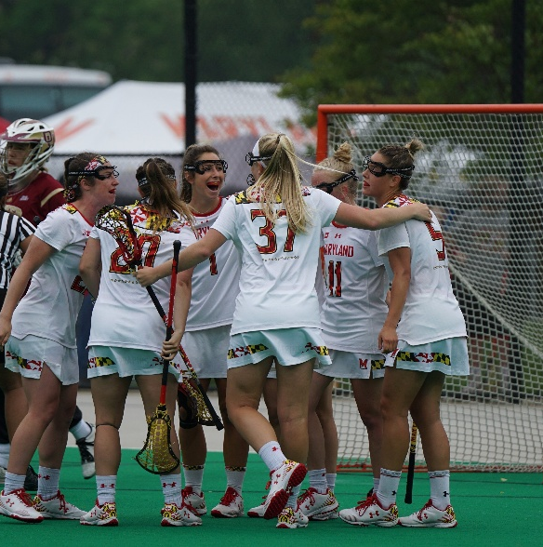


Explore a career as a…
Here are some example roles and careers linked to Physical Education
Choreographer/Dancer
Sports Development Officer
Sports Commentator
BBC Bitesize case study
BBC Bitesize case study
BBC Bitesize case study
BBC Bitesize case study
Notes:
Jobs that use PE BBC Bitesize Careers: https://www.bbc.co.uk/bitesize/tags/zjcwvk7/jobs-that-use-pe/1
Activity Ideas:
Ahead of revealing content of slide, encourage students to think about as many roles linked to your subject as they can in pairs/groups.
Encourage students to engage with specific videos/profiles or direct students to specific roles/careers to predict, research and reflect on:
Pathways
Essential Skills
Wages/Work Conditions
Why they, might like/not like in a particular role?

Slide 4
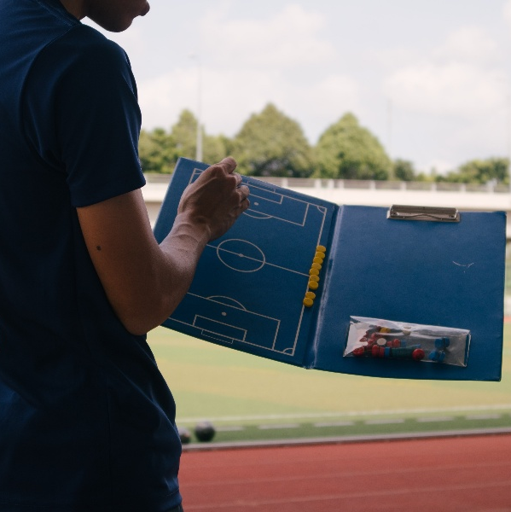

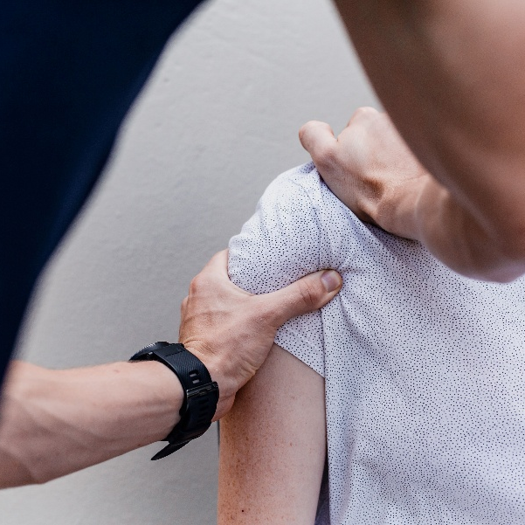
Explore a career as a…
Here are some example roles and careers linked to Physical Education
Sports Coach
Firefighter
Physiotherapist
BBC Bitesize case study
BBC Bitesize case study
BBC Bitesize case study
BBC Bitesize case study
Notes:
Jobs that use PE BBC Bitesize Careers: https://www.bbc.co.uk/bitesize/tags/zjcwvk7/jobs-that-use-pe/1
Activity Ideas:
Ahead of revealing content of slide, encourage students to think about as many roles linked to your subject as they can in pairs/groups,
Encourage students to engage with specific videos/profiles or direct students to specific roles/careers to predict, research and reflect on:
Pathways
Essential Skills
Wages/Work Conditions
Why they, might like/not like in a particular role?

Slide 5


Not so obvious careers that use PE:
Ever thought about..?
How to become a Development Officer: Jenna's story
Resort Representative | Explore careers | National Careers Service
How to become a Firefighter: Izzy's story
Leisure Centre Manager | Explore careers | National Careers Service
How to become a Stunt Performer: Rick's story
Health Play Specialist | Explore careers | National Careers Service
Notes:
It’s important for students to understand the wide range of possibilities arising from your subject. Here’s some to explore…try and focus on less obvious choices,
To select more yourself:
BBC Bitesize link:
Careers in sport - Careers - BBC Bitesize
National Careers Service link:
https://nationalcareers.service.gov.uk/explore-careers

Slide 6

From passion to profession:
Share a role that sparks your interest
Prepare a 3 - 5 minute talk to share with a small group on any role that interests you related to Physical Education.
What is the role?
What do you need to do to get this role?
Where do you need to go to carry out this role?
What might a typical day look like?
Why are you interested in this role?

Slide 7
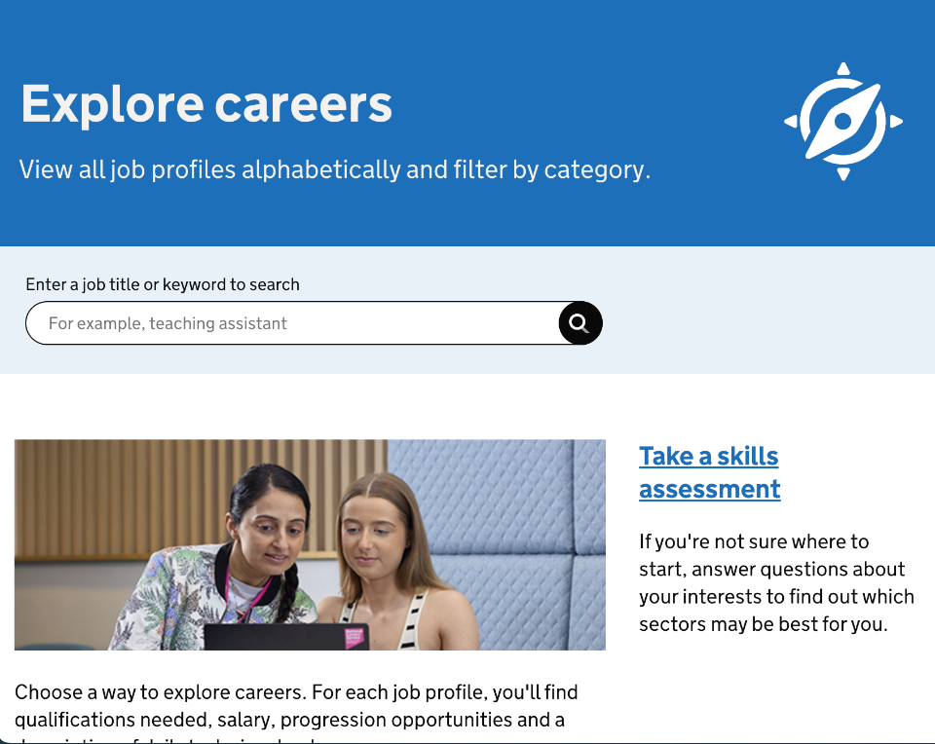
Discover more about different roles
Visit National Careers Service to find out more about different jobs and find one that might suit you!
Includes:
Average salary
Typical hours
Work patterns
Pathways/How to become
Essential Skills
Daily tasks
Career path and progression
Current opportunities
Research Ideas:
Choreographer
Sports Development Officer
Sports Commentator
Sports Coach
Firefighter
Physiotherapist
Notes:
https://nationalcareers.service.gov.uk/explore-careers
How to use this slide:
Highlight the National Careers Service: Explore Careers Tool https://nationalcareers.service.gov.uk/explore-careers
Encourage students to access the tool and research general or specific roles linked to your subject.
Set students comparative/reflective tasks about why students may/may not like jobs they research.
Ask if your students have done the Buzz quiz (5mins to complete) – if they haven’t then consider setting this as a pre/post task to allow them to reflect on how these roles may suit them based n their profile. Take the test and find out which animal you are, too!
The Buzz Quiz (Quiz) - North East Ambition

Slide 8


Why not teach Physical Education?
Progress your career into leadership and management
Bring your outside interests into the classroom and your subject
No two days are the same – and neither are the pupils
Once qualified you can teach throughout your life
You could teach abroad
Explore teaching
From the pitch to the classroom! Mr Young is making a difference in students’ lives as a teacher. See how his experience as a professional footballer shapes his approach to education and inspires the next generation. Greg Young played football professionally for years - before returning to his old secondary school, Hall Cross Academy in Doncaster, as a PE teacher and pastoral lead. Learn more about working as a PE teacher: PE teacher | Explore Careers | National Careers Service Explore Get Into Teaching: Get Into Teaching | Get Into Teaching GOV.UK
What makes a great teacher?

Slide 9

GCSE
While there are different routes you can take to be a teacher there are a few essential things that you will need:
• A minimum GCSE Grade 4 or above in English and Maths (plus Science if you want to teach primary)
A degree or equivalent qualification
A-Level
T level
Vocational/Technical Qualification
Apprenticeships
A-Levels are 2 years of study
T levels are nationally recognised, technical qualifications for 16–19-year-olds. Designed by leading employers, one T level is equivalent in size to 3 A-Levels
These include BTEC, Applied General Qualifications (AGQ) and Vocational Technical Qualifications (VTQ) – all at Level 3
Apprenticeships are jobs which combine practical work and study. Intermediate is Level 2, Advanced is Level 3
Degree
Level 4/5 qualifications
Higher apprenticeships
Complete a degree course
It is possible to get QTS as part of an undergraduate degree, for example:
• Bachelor of Arts (BA) with QTS
• Bachelor of Education (BEd) with QTS
• Bachelor of Science (BSc) with QTS
Complete a L4/5 course and top up to a degree – L4/5 includes Certificate of HE, Diploma of HE, Higher Technical Qualification (HTQ), HNC, HND and Foundation degrees
Top up to a degree (Level 6) in a year of full-time study
Higher level apprenticeship (foundation degree / Level 5)
Degree apprenticeships
Degree apprenticeship
(Level 6-7). There is a Level 6 Teaching apprenticeship programme
Initial Teacher Training (ITT) with qualified teacher status (QTS)
Teacher
Notes:
Here is the power point version of the infographic resource showing different options learners could follow to get into teaching.
Go through this with your learners and give examples of different staff in your school, special school or college who followed these paths.

Slide 10



Physical Education pathways
Combine study
and work
Study
Work
Notes:
These are the three pathway choices all students have.

Slide 11

Combine study and work
Apprenticeships
Personal Trainer
Sports Turf Operative
Teacher
Leisure Team Member
Sports Coach
T Levels
Health
Healthcare Science
Education and Early Years
Animal Care and Management
Agriculture, Land Management and Production
Golf Greenkeeper
Community Activator Coach
Outdoor Activity Instructor
Operational Firefighter
Sporting Excellence Professional ​
Workboat Crew Member​
VTQs
Sport and Physical Activity
Sport and Exercise Science
Sport and outdoor Activities
Sport, Fitness and Personal Training
Sporting Excellence and Performance
Sports Coaching and Development
Uniformed Protective Services

Slide 12

Study pathways
HTQs (Higher Technical Qualifications)
You might find courses in:
Health and Science
Education and Early Years
A levels
You might find courses in:
Physical Education
Psychology
Biology
Higher education
You might find courses in:
Applied Sports Science
Applied Sports Science and Management
Adventure Sports and Coaching
Ballet Education
Dance Education
Applied Sports Coaching
Applied Sports Coaching and Physical Education ​
Football Business

Slide 13

Work pathways
Supported internships with an education, health and care plan
You might read about:
Access to Work Funding (if you have a disability or health condition)
Preparing for Adulthood
School leaver programmes
You might read about:
How to fill in an application form
How to write a CV
Interview help
Progressing your career (Careers Advice from NCS)
Notes:
Apprenticeships can take between 1 and 5 years to complete, depending on the level. To start an apprenticeship you must be :
16 or over; Live in England; Not be in full-time education.
You can apply whilst you are still at school.
T Levels are nationally recognised qualifications for 16-19 year olds that last for two years and an alternative to doing A levels
VTQs (Vocational technical qualifications) are practical qualifications for over 16s. They are designed to help students gets the skills they need to start a career or go on to higher levels of education. There are different types, including
BTECs What is a BTEC diploma? - Nationals, Firsts & Apprenticeships (ucas.com);
Cambridge Nationals Cambridge Nationals (ocr.org.uk)
Cambridge Technicals Cambridge Technicals (ocr.org.uk)
T Levels T Levels | National Careers Service

Slide 14


University league tables
See at a glance the university ranking for Physical Education
Sports Science Rankings (thecompleteuniversityguide.co.uk)
Filter by:
Overall score
Entry standards
Student satisfaction
Research quality
Research intensity
Graduate prospects

Slide 15


