Slide 1


Computer Science/IT
My Learning, My Future
Where can studying Computer Science/IT take you? Highlighting the relevance of Chemistry to future careers and opportunities​
Notes:
Purpose of slides:
To allow you to highlight the relevance of your subject to future careers and opportunities.
To enable students to explore the full range of options available to them.
Aims:
To engage students in your subject
To highlight pathways and opportunities from your subject
To encourage students to consider your subject at KS4/Post 16
To support work across the school towards Gatsby Benchmark 4
How to use these slides?
These slides can be used at any point during KS3/4 or post 16 to engage students in learning and to highlight the relevance of your subject to future careers and opportunities.
They will be of most relevance within an option process and can support work you are doing to encourage students to consider their options for KS4/Post 16.

Slide 2
Why study Computer Science/IT?
Global and remote opportunities
Impact on the world
High demand and careers opportunities
Problem-solving and creativity
Foundation for the future
Notes:
High demand and careers opportunities
Computer Science skills are in high demand across nearly every industry, from tech and finance to healthcare and entertainment. Careers in software development, cybersecurity, data science, and AI offer strong job prospects and competitive salaries.
Problem-solving and creativity
Studying computer science hones your ability to think logically and solve complex problems. It also encourages creativity, especially when designing software, building apps, or developing innovative tech solutions.
Impact on the world
Technology shapes modern life. With computer science, you can contribute to meaningful projects like improving healthcare systems, advancing education, or addressing climate change through data and automation.
Global and remote opportunities
Tech jobs often offer flexibility, including remote work and international opportunities. This makes it easier to work from anywhere and collaborate with diverse teams around the world.
Foundation for the future
As AI, robotics, and quantum computing evolve, Computer Science provides the foundation to understand and shape the future. It’s a field that constantly grows and adapts, keeping your skills relevant and valuable.

Slide 3



Explore a career as a…
Here are some example roles and careers linked to Computing and IT
Cyber Security Intelligence Officer
UX/User Experience Designer
Software Developer/ Engineer
BBC Bitesize case study
BBC Bitesize case study
BBC Bitesize case study
BBC Bitesize case study
Notes:
Jobs that use Computer Science/IT on BBC Bitesize Careers: https://www.bbc.co.uk/bitesize/tags/zhj692p/jobs-that-use-computing-and-ict/1
Activity Ideas:
Ahead of revealing content of slide, encourage students to think about as many roles linked to your subject as they can in pairs/groups.
Encourage students to engage with specific videos/profiles or direct students to specific roles/careers to predict, research and reflect on:
Pathways
Essential Skills
Wages/Work Conditions
Why they, might like/not like in a particular role?

Slide 4



Explore a career as a…
Here are some example roles and careers linked to Computing and IT
Youtuber/Vlogger
Computer Games Developer
Systems Analyst/
Engineer
BBC Bitesize case study
BBC Bitesize case study
BBC Bitesize case study
BBC Bitesize case study
Notes:
Jobs that use Computer Science/IT on BBC Bitesize Careers: https://www.bbc.co.uk/bitesize/tags/zhj692p/jobs-that-use-computing-and-ict/1
Activity Ideas:
Ahead of revealing content of slide, encourage students to think about as many roles linked to your subject as they can in pairs/groups.
Encourage students to engage with specific videos/profiles or direct students to specific roles/careers to predict, research and reflect on:
Pathways
Essential Skills
Wages/Work Conditions
Why they, might like/not like in a particular role?

Slide 5


Not so obvious subjects using Computer Science/IT: Ever thought about..?
How to become a Trainee Business Analyst: Megan's story
Geospatial Technicin | Explore careers | National Careers Service
How to become a Senior systems Engineer: Ben's story
Robotics Engineer | Explore careers | National Careers Service
How to become a Gaming Company Director: Mike's story
Notes:
It’s important for students to understand the wide range of possibilities arising from your subject. Here’s some to explore…try and focus on less obvious choices
To select more yourself:
BBC Bitesize link:
https://www.bbc.co.uk/bitesize/tags/zhj692p/jobs-that-use-computing-and-ict/1
National Careers Service link:
https://nationalcareers.service.gov.uk/explore-careers

Slide 6

MYPATH Job of the week (Computer Science/IT)
Intelligence Analyst
IT Technician
Financial Advisor
Notes:
MYPATH are a series of fabulous videos designed to inspire students in a variety of jobs.
https://www.mypathcareersuk.com/other-careers-videos
Inspire students with these clips.

Slide 7

From passion to profession:
Share a role that sparks your interest
Prepare a 3-5 minute talk to share with a small group on any role that interests you related to Computer Science/IT.
What is the role?
What do you need to do to get this role?
Where do you need to go to carry out this role?
What might a typical day look like?
Why are you interested in this role?

Slide 8
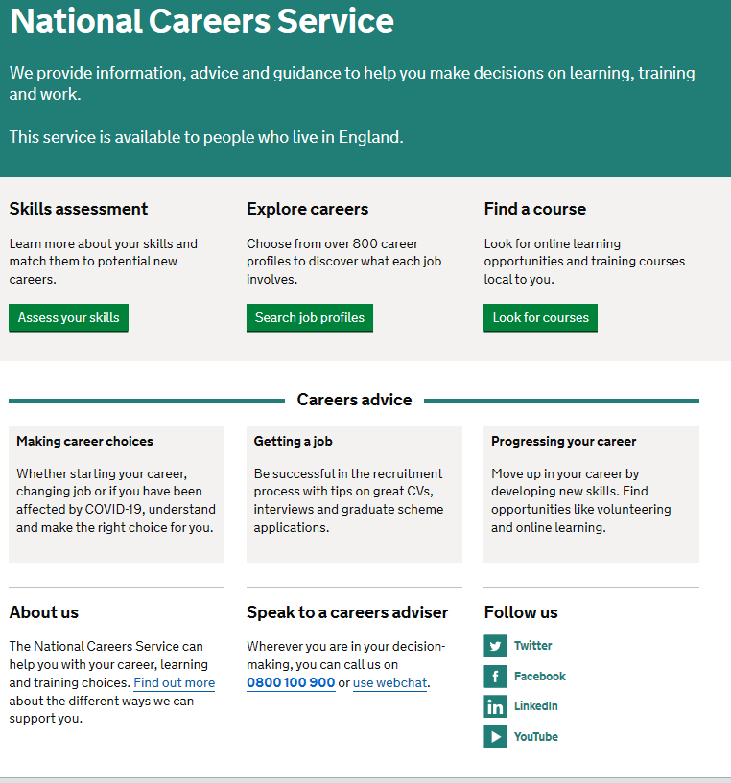
Discover more about the role
Explore careers using National Careers Service and find out about what jobs involve and how they are right for you
Cyber Security Intelligence Officer
UX User Experience Designer
Software/Web Developer
Youtuber/Vlogger
Computer Games Developer
Systems Analyst/Engineer
Includes:
Average salary
Typical hours
Work patterns
Pathways/How to become
Essential Skills
Daily tasks
Career path and progression
Current opportunities
Notes:
https://nationalcareers.service.gov.uk/explore-careers
How to use this slide:
Highlight the National Careers Service: Explore Careers Tool https://nationalcareers.service.gov.uk/explore-careers
Encourage students to access the tool and research general or specific roles linked to your subject.
Set students comparative/reflective tasks about why students may/may not like jobs they research.
Ask if your students have done the Buzz quiz (5mins to complete) – if they haven’t then consider setting this as a pre/post task to allow them to reflect on how these roles may suit them based n their profile. Take the test and find out which animal you are, too!
The Buzz Quiz - North East Ambition

Slide 9


Why not teach Computer Science/IT?
Progress your career into leadership and management
Bring your outside interests into the classroom and your subject
No two days are the same – and neither are the pupils
Once qualified you can teach throughout your life
You could teach abroad
Explore teaching
Daniel’s Story
Jem’s Story
Shaniqua’s Story
What makes a great teacher?
The right skills to teach?
Work well in a team?
Love to nurture imagination?
Love to keep learning?
Notes:
Use the bullets on the slide to discuss benefits of teaching.
Bring through the reasons cited in your guide P5:
Re teaching:
2. Turn your passion into a career
3. The reward is always worth the challenge
4. More time for what you love
5. Start on at least £25k (£32k inner London)
‘Explore teaching’ is a great introduction for your students to consider what it is really like to be on the other side of the desk (you choose the best fit video for your students).
·Daniel is the early stages of his teaching career as a primary teacher and shares his journey, belief, and pride that great teachers make all the difference
·Jem who always wanted to be a teacher from his time at university, teaches history and politics in an 11-18 secondary school. Filmed in his school, he shares his career progression, along with pupils sharing why they enjoy his lessons.
·Shaniqua is a primary teacher who shares her inspiring and personal journey from having to retake her GCSEs, to working as a Teaching Assistant, alongside studying for a degree. Filmed in her school, which she used to attend, Shaniqua shares her message that there are ‘other ways to become a teacher than doing A Levels and straight to university’.
The right skills to teach?
These three very short films show students those skills they have already gained like teamwork, imagination or a love of learning - could they be more of teacher than they think?
What makes a great teacher
A short video where secondary pupils share their responses to this question. Try asking your students first and then comparing their answers with the students on film.

Slide 10
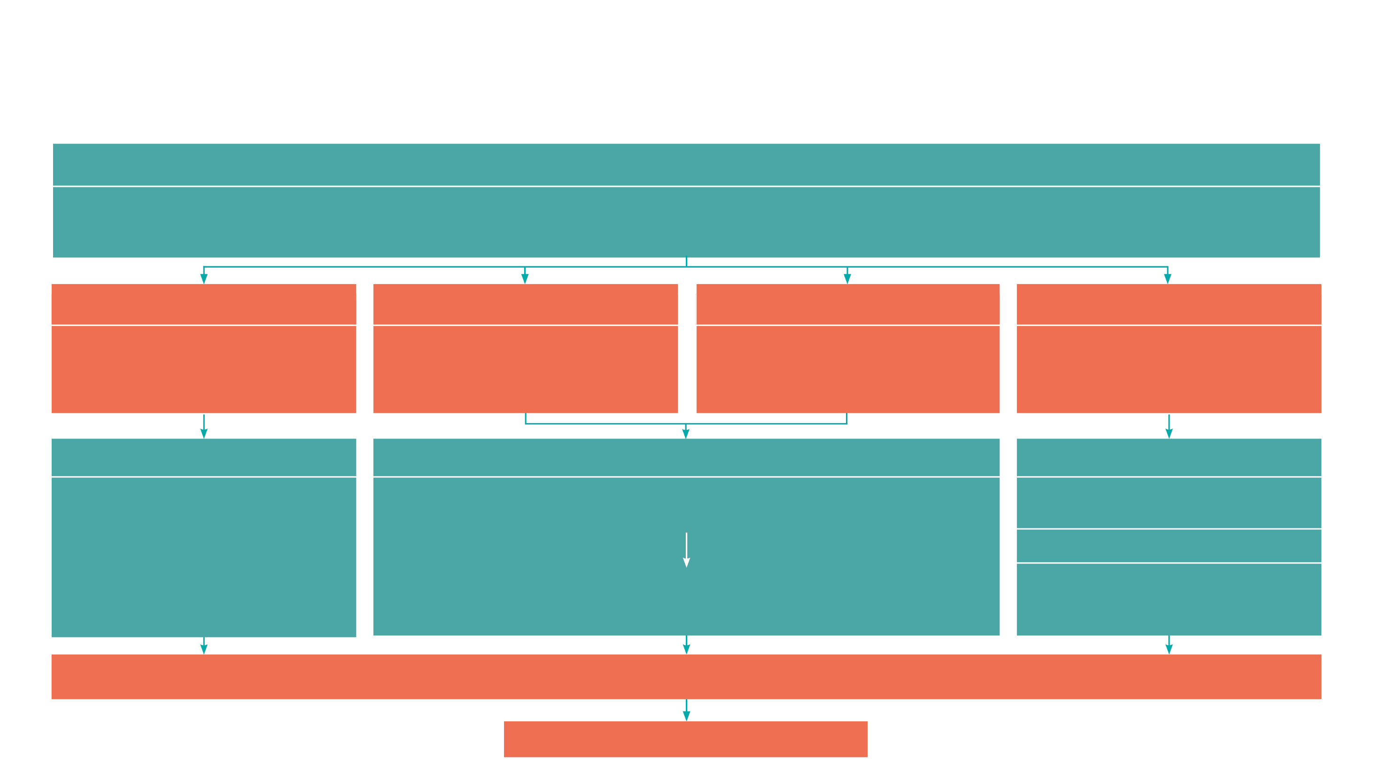
GCSE
While there are different routes you can take to be a teacher there are a few essential things that you will need:
• A minimum GCSE Grade 4 or above in English and Maths (plus Science if you want to teach primary)
A degree or equivalent qualification
A-Level
T level
Vocational/Technical Qualification
Apprenticeships
A-Levels are 2 years of study
T levels are nationally recognised, technical qualifications for 16–19-year-olds. Designed by leading employers, one T level is equivalent in size to 3 A-Levels
These include BTEC, Applied General Qualifications (AGQ) and Vocational Technical Qualifications (VTQ) – all at Level 3
Apprenticeships are jobs which combine practical work and study. Intermediate is Level 2, Advanced is Level 3
Degree
Level 4/5 qualifications
Higher apprenticeships
Complete a degree course
It is possible to get QTS as part of an undergraduate degree, for example:
• Bachelor of Arts (BA) with QTS
• Bachelor of Education (BEd) with QTS
• Bachelor of Science (BSc) with QTS
Complete a L4/5 course and top up to a degree – L4/5 includes Certificate of HE, Diploma of HE, Higher Technical Qualification (HTQ), HNC, HND and Foundation degrees
Top up to a degree (Level 6) in a year of full-time study
Higher level apprenticeship (foundation degree / Level 5)
Degree apprenticeships
Degree apprenticeship
(Level 6-7). There is a Level 6 Teaching apprenticeship programme
Initial Teacher Training (ITT) with qualified teacher status (QTS)
Teacher
Notes:
Here is the power point version of the infographic resource showing different options learners could follow to get into teaching.
Go through this with your learners and give examples of different staff in your school, special school or college who followed these paths.

Slide 11



Computer Science/IT pathways
Combine study and work
Study
Work

Slide 12

Combine study and work
Apprenticeships
Applications Support Lead
AI Data Specialist
Network Manager
Digital Community Manager
Cyber Security Analyst
Software Developer
T Levels
Design, Surveying and Planning for Construction
Design and Development for Engineering and Manufacturing
Digital Support and Security
Engineering, manufacturing, Processing and Control
Maintenance, Installation and Repair for Engineering and Manufacturing
Management and Administration
Media, Broadcast and Production
Creative Digital Design Professional
Network Cable Installer
Game Programmer
Network Engineer
Digital Accessibility Specialist
VTQs
Computer Science and ICT
Digital Technologies
Computing
Creative Digital Media Production
Creative Media Practice
Information Technology
ESports
Spreadsheet Processing Techniques
ICT Systems and Principles
Communications Cabling and Networks

Slide 13

Study pathways
HTQs (Higher Technical Qualifications)
You will find occupation routes in:
Digital
Engineering and Manufacturing
Construction and the Built Environment
A levels
You might find courses in:
Computer Science
Physics
ICT/ Digital Technology
Applied ICT
Software Systems Development
Higher education
You might find courses in:
Computer Science
Information Systems
Software Engineering
Artificial Intelligence
Health Informatics
Virtualisation and Cloud Computing
Programming Languages
Ethical Hacking
Application and Web Development​
Networking and Operating Systems
Algorithms and Modelling

Slide 14

Work pathways
Supported internships with an education, health and care plan
You might read about:
• Access to Work Funding (if you have a disability or health condition)
• Preparing for Adulthood
School leaver programmes
School Leavers Schemes
You might read about:
• How to fill in an application form
• How to write a CV
• Interview help
• Progressing your career (Careers Advice from NCS)

Slide 15


University league tables
See at a glance the university ranking for Computer Science/IT
Computer Science Rankings (thecompleteuniversityguide.co.uk)
Filter by:
• Overall score • Entry standards • Student satisfaction • Research quality • Research intensity • Graduate prospects

Slide 16


