Slide 1


Geography
My Learning, My Future
Where can studying Geography take you? Highlighting the relevance of Geography to future careers and opportunities​
Notes:
​
​
​
​
​
​
​

Slide 2
Why study Geography?
Understanding value
Developing essential transferable skills
Broad career opportunities
Understanding
the world around you
Addressing global issues
Notes:
Why study Geography?
Broad career opportunities
Geography opens doors to a wide array of career opportunities across various sectors due to the interdisciplinary nature of the subject and the versatile skills it imparts. Careers you could pursue include town and urban planning, travel and tourism, education and research, international charities and cartography.
Developing essential skills
Studying geography develops a diverse range of transferable skills that are highly sought after in various academic and professional fields. These include planning, research, teamwork, collaboration and communication.
Understanding the world around you
Geography goes beyond memorising places; it provides the framework to understand the intricate connections between human societies, economic systems, and the physical environment.
Addressing global issues
Geography is at the forefront of tackling some of the most critical issues facing humanity today. It provides the tools to analyse and comprehend global warming and climate change, sustainability, natural disasters and the spread of disease.
Understanding value
Geography is a dynamic and essential subject that offers a unique blend of scientific and artistic perspectives, fostering a deep understanding of our world and equipping individuals with highly valuable skills to change the world.
Reflection:
Is there anything else you would add to this list?
How do you share the importance of studying Geography with learners?
How do you communicate the value of studying Geography with parents and carers?

Slide 3
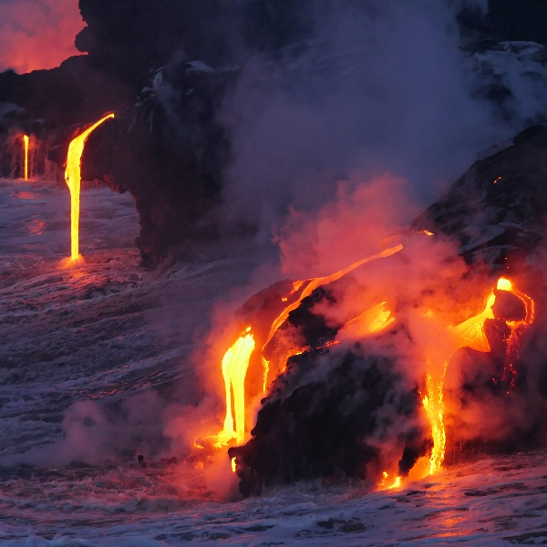
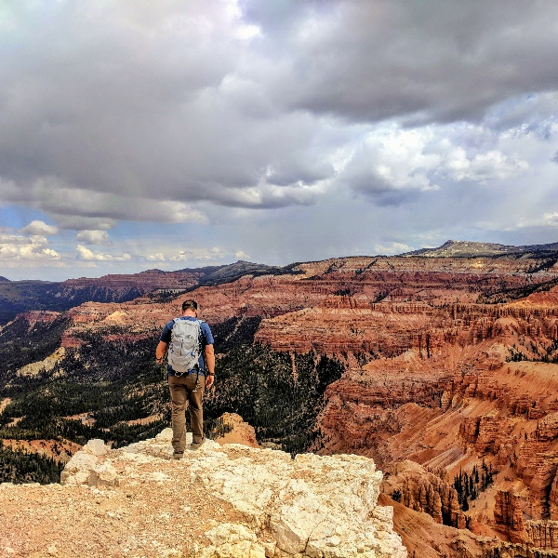

Explore a career as a…
Here are some example roles and careers linked to​ Geography
Volcano Vlogger
Mineral Technology Apprentice/ Geoscientist
Cartographer
BBC Bitesize case study
BBC Bitesize case study
BBC Bitesize case study
Notes:
Jobs that use Geography BBC Bitesize Careers: https://www.bbc.co.uk/bitesize/tags/zbp3mfr/jobs-that-use-geography/1
Activity Ideas:
Ahead of revealing content of slide, encourage students to think about as many roles linked to your subject as they can in pairs/groups.
Encourage students to engage with specific videos/profiles or direct students to specific roles/careers to predict, research and reflect on:
Pathways
Essential Skills
Wages/Work Conditions
Why they might like/not like in a particular role?

Slide 4
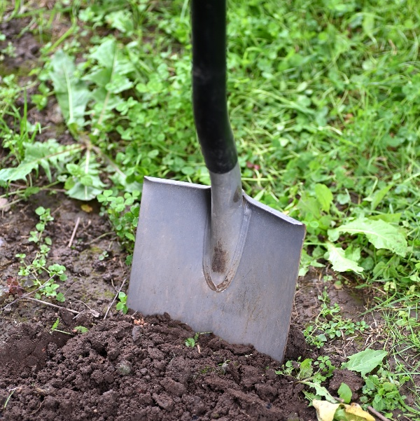


Explore a career as a…
Here are some example roles and careers linked to​ Geography
Landscaper
Countryside/
Conservation Officer
Town Planner
BBC Bitesize case study
icould case study
BBC Bitesize case study
BBC Bitesize case study
Notes:
Jobs that use Geography BBC Bitesize Careers: https://www.bbc.co.uk/bitesize/tags/zbp3mfr/jobs-that-use-geography/1
Activity Ideas:
Ahead of revealing content of slide, encourage students to think about as many roles linked to your subject as they can in pairs/groups.
Encourage students to engage with specific videos/profiles or direct students to specific roles/careers to predict, research and reflect on:
Pathways
Essential Skills
Wages/Work Conditions
Why they might like/not like in a particular role?

Slide 5


Not so obvious subjects using Geography:
Ever thought about..?
How to become a Landscape Assistant: Florence's story
Cartographer | Explore careers | National Careers Service
How to become a Volcano Vlogger and Guide: Chris' story
Coastguard | Explore careers | National Careers Service
How to become a Conservation Apprentice: Lorna's story
Air Trffic Controller | Explore careers | National Careers Service
Notes:
It’s important for students to understand the wide range of possibilities arising from your subject. Here’s some to explore…try and focus on less obvious choices.
To select more yourself:
BBC Bitesize link:
https://www.bbc.co.uk/bitesize/tags/zbp3mfr/jobs-that-use-geography/1
National Careers Service link:
https://nationalcareers.service.gov.uk/explore-careers

Slide 6

MYPATH Job of the week (Geography)
Hydrogeologist
Wellsite Geologist
Air Cabin Crew
Notes:
MYPATH are a series of fabulous videos designed to inspire students in a variety of jobs.
https://www.mypathcareersuk.com/other-careers-videos
Inspire students with these clips.

Slide 7
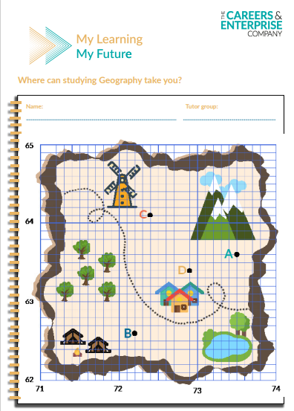
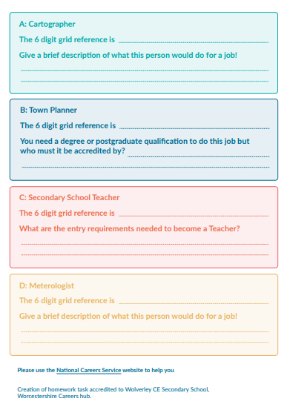
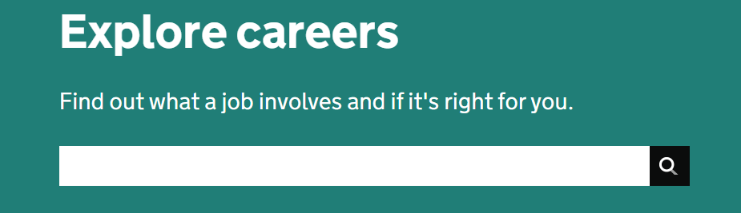
KS3 Home learning task
Use the National Careers Service Explore careers tool to research for this homework
Explore here

Slide 8


From passion to profession:
Share a role that sparks your interest
Prepare a 3 - 5 minute talk to share with a small group on any role that interests you related to Geography
What is the role?
What do you need to do to get this role?
Where do you need to go to carry out this role?
What might a typical day look like?
Why are you interested in this role?

Slide 9
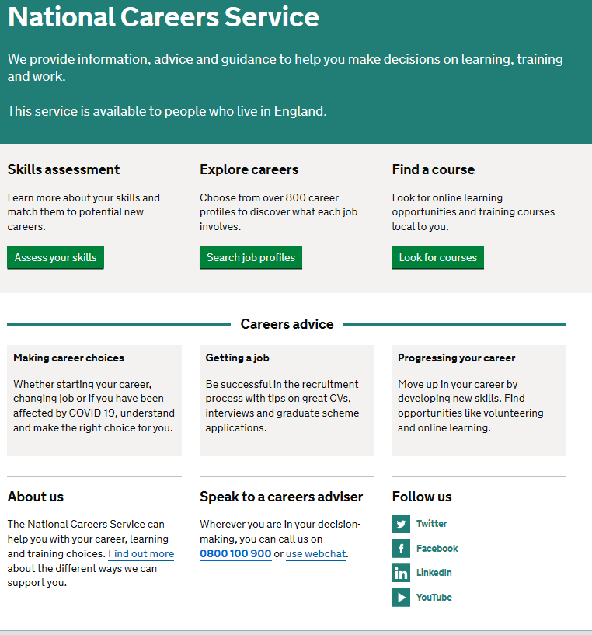
Discover more about the role
Explore careers using National Careers Service and find out about what jobs involve and how they are right for you
Includes:
Average salary
Typical hours
Work patterns
Pathways/How to become
Essential Skills
Daily tasks
Career path and progression
Current opportunities
Research Ideas:
Vlogger
Mineral Technology/Geoscientist
Cartographer
Landscaper
Countryside Officer
Town Planner
Notes:
https://nationalcareers.service.gov.uk/explore-careers
How to use this slide:
Highlight the National Careers Service: Explore Careers Tool https://nationalcareers.service.gov.uk/explore-careers
Encourage students to access the tool and research general or specific roles linked to your subject.
Set students comparative/reflective tasks about why students may/may not like jobs they research.
Ask if your students have done the Buzz quiz (5mins to complete) – if they haven’t then consider setting this as a pre/post task to allow them to reflect on how these roles may suit them based n their profile. Take the test and find out which animal you are, too!
The Buzz Quiz (Quiz) - North East Ambition

Slide 10


Why not teach Geography?
Progress your career into leadership and management
Bring your outside interests into the classroom and your subject
No two days are the same – and neither are the pupils
Once qualified you can teach throughout your life
You could teach abroad
Explore teaching
Daniel’s Story
Jem’s Story
Shaniqua’s Story
What makes a great teacher?
The right skills to teach?
Work well in a team?
Love to nurture imagination?
Love to keep learning?
Notes:
Use the bullets on the slide to discuss benefits of teaching.
Bring through the reasons cited in your guide P5:
Re teaching:
2. Turn your passion into a career
3. The reward is always worth the challenge
4. More time for what you love
5. Start on at least £25k (£32k inner London)
‘Explore teaching’ is a great introduction for your students to consider what it is really like to be on the other side of the desk (you choose the best fit video for your students).
·Daniel is the early stages of his teaching career as a primary teacher and shares his journey, belief, and pride that great teachers make all the difference.
·Jem who always wanted to be a teacher from his time at university, teaches history and politics in an 11-18 secondary school. Filmed in his school, he shares his career progression, along with pupils sharing why they enjoy his lessons.
·Shaniqua is a primary teacher who shares her inspiring and personal journey from having to retake her GCSEs, to working as a Teaching Assistant, alongside studying for a degree. Filmed in her school, which she used to attend, Shaniqua shares her message that there are ‘other ways to become a teacher than doing A Levels and straight to university’.
The right skills to teach?
These three very short films show students those skills they have already gained like teamwork, imagination or a love of learning - could they be more of teacher than they think?
What makes a great teacher
A short video where secondary pupils share their responses to this question. Try asking your students first and then comparing their answers with the students on film.

Slide 11
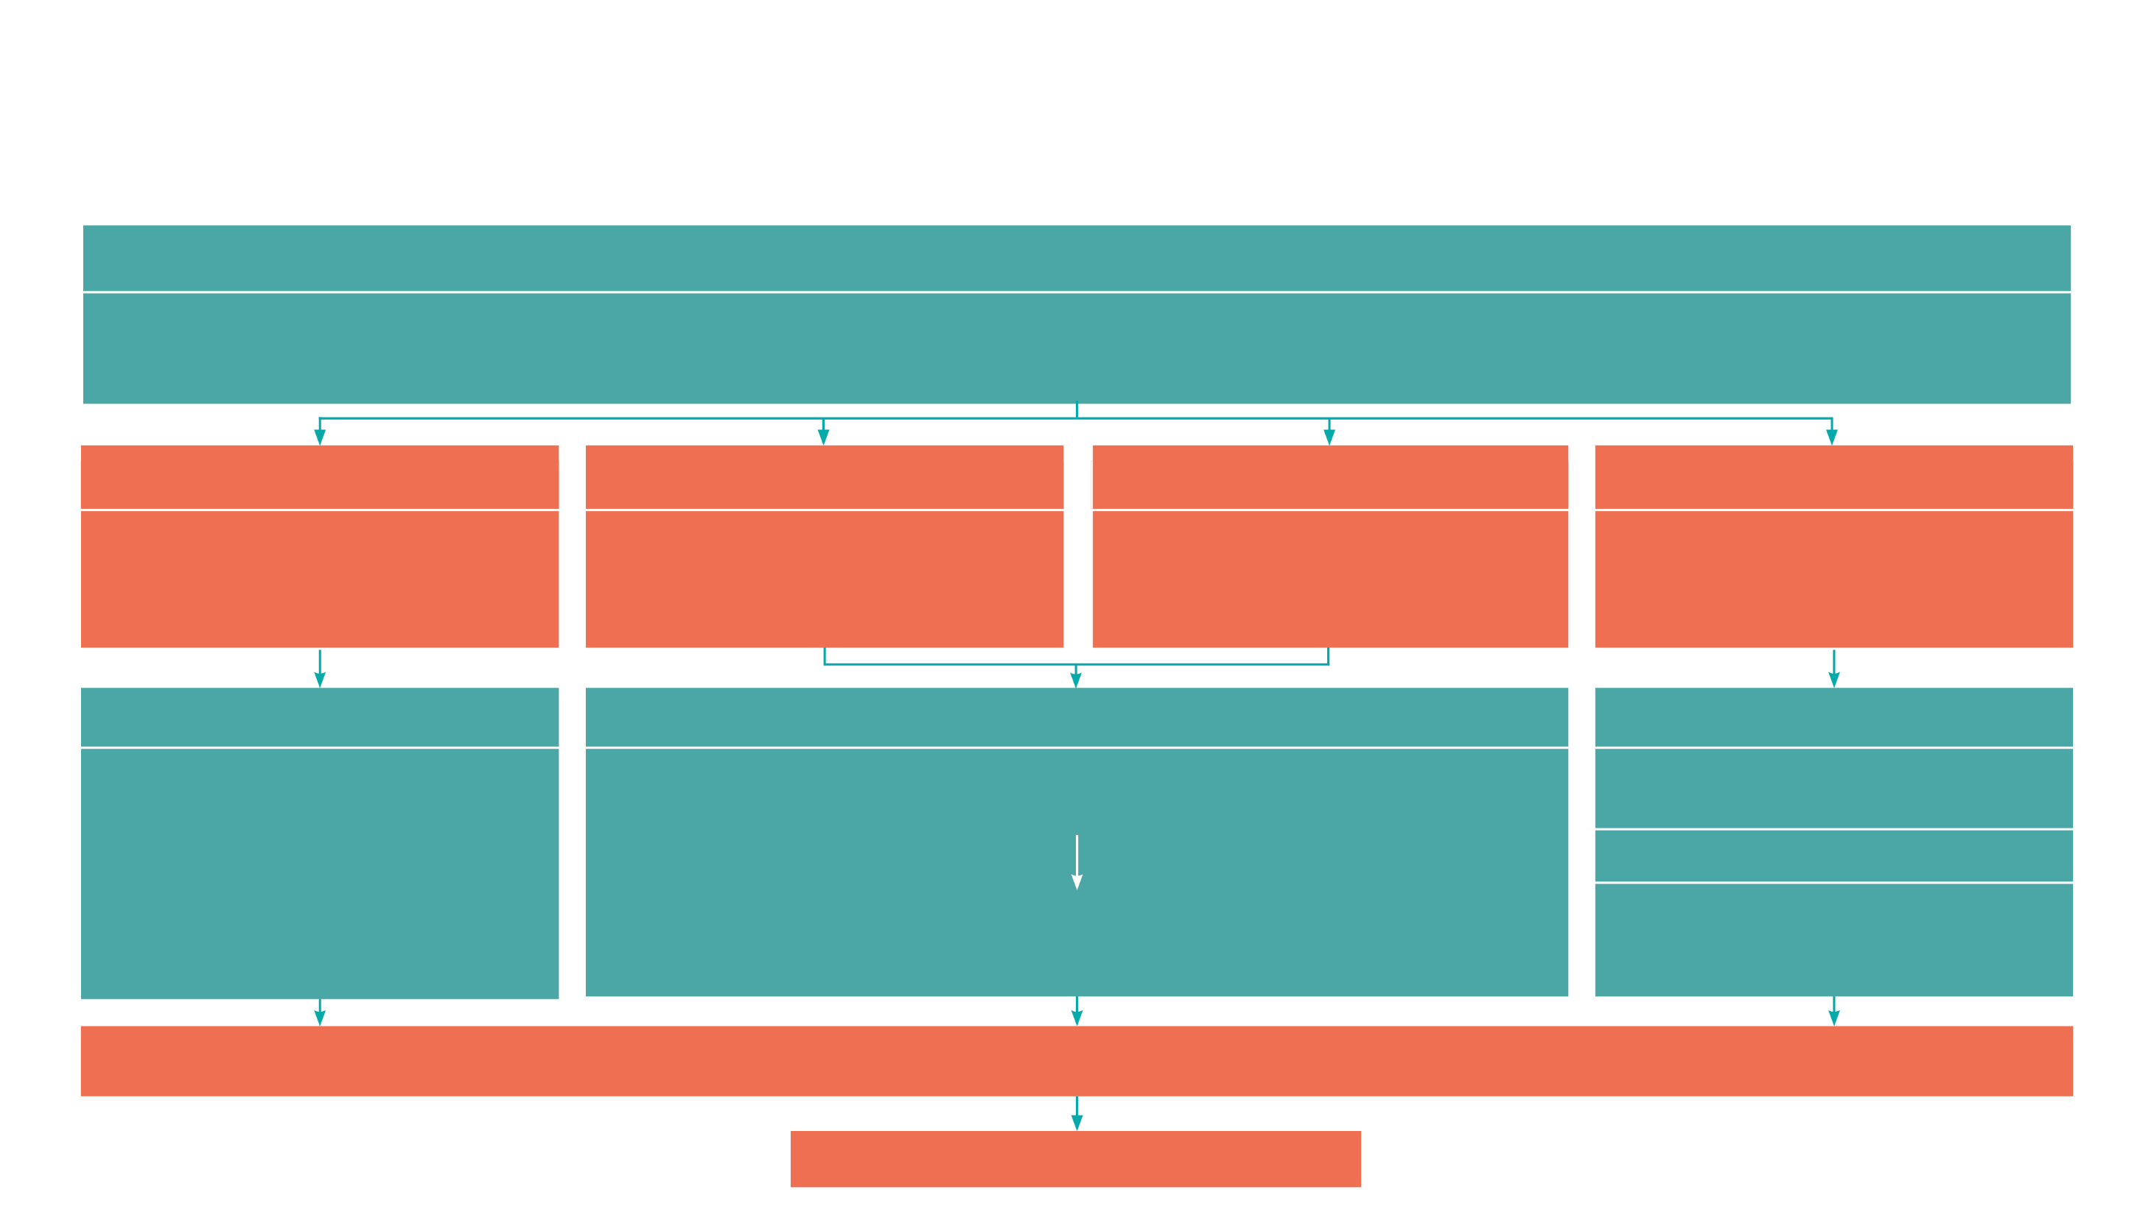
GCSE
While there are different routes you can take to be a teacher there are a few essential things that you will need:
• A minimum GCSE Grade 4 or above in English and Maths (plus Science if you want to teach primary)
A degree or equivalent qualification
A-Level
T level
Vocational/Technical Qualification
Apprenticeships
A-Levels are 2 years of study
T levels are nationally recognised, technical qualifications for 16–19-year-olds. Designed by leading employers, one T level is equivalent in size to 3 A-Levels
These include BTEC, Applied General Qualifications (AGQ) and Vocational Technical Qualifications (VTQ) – all at Level 3
Apprenticeships are jobs which combine practical work and study. Intermediate is Level 2, Advanced is Level 3
Degree
Level 4/5 qualifications
Higher apprenticeships
Complete a degree course
It is possible to get QTS as part of an undergraduate degree, for example:
• Bachelor of Arts (BA) with QTS
• Bachelor of Education (BEd) with QTS
• Bachelor of Science (BSc) with QTS
Complete a L4/5 course and top up to a degree – L4/5 includes Certificate of HE, Diploma of HE, Higher Technical Qualification (HTQ), HNC, HND and Foundation degrees
Top up to a degree (Level 6) in a year of full-time study
Higher level apprenticeship (foundation degree / Level 5)
Degree apprenticeships
Degree apprenticeship
(Level 6-7). There is a Level 6 Teaching apprenticeship programme
Initial Teacher Training (ITT) with qualified teacher status (QTS)
Teacher
Notes:
Here is the power point version of the infographic resource showing different options learners could follow to get into teaching.
Go through this with your learners and give examples of different staff in your school, special school or college who followed these paths.

Slide 12



Geography pathways
Combine study
and work
Study
Work

Slide 13

Combine study and work
Apprenticeships
Ecologist
Landscape Technician
Countryside Worker
Chartered Town Planner
Travel Consultant
Crop Technician
T Levels
Geospatial Technician
Express Delivery Manager
Waste Resource Operative
Tunnelling Operative
Harbour Master
Education and Early Years​
Design, Surveying and Planning for Construction ​
Agriculture, Land Management and Production ​
Animal Care and Management ​
VTQs
Travel and Tourism
Tourism
Countryside Management​
Environmental Sustainability
Land-based Technology​
Agriculture
Horticulture​
Air Cabin Crew

Slide 14

Study pathways
HTQs (Higher Technical Qualifications)
You will find occupation routes in:
Education and Early Years
Construction and the Built Environment
Engineering and Manufacturing
A levels
You might find courses in:
Geography
Geology
Environmental Science
Travel and Tourism
Higher education
You might find courses in:
Quality and safety across the food chain
Agricultural Technology
Conservation
Wildlife and Countryside Conservation
Geography
Geography and Anthropology
Human Geography
Geography (Physical)​
Aviation and Airport Management ​
Ecology and Wildlife ​
Flood and Coastal Engineering​
Global Challenges

Slide 15

Work pathways
Supported internships with an education, health and care plan
You might read about:
• Access to Work Funding (if you have a disability or health condition)
• Preparing for Adulthood
School leaver programmes
You might read about:
• How to fill in an application form
• How to write a CV
• Interview help
• Progressing your career (Careers Advice from NCS)
Notes:
Supported internship (with EHCP) is an unpaid work-based study programme that usually lasts for one year. It includes an extended work placement that lasts for at least 6
months. This will help young people take the first step from education into the workplace while gaining the skills they need to get a paid job.
School Leaver schemes. Some companies offer school leaver schemes to young people who have completed A levels. The scheme allows them to learn and train with a large company while earning a wage. You need to check each company’s website to see if they offer a school leaver scheme and how to apply.
You need to be 18 or over and not in full time education. Usually, the schemes require high A level grades or equivalent qualifications.

Slide 16


University league tables
See at a glance the university ranking for Geography
Geography and Environmental Science Rankings (thecompleteuniversityguide.co.uk)
Filter by:
Overall score
Entry standards
Student satisfaction
Research quality
Research intensity
Graduate prospects

Slide 17


