Slide 1


Food and Nutrition
My Learning, My Future
Where can studying Food and Nutrition take you? Highlighting the relevance of Food and Nutrition to future careers and opportunities​
Notes:
Purpose of slides: ​
To allow you to highlight the relevance of your subject to future careers and opportunities​.
To enable students to explore the full range of options available to them​.
​
Aims:​
To engage students in your subject​
To highlight pathways and opportunities from your subject​
To encourage students to consider your subject at KS4/Post 16​
To support work across the school towards Gatsby Benchmark 4​
​
​
How to use these slides?​
These slides can be used at any point during KS3/4 or post 16 to engage students in learning and to highlight the relevance of your subject to future careers and opportunities.​
They will be of most relevance within an option process and can support work you are doing to encourage students to consider their options for KS4/Post 16​.
​
​
​
​
​
​
​
​
​
​
​
​
​

Slide 2
Why study Food and Nutrition?
Enhances mental and physical performance
Developing essential skills
Opens diverse career opportunities
Promotes better health
Supports sustainable and ethical eating
Notes:
Why study Food and Nutrition?
Opens diverse career opportunities
A background in food and nutrition can lead to careers in dietetics, public health, food science, sports nutrition, education, research, or even culinary arts and food journalism.
Developing essential skills
From lab work and data analysis to teamwork and creative thinking, Food and Nutrition builds a skill set that’s in demand across industries not just in food.
Promotes better health Learning about nutrition helps individuals make healthier food choices, reducing the risk of chronic illnesses like heart disease, diabetes, and obesity.
Enhances mental and physical performance A well-balanced diet supports brain function, concentration, and energy levels key for academic success, athletic performance, and overall well-being.
Supports sustainable and ethical eating Studying food systems and environmental impacts encourages more sustainable and ethical food choices, such as reducing food waste or choosing locally sourced produce.
Reflection:
Is there anything else you would add to this list?
How do you share the importance of studying Food and Nutrition with learners?
How do you communicate the value of studying Food and Nutrition with parents and carers?

Slide 3

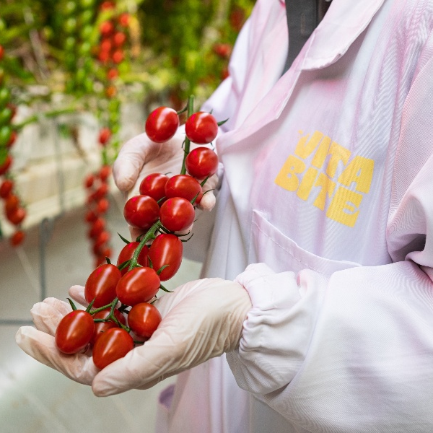
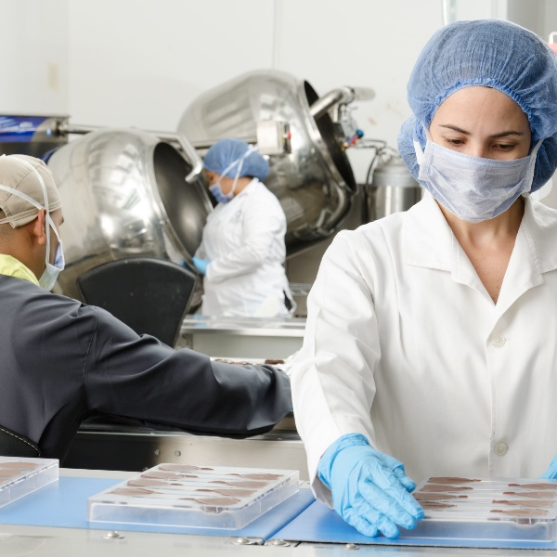
Explore a career as a…
Here are some example roles and careers linked to​ Food and Nutrition
Chef
Food Technologist
Food Quality Control Inspector
BBC Bitesize case study
icould case study
BBC Bitesize Profile
BBC Bitesize case study
STEM case study
Notes:
Jobs that use Food and Nutrition BBC Bitesize Careers: https://www.bbc.co.uk/bitesize/tags/zvty7nb/jobs-that-use-food-and-nutrition/1
Activity Ideas:
Ahead of revealing content of slide, encourage students to think about as many roles linked to your subject as they can in pairs/groups.
Encourage students to engage with specific videos/profiles or direct students to specific roles/careers to predict, research and reflect on:
Pathways
Essential Skills
Wages/Work Conditions
Why they might like/not like in a particular role?

Slide 4



Explore a career as a…
Here are some example roles and careers linked to​ Food and Nutrition
Dietician
Restaurant Manager
Food & Beverage Manager
icould case study
BBC Bitesize Profile
icould case study
icould case study
YEUK case study
Notes:
Jobs that use Food and Nutrition BBC Bitesize Careers: https://www.bbc.co.uk/bitesize/tags/zvty7nb/jobs-that-use-food-and-nutrition/1
Activity Ideas:
Ahead of revealing content of slide, encourage students to think about as many roles linked to your subject as they can in pairs/groups.
Encourage students to engage with specific videos/profiles or direct students to specific roles/careers to predict, research and reflect on:
Pathways
Essential Skills
Wages/Work Conditions
Why they, might like/not like in a particular role?

Slide 5


Not so obvious subjects using Food and Nutrition:
Ever thought about..?
Consumer Scientist | Explore careers | National Careers Service
How to become a Personal Trainer: Louis' story
How to become a Chocolate maker: Max's story
Wedding Planner | Explore careers |National Careers Service
How to become a Dental lab Assistant: Tom's story
Notes:
It’s important for students to understand the wide range of possibilities arising from your subject. Here’s some to explore…try and focus on less obvious choices.
To select more yourself:
BBC Bitesize link:
https://www.bbc.co.uk/bitesize/tags/zjb8f4j/jobs-that-use-science/1
National Careers Service link:
https://nationalcareers.service.gov.uk/explore-careers

Slide 6

MYPATH Job of the week (Food and Nutrition)
Nutritionist
Chef
Toxicologist
Notes:
MYPATH are a series of fabulous videos designed to inspire students in a variety of jobs.
https://www.mypathcareersuk.com/other-careers-videos
Inspire students with these clips.

Slide 7
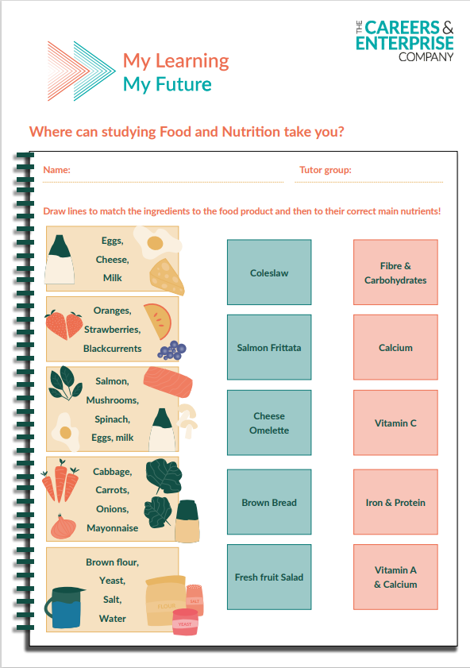
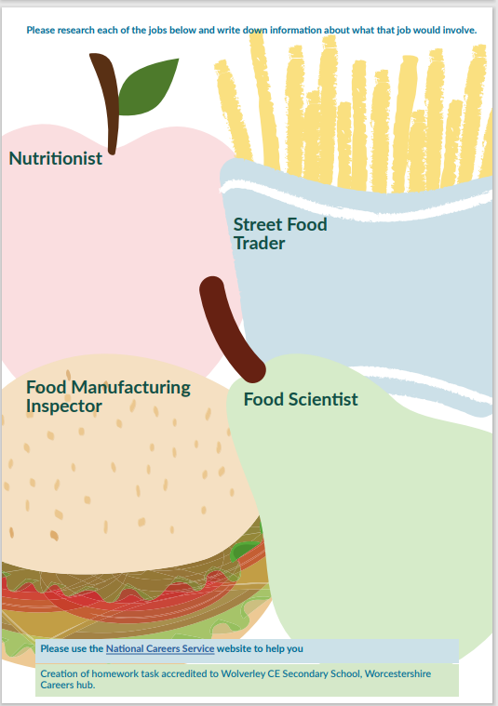
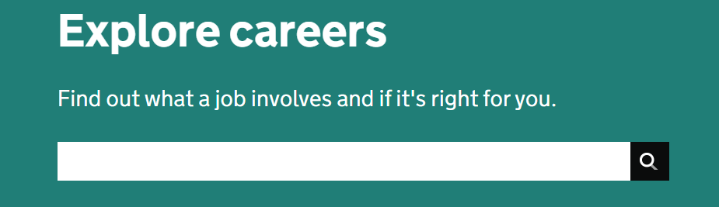
KS3 Home learning task
Use the National Careers Service Explore careers tool to research for this homework
Explore here

Slide 8


From passion to profession:
Share a role that sparks your interest
Prepare a 3 - 5 minute talk to share with a small group on any role that interests you related to Food and Nutrition.
What is the role?
What do you need to do to get this role?
Where do you need to go to carry out this role?
What might a typical day look like?
Why are you interested in this role?

Slide 9
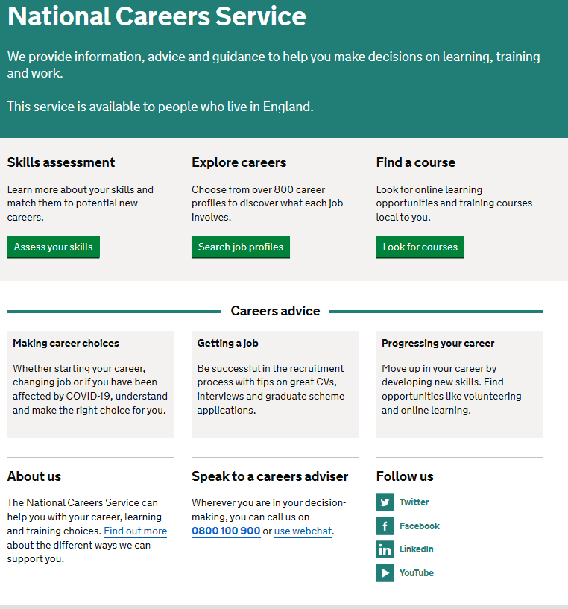
Discover more about the role
Explore careers using National Careers Service and find out about what jobs involve and how they are right for you
Includes:
Average salary
Typical hours
Work patterns
Pathways/How to become
Essential Skills
Daily tasks
Career path and progression
Current opportunities
Research Ideas:
Chef
Food Technologist/Scientist
Food Quality Control Inspector
Dietician
Restaurant Manager
Catering Manager
Notes:
https://nationalcareers.service.gov.uk/explore-careers
How to use this slide:
Highlight the National Careers Service: Explore Careers Tool https://nationalcareers.service.gov.uk/explore-careers
Encourage students to access the tool and research general or specific roles linked to your subject.
Set students comparative/reflective tasks about why students may/may not like jobs they research.
Ask if your students have done the Buzz quiz (5mins to complete) – if they haven’t then consider setting this as a pre/post task to allow them to reflect on how these roles may suit them based n their profile. Take the test and find out which animal you are, too!
The Buzz Quiz (Quiz) - North East Ambition

Slide 10


Why not teach Food and Nutrition?
Progress your career into leadership and management
Bring your outside interests into the classroom and your subject
No two days are the same – and neither are the pupils
Once qualified you can teach throughout your life
You could teach abroad
Explore teaching
Daniel’s Story
Jem’s Story
Shaniqua’s Story
What makes a great teacher?
The right skills to teach?
Work well in a team?
Love to nurture imagination?
Love to keep learning?
Notes:
Use the bullets on the slide to discuss benefits of teaching.
Bring through the reasons cited in your guide P5:
Re teaching:
2. Turn your passion into a career
3. The reward is always worth the challenge
4. More time for what you love
5. Start on at least £25k (£32k inner London)
‘Explore teaching’ is a great introduction for your students to consider what it is really like to be on the other side of the desk (you choose the best fit video for your students).
·Daniel is the early stages of his teaching career as a primary teacher and shares his journey, belief, and pride that great teachers make all the difference.
·Jem who always wanted to be a teacher from his time at university, teaches history and politics in an 11-18 secondary school. Filmed in his school, he shares his career progression, along with pupils sharing why they enjoy his lessons.
·Shaniqua is a primary teacher who shares her inspiring and personal journey from having to retake her GCSEs, to working as a Teaching Assistant, alongside studying for a degree. Filmed in her school, which she used to attend, Shaniqua shares her message that there are ‘other ways to become a teacher than doing A Levels and straight to university’.
The right skills to teach?
These three very short films show students those skills they have already gained like teamwork, imagination or a love of learning - could they be more of teacher than they think?
What makes a great teacher
A short video where secondary pupils share their responses to this question. Try asking your students first and then comparing their answers with the students on film.

Slide 11

GCSE
While there are different routes you can take to be a teacher there are a few essential things that you will need:
• A minimum GCSE Grade 4 or above in English and Maths (plus Science if you want to teach primary)
A degree or equivalent qualification
A-Level
T level
Vocational/Technical Qualification
Apprenticeships
A-Levels are 2 years of study
T levels are nationally recognised, technical qualifications for 16–19-year-olds. Designed by leading employers, one T level is equivalent in size to 3 A-Levels
These include BTEC, Applied General Qualifications (AGQ) and Vocational Technical Qualifications (VTQ) – all at Level 3
Apprenticeships are jobs which combine practical work and study. Intermediate is Level 2, Advanced is Level 3
Degree
Level 4/5 qualifications
Higher apprenticeships
Complete a degree course
It is possible to get QTS as part of an undergraduate degree, for example:
• Bachelor of Arts (BA) with QTS
• Bachelor of Education (BEd) with QTS
• Bachelor of Science (BSc) with QTS
Complete a L4/5 course and top up to a degree – L4/5 includes Certificate of HE, Diploma of HE, Higher Technical Qualification (HTQ), HNC, HND and Foundation degrees
Top up to a degree (Level 6) in a year of full-time study
Higher level apprenticeship (foundation degree / Level 5)
Degree apprenticeships
Degree apprenticeship
(Level 6-7). There is a Level 6 Teaching apprenticeship programme
Initial Teacher Training (ITT) with qualified teacher status (QTS)
Teacher
Notes:
Here is the power point version of the infographic resource showing different options learners could follow to get into teaching.
Go through this with your learners and give examples of different staff in your school, special school or college who followed these paths.

Slide 12



Food and Nutrition pathways
Combine study and work
Study
Work

Slide 13

Combine study and work
Apprenticeships
Dietitian
Hospitality team member
Fishmonger
Butcher
Advanced Baker
T Levels
Senior Production Chef
Dairy Technologist
Commis Chef
Food & Drink Engineer
Chef de Partie
Science
Agriculture, Land Management and Production
VTQs
Food Science and Nutrition
Professional Cookery
Professional Chefs
Global Hospitality
Food safety in Catering
Hospitality and Catering​ Nutrition​
Professional Bartending​

Slide 14

Study pathways
HTQs (Higher Technical Qualifications)
You will find occupation routes in:
Education and Early Years ​
Business and Management​
A levels
You might find courses in:
Travel and Tourism
Higher education
You might find courses in:
Quality and safety across the food chain
Sensory Science
Human Nutrition
Food Chemistry
Sustainable Agriculture and ingredient sourcing
Hospitality and Catering

Slide 15

Work pathways
Supported internships with an education, health and care plan
You might read about:
• Access to Work Funding (if you have a disability or health condition)
• Preparing for Adulthood
School leaver programmes
You might read about:
• How to fill in an application form
• How to write a CV
• Interview help
• Progressing your career (Careers Advice from NCS)

Slide 16


University league tables
See at a glance the university ranking for Food and Nutrition
Food and Nutrition Rankings (thecompleteuniversityguide.co.uk)
Filter by:
Overall score
Entry standards
Student satisfaction
Research quality
Research intensity
Graduate prospects

Slide 17


