Slide 1


Engineering
My Learning, My Future
Where can studying Engineering take you? Highlighting the relevance of Engineering to future careers and opportunities​
Notes:
Purpose of slides:
To allow you to highlight the relevance of your subject to future careers and opportunities.
To enable students to explore the full range of options available to them.
Aims:
To engage students in your subject
To highlight pathways and opportunities from your subject
To encourage students to consider your subject at KS4/Post 16
To support work across the school towards Gatsby Benchmark 4
How to use these slides?
These slides can be used at any point during KS3/4 or post 16 to engage students in learning and to highlight the relevance of your subject to future careers and opportunities.
They will be of most relevance within an option process and can support work you are doing to encourage students to consider their options for KS4/Post 16.

Slide 2
Why study Engineering?
Foundation for leadership and entrepreneurship
Innovation and creativity
Strong career prospects
Solve real-world problems
Global opportunities
Notes:
Why study Engineering?
Strong career prospects
Engineering offers diverse career paths in industries like aerospace, automotive, construction, tech, and manufacturing. It’s known for high employability and competitive salaries.
Innovation and creativity
Engineering isn’t just about maths and science; it is also about creativity. Engineers invent new technologies, improve existing systems, and push the boundaries of what is possible.
Solve real-world problems
Engineers design solutions to everyday challenges from clean energy and safe transportation to medical devices and sustainable infrastructure. It’s a field where you can make a tangible impact on society.
Global opportunities
Engineering skills are valued worldwide, giving you the chance to work abroad, collaborate internationally, or contribute to global projects.
Foundation for leadership and entrepreneurship Many engineers go on to become leaders, managers, or entrepreneurs. The problem-solving mindset and technical knowledge gained in engineering are excellent foundations for starting your own business or leading teams.
Reflection:
Is there anything else you would add to this list?
How do you share the importance of studying Engineering with learners?
How do you communicate the value of studying Engineering with parents and carers?
Reflection:
What else would learners add to this list?

Slide 3



Explore a career as a…
Here are some example roles and careers linked to Engineering
Aerospace Engineer
Biomedical Engineer
Robotics Engineer
BBC Bitesize case study
neon case study
BBC Bitesize case study
neon case study
neon case study
neon case study
Notes:
Jobs in Engineering Bitesize Careers: https://www.bbc.co.uk/bitesize/tags/zn7h8xs/jobs-that-use-design-and-technology/1
Activity Ideas:
Ahead of revealing content of slide, encourage students to think about as many roles linked to your subject as they can in pairs/groups.
Encourage students to engage with specific videos/profiles or direct students to specific roles/careers to predict, research and reflect on:
Pathways
Essential Skills
Wages/Work Conditions
Why they, might like/not like in a particular role?

Slide 4



Explore a career as a…
Here are some example roles and careers linked to Engineering
Marine Engineer
Electrical Engineer
Civil Engineer
BBC Bitesize case study
BBC Bitesize case study
BBC Bitesize case study
neon case study
BBC Bitesize case study
BBC Bitesize case study
Notes:
Jobs in Engineering Bitesize Careers: https://www.bbc.co.uk/bitesize/tags/zn7h8xs/jobs-that-use-design-and-technology/1
Activity Ideas:
Ahead of revealing content of slide, encourage students to think about as many roles linked to your subject as they can in pairs/groups.
Encourage students to engage with specific videos/profiles or direct students to specific roles/careers to predict, research and reflect on:
Pathways
Essential Skills
Wages/Work Conditions
Why they, might like/not like in a particular role?

Slide 5


Not so obvious jobs using Engineering: Ever thought about..?
How to become a Formula 1 Engineer: Amy's story
Agricultural Engineer | Explore careers | National Careers Service
How to become a Wing Designer: Zuzanna's story
Broadcast Engineer | Explore careers | National Careers Service
How to become an Apprentice Welder: Billy's story
CNC Machinist | Explore careers | National Careers Service
Notes:
It’s important for students to understand the wide range of possibilities arising from your subject. Here’s some to explore…try and focus on less obvious choices.
To select more yourself:
BBC Bitesize link:
https://www.bbc.co.uk/bitesize/articles/z7n4bdm
National Careers Service link:
https://nationalcareers.service.gov.uk/explore-careers

Slide 6

MYPATH Job of the week (Engineering)
Disaster Manager
Furniture Designer
Games Tester
Notes:
MYPATH are a series of fabulous videos designed to inspire students in a variety of jobs.
https://www.mypathcareersuk.com/other-careers-videos
Inspire students with these clips.

Slide 7
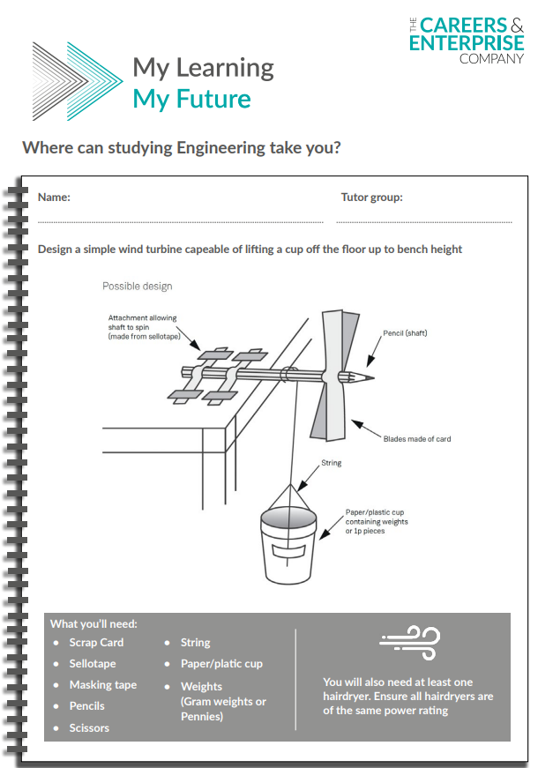
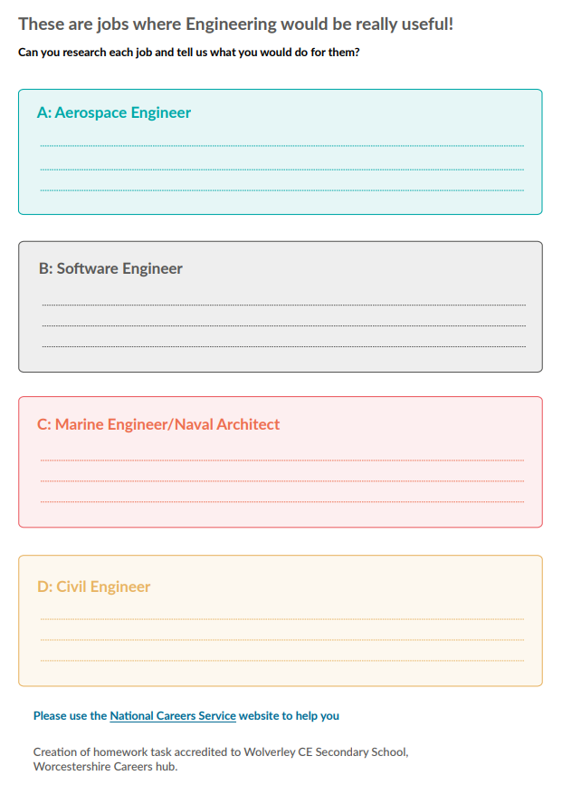
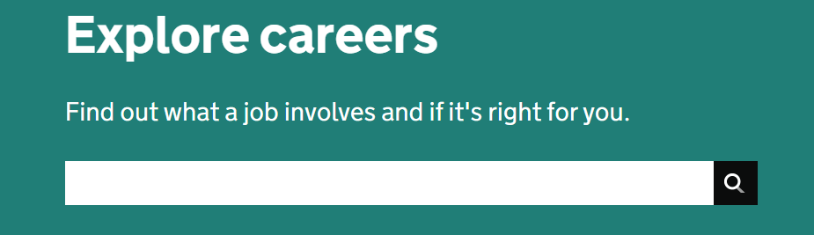

KS3 Home learning task
Use the National Careers Service Explore careers tool to research for this homework
Explore here

Slide 8

From passion to profession:
Share a role that sparks your interest
Prepare a 3 - 5 minute talk to share with a small group on any role that interests you related to Engineering
What is the role?
What do you need to do to get this role?
Where do you need to go to carry out this role?
What might a typical day look like?
Why are you interested in this role?

Slide 9
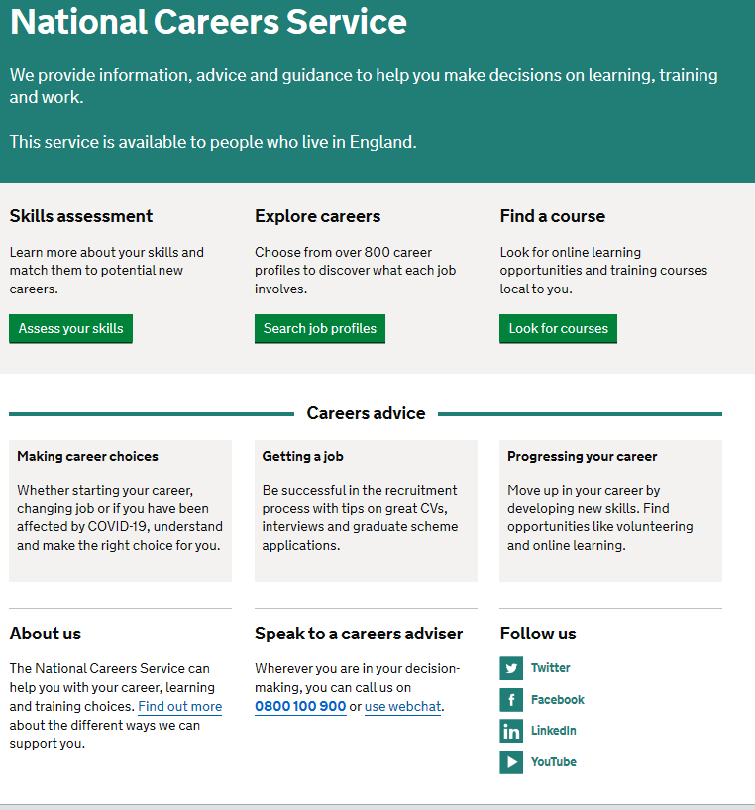
Discover more about the role
Explore careers using National Careers Service and find out about what jobs involve and how they are right for you
Includes:
Average salary
Typical hours
Work patterns
Pathways/How to become
Essential Skills
Daily tasks
Career path and progression
Current opportunities
Cyber Security Intelligence Officer
UX User Experience Designer
Software/Web Developer
Youtuber/Vlogger
Computer Games Developer
Systems Analyst/Engineer
Notes:
https://nationalcareers.service.gov.uk/explore-careers
How to use this slide:
Highlight the National Careers Service: Explore Careers Tool https://nationalcareers.service.gov.uk/explore-careers
Encourage students to access the tool and research general or specific roles linked to your subject.
Set students comparative/reflective tasks about why students may/may not like jobs they research.
Ask if your students have done the Buzz quiz (5mins to complete) – if they haven’t then consider setting this as a pre/post task to allow them to reflect on how these roles may suit them based n their profile. Take the test and find out which animal you are, too!
The Buzz Quiz (Quiz) - North East Ambition

Slide 10


Why not teach Engineering?
Progress your career into leadership and management
Bring your outside interests into the classroom and your subject
No two days are the same – and neither are the pupils
Once qualified you can teach throughout your life
You could teach abroad
Explore teaching
Daniel’s Story
Jem’s Story
Shaniqua’s Story
What makes a great teacher?
The right skills to teach?
Work well in a team?
Love to nurture imagination?
Love to keep learning?
Notes:
Use the bullets on the slide to discuss benefits of teaching.
Bring through the reasons cited in your guide P5:
Re teaching:
2. Turn your passion into a career
3. The reward is always worth the challenge
4. More time for what you love
5. Start on at least £25k (£32k inner London)
‘Explore teaching’ is a great introduction for your students to consider what it is really like to be on the other side of the desk (you choose the best fit video for your students).
·Daniel is the early stages of his teaching career as a primary teacher and shares his journey, belief, and pride that great teachers make all the difference.
·Jem who always wanted to be a teacher from his time at university, teaches history and politics in an 11-18 secondary school. Filmed in his school, he shares his career progression, along with pupils sharing why they enjoy his lessons.
·Shaniqua is a primary teacher who shares her inspiring and personal journey from having to retake her GCSEs, to working as a Teaching Assistant, alongside studying for a degree. Filmed in her school, which she used to attend, Shaniqua shares her message that there are ‘other ways to become a teacher than doing A Levels and straight to university’.
The right skills to teach?
These three very short films show students those skills they have already gained like teamwork, imagination or a love of learning - could they be more of teacher than they think?
What makes a great teacher
A short video where secondary pupils share their responses to this question. Try asking your students first and then comparing their answers with the students on film.

Slide 11

GCSE
While there are different routes you can take to be a teacher there are a few essential things that you will need:
• A minimum GCSE Grade 4 or above in English and Maths (plus Science if you want to teach primary)
A degree or equivalent qualification
A-Level
T level
Vocational/Technical Qualification
Apprenticeships
A-Levels are 2 years of study
T levels are nationally recognised, technical qualifications for 16–19-year-olds. Designed by leading employers, one T level is equivalent in size to 3 A-Levels
These include BTEC, Applied General Qualifications (AGQ) and Vocational Technical Qualifications (VTQ) – all at Level 3
Apprenticeships are jobs which combine practical work and study. Intermediate is Level 2, Advanced is Level 3
Degree
Level 4/5 qualifications
Higher apprenticeships
Complete a degree course
It is possible to get QTS as part of an undergraduate degree, for example:
• Bachelor of Arts (BA) with QTS
• Bachelor of Education (BEd) with QTS
• Bachelor of Science (BSc) with QTS
Complete a L4/5 course and top up to a degree – L4/5 includes Certificate of HE, Diploma of HE, Higher Technical Qualification (HTQ), HNC, HND and Foundation degrees
Top up to a degree (Level 6) in a year of full-time study
Higher level apprenticeship (foundation degree / Level 5)
Degree apprenticeships
Degree apprenticeship
(Level 6-7). There is a Level 6 Teaching apprenticeship programme
Initial Teacher Training (ITT) with qualified teacher status (QTS)
Teacher
Notes:
Here is the power point version of the infographic resource showing different options learners could follow to get into teaching.
Go through this with your learners and give examples of different staff in your school, special school or college who followed these paths.

Slide 12



Engineering pathways
Combine study and work
Study
Work

Slide 13

Combine study and work
Apprenticeships
Metrology Technician
Food Industry Technician
Acoustics Engineer
Electronic Technical Support Engineer
Mechanical Engineer
T Levels
Agriculture, Lane Management and Production
Building Services Engineering for Construction
Design and Development for Engineering and Manufacturing
Design, Surveying and Planning for Construction
Engineering, Manufacturing, Processing and Control
Maintenance, Installation and Repair for Engineering and Manufacturing
Science
Manufacturing: Building Services
Design and Engineering
Civil Engineer
Environmental Engineer
Railway Engineer
Nuclear Technician
VTQs
Engineering Design and Technology
Engineering Design
Engineering
Creative iMedia​
Digital Media

Slide 14

Study pathways
HTQs (Higher Technical Qualifications)
You will find occupation routes in:
Engineering and Manufacturing
Construction and the Built Environment
Business and Management
A levels
You might find courses in:
Electronics
Design and Technology
Design and Technology: Engineering
Computer Science​
Higher education
You might find courses in:
Aerospace Engineering
Agriculture and related Sciences
Architecture, Building and Planning
Chemical Engineering
Civil Engineering
Electrical and Electronic Engineering​
Engineering and Technology​
Materials Science and Engineering ​
Mechanical Engineering ​
Medicine and allied subjects​
Radiology and Medical Technology
Software Engineering

Slide 15

Work pathways
Supported internships with an education, health and care plan
You might read about:
• Access to Work Funding (if you have a disability or health condition)
• Preparing for Adulthood
School leaver programmes
You might read about:
• How to fill in an application form
• How to write a CV
• Interview help
• Progressing your career (Careers Advice from NCS)

Slide 16


University league tables
See at a glance the university ranking for Engineering
General Engineering Rankings (thecompleteuniversityguide.co.uk)
Filter by:
Overall score
Entry standards
Student satisfaction
Research quality
Research intensity
Graduate prospects

Slide 17


