Slide 1


Chemistry
My Learning, My Future
Where can studying Chemistry take you? Highlighting the relevance of Chemistry to future careers and opportunities​

Slide 2
Why study Chemistry?
Discover the science behind everyday life
Developing essential skills
Unlock exciting career opportunities
Solve real-world problems
Make a difference in medicine
Notes:
Why study Chemistry?
Unlock exciting career opportunities
Chemistry opens doors to careers in pharmaceuticals, environmental science, forensic analysis, cosmetics, food technology, and more. Chemistry connects science with innovation.
Developing essential skills
Studying Chemistry enhances your ability to reason critically and solve complex problems.
Solve real-world problems
Chemistry is at the heart of addressing global challenges like developing clean energy, reducing pollution, creating sustainable materials, and improving health.
Discover the science behind everyday life
Chemistry explains the world around us: why food cooks, how batteries work, or what makes fireworks explode. Chemistry makes sense of everyday experiences through science.
Make a difference in medicine
From designing life-saving drugs to understanding how our bodies work, Chemistry plays a vital role in healthcare. Studying it can lead to careers that improve and save lives.
Reflection:
What else would you add to this list?
How do you share the importance of studying Chemistry with learners?
How do you communicate the value of studying Chemistry with parents and carers?

Slide 3

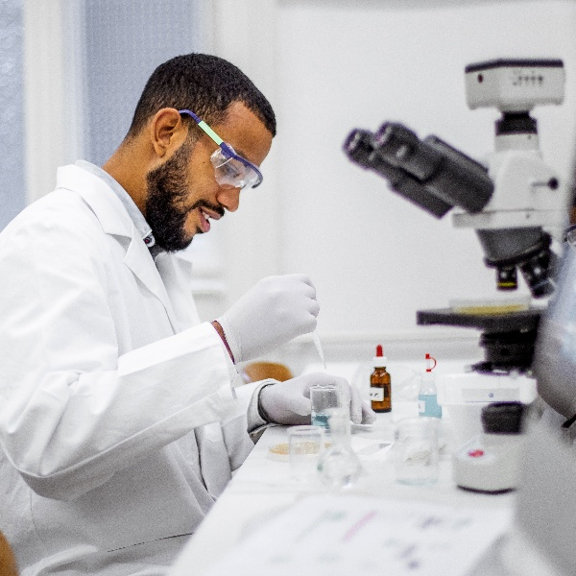

Explore a career as a…
Here are some example roles and careers linked to Chemistry
Pharmacologist
Chemist
Research and Development
BBC Bitesize case study
BBC Bitesize case study
STEM Learning case study
Notes:
Jobs that use Science BBC Bitesize Careers: https://www.bbc.co.uk/bitesize/tags/zjb8f4j/jobs-that-use-science/1
Activity Ideas:
Ahead of revealing content of slide, encourage students to think about as many roles linked to your subject as they can in pairs/groups.
Encourage learners to engage with specific videos/profiles or direct learners to specific roles/careers to predict, research and reflect on:
Pathways
Essential Skills
Wages/Work Conditions
Why they, might like/not like in a particular role?

Slide 4



Explore a career as a…
Here are some example roles and careers linked to Chemistry
Biochemist
Chemical Engineer
Nuclear Chemical Technician
BBC Bitesize case study
NSF case study
STEM Learning case study
BBC Bitesize case study
Notes:
Jobs that use Science BBC Bitesize Careers: https://www.bbc.co.uk/bitesize/tags/zjb8f4j/jobs-that-use-science/1
Activity Ideas:
Ahead of revealing content of slide, encourage students to think about as many roles linked to your subject as they can in pairs/groups.
Encourage learners to engage with specific videos/profiles or direct learners to specific roles/careers to predict, research and reflect on:
Pathways
Essential Skills
Wages/Work Conditions
Why they, might like/not like in a particular role?

Slide 5


Not so obvious subjects using Chemistry:
Ever thought about..?
How to become an Air Ambulance Doctor: Matt's story
Agronomist | Explore careers | National Careers Service
How to become a Vet: Lucy's story
Fingerprint Officer | Explore careers | National Careers Service
How to become a Professor: Saiful Islam's story
Technical Brewer | Explore careers | National Careers Service
https://www.bbc.co.uk/bitesize/articles/zhst2sg
https://nationalcareers.service.gov.uk/explore-careers
Notes:
It’s important for learners to understand the wide range of possibilities arising from your subject. Here’s some to explore…try and focus on less obvious choices.
To select more yourself:
BBC Bitesize link:
https://www.bbc.co.uk/bitesize/tags/zjb8f4j/jobs-that-use-science/1
National Careers Service link:
https://nationalcareers.service.gov.uk/explore-careers

Slide 6

MYPATH Job of the week (Chemistry)
Toxicologist
Anaesthetist
Veterinary Surgeon
Notes:
MYPATH are a series of fabulous videos designed to inspire learners in a variety of jobs.
https://www.mypathcareersuk.com/other-careers-videos
Inspire learners with these clips.

Slide 7

From passion to profession:
Share a role that sparks your interest
Prepare a 3-5 minute talk to share with a small group on any role that interests you related to Chemistry.
What is the role?
What do you need to do to get this role?
Where do you need to go to carry out this role?
What might a typical day look like?
Why are you interested in this role?

Slide 8
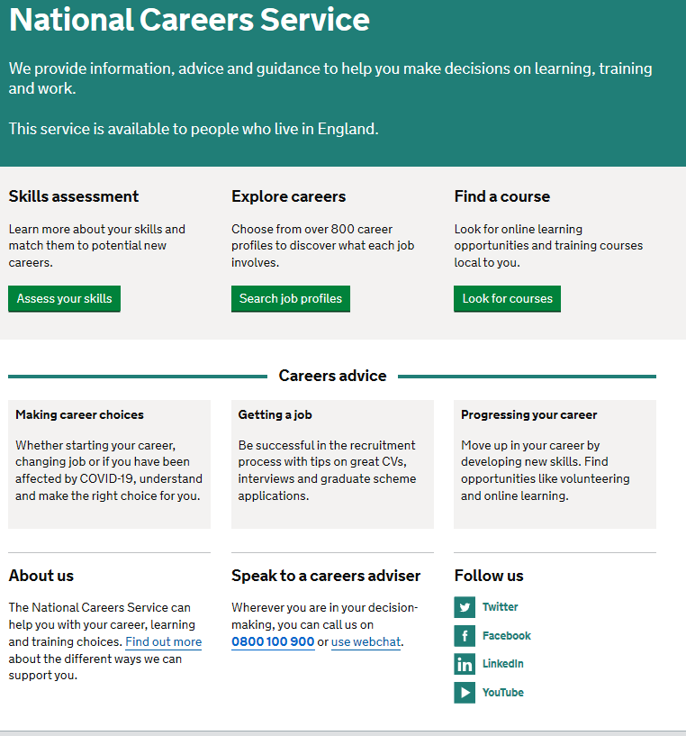
Discover more about the role
Explore careers using National Careers Service and find out about what jobs involve and how they are right for you
Includes:
Average salary
Typical hours
Work patterns
Pathways/How to become
Essential Skills
Daily tasks
Career path and progression
Current opportunities
Pharmacologist
Chemist
Research and Development
Biochemist
Chemical Engineer
Nuclear Technician
Notes:
https://nationalcareers.service.gov.uk/explore-careers
How to use this slide:
Highlight the National Careers Service: Explore Careers Tool https://nationalcareers.service.gov.uk/explore-careers
Encourage learners to access the tool and research general or specific roles linked to your subject.
Set learners comparative/reflective tasks about why learners may/may not like jobs they research.
Ask if your learners have done the Buzz quiz (5mins to complete) – if they haven’t then consider setting this as a pre/post task to allow them to reflect on how these roles may suit them based n their profile. Take the test and find out which animal you are, too!
The Buzz Quiz (Quiz) - North East Ambition

Slide 9


Why not teach Chemistry?
Progress your career into leadership and management
Bring your outside interests into the classroom and your subject
No two days are the same – and neither are the pupils
Once qualified you can teach throughout your life
You could teach abroad
Explore teaching
Daniel’s Story
Jem’s Story
Shaniqua’s Story
What makes a great teacher?
The right skills to teach?
Work well in a team?
Love to nurture imagination?
Love to keep learning?
Notes:
Use the bullets on the slide to discuss benefits of teaching.
Bring through the reasons cited in your guide P5:
Re teaching:
2. Turn your passion into a career
3. The reward is always worth the challenge
4. More time for what you love
5. Start on at least £25k (£32k inner London)
‘Explore teaching’ is a great introduction for your students to consider what it is really like to be on the other side of the desk (you choose the best fit video for your students).
·Daniel is the early stages of his teaching career as a primary teacher and shares his journey, belief, and pride that great teachers make all the difference.
·Jem who always wanted to be a teacher from his time at university, teaches history and politics in an 11-18 secondary school. Filmed in his school, he shares his career progression, along with pupils sharing why they enjoy his lessons.
·Shaniqua is a primary teacher who shares her inspiring and personal journey from having to retake her GCSEs, to working as a Teaching Assistant, alongside studying for a degree. Filmed in her school, which she used to attend, Shaniqua shares her message that there are ‘other ways to become a teacher than doing A Levels and straight to university’.
The right skills to teach?
These three very short films show students those skills they have already gained like teamwork, imagination or a love of learning - could they be more of teacher than they think?
What makes a great teacher?
A short video where secondary pupils share their responses to this question. Try asking your students first and then comparing their answers with the students on film.

Slide 10

GCSE
While there are different routes you can take to be a teacher there are a few essential things that you will need:
• A minimum GCSE Grade 4 or above in English and Maths (plus Science if you want to teach primary)
A degree or equivalent qualification
A-Level
T level
Vocational/Technical Qualification
Apprenticeships
A-Levels are 2 years of study
T levels are nationally recognised, technical qualifications for 16–19-year-olds. Designed by leading employers, one T level is equivalent in size to 3 A-Levels
These include BTEC, Applied General Qualifications (AGQ) and Vocational Technical Qualifications (VTQ) – all at Level 3
Apprenticeships are jobs which combine practical work and study. Intermediate is Level 2, Advanced is Level 3
Degree
Level 4/5 qualifications
Higher apprenticeships
Complete a degree course
It is possible to get QTS as part of an undergraduate degree, for example:
• Bachelor of Arts (BA) with QTS
• Bachelor of Education (BEd) with QTS
• Bachelor of Science (BSc) with QTS
Complete a L4/5 course and top up to a degree – L4/5 includes Certificate of HE, Diploma of HE, Higher Technical Qualification (HTQ), HNC, HND and Foundation degrees
Top up to a degree (Level 6) in a year of full-time study
Higher level apprenticeship (foundation degree / Level 5)
Degree apprenticeships
Degree apprenticeship
(Level 6-7). There is a Level 6 Teaching apprenticeship programme
Initial Teacher Training (ITT) with qualified teacher status (QTS)
Teacher
Notes:
Here is the power point version of the infographic resource showing different options learners could follow to get into teaching.
Go through this with your learners and give examples of different staff in your school, special school or college who followed these paths.

Slide 11



Chemistry pathways
Combine study
and work
Study
Work

Slide 12

Combine study and work
Apprenticeships
Metrology Technician
Laboratory Scientist
Food Industry Tech Professional
Forensic Practitioner
Pharmacologist Technician
T levels
Education and Early Years
Health
Management and Administration
Healthcare Science
Engineering, Manufacturing, Processing and Control
Agriculture, Land Management and Production
Ecologist
Laboratory Analyst
Biochemist
Chemical Engineering
VTQs
Applied Science
Chemistry
Health and Social Care​
NHS Careers

Slide 13

Study pathways
HTQs (Higher Technical Qualifications)
You will find occupation routes in:
Education and Early Years
Engineering and Manufacturing
Health and Science
A levels
You might find courses in:
Chemistry
Applied Science
Mathematics
Higher education
You might find courses in:
Chemical Engineering
Energy Engineering
Medicinal/Physical Chemistry
Environmental Chemistry
Biochemistry
Ecology​
Forensics ​
Dentistry ​
Chemical Process and Energy​
Chemistry with a second subject
(management/Industrial placement)

Slide 14

Work pathways
Supported internships with an education, health and care plan
You might read about:
• Access to Work Funding (if you have a disability or health condition)
• Preparing for Adulthood
School leaver programmes
You might read about:
• How to fill in an application form
• How to write a CV
• Interview help
• Progressing your career (Careers Advice from NCS)

Slide 15


University league tables
See at a glance the university ranking for Chemistry
Chemistry Rankings (thecompleteuniversityguide.co.uk)
Filter by:
• Overall score
• Entry standards
• Student satisfaction
• Research quality
• Research intensity
• Graduate prospects

Slide 16


