Slide 1


My Learning, My Future
Bringing learning to life: Connecting your subject to careers, pathways, and the world beyond the classroom
Notes:
This presentation has designed to be delivered in 10-15 mins and there are ideas on how to add content if you have a longer slot.
The presentation aims to highlight the value and benefit of embedding careers in the curriculum.
What exactly is meant by embedding careers in the curriculum.
How staff can use My Learning, My Future to easily embed careers in the curriculum.

Slide 2
Why embed careers in the curriculum?
Increases learner engagement
Enhances curriculum relevance
Supports learners' skills development
Notes:
Ask this question of colleagues – focus on the benefits to teaching staff.
Reflect on these ideas and compare them with contributions from your colleagues.
Embedding careers in the curriculum can increase learner engagement by showing how subjects connect to careers and the world of work – there is also evidence that career-related learning can improve learner overall outcomes Motivated to achieve: How encounters with the world of work can change attitudes and improve academic achievement - Education and Employers
Highlight relevance of your subject and specific topics/learning enhances curriculum relevance and can drive interest in your subject...particularly during options processes, etc.
Embedding careers in the curriculum also supports learner skills development by making links to skills and their application in the world of work.

Slide 3


What does it mean to embed careers in the curriculum?
Highlight the relevance of your subject
Make links from the curriculum to essential skills and to careers and the world of work
Extension: Meaningful employer encounters and work experiences linked to curriculum topics
Extension: Embedding curriculum learning in the context of the world of work.
Notes:
It can feel overwhelming to embed careers into the curriculum.
You may find it useful to support staff to understand what you mean by careers and then break down how they can engage learners by highlighting the relevance of their subject and making links from the curriculum to essential skills and to pathways/ careers.
Useful definition of careers:
Supporting learners to:
make aspirational and informed decisions
make effective and sustained transitions
develop career readiness.
You may also find it useful to highlight that encounters and experiences and embedding teaching in the context of careers and the world of work are extensions to your core ask of:
All staff highlighting the relevance of their subject and all staff making links from the curriculum to essential skills, pathways and the world of work.
What does it mean for staff to highlight the relevance of their subject?
This is outside of curriculum teaching and involves staff considering the optimal time to highlight the relevance of their subject – this may be at the start of a course or during an options process to support learners to make effective decision, it may also be within National Careers Week, etc. if staff are asked to deliver careers content. Examples include workshops, home learning activities, mini research tasks where learners explore the value and benefit of studying a particular subject.
What does it mean for staff to make links from the curriculum to essential skills,, pathways and careers?
This is the heart of BM4 and staff will appreciate clarity on what this means and what it could look like.
At it’s most simple this is about staff making reference from specific topics/elements of learning to:
Essential skills being developed and their application in real-life situation.
Different roles, jobs or careers associated with elements and topics of learning.
Pathways linked to these roles and pathways and next steps learners could take to explore elements of your subject to a higher level.
In some schools, special schools and colleges staff are also encouraged to consider Meaningful employer encounters and work experiences linked to curriculum topics. This goes beyond BM4 and relates to BM5 & 6(and potentially 7!) and can bring real value to how staff highlight the relevance of their subject and how they make links from the curriculum to essential skills, pathways and careers. How you position this depends on your expectations of staff and how they are encouraged/supported to consider embedding meaningful achievement of Benchmark 5 and 6 within careers in the curriculum.
Similarly, some schools, special schools, colleges and trusts support staff to embed curriculum learning in the context of careers. This is an extension beyond Benchmark 4 and involves working with employers to plan curriculum learning and schemes of work fully embedded in the context of the world of work. Consider your position on this and what expectations are of staff to consider whether you will include this element of practice in this presentation.
The aim of this slide is to break down into simple steps what is meant and what is expected as a valuable and manageable approach to career sin the curriculum that all staff can be supported to take.
.
Please note that this presentation is designed to be delivered in a 10-15 min slot – if you have longer then you could consider inviting staff to share practice on how they highlight the relevance of their subject and how they make links from the curriculum to essential skills, pathways and careers.

Slide 4

What is My Learning, My Future?
Empowers you to easily and confidently highlight the relevance of your subject and to embed careers into your curriculum.
27 subject guides and learner slide decks.
"Plug and play" resource and signpost to further information and CPD.

Slide 5
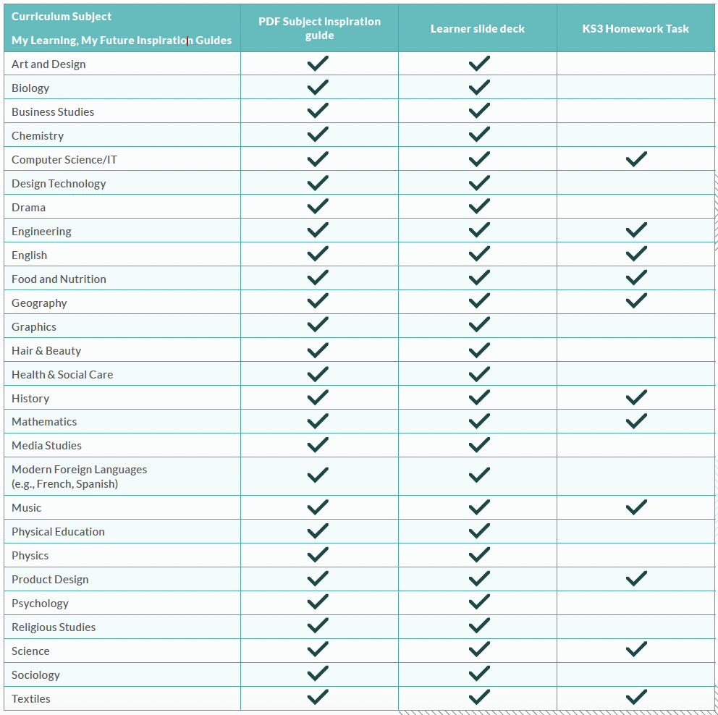
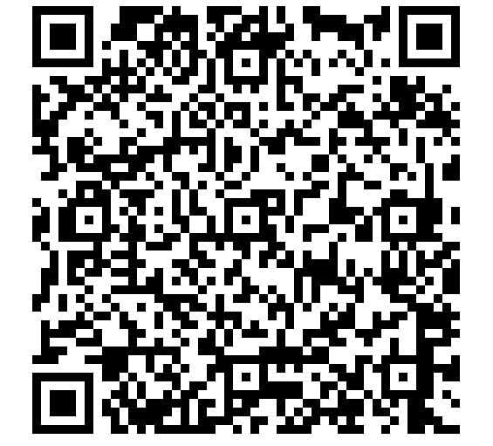
Notes:
27 guides all with learner facing decks and 11 subjects with a PDF KS3 home learning task.

Slide 6
My Learning, My Future: Subject Inspiration Guides
Inside the subject inspiration guides and slide decks
Why study (subject)
Highlighting the relevance of studying (subject) with learners
Making links from the(subject) curriculum to careers & essential skills
Meaningful employer encounters and work experiences linked to curriculum topics
(subject) Pathway Maps
Further information/support
Acknowledgements
Notes:
My Learning, My Future offers a comprehensive suite of careers-linked curriculum resources designed to support subject teachers in embedding career-related learning meaningfully and confidently.
There are teacher inspiration guides for 27 subjects that include easy and practical support for staff to highlight the relevance of their subject and make links from their curriculum to essential skills and to pathways and careers.
There is also support for staff to explore the extension approaches of Meaningful employer encounters and work experiences linked to curriculum topics and embedding curriculum in the context of the world of work.
All guides provide signposting to subject specific information, links, activities and relevant further CPD opportunities.

Slide 7
My Learning, My Future: Learner Slide Decks
Inside the subject inspiration guides and slide decks
Why study (subject)
Explore a careers as a …(5 careers relevant to your subject)
Not so obvious careers that use your subject
Why not teach
From passion to profession: research activity
Job of the week linked to your subject
Pathways from your subject: study, study & work, work
Notes:
All 27 subjects have a learner facing slide deck bespoke to each subject.

Slide 8
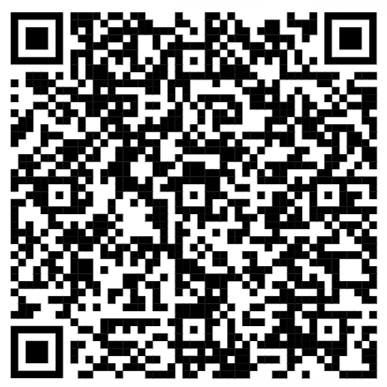
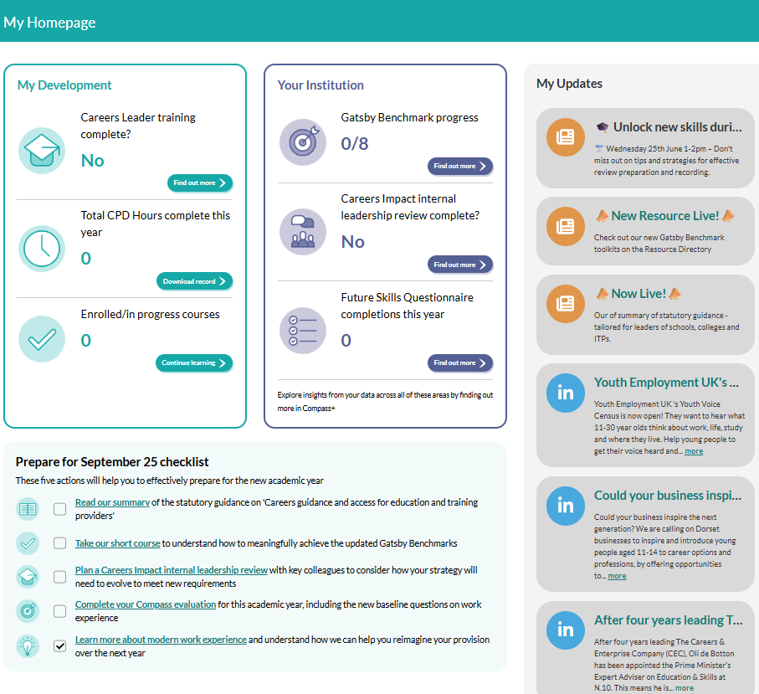
The Careers & Enterprise Academy
Our new digital platform is for Career Leaders and all those who work with them to plan and deliver strategic, progressive career programmes.
For Careers Leaders, bespoke learning content is available to build foundational knowledge, then develop deeper skills including learning how to effectively engage parents/carers and using our digital tools to drive impact. To support the release of updated Statutory Guidance, the site also includes a new homepage exclusively for Careers Leaders with a data and learning dashboard, a checklist highlighting all the steps needed to prepare for September 2025 and a handy newsfeed alerting users to new content and events.
For Education Leaders, Governors, SENCOs or the wider teaching workforce, tailored content is available to help everyone effectively play their part in helping young people find their best next step.
For all users, there are 15 courses available, including all those for educators previously on the Digital Hub, plus NEW courses:
Understanding the updates to the Gatsby Benchmarks
Understanding the Careers Impact internal leadership review
Preparing for meaningful achievement of the updated Gatsby Benchmarks

Slide 9

My Learning, My Future
Notes:
Links to the My Learning, My Future Resources

