Slide 1


Design Technology
My Learning, My Future
Where can studying Design Technology take you? Highlighting the relevance of Design Technology to future careers and opportunities​
Notes:
Purpose of slides:
To allow you to highlight the relevance of your subject to future careers and opportunities.
To enable students to explore the full range of options available to them.
Aims:
To engage students in your subject
To highlight pathways and opportunities from your subject
To encourage students to consider your subject at KS4/Post 16
To support work across the school towards Gatsby Benchmark 4
How to use these slides?
These slides can be used at any point during KS3/4 or post 16 to engage students in learning and to highlight the relevance of your subject to future careers and opportunities.
They will be of most relevance within an option process and can support work you are doing to encourage students to consider their options for KS4/Post 16.

Slide 2
Why study Design Technology?
Practical application of STEM skills
Essential workplace skills
Broad career pathways
Shaping our world
Nurturing creativity and innovation
Notes:
Why study Design Technology?
Broad career pathways
Designers have opportunities to explore varied employment sectors, influencing everything from space exploration, sustainable transportation, digital experiences and healthcare. For example, spacecraft design, electric cars, robotics and prosthetic limbs.
Essential workplace skills
The skills acquired through Design Technology are highly valued and essential in today's dynamic workplace. These include critical thinking, problem-solving, collaboration, project management, communication, and adaptability.
Shaping our world
Design Technology’s interdisciplinary nature also serves as excellent preparation for other fields, including rapidly evolving areas like computer science, where problem-solving and design thinking are increasingly crucial.
Nurturing creativity and innovation
Design Technology cultivates and showcases students' innate creativity and innovation skills. Through iterative design processes, prototyping, and problem-solving challenges, students are encouraged to think outside the box.
Practical application of STEM skills
Studying Design Technology offers a unique opportunity for students to bridge the gap between theoretical knowledge and practical application.
Reflection:
Is there anything else you would add to this list?
How do you share the importance of studying Design Technology with learners?
How do you communicate the value of studying Design Technology with parents and carers?

Slide 3



Explore a career as a…
Here are some example roles and careers linked to Design Technology
Energy Assessor
CAD Technician
Architect
BBC Bitesize case study
BBC Bitesize case study
BBC Bitesize case study
STEM Learning case study
BBC Bitesize case study
Notes:
Jobs that use Design and Technology BBC Bitesize Careers: https://www.bbc.co.uk/bitesize/tags/zn7h8xs/jobs-that-use-design-and-technology/1
Activity Ideas:
Ahead of revealing content of slide, encourage students to think about as many roles linked to your subject as they can in pairs/groups.
Encourage students to engage with specific videos/profiles or direct students to specific roles/careers to predict, research and reflect on:
Pathways
Essential Skills
Wages/Work Conditions
Why they, might like/not like in a particular role?

Slide 4



Explore a career as a…
Here are some example roles and careers linked to Design Technology
Video Games Designer
Civil Engineer
Motor Mechanic
BBC Bitesize case study
BBC Bitesize case study
BBC Bitesize case study
BBC Bitesize case study
BBC Bitesize case study
Notes:
Jobs that use Design and Technology BBC Bitesize Careers: https://www.bbc.co.uk/bitesize/tags/zn7h8xs/jobs-that-use-design-and-technology/1
Activity Ideas:
Ahead of revealing content of slide, encourage students to think about as many roles linked to your subject as they can in pairs/groups.
Encourage students to engage with specific videos/profiles or direct students to specific roles/careers to predict, research and reflect on:
Pathways
Essential Skills
Wages/Work Conditions
Why they might like/not like in a particular role?

Slide 5


Not so obvious subjects using Design Technology:
Ever thought about..?
How to become a Soldier: Naomi's story
Ergonomist | Explore careers | National Careers Service
How to become a Waste Warrior: Grace's story
Footwear Designer | Explore careers | National Careers Service
How to become and Electrical Engineer: Ben's story
Technical Author | Explore careers | National Careers Service
Notes:
It’s important for students to understand the wide range of possibilities arising from your subject. Here’s some to explore…try and focus on less obvious choices.
To select more yourself:
BBC Bitesize link:
https://www.bbc.co.uk/bitesize/tags/zn7h8xs/jobs-that-use-design-and-technology/1
National Careers Service link:
https://nationalcareers.service.gov.uk/explore-careers

Slide 6

MYPATH Job of the week (Design Technology)
Kitchen Fitter
UX Designer
Quantity Surveyor
Notes:
MYPATH are a series of fabulous videos designed to inspire students in a variety of jobs.
https://www.mypathcareersuk.com/other-careers-videos
Inspire students with these clips.

Slide 7

From passion to profession:
Share a role that sparks your interest
Prepare a 3 - 5 minute talk to share with a small group on any role that interests you related to Design Technology.
What is the role?
What do you need to do to get this role?
Where do you need to go to carry out this role?
What might a typical day look like?
Why are you interested in this role?

Slide 8
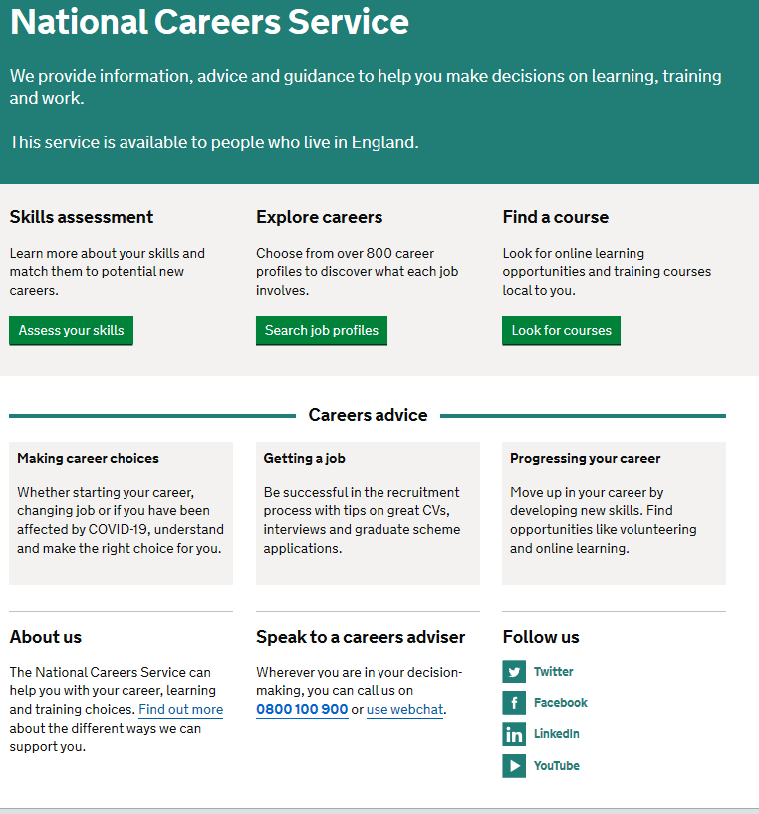
Discover more about the role
Explore careers using National Careers Service and find out about what jobs involve and how they are right for you.
Includes:
Average salary
Typical hours
Work patterns
Pathways/How to become
Essential Skills
Daily tasks
Career path and progression
Current opportunities
Research Ideas:
Energy Assessor
CAD Technician
Architect
Video games Designer
Civil Engineer
Motor Mechanic
Notes:
https://nationalcareers.service.gov.uk/explore-careers
How to use this slide:
Highlight the National Careers Service: Explore Careers Tool https://nationalcareers.service.gov.uk/explore-careers
Encourage students to access the tool and research general or specific roles linked to your subject.
Set students comparative/reflective tasks about why students may/may not like jobs they research.
Ask if your students have done the Buzz quiz (5mins to complete) – if they haven’t then consider setting this as a pre/post task to allow them to reflect on how these roles may suit them based n their profile. Take the test and find out which animal you are, too!
The Buzz Quiz (Quiz) - North East Ambition

Slide 9


Why not teach Design Technology?
Progress your career into leadership and management
Bring your outside interests into the classroom and your subject
No two days are the same – and neither are the pupils
Once qualified you can teach throughout your life
You could teach abroad
Explore teaching
Daniel’s Story
Jem’s Story
Shaniqua’s Story
What makes a great teacher?
The right skills to teach?
Work well in a team?
Love to nurture imagination?
Love to keep learning?
Notes:
Use the bullets on the slide to discuss benefits of teaching.
Bring through the reasons cited in your guide P5:
Re teaching:
2. Turn your passion into a career
3. The reward is always worth the challenge
4. More time for what you love
5. Start on at least £25k (£32k inner London)
‘Explore teaching’ is a great introduction for your students to consider what it is really like to be on the other side of the desk (you choose the best fit video for your students).
·Daniel is the early stages of his teaching career as a primary teacher and shares his journey, belief, and pride that great teachers make all the difference.
·Jem who always wanted to be a teacher from his time at university, teaches history and politics in an 11-18 secondary school. Filmed in his school, he shares his career progression, along with pupils sharing why they enjoy his lessons.
·Shaniqua is a primary teacher who shares her inspiring and personal journey from having to retake her GCSEs, to working as a Teaching Assistant, alongside studying for a degree. Filmed in her school, which she used to attend, Shaniqua shares her message that there are ‘other ways to become a teacher than doing A Levels and straight to university’.
The right skills to teach?
These three very short films show students those skills they have already gained like teamwork, imagination or a love of learning - could they be more of teacher than they think?
What makes a great teacher
A short video where secondary pupils share their responses to this question. Try asking your students first and then comparing their answers with the students on film.

Slide 10
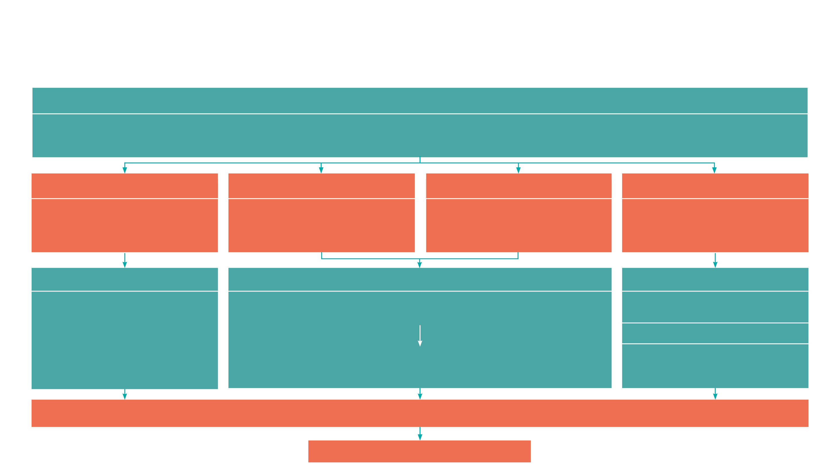
GCSE
While there are different routes you can take to be a teacher there are a few essential things that you will need:
• A minimum GCSE Grade 4 or above in English and Maths (plus Science if you want to teach primary)
A degree or equivalent qualification
A-Level
T level
Vocational/Technical Qualification
Apprenticeships
A-Levels are 2 years of study
T levels are nationally recognised, technical qualifications for 16–19-year-olds. Designed by leading employers, one T level is equivalent in size to 3 A-Levels
These include BTEC, Applied General Qualifications (AGQ) and Vocational Technical Qualifications (VTQ) – all at Level 3
Apprenticeships are jobs which combine practical work and study. Intermediate is Level 2, Advanced is Level 3
Degree
Level 4/5 qualifications
Higher apprenticeships
Complete a degree course
It is possible to get QTS as part of an undergraduate degree, for example:
• Bachelor of Arts (BA) with QTS
• Bachelor of Education (BEd) with QTS
• Bachelor of Science (BSc) with QTS
Complete a L4/5 course and top up to a degree – L4/5 includes Certificate of HE, Diploma of HE, Higher Technical Qualification (HTQ), HNC, HND and Foundation degrees
Top up to a degree (Level 6) in a year of full-time study
Higher level apprenticeship (foundation degree / Level 5)
Degree apprenticeships
Degree apprenticeship
(Level 6-7). There is a Level 6 Teaching apprenticeship programme
Initial Teacher Training (ITT) with qualified teacher status (QTS)
Teacher
Notes:
Here is the power point version of the infographic resource showing different options learners could follow to get into teaching.
Go through this with your learners and give examples of different staff in your school, special school or college who followed these paths.

Slide 11



Design Technology pathways
Combine study
and work
Study
Work

Slide 12

Combine study and work
Apprenticeships
Network Engineer
Software Developer
CAD Technician
Creative Digital Design Professional
T Levels
Agriculture, Land Management and Production
Building Services Engineering for Construction
Craft and Design
Design and Development for Engineering and Manufacturing
Design, Surveying and Planning for Construction
Engineering, Manufacturing, Processing and Control
Maintenance, Installation and repair for Engineering a Manufacturing
Materials Planner/Buyer
Games Programmer
VTQs
Construction
Engineering
Land-based​
Design and Technology​

Slide 13

Study pathways
HTQs (Higher Technical Qualifications)
You will find occupation routes in:
Digital
Engineering and Manufacturing
Construction and the Built Environment
A levels
You might find courses in:
Computer Science
Electronics
Computer Science
Design and Technology
Design and Technology: Engineering Design
Design and Technology: Fashion and Textiles
Design and Technology: Systems and Control
Design and Technology: Product Design
Higher education
You might find courses in:
Aerospace Engineering
Architecture, building and planning
Civil Engineering
Radiography and Medical Technology
Materials Science and Engineering
Mechanical Engineering​
Game Design ​
Software Engineering

Slide 14

Work pathways
Supported internships with an education, health and care plan
You might read about:
• Access to Work Funding (if you have a disability or health condition)
• Preparing for Adulthood
School leaver programmes
You might read about:
• How to fill in an application form
• How to write a CV
• Interview help
• Progressing your career (Careers Advice from NCS)

Slide 15


University league tables
See at a glance the university ranking for Design Technology
Aeronautical and Aerospace Engineering
Building
Manufacturing and Production Engineering
Filter by:
• Overall score
• Entry standards
• Student satisfaction
• Research quality
• Research intensity
• Graduate prospects

Slide 16


