Slide 1

Careers Impact System

Slide 2
To appreciate how engaging with the Careers Impact System can support continuous improvement.
To understand the value & purpose of engaging with a Careers Impact peer-to-peer review.
To understand the process and commitment to engage in a Careers Impact peer-to-peer review.
Session Aims

Slide 3
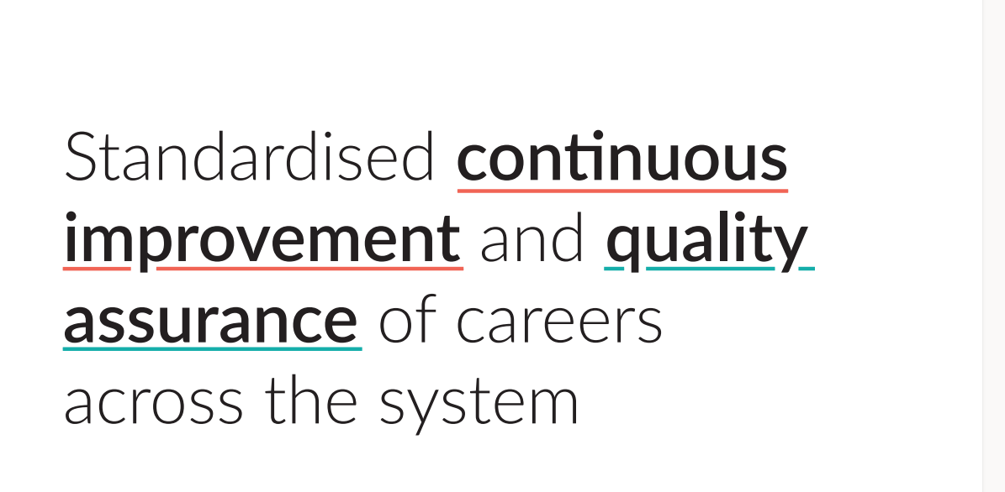
Notes:
This is the overarching ambition for the Careers Impact System.
Rooted in the Gatsby Benchmarks and other evidence about best practice in careers, the Careers Impact System aims to:
Provide assurance of quality of careers provision
Improve careers provision across the country
Elevate the status of Careers Leadership
Support leaders to feel confident in a quality careers education programme that is actually designed to support whole school improvement.

Slide 4
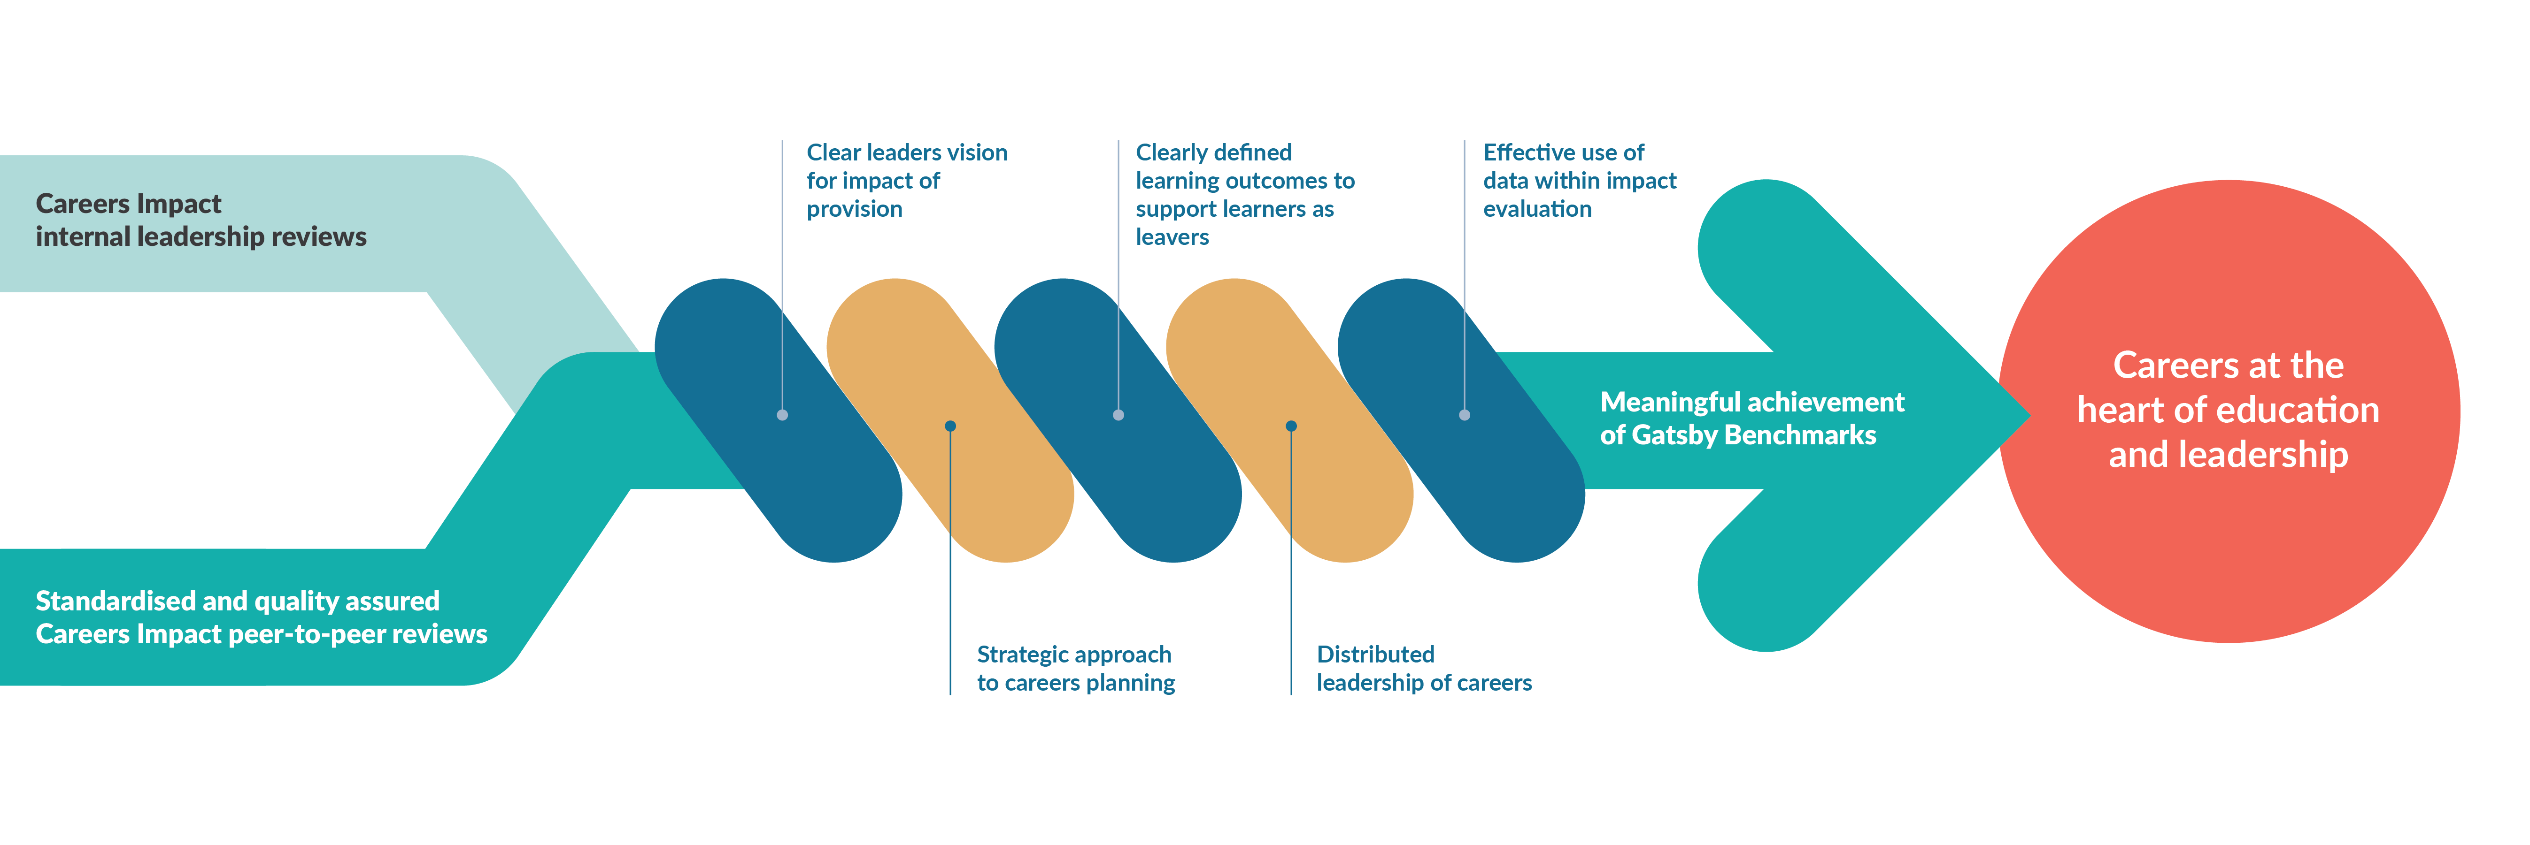
The Careers Impact Model
Notes:
The Careers Impact System is made up of two key parts, both of which I will outline today
Careers Impact internal leadership reviews and peer-to-peer reviews, both of which are based in the five conditions for success that were identified as the elements that need to be in place in order to ensure a sustainable and strategic approach to careers leadership and the meaningful achievement of the Gatsby Benchmarks.
The five conditions for success are embedded within the Careers Impact System and help leaders to focus time and effort in the places that will make the biggest difference.
These are ensuring a clear, well-articulated leaders' vision for the impact of the provision, a strategic approach to careers planning, aligning with wider school improvement priorities, clearly defined learning outcomes to support learners as leavers, a distributed approach to careers leadership and the effective use of data within impact evaluation.

Slide 5
“A different way of talking about careers and careers leadership: in the realm of overall improvement.”
“An opportunity to identify the actions that will create a more sustainable and embedded approach where leadership is distributed, and careers is considered to be everyone’s responsibility.”
“A strategic focus on the impact and outcomes of careers provision, when the temptation can be to focus on the operational inputs and activities.”
What does the Careers Impact System give us?
Notes:
The system overall provides us with a different way of talking about careers and careers leadership, specifically through the lens of wider school, special school and college improvement
The reviews within the system allow us all to reflect on practice and to identify actions that will create a more sustainable and strategic approach to careers leadership
The reviews give you a safe space to focus on the strategic leadership of careers and to step back from the to-do list to re-calibrate, focusing time and effort on the things that will make the biggest difference in your setting,

Slide 6

What is a Careers Impact internal leadership review?
Self-evaluation: Enabling institutions to reflect on their careers leadership maturity using the Careers Impact Maturity Model.
Strategic alignment: Helping centrally position careers as a driver for whole-institution improvement.
Collaborative insight: Encouraging input from key staff to reach those most in need.
Continuous improvement: Supporting progress toward meaningful Gatsby Benchmark achievement and whole institution improvement.
Foundation for peer review: Preparing institutions for deeper engagement through peer-to-peer reviews and strategic planning.
Notes:
Self-evaluation: Enabling institutions to reflect on their careers leadership maturity using the Careers Impact Maturity Model.
Strategic alignment: Helping centrally position careers as part of the solution - a driver for whole-institution improvement, rather than a standalone activity.
Collaborative insight: Encouraging input from key staff (e.g. Careers Leader, SLT, Pupil Premium lead, SENCo) to build a shared understanding of current practice, reach those most in need and develop a distributed approach to careers leadership.
Continuous improvement: Identifying strengths and surfacing areas for development, supporting progress toward meaningful Gatsby Benchmark achievement and whole institution improvement.
Foundation for peer review: Preparing institutions for deeper engagement through peer-to-peer reviews and strategic planning.

Slide 7
“We strongly recommend the use of the Careers Impact System which supports a quality assured, sustainable and strategic approach to careers leadership and establishes a shared and standardised language of quality improvement for careers, aligned to school and college improvement.”
Department for Education Statutory Guidance: Careers guidance and access for education and training providers May 2025
Notes:
It is recommended in Statutory Guidance, that institutions undertake a Careers Impact internal leadership review. This process involves key senior staff and will support you in understanding what embedded good practice looks like and how to recognise it.
Engagement with this process also enables you more confidently articulate the intent, design and impact of your careers provision whether for internal reflection, external validation, during an Ofsted inspection or within stakeholder engagement.
Through this process, leaders gain:
a clear understanding of strengths and areas for development within their careers provision.
evidence-based insights to inform inspection discussions and stakeholder engagement.
increased confidence across leadership and staff in articulating impact and strategic direction.
a demonstration of a culture of continuous improvement and strategic oversight.
strengthened collaboration across departments, fostering shared ownership of careers education.
development of robust impact measures aligned with institutional priorities.
the ability to monitor progress over time and adapt strategies responsively.

Slide 8
Confident articulation of impact across new
Ofsted Evaluation areas
Evaluation Area | Questions to consider
Leadership and Governance | How well do leaders understand learners’ needs, and how has this shaped the careers provision? Has careers provision been used to address key institutional challenges?
Curriculum and teaching / Curriculum teaching and training | Is the curriculum designed to build knowledge and skills for future education, training, or employment? How does the strategic careers plan influence curriculum intent and planning? How is destination data used to shape curriculum decisions? Does the curriculum reflect local labour market needs? What support is available to help staff understand labour market information and transition pathways? How are staff supported to highlight the relevance of their subject to careers, pathways, & essential skills? How are staff supported to make links from the curriculum to careers, pathways, and essential skills?
Attendance and behaviour / Participation and Development | Does the strategic careers plan help build cultural capital, especially for disadvantaged learners and those with SEND? Does the strategic careers plan support positive attitudes to learning and improved engagement? Do employer and education encounters inspire learners and improve attendance?
Inclusion | How is data on vulnerable groups used to plan targeted careers provision? How do you ensure all learners including those absent or in alternative provision access careers provision? What evidence shows the impact of differentiated careers provision for vulnerable learners?
Notes:
The NEW Ofsted guide coming out in the next few weeks will dig deeper into how to confidently articulate impact to Ofsted.
The process of undertaking a Careers Leadership internal leadership review is not only recommended in Statutory Guidance, it also can help strengthen your confidence in effectively articulating how careers provision contributes to other Ofsted evaluation areas. You can see some examples of the types of reflective questions and conversations that will arise through the process of collective self-evaluation.
Senior leader participation in a Careers Impact internal leadership review or their strategic and responsive involvement in a peer-to-peer review, provides a strong indication of effective leadership. Participation not only supports informed decision-making but also demonstrates a commitment to inclusive, high-quality provision. The peer-to-peer review adds further rigour, and the resulting impact-evaluated strategic action planning can serve as potential evidence of ‘strong’ or even ‘exemplary’ practice under the new framework.

Slide 9
Strategic insight: Provides a clear, evidence-based view of how careers provision aligns with improvement priorities.
Informed decision-making: Supports data-led planning and resource allocation.
Improved leadership engagement: Encourages senior leaders to take an active role in shaping careers strategy, embedding it across the institution.
Enhanced accountability: Aligns with Ofsted expectations and national frameworks such as the Gatsby Benchmarks.
Sustainable improvement: Lays the foundation for long-term, strategic careers leadership with a strategic focus on impact, equity and consistency.
Benefits of undertaking an internal leadership review
Notes:
Here are a few of the benefits of undertaking a Careers Impact internal leadership review.
Strategic insight: Provides a clear, evidence-based view of how careers provision aligns with whole-school, special school, or college improvement priorities.
Informed decision-making: Supports data-led planning and resource allocation by identifying strengths, gaps, and opportunities for development, particularly to support those at most disadvantage.
Improved leadership engagement: Encourages senior leaders to take an active role in shaping careers strategy, embedding it across the institution, strengthening distributed leadership and cross-departmental collaboration.
Enhanced accountability: Aligns with Ofsted expectations and national frameworks (e.g. Gatsby Benchmarks), supporting inspection readiness.
Sustainable improvement: Lays the foundation for long-term, strategic careers leadership through the Maturity Model with a strategic focus on impact, equity and consistency.
The entire process is owned by you. It is completed internally and is for internal use to help you confidently prioritise for continuous improvement.
And there is good reason to get this right. There is well developed evidence linking good careers guidance to reduced levels of young people not in education, employment or training (NEET) at post-16 and post-18. Young people in schools and colleges with the highest quality careers provision are 8% less likely to become NEET. This reduction in NEET rates can reach 20% for the most disadvantaged schools.

Slide 10

Why undertake an internal leadership review?

Slide 11

  “Careers is the cornerstone of education, and the internal leadership review showed us how much we haven’t thought about yet.
  The maturity model takes a lot of that thinking work away – it enables us to work out where we are and what we need to do next because it’s written down for us – so we can focus on strategy and implementation.”
  Senior Leader (2024)
  Following involvement in an internal leadership review

Slide 12
What is a Careers Impact peer-to-peer review?
Collaborative: Careers Leaders and Senior Leaders providing support and challenge.
Standardised: Methodology to support equity of experience with a focus on strategic development.
Facilitated: Guided discussions involving celebrating strengths and committing to highest leverage actions.
Strategic discussion: Time and space to reflect and prioritise, to achieve a sustainable and impactful provision.
Continuous improvement: Supporting progress toward meaningful Gatsby Benchmark achievement and whole institution improvement.
Notes:
Self-evaluation: Enabling institutions to reflect on their careers leadership maturity using the Careers Impact Maturity Model.
Strategic alignment: Helping centrally position careers as part of the solution - a driver for whole-institution improvement, rather than a standalone activity.
Collaborative insight: Encouraging input from key staff (e.g. Careers Leader, SLT, Pupil Premium lead, SENCo) to build a shared understanding of current practice, reach those most in need and develop a distributed approach to careers leadership.
Continuous improvement: Identifying strengths and surfacing areas for development, supporting progress toward meaningful Gatsby Benchmark achievement and whole institution improvement.
Foundation for peer review: Preparing institutions for deeper engagement through peer-to-peer reviews and strategic planning.

Slide 13
Improved outcomes particularly for disadvantaged learners by driving equity, inclusion, and targeted support across the whole institution.
Alignment of careers to overall improvement priorities, driving impact for each and every young person.
Clarity and coherence in approaches to personal development, leadership and management.
Defined actions as the review leads to a practical action plan that supports school, special school or college improvement.
A fresh perspective as external insight and challenge from peers can validate strengths and identify areas for growth.
Benefits of participating in a peer-to-peer review
Notes:
Engaging in a peer-to-peer review is a wonderful opportunity to reflect with senior leaders and Careers Leaders from across or beyond your region, providing the opportunity to learn from others.
The peer-to-peer process will support:
Improved careers provision and understanding of best practice in careers leadership and of meaningful achievement of the Gatsby Benchmarks.
Improved outcomes, particularly for disadvantaged learners by driving equity, inclusion, and targeted support across the whole institution.
Recognition of strengths in careers leadership and careers provision.
Greater SLT engagement in and understanding of careers and increased empowerment of careers leadership.
Wider distributed leadership of careers, resulting in a whole institution approach to careers and improved learner outcomes.
Alignment of careers to overall improvement priorities, driving impact for each and every young person.
A fresh perspective, external insight and challenge from peers can validate strengths and identify areas for growth.
Professional development for the staff involved who can gain leadership experience and strategic insight.
Actionable outcomes as the review leads to a practical action plan that supports school, special school or college improvement.
Clarity and coherence in approaches to personal development, leadership and management.

Slide 14

Why undertake a peer-to-peer review?

Slide 15
Cumulative Added Value of Careers Impact Reviews
Internal Leadership
Review
Broadening understanding through wider SLT engagement in Careers
Collaborative awareness of current positioning of careers
Peer-to-Peer Review
Support and challenge from peers with a focus on impact and quality of provision
Expert guidance from a trained facilitator using standardised methodology
Summary of Review,
Action Planning and Post-Review Stages
A summary of identified strengths and agreed highest leverage actions to inform SLT and Governors
Collaborative action planning to ensure sustainable, strategic, impact-driven improvement
Stimulates initial thoughts around how to achieve progress through the Maturity Model
Collaboratively agreed highest leverage actions prompted by the Maturity Model language
Ongoing support to enable long-term impact where careers is leveraged as a vehicle for overall improvement
Notes:
Following an internal leadership review, you may decide that engaging in a peer-to-peer review is the natural progression. It adds value through:
Expert guidance and constructive challenge.
Supportive collaboration with peers, enabling shared learning and best practice exchange.
The collective identification and lasting impact of highest leverage actions.
It builds on the strengths and areas for development surfaced through the internal leadership review and senior leaders and practitioners work together and share best practice examples and engage in reflective dialogue, to identify highest leverage actions in a fraction of the time.
The process results in a clear, prioritised direction of travel, documented in a summary report which includes a collaborative action plan to drive improvement.

Slide 16
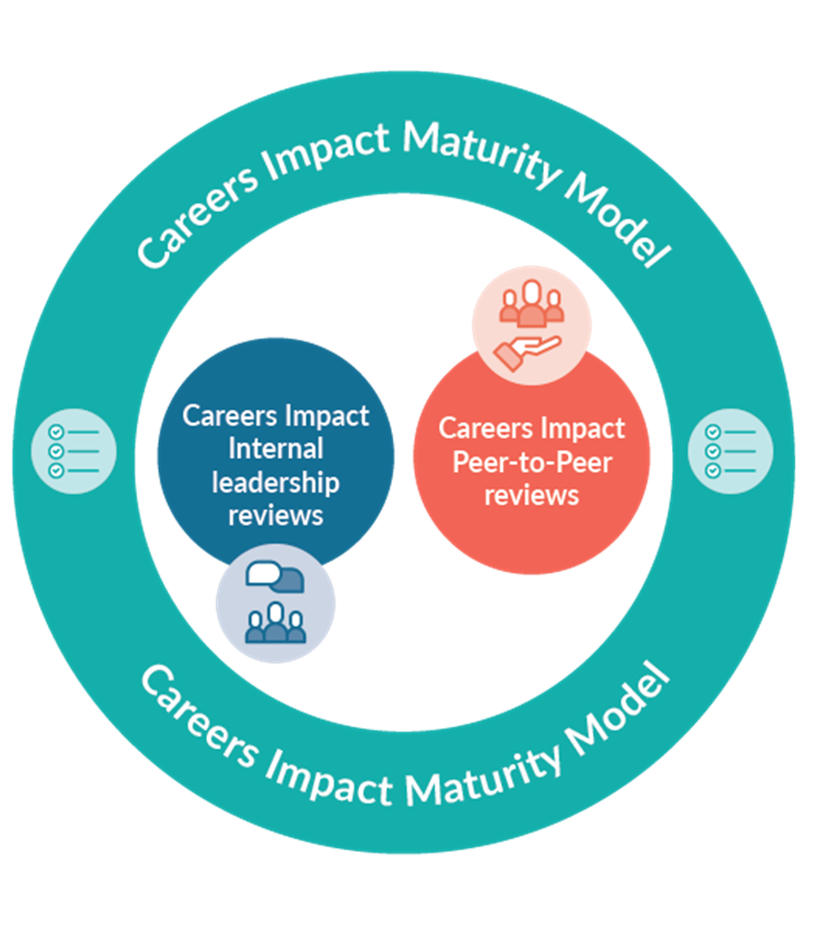
Peer-to-peer review process
Internal leadership review
Convene
Agree
Record
Trio formation, preparation and commitment
Connect
Support
Prepare
Review
Standardised methodology
Lines of enquiry
Agreed priorities and actions
Act
Highest Leverage Actions
Action planning
Present to SLT & Governors
Reconvening
Careers Impact
Self-evaluation tool
Notes:
Internal leadership review
Institutions begin by bringing together the right colleagues (internal to their institution) to complete an internal leadership review, reflecting on strengths and areas for development in relation to Careers Leadership Maturity.
Forming trios and preparation for review
Institutions are grouped into trios for the review day. Groupings may be based on setting type (e.g. special schools, colleges), similar /different benchmarks or priorities, geographical location, or Trust membership. Sharing the rationale for groupings with leaders helps reinforce the value of the collaborative approach. Colleagues will need to prepare for the review which will be covered in the next section on commitment.
Review day participation
Each institution commits up to two staff members to attend the full review day, one of whom must be the senior leader responsible for careers. Full engagement is essential for meaningful peer learning and reflection.
Post-review – Summary and action planning
Following the review, the facilitator provides a summary of review document. Each institution then completes an action plan within the same document. This is designed to support strategic conversations with wider leadership teams and governors, promoting distributed leadership of careers. There is finally the option to reconvene as a trio to share progress and maintain momentum.

Slide 17
“Today has been incredibly useful – I have gained an understanding that I need to drive this more whole school from SLT level. I can see how it is linked into raising attainment and other key priority areas.”
  Senior Leader (2025)
  Following involvement in a peer-to-peer review

Slide 18
Careers Impact System engagement
The expectation is that each institution:
Completes an internal leadership review annually, to track and measure progress.
Engages in a peer-to-peer review every three years (with every institution to have taken part by 2028/29).
Notes:
The expectation is that each institution:
Completes an internal leadership review annually, to track and measure progress.
Engages in a peer-to-peer review every three years.
This will ensure the ongoing internal reflection and external support and challenge continues to drive improvement and benefit each and every learner.

Slide 19
Without strategic reflection,
careers provision risks remaining fragmented, reactive, and disconnected from wider improvement efforts,
ultimately limiting its impact on learners.
Notes:
Not engaging risks careers provision that is not providing for our learners, particularly impacting those who are at disadvantage. Without reflection and continuous improvement driven by school, special school and college leaders, careers provision risks remaining fragmented, reactive, and disconnected from wider improvement efforts, ultimately limiting its impact on learner outcomes.

Slide 20
Q&A

Slide 21
Careers education
In gathering evidence about careers education, inspectors consider the extent to which:
Leaders ensure that all secondary-age pupils are well prepared and supported to progress in education, employment or training, including continuing in education or training until at least their 18th birthday
where relevant, there is an appropriate careers programme that meets the Gatsby Benchmarks and includes impartial advice and guidance from a qualified careers adviser, opportunities for workplace experiences, and engagement with employers, colleges, training providers and universities
secondary-age pupils have an appropriate understanding of relevant trends in local and national employment and the implications of the choices they make in relation to these
pupils with SEND develop independence, contribute to their community, make positive friendships and are supported to be as healthy as possible

Slide 22
Other careers indicators in inspection toolkit
Personal Development and well-being
supporting pupils’ readiness for the next phase of education, training or employment so that they are equipped to make the transition successfully, including by providing impartial careers information, education, advice and guidance for secondary-age pupils
Inclusive personal development and well being
all pupils benefit from high-quality careers education opportunities, where relevant, including the groups of pupils listed above
Expected standard:
The school’s careers education, where relevant, prepares pupils for future education, employment or training. The school is making steady progress towards the Gatsby benchmarks
Post 16 Provision
how the wider curriculum enriches students’ education by providing careers education, work experience, industry placements, RSHE and non-qualification activities to equip them with vital life skills for adulthood, successful employment or higher-level study

Slide 23
Inspectors (different provider types, e.g. UTCs):
work with leaders to understand the setting’s unique nature and its context, including its curriculum offer, its links to the world of work, and how it prepares students for future careers
Curriculum and Teaching
teachers link curriculum learning with careers; they highlight progression routes for their subject and how the knowledge and skills developed in it are relevant to a wide range of career pathways
Preparation for next steps
the work-related learning and careers programme meets the requirements of the 16 to 19 study programme and includes high-quality work experience; work-related learning is well planned and relevant
Inclusive practices in the post-16 provision
structured careers education and guidance provide tailored support so that these groups of students are able to make informed decisions about their next steps

