Slide 1

Careers Impact System

Slide 2
To appreciate how engaging with the Careers Impact System can support continuous improvement.
To understand the value & purpose of engaging with a Careers Impact peer-to-peer review.
To understand the process and commitment to engage in a Careers Impact peer-to-peer review.
Session Aims

Slide 3
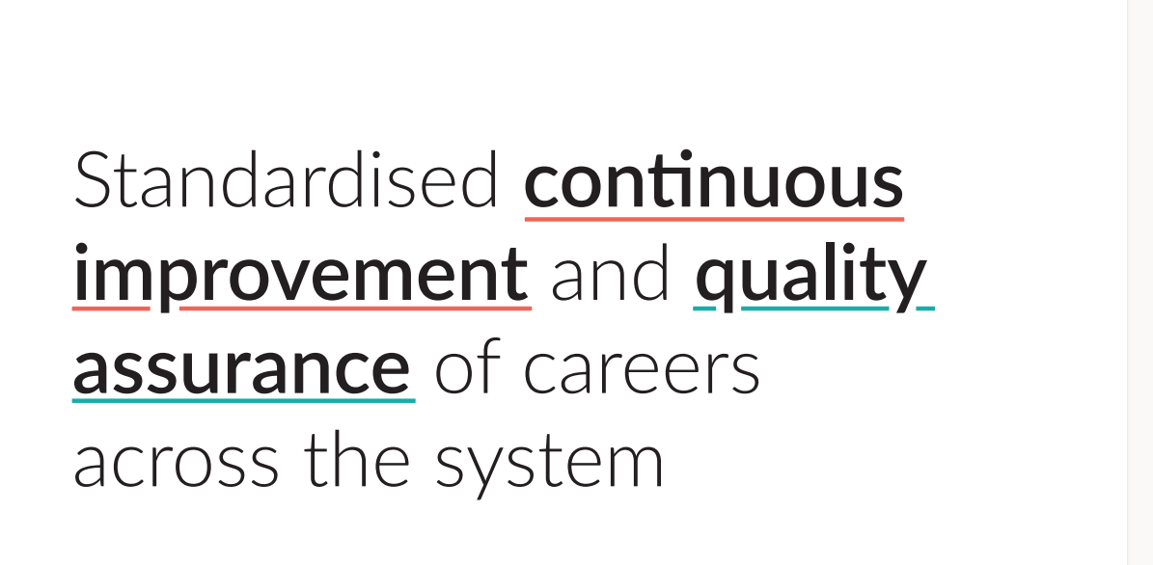
Notes:
This is the overarching ambition for the Careers Impact System.
Rooted in the Gatsby Benchmarks and other evidence about best practice in careers, the Careers Impact System aims to:
Provide assurance of quality of careers provision
Improve careers provision across the country
Elevate the status of Careers Leadership
Support leaders to feel confident in a quality careers education programme that is actually designed to support whole school improvement.

Slide 4
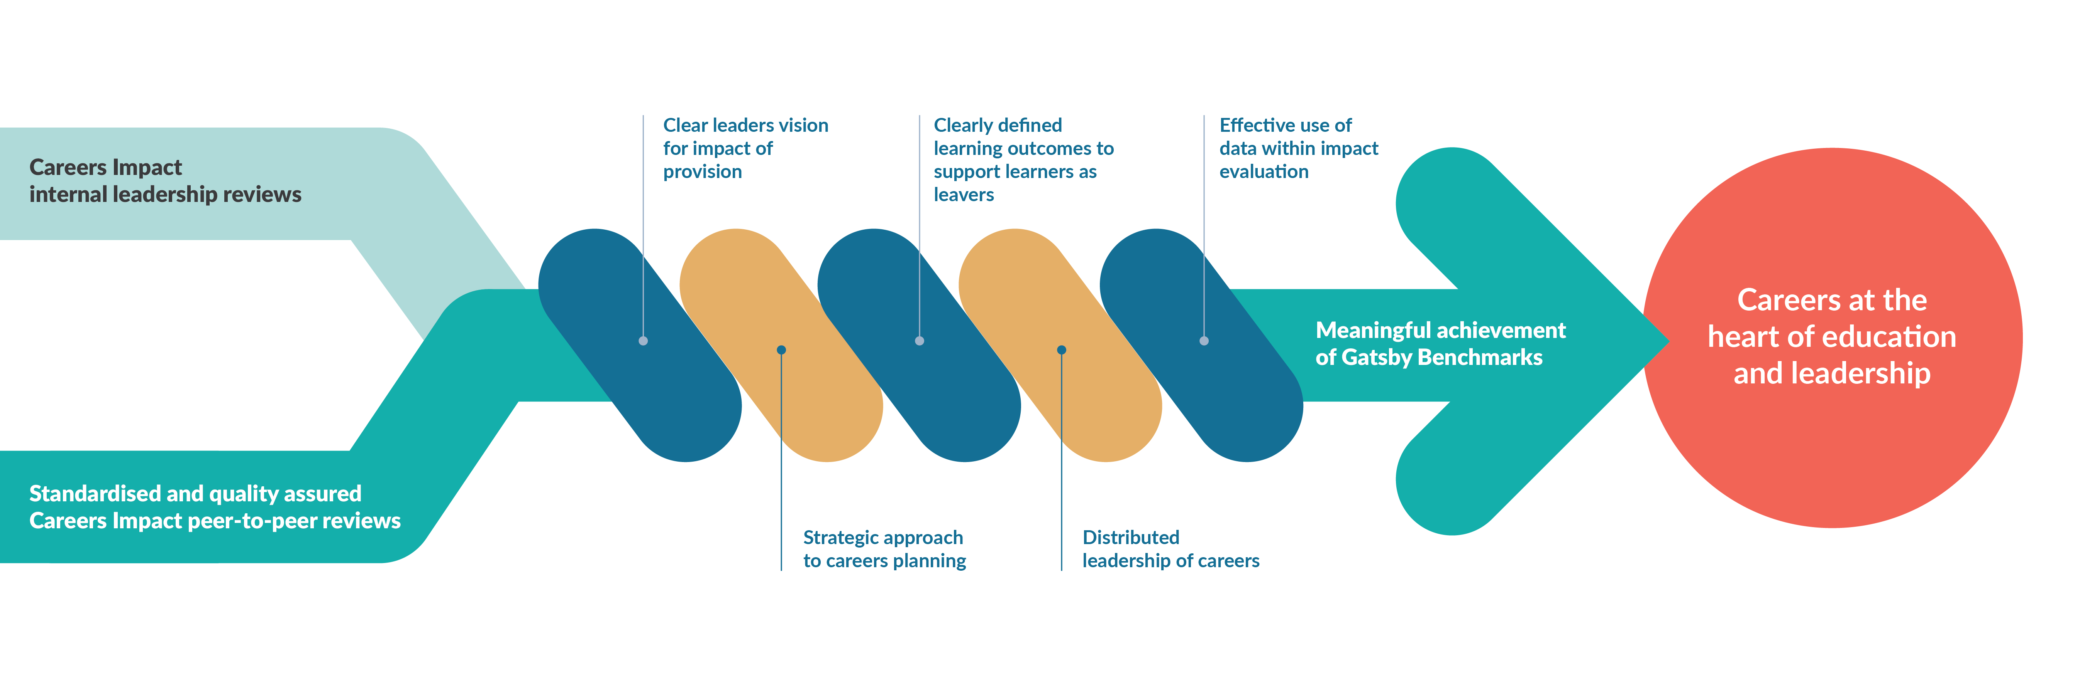
The Careers Impact Model
Notes:
The Careers Impact System is made up of two key parts, both of which I will outline today
Careers Impact internal leadership reviews and peer-to-peer reviews, both of which are based in the five conditions for success that were identified as the elements that need to be in place in order to ensure a sustainable and strategic approach to careers leadership and the meaningful achievement of the Gatsby Benchmarks.
The five conditions for success are embedded within the Careers Impact System and help leaders to focus time and effort in the places that will make the biggest difference.
These are ensuring a clear, well-articulated leaders' vision for the impact of the provision, a strategic approach to careers planning, aligning with wider school improvement priorities, clearly defined learning outcomes to support learners as leavers, a distributed approach to careers leadership and the effective use of data within impact evaluation.

Slide 5
“A different way of talking about careers and careers leadership: in the realm of overall improvement.”
“An opportunity to identify the actions that will create a more sustainable and embedded approach where leadership is distributed, and careers is considered to be everyone’s responsibility.”
“A strategic focus on the impact and outcomes of careers provision, when the temptation can be to focus on the operational inputs and activities.”
What does the Careers Impact System give us?
Notes:
The system overall provides us with a different way of talking about careers and careers leadership, specifically through the lens of wider school, special school and college improvement
The reviews within the system allow us all to reflect on practice and to identify actions that will create a more sustainable and strategic approach to careers leadership
The reviews give you a safe space to focus on the strategic leadership of careers and to step back from the to-do list to re-calibrate, focusing time and effort on the things that will make the biggest difference in your setting,

Slide 6

What is a Careers Impact internal leadership review?
Self-evaluation: Enabling institutions to reflect on their careers leadership maturity using the Careers Impact Maturity Model.
Strategic alignment: Helping centrally position careers as a driver for whole-institution improvement.
Collaborative insight: Encouraging input from key staff to reach those most in need.
Continuous improvement: Supporting progress toward meaningful Gatsby Benchmark achievement and whole institution improvement.
Foundation for peer review: Preparing institutions for deeper engagement through peer-to-peer reviews and strategic planning.
Notes:
Self-evaluation: Enabling institutions to reflect on their careers leadership maturity using the Careers Impact Maturity Model.
Strategic alignment: Helping centrally position careers as part of the solution - a driver for whole-institution improvement, rather than a standalone activity.
Collaborative insight: Encouraging input from key staff (e.g. Careers Leader, SLT, Pupil Premium lead, SENCo) to build a shared understanding of current practice, reach those most in need and develop a distributed approach to careers leadership.
Continuous improvement: Identifying strengths and surfacing areas for development, supporting progress toward meaningful Gatsby Benchmark achievement and whole institution improvement.
Foundation for peer review: Preparing institutions for deeper engagement through peer-to-peer reviews and strategic planning.

Slide 7
“We strongly recommend the use of the Careers Impact System which supports a quality assured, sustainable and strategic approach to careers leadership and establishes a shared and standardised language of quality improvement for careers, aligned to school and college improvement.”
Department for Education Statutory Guidance: Careers guidance and access for education and training providers May 2025
Notes:
It is recommended in Statutory Guidance, that institutions undertake a Careers Impact internal leadership review. This process involves key senior staff and will support you in understanding what embedded good practice looks like and how to recognise it.
Engagement with this process also enables you more confidently articulate the intent, design and impact of your careers provision whether for internal reflection, external validation, during an Ofsted inspection or within stakeholder engagement.
Through this process, leaders gain:
a clear understanding of strengths and areas for development within their careers provision.
evidence-based insights to inform inspection discussions and stakeholder engagement.
increased confidence across leadership and staff in articulating impact and strategic direction.
a demonstration of a culture of continuous improvement and strategic oversight.
strengthened collaboration across departments, fostering shared ownership of careers education.
development of robust impact measures aligned with institutional priorities.
the ability to monitor progress over time and adapt strategies responsively.

Slide 8
Confident articulation of impact across new
Ofsted Evaluation areas
Evaluation Area | Questions to consider
Leadership (and Governance) | How well do leaders understand learners’ needs, and how has this shaped the careers provision? Has careers provision been used to address key institutional challenges?
Curriculum | Is the curriculum designed to build knowledge and skills for future education, training, or employment? How does the strategic careers plan influence curriculum intent and planning? How is destination data used to shape curriculum decisions? Does the curriculum reflect local labour market needs?
Developing Teaching (and Training) | What support is available to help staff understand labour market information and transition pathways? How are staff supported to highlight the relevance of their subject to careers, pathways, & essential skills? How are staff supported to make links from the curriculum to careers, pathways, and essential skills?
Behaviour and Attitudes / Participation and Development | Does the strategic careers plan help build cultural capital, especially for disadvantaged learners and those with SEND? Does the strategic careers plan support positive attitudes to learning and improved engagement? Do employer and education encounters inspire learners and improve attendance?
Inclusion | How is data on vulnerable groups used to plan targeted careers provision? How do you ensure all learners including those absent or in alternative provision access careers provision? What evidence shows the impact of differentiated careers provision for vulnerable learners?
Notes:
The process of undertaking a Careers Leadership internal leadership review is not only recommended in Statutory Guidance, it also can help strengthen your confidence in effectively articulating how careers provision contributes to other Ofsted evaluation areas. You can see some examples of the types of reflective questions and conversations that will arise through the process of collective self-evaluation.
Senior leader participation in a Careers Impact internal leadership review or their strategic and responsive involvement in a peer-to-peer review, provides a strong indication of effective leadership. Participation not only supports informed decision-making but also demonstrates a commitment to inclusive, high-quality provision. The peer-to-peer review adds further rigour, and the resulting impact-evaluated strategic action planning can serve as potential evidence of ‘strong’ or even ‘exemplary’ practice under the new framework.

Slide 9
Strategic insight: Provides a clear, evidence-based view of how careers provision aligns with improvement priorities.
Informed decision-making: Supports data-led planning and resource allocation.
Improved leadership engagement: Encourages senior leaders to take an active role in shaping careers strategy, embedding it across the institution.
Enhanced accountability: Aligns with Ofsted expectations and national frameworks such as the Gatsby Benchmarks.
Sustainable improvement: Lays the foundation for long-term, strategic careers leadership with a strategic focus on impact, equity and consistency.
Benefits of undertaking an internal leadership review
Notes:
Here are a few of the benefits of undertaking a Careers Impact internal leadership review.
Strategic insight: Provides a clear, evidence-based view of how careers provision aligns with whole-school, special school, or college improvement priorities.
Informed decision-making: Supports data-led planning and resource allocation by identifying strengths, gaps, and opportunities for development, particularly to support those at most disadvantage.
Improved leadership engagement: Encourages senior leaders to take an active role in shaping careers strategy, embedding it across the institution, strengthening distributed leadership and cross-departmental collaboration.
Enhanced accountability: Aligns with Ofsted expectations and national frameworks (e.g. Gatsby Benchmarks), supporting inspection readiness.
Sustainable improvement: Lays the foundation for long-term, strategic careers leadership through the Maturity Model with a strategic focus on impact, equity and consistency.
The entire process is owned by you. It is completed internally and is for internal use to help you confidently prioritise for continuous improvement.
And there is good reason to get this right. There is well developed evidence linking good careers guidance to reduced levels of young people not in education, employment or training (NEET) at post-16 and post-18. Young people in schools and colleges with the highest quality careers provision are 8% less likely to become NEET. This reduction in NEET rates can reach 20% for the most disadvantaged schools.

Slide 10

Why undertake an internal leadership review?

Slide 11

  “Careers is the cornerstone of education, and the internal leadership review showed us how much we haven’t thought about yet.
  The maturity model takes a lot of that thinking work away – it enables us to work out where we are and what we need to do next because it’s written down for us – so we can focus on strategy and implementation.”
  Senior Leader (2024)
  Following involvement in an internal leadership review

Slide 12
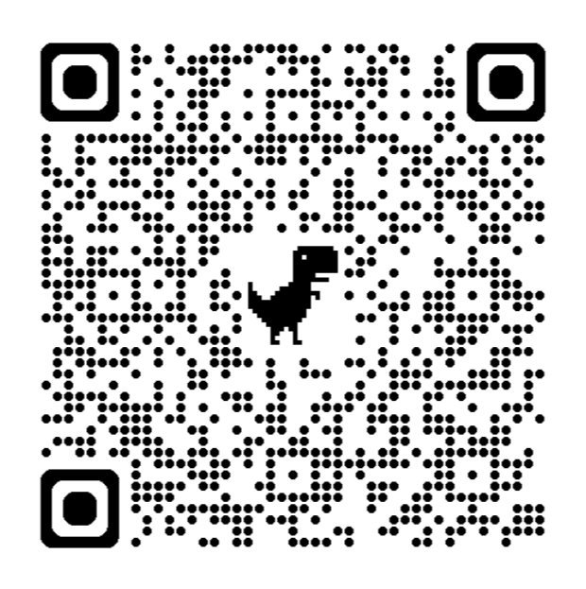
Things to notice:
The model is split into six themes
Each theme is broken down into multiple components
The description of quality within each component improves from left to right – on a continuum of increasing maturity
How the language of the BMs is embedded
Where existing systems, structures and processes might feature
Careers Impact
Maturity Model
Increasing maturity
Notes:
The ~NEW Maturity Model now available in Compass& Compass+ within the guidance and help centre articles
For those of you who have previously leaned into pilot and early roll out, you will notice differences in the maturity models
The model is split into 6 themes still, yet we have front loaded Themes 1 & with the key conditions for success that ensure strategic and sustainable careers leadership
There is also an additional line in both models about quality assurance
The model itself maintains the same dynamic of the description of quality and growth in maturity of strategic and sustainable maturity increasing from left to right. The BMs are still core to the models and allow us to really get under the skin of what good looks like for these world class standards
Remember, this is a journey and the more we use the model the more naturally this language will be used within improvement planning .
Maturity Model for Schools and Special Schools
Maturity Model for FE

Slide 13
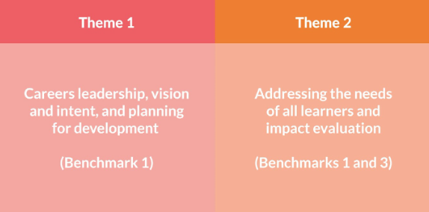
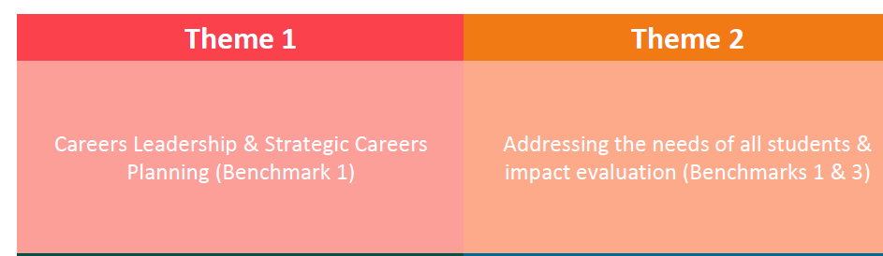
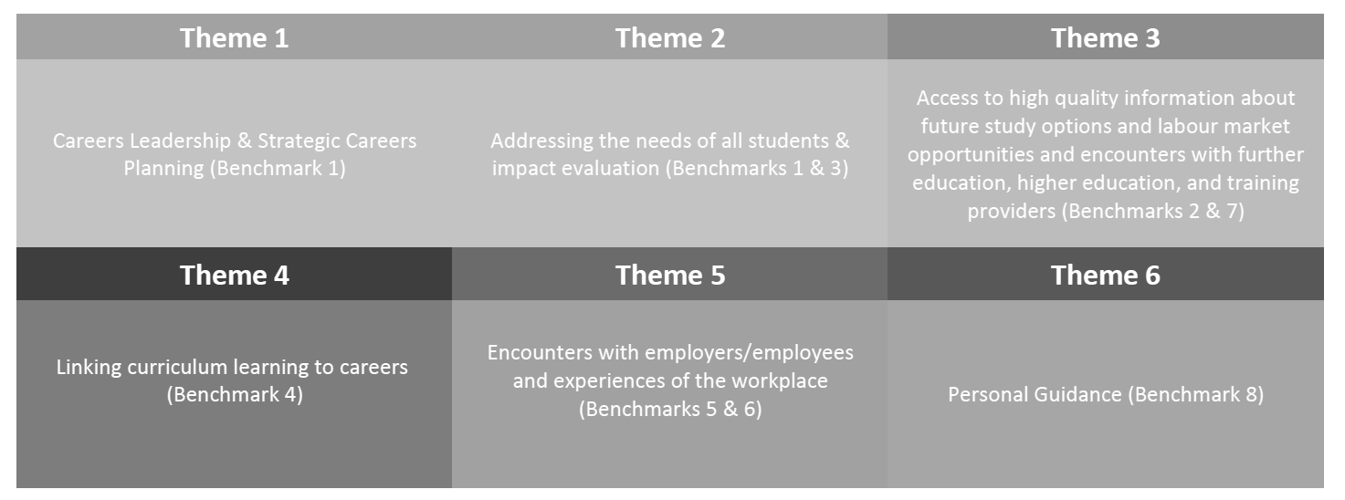
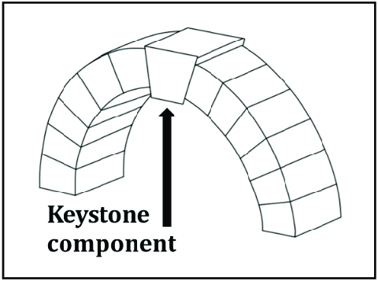
Themes 1 & 2 act as keystone themes
*keystone = the central part of a system, on which all else depends
Notes:
UPDATED

Slide 14
Challenges
Conditions for Success
A sustainable and strategic approach to careers leadership
Notes:
Consider this slide and which challenges present barriers to schools, special schools and colleges in your network
Take a moment to visualize or note down the underlying challenges or how they manifest
Start also to consider the practice that you have seen in your schools, special schools and colleges that overcome these challenges and what allows for a strategic and sustainable approach to careers leadership
You can reflect on this yourselves or do also use the chat
2mins

Slide 15
Challenges
Conditions for Success
A sustainable and strategic approach to careers leadership
Turnover of staff
Leaders' Vision
G|
Changing cohort needs/contexts
Strategic Careers Planning
Insufficient prioritisation
Distributed Leadership
Absence of mechanism for effective
impact evaluation
Student Career Learning Journeys
Lack of strategic approach
Impact Evaluation
Notes:
CL time, churn of CLs,, increases in persistent absence and other competing priorities may often feel like barriers and this is how challenge manifests and presents on the surface
All of these are manifestations of careers not being embedded in wider school, special school or college improvement
They can all be mitigated or overcome by what we describe as conditions for success

Slide 16
1
2
Represents indicators of intentional provision with conscious decision making, moving towards a more strategic and progressive provision that has elements of continuous improvement
3
Starts to move into a whole school, special school or college approach that is more responsive to data and cohort needs… leading to stability and sustainability of provision
4
Is where careers is a golden thread to school, special school and college improvement...where careers is hardwired as part of the solution to the key strategic priorities of the institution
Generally represents indicators of a standalone provision with ad hoc activity that may of course bring value yet potentially more from happenstance than design
Language of the columns – what do we notice?
Notes:
Back to the model!
As the descriptors progress from left to right, we can see increasing indicators of maturity.
We may experience movement along the continuum in both directions. That is to be expected. The key here, is to ask ourselves the question, how do we mitigate against that and/or, what can we do or put in place to respond when the inevitable happens?
In this model lies the answer to the challenges that present barriers to strategic and sustainable careers leadership

Slide 17
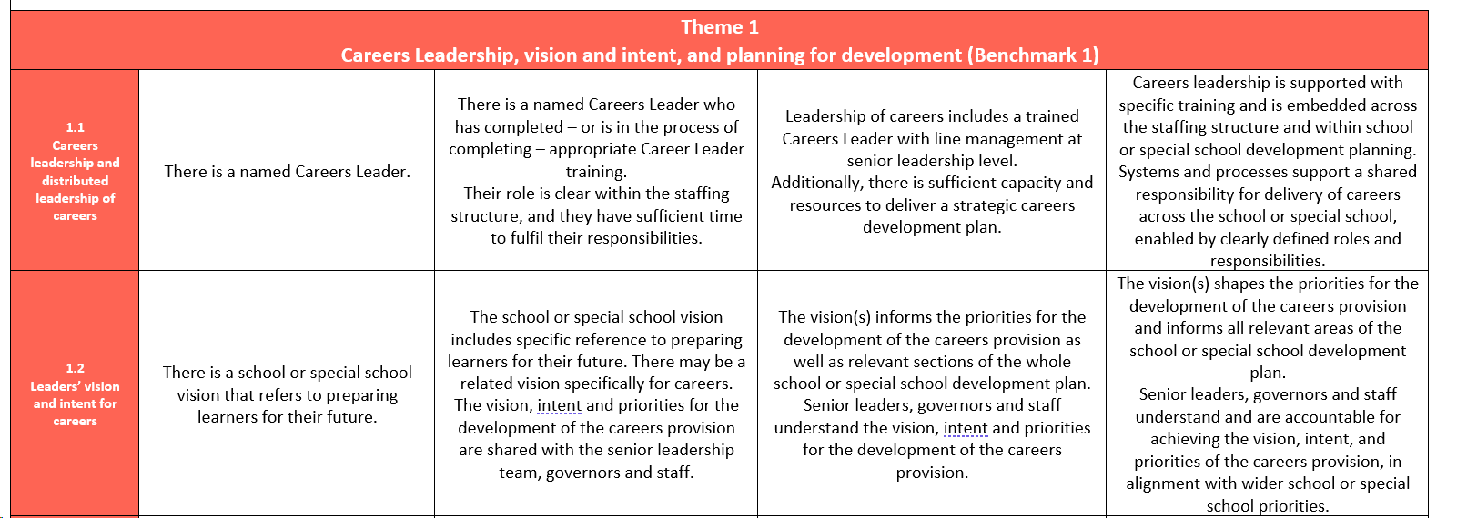
Notes:
This is an excerpt from the maturity model Theme 1 and reflects some of those factors and conditions for success
Straight away you can see the description of practice and articulation of what good looks like and straight away I bet you are already plotting some of your caseload on this…this is how the internal leadership review came into being ☺
This process of reflection has always been step 1 of a p2p review – within that process it was referred to as self-evaluation part B, which is not a very catchy title and is also a mis-representation about the process.
Before a p2p review schools, special schools and colleges were asked to RAG rate themselves on this document with key SLT colleagues and with sign off from the Head
We found that this stage of the process really started the process of continuous improvement and started to spark lightbulb moment before the review had even happened – this is what prompted u to look more closely at this first step of a P2P review and to test it as a review in its own right for that is exactly what it is!
When we started to reflect on how institutions had approach the internal leadership review we noticed that there was a real difference in the maturity of different approaches and that this was okay! I will move non to some of the detail from theguidance that accompanies the internal leadership reviews in a moment and you could almost plot them in the columns of the maturity model!

Slide 18




Value of the Careers Impact internal leadership reviews
Schools, Special Schools and Colleges
Improved understanding of best practice in careers leadership and of the Gatsby Benchmarks
Recognition of strengths in careers leadership and careers provision
Greater SLT engagement in and understanding of careers leadership
Motivation and actions to develop careers leadership and careers provision
Notes:
This is the value to YOU and to your school, special school or college of engaging in a Careers Impact peer-to-peer review
The process is designed to improve understanding of best practice ni careers lederhip and to really get under the skin of the gstsby Benchmarks
The review system is underpinned by a matutiyy model, which unpacks careers leadership and articulates a journey of careers lederhip tto how careers leadership v

Slide 19
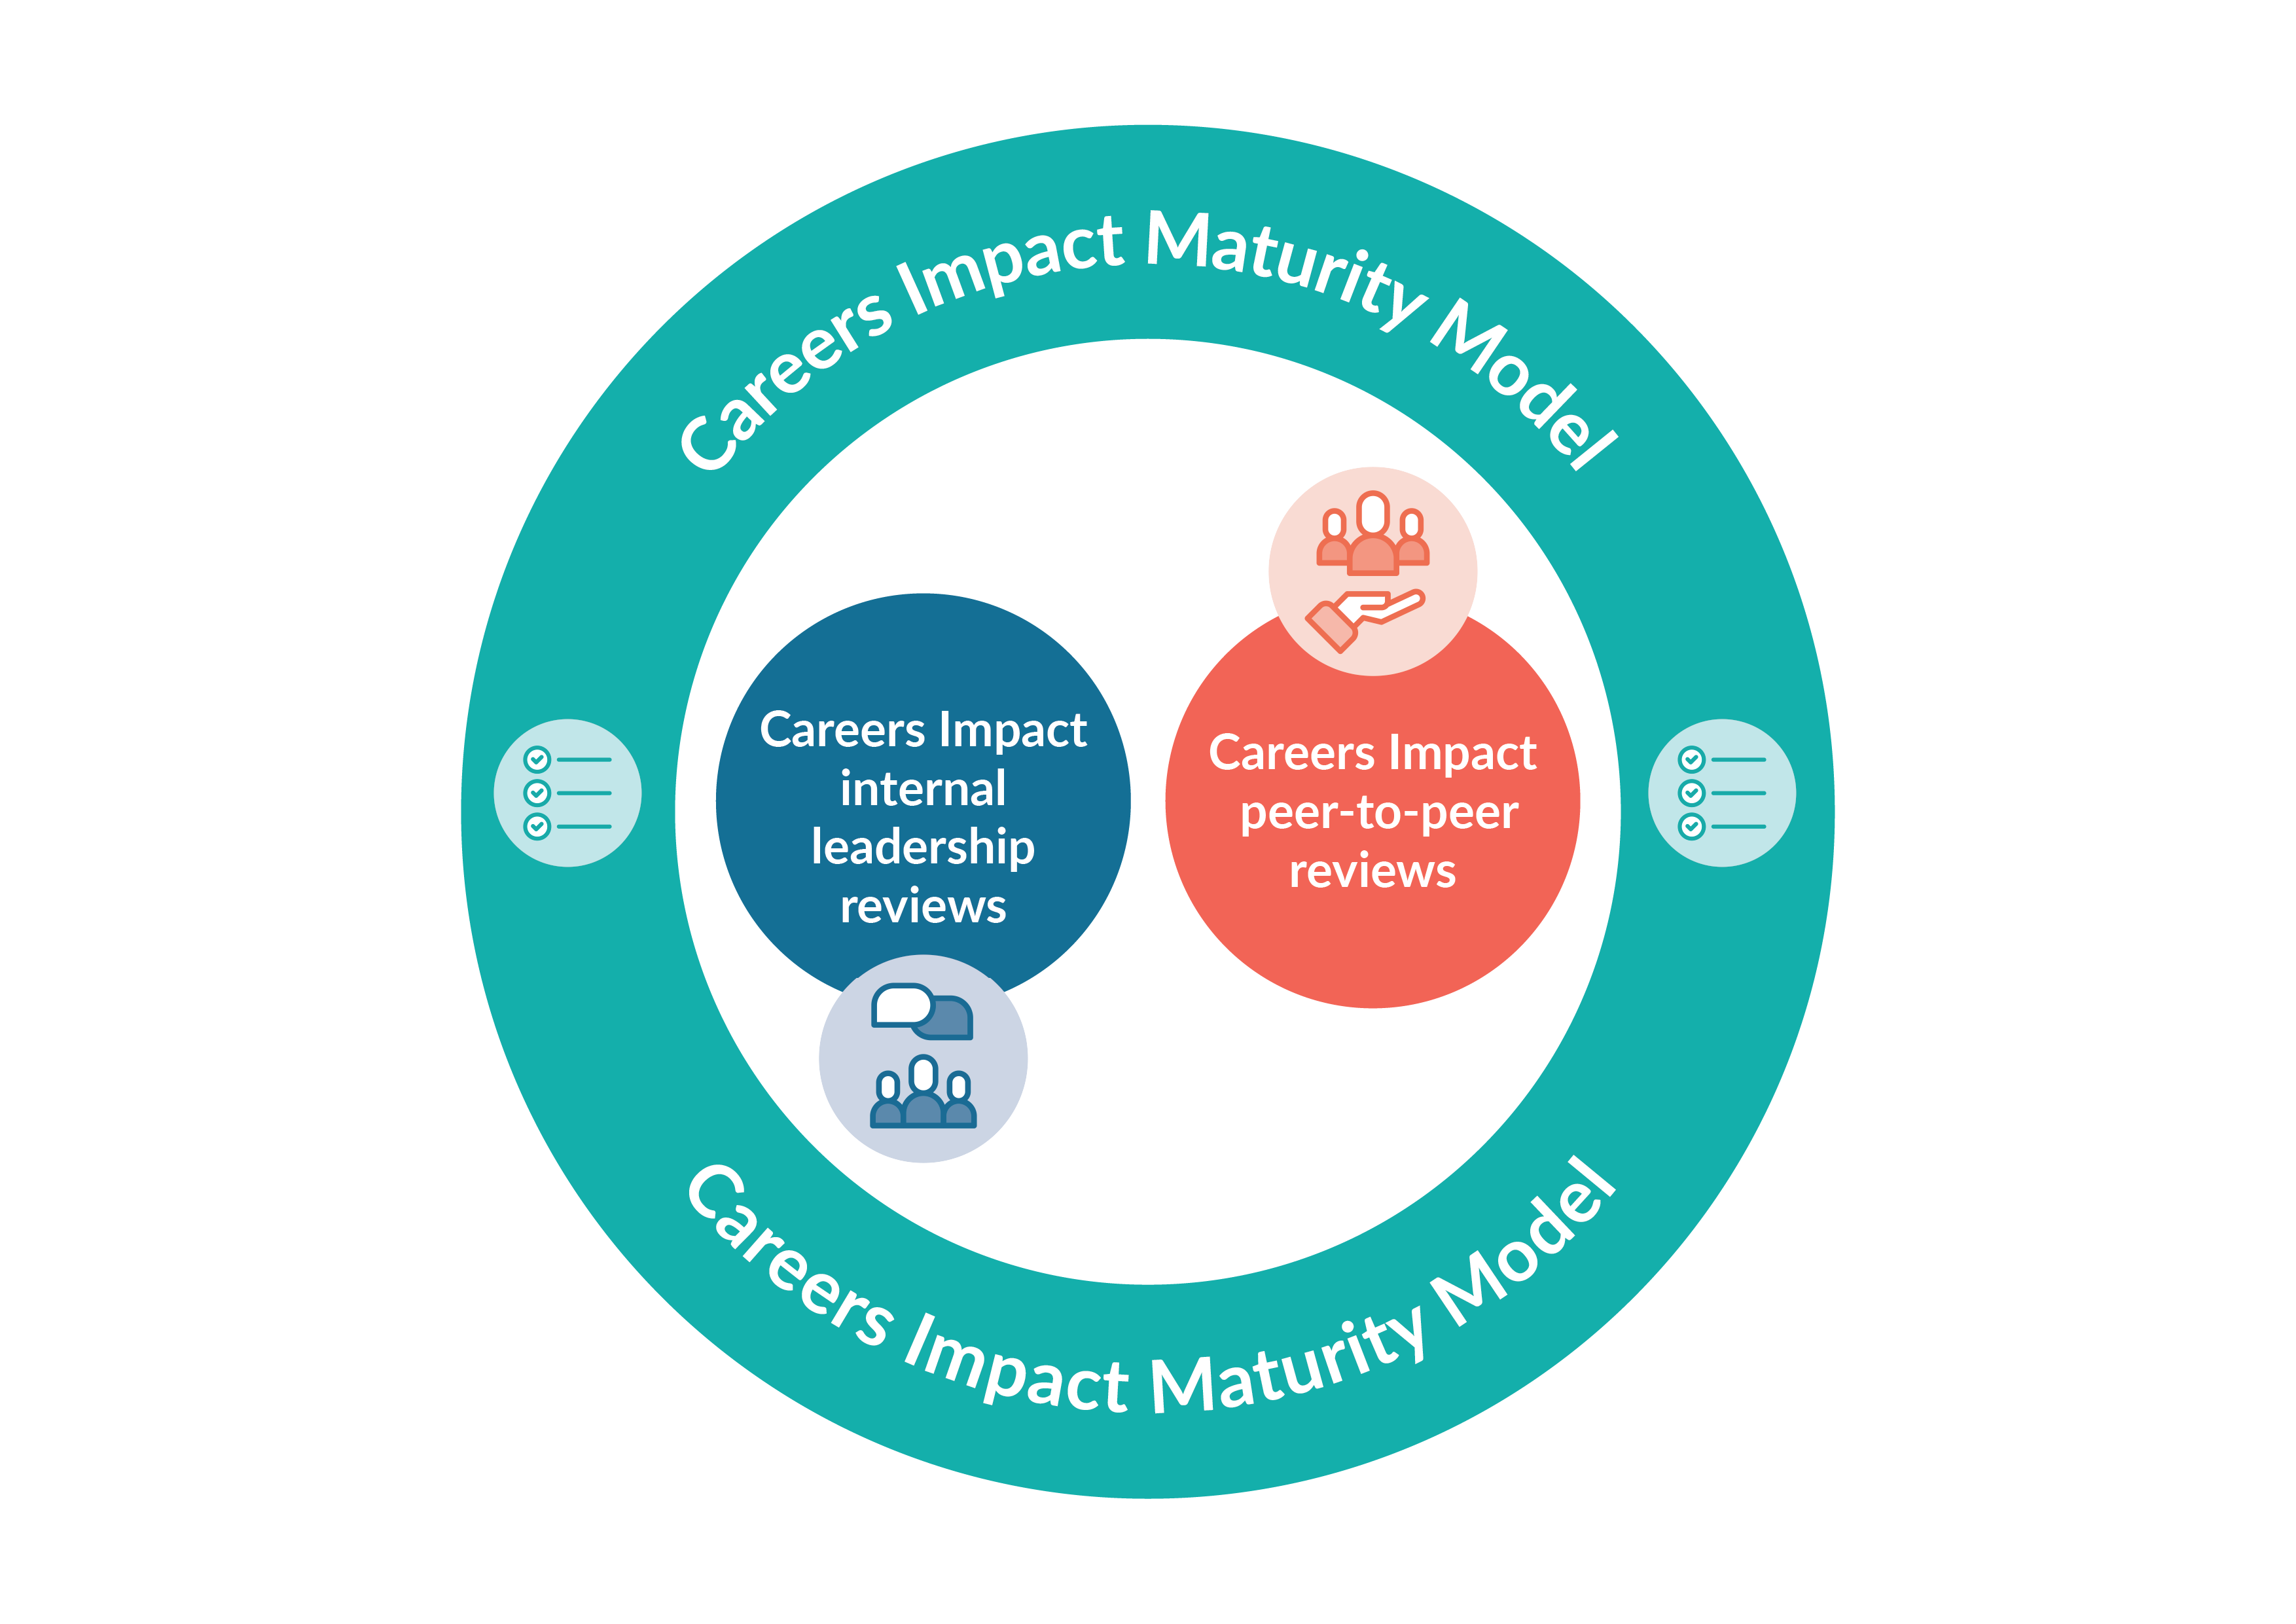
Internal leadership reviews
Convene
All those involved in the distributed leadership of careers should be involved in the review process
Agree
The review involves colleagues reflecting on which statements in the Maturity Model best describe the practice their institution
Record
The digital feature allows institutions to record the responses collaboratively agreed during an institution’s internal review. Colleagues will have access to a summary of institution's insights, showing a snapshot of indicated areas of strength and priority action areas
Act
Institution identification of highest leverage actions to drive school, special school or college improvement and to support improved student outcomes
Careers Impact
Self-evaluation tool
Notes:
They are deliberately named: these are internal to the institution AND they are to engage all those involved in distributed leadership of careers, including education leaders
Ambition that every school, special school and college undertakes a careers impact internal leadership review annually within their impact evaluation process
The key steps to a review are highlighted on this slide
All those involved in distributed leadership of careers within an institution should convene in the review process
Those convened then consider the maturity model and agree the best ft statements on each line that describes practice in their institutions
We then encourage colleagues to return to the digital tool to record their responses – crucial that this lands as an offline review/discussion process where responses are recorded online through compass/Compass+
The digital functionality allows institutions to see data visualisations of their strengths and areas for focus and recommendations for improvement
The data that institutions see will inform next steps and action planning
The engagement collateral folder will include an overview doc of internal leadership review value, purpose and process. There is also an animation in train that should be ready for September

Slide 20
  "As a senior leader with many 'different hats' it is easy to end up focusing on the operational / logistical side of careers
  i.e. making sure events are happening like drop-down days or ensuring the careers advisor system is working effectively etc.
  The Career Impact internal leadership review helped create space/time to focus and reflect on the strategic side of careers and very importantly, to look at ways to improve and build our provision and impact on our students."
  Senior Education Leader, (October 2024)
  Careers Impact internal leadership review

Slide 21

Who should take part in an internal leadership review?
All those involved in the distributed leadership of careers should be involved in the review process​
Notes:
The naming of the review is intentional – it is internal to the institutions and should be lead internally. This is critical – there is not the expectation that you or colleagues from the hub lead this review. That commitment and capacity is for your approach to the P2P – that is where our value can be added
This is about the institution themselves kickstarting a deep reflection on the maturity of the careers leadership
The review should and could involve an array of colleagues from with a school, special school or college – it is at your discretion if you offer your own views within the internal review.
The role of Eas is also a very interesting one – an EA who is strategic may be the one to bring this to SLT, or a Careers Link Governor may suggest the review and play a key role?
Those involved may include: Link Governor, Enterprise Adviser, SENCo/Head of SEND/Head of Inclusion, Central Strategic Careers Leader, Wider SLT colleagues, Vice Principal/Assistant Principal, PSHE Lead, Student Support/Student Services, Careers Adviser, Head(s) of Year, Head(s) of Department, etc
The Careers Leader and HT should be involved as a pre-requisite

Slide 22
The review involves colleagues reflecting on which statements in the Maturity Model best describe the practice their institution. ​
They should consider the statements and the responses which indicate progressive maturity within each of the six themes. ​
Colleagues should do this ahead of coming together to discuss and agree a final response for each statement that represents their institution. ​
What does an internal leadership review involve?
Notes:
As I referenced earlier – the whole process is underpinned by the maturity model and includes colleagues reflecting on each row to decide their best fit
Consider for a moment how you imagine colleagues would convene to do to agree the best fit responses?

Slide 23
Approaches to completing an internal leadership review
1. HT Confirmation of CL View
3. Governor Collaboration
“As the Careers Leader, I completed the process and then met with the Headteacher to discuss this.
Where there was a difference of opinion, I was able to explain my judgement and we discussed and were then able to agree on the ‘best-fit’ response.”
“A core group of us met together (Careers Leader, Trust Central Strategic Careers Leader, Careers Link Governor) and we agreed the ‘best-fit’ statements through discussion and debate, with elements requiring us to refer to evidence to justify our decisions with each other. These were then signed off by the headteacher.”
2. SLT Collaboration
4. Collaboration and SLT Confirmation
“We initially completed the self-evaluation process as a team of two (CL and SLT CL).
We then discussed with the wider Senior Leadership team which has helped to raise the profile of careers and gain further buy-in from the Headteacher and SLT.”
“We took a 3-stage approach to complete and QA the process”
Review by Careers Team (CL and SLT CL)
Feedback on our responses from wider SLT, including SENCo
Final agreement by Headteacher and SLT Careers Leader of best-fit responses
Notes:
How do these match with the ideas that you had in your head?
What do you notice and what reflections do you have?
You will notice that this activity is offline ☺

Slide 24
The digital feature allows colleagues to record the responses collaboratively agreed during the institution's internal leadership review. ​
There is will instant access to a summary of the institution's insights, including a graphic showing a snapshot of the institution’s indicated areas of strengths and priority action areas​
These can be shared
The digital feature also signposts to support and resources for each theme area to drive continuous improvement​
Recording your responses
Notes:
This makes the digital feature unique amongst our suite of tools as the main action is conducted online
Colleagues go online to access the guidance and download the maturity model and then convene with colleagues to agree their best fit
The usp of returning to record responses are the data visualisations and the signposting – which is primarily to the CL and wider workforce CPD offer

Slide 25

Careers Impact internal leadership review

Slide 26

Demo:
internal leadership review
Notes:
To record your responses:
Where to locate in Evaluation
Main screen navigation
Where to go for pre-support and download grid
Where to go to get started (once grid agreed)
Remind all that this is the toll to RECORD the review after you have agreed the components
How to record (identify similarity with compass evaluation completion format and indicators of progress)
You can stop and return at any stage (show this in demo front screen)
Once completed – summary of insights for themes 1 and 2 (they contain the 5 key factors for success) and therefore will have the greatest impact once identified as areas of focus
Can view all responses (grid format) and share if wish
Can view key insights
Colour coded – orange less mature; green towards greater maturity
Can identify areas of strength and celebrate
Identify areas of development
Demonstrate recommendations (points to resources etc)
Demonstrate comparing progress (although it will be some time before they can actually do this)

Slide 27
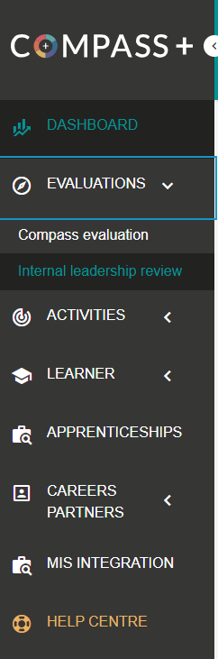
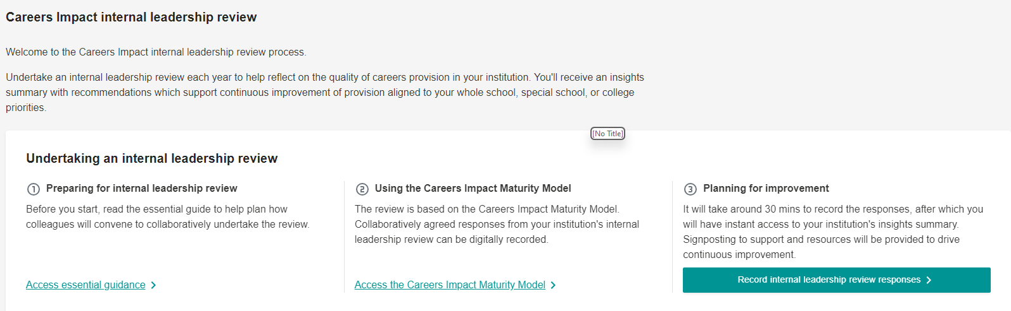
How to record your internal leadership review
In evaluations, go to internal leadership review, click
You will require @30 minutes to record your responses
You will be prompted to record who took part in your internal leadership review
Notes:
The RECORD stage is facilitated by a new feature in Compass and Compass+ available to all from September 24.
You should have already convened as a group and agreed the responses. You have most likely downloaded the digital version from Compass+ to complete by hand. However, having a digital version means you can see progress year on year. Within the tool are also recommendations for action, highlighting areas to focus upon.
In addition, the Help Centre articles support users through every step of the process, including providing examples of how pilot institutions effectively carried out the CONVENE/AGREE stage, and how to get the most out of the new digital functionality.

Slide 28
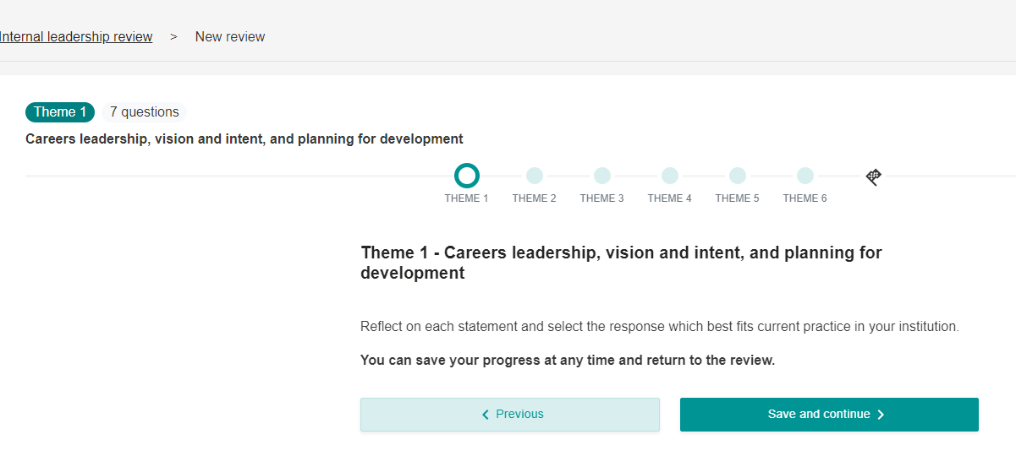
How to record your internal leadership review
Each theme will take you through a series of questions and you can track progress.
You can save and continue, or close and return to the document later.
Copy the results from your paper version
Any in progress or completed reviews will appear on your leadership review dashboard
Notes:
The RECORD stage is facilitated by a new feature in Compass and Compass+ available to all from September 24.
You should have already convened as a group and agreed the responses. You have most likely downloaded the digital version form Compass+ to complete by hand. However, having a digital version means you can see progress year on year. Within the tool are also recommendations for action, highlighting areas to focus upon.
In addition, the Help Centre articles support users through every step of the process, including providing examples of how pilot institutions effectively carried out the CONVENE/AGREE stage, and how to get the most out of the new digital functionality.

Slide 29
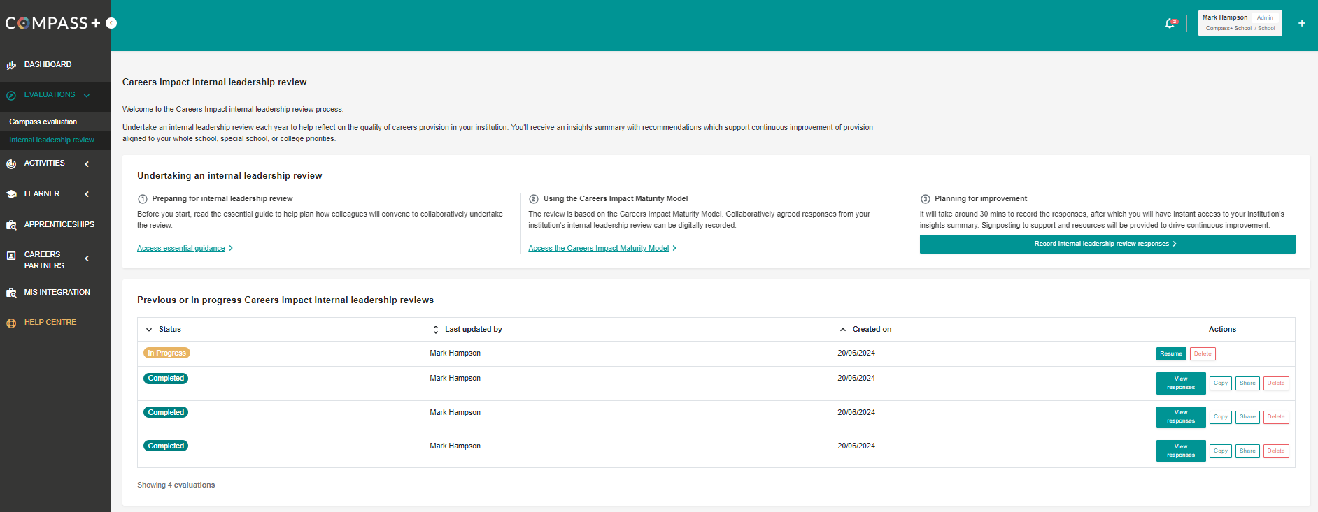
How to record your internal leadership review
Notes:
You can see a screenshot here of what your leadership review dashboard will look like once a few reviews are completed. This will take Careers leaders a couple of years to get to this stage of multiple reviews.
There is the option in tool to compare progress from one to the next which I’ll show you

Slide 30
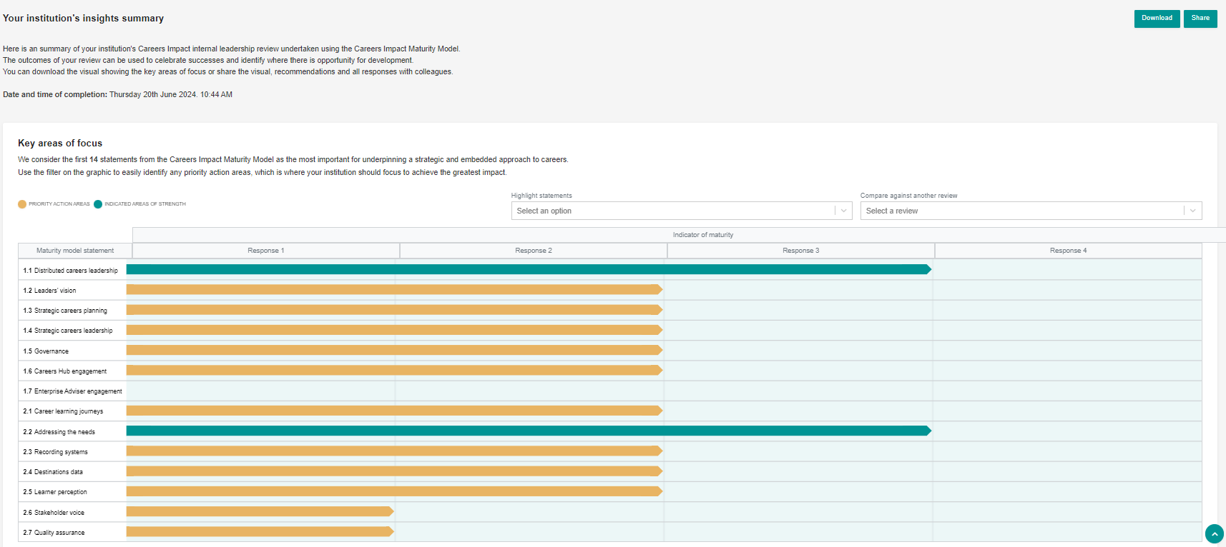
How to record your internal leadership review
Notes:
Once completed you can view your responses to themes 1 and 2.
You can download them into a single pdf or share via email with key stakeholders.

Slide 31
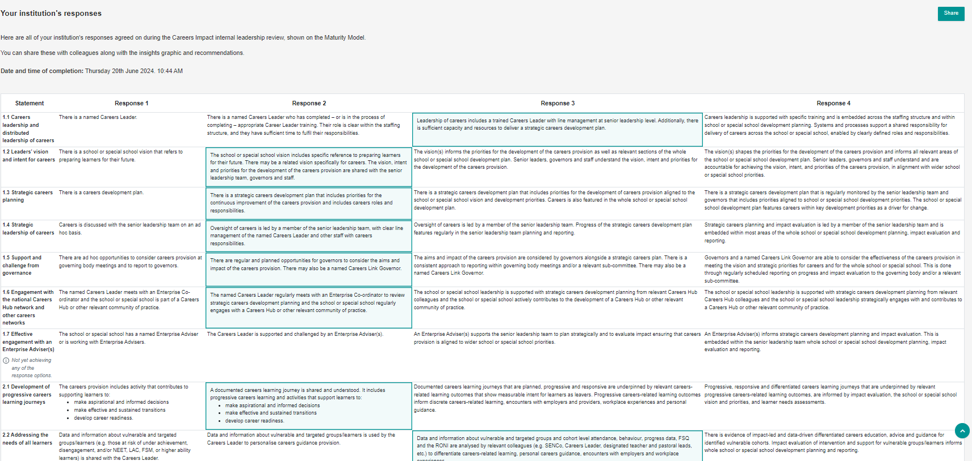
How to record your internal leadership review
Notes:
You can view all responses and share this as you wish

Slide 32
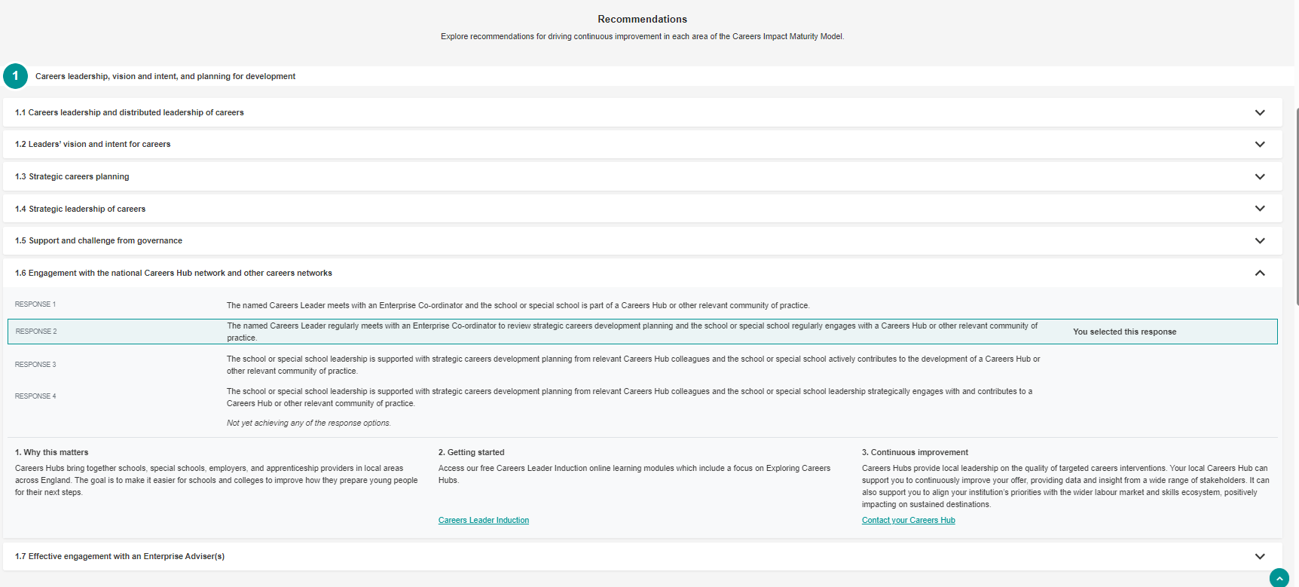
How to record your internal leadership review
Notes:
You can view recommendations too be selecting any statement

Slide 33
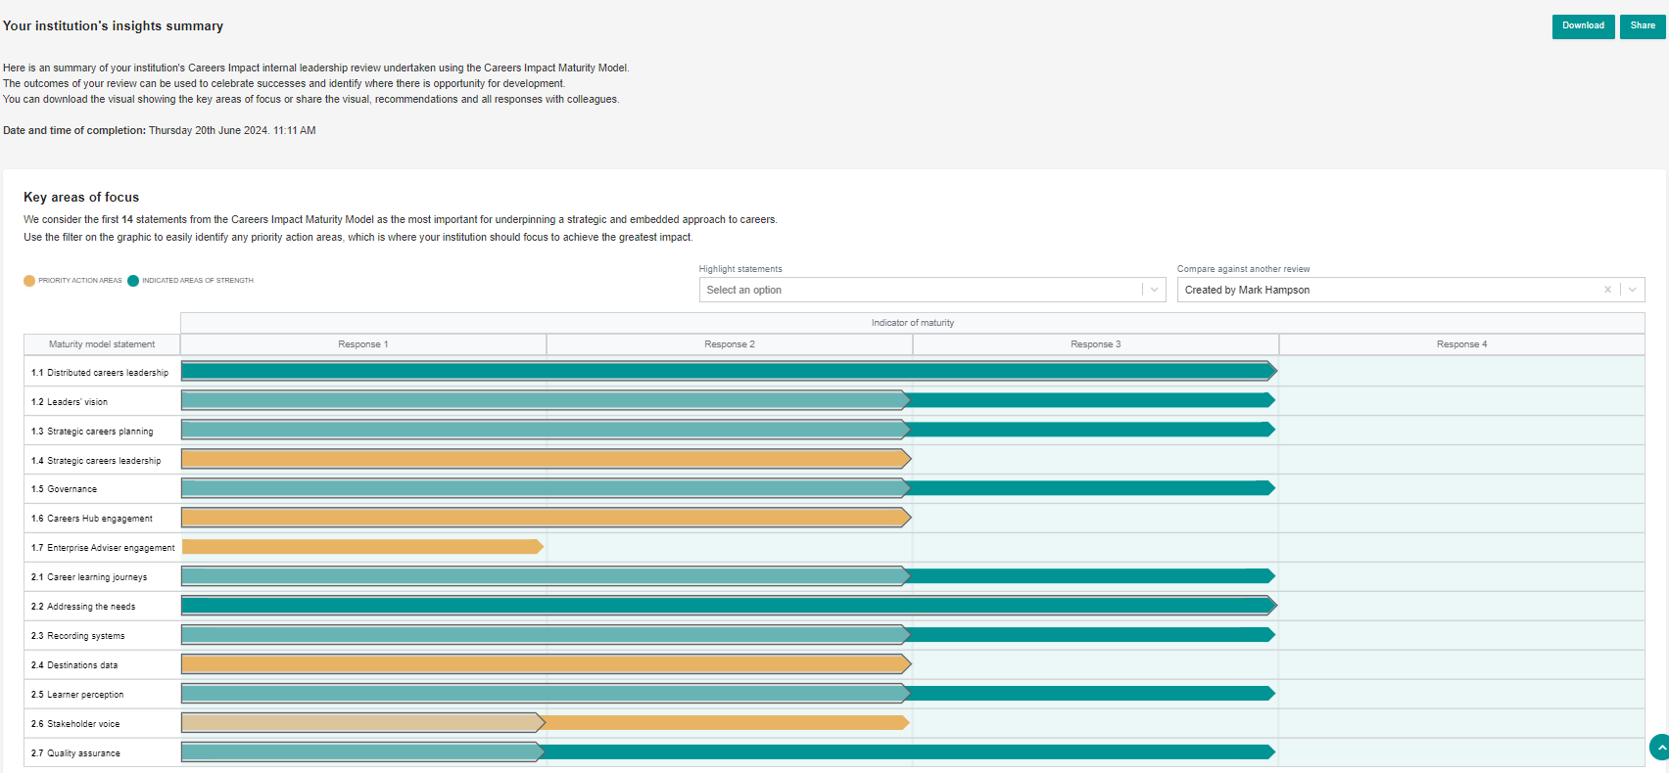
How to record your internal leadership review
Notes:
Once you have completed two or more internal leadership reviews (usually only completed at least annually) you can compare progress made. This is helpful to share with SLT/Governors and use to report success.

Slide 34
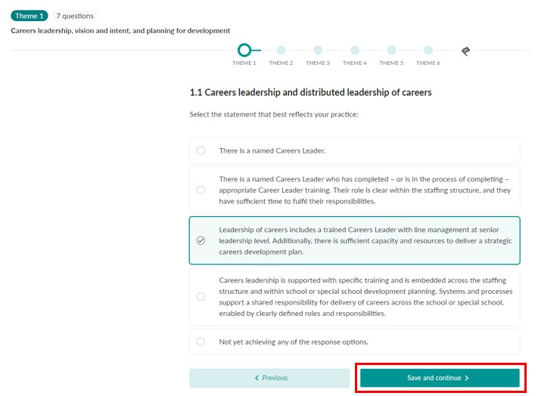
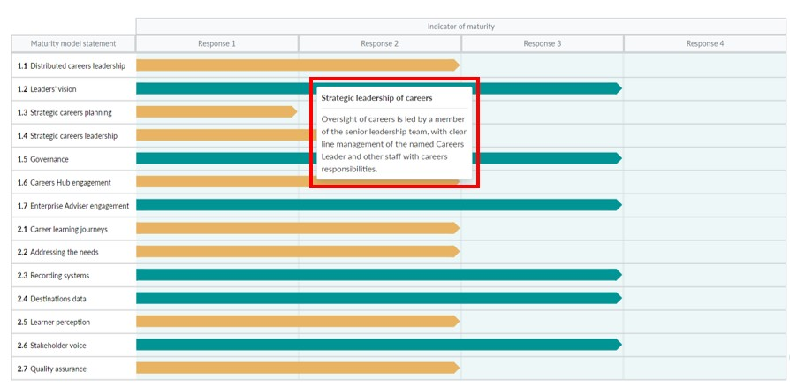
Internal leadership reviews:
Recording responses and gaining insight via Compass & Compass+ (from Sept 24)
Support from Help Centre articles on how to prepare for an internal leadership review, how to complete the process using the digital feature and how to find your institution’s responses and recommended actions.
Compass+ Help Centre
Compass Help Centre (by institution type)
Notes:
The RECORD stage is facilitated by a new feature in Compass and Compass+ available to all from September 24.
Digital version of the maturity model so once an institution has CONVENED and AGREED, a representative is ready to use the feature to record their responses so they have central record and can see progress year on year. It also sets them up for the final stage, ACT, by providing them with recommended actions, highlighting areas to focus on. Key recommended actions include CLT training, and other modules on the Digital Hub for educators, plus content such as My Learning, My Future and Talking Futures.
The Help Centre articles support users through every step of the process, including providing examples of how pilot institutions effectively carried out the CONVENE/AGREE stage, and how to get the most out of the new digital functionality.

Slide 35
Visit our Resource Directory to get started with the Careers Impact internal leadership review
Notes:
This is the main page for internal leadership reviews via resource directory – there are also a plethora of guidance and help centre articles to support colleagues in the process
Your schools can get started on this today
Find out more: Careers Impact Internal Leadership Review | CEC Resource Directory (careersandenterprise.co.uk)
Following this session, you will receive a copy of these slides, a link to an animation, an engagement deckyou can deliver to your CLs and pdf of an overview briefing about the reviews that you can share vai email with Careers and Education Leaders

Slide 36
Without strategic reflection,
careers provision risks remaining fragmented, reactive, and disconnected from wider improvement efforts,
ultimately limiting its impact on learners.
Notes:
Not engaging risks careers provision that is not providing for our learners, particularly impacting those who are at disadvantage. Without reflection and continuous improvement driven by school, special school and college leaders, careers provision risks remaining fragmented, reactive, and disconnected from wider improvement efforts, ultimately limiting its impact on learner outcomes.

Slide 37
Q&A

