Slide 1

Teacher Encounters
Enhancing Teaching through Employer Engagement
Supporting schools to build future-ready learners

Slide 2

What is a Teacher Encounter?
A Teacher Encounter is a CPD opportunity for teachers to spend time with an employer, learning how their subject applies in the real world and the skills their students need to thrive.

Slide 3

Why do they matter?
Strengthen teaching by showing how subject knowledge applies in real workplaces.
Embed easily into existing education CPD frameworks, with minimal additional costs or workload.
Make learning more meaningful by linking classroom content to real careers.
Help meet Ofsted expectations and deliver Gatsby Benchmarks, specifically Benchmark 4.
Boost teacher motivation and pride by connecting teaching to future impact.

Slide 4

Are there specific benefits for MATs?
Supports trust-wide curriculum development and consistency
Enables cost-effective, high-impact CPD through shared INSET days
Builds employer partnerships that benefit multiple schools
Involves support staff in careers education, strengthening whole-trust impact

Slide 5
How do they align to Ofsted and Government priorities? ​

Slide 6
Policy and Ofsted alignment
Government are reinforcing the need for modern work experience and real-world readiness for all learners.
The updated Gatsby Benchmarks highlight the importance of every young person, regardless of background, being able to develop the knowledge and skills they need for life.
Subject teachers should be able to highlight the progression routes for their subject and the relevance of the knowledge and skills for a wide range of future career paths.
Careers should form part of the institution’s ongoing staff development programme for teachers, subject staff and all staff who support learners.
Teacher Encounters support the strategic direction of a school’s careers plan, aligning with whole-school improvement priorities and helping senior leaders embed careers into institutional vision.
Schools are increasingly expected to build and sustain partnerships with employers. Teacher Encounters can support this by connecting educators with industry.
Teacher Encounters can help teachers better understand the full range of post-18 options, including technical and vocational, not just more traditional further education options.

Slide 7




Career readiness is an emerging priority
45% of employers rank work readiness as more important than qualifications (CBI).​
Career readiness is declining, especially among disadvantaged learners, but delivering the Gatsby Benchmarks is proven to improve readiness and drive better outcomes.
Teacher Encounters help schools fulfil their role in ensuring learners are not just academically ready, but pathway-aware and employment-ready to make aspirational and informed decisions, effective and sustained transitions and develop their career readiness

Slide 8
There are lots of benefits across school life…

Slide 9



Benefits... for teachers
Enriches lessons with up-to-date industry insight​
Builds confidence to discuss a wider range of career pathways
Strengthens teachers as career influencers, beyond academic routes​
Supports ongoing CPD by embedding careers into staff development, in line with statutory guidance.

Slide 10

Benefits... for teachers
Enables access to up-to-date labour market insights, helping teachers support informed career conversations.
Teacher Encounters bridge a training gap, with 88% of teachers reporting their initial teacher education didn’t prepare them to deliver careers information and guidance
Promotes cross department collaboration and shared learning​

Slide 11
Benefits... for schools
Strengthens curriculum through real-world relevance​
Supports teacher retention, motivation and well being with meaningful CPD​
Helps students access various forms of informed careers guidance and labour market information, securing positive student destinations
Builds whole-school confidence in careers conversations

Slide 12
Benefits... for learners
Better understanding of careers and pathways​
Higher aspiration, motivation and attainment - reducing risk of becoming NEET
More engaging, relevant classroom learning​
Makes learning more relevant by showing how subject knowledge links to real careers — every subject, every year.

Slide 13

Barriers to Teacher Encounters and how to address them.

Slide 14

Time and cost restraints
We know this is one of the biggest challenges, but…
Teacher Encounters are designed to slot into existing CPD structures and contribute to multiple school priorities at once.
Your local Careers Hubs are here to support you.

Slide 15

Competing priorities? Why should Teacher Encounters move up the priority list?
​
Supports school improvement goals by enhancing curriculum and teacher effectiveness.
Contributes to attainment, destinations, and overall learner outcomes.
Embeds employer voice in curriculum design.
Boosts teacher motivation, wellbeing, and professional satisfaction by connecting their classroom practice to real world impact, reinforcing the value and purpose of their role.

Slide 16
We’ve tested and evaluated Teacher Encounters

Slide 17
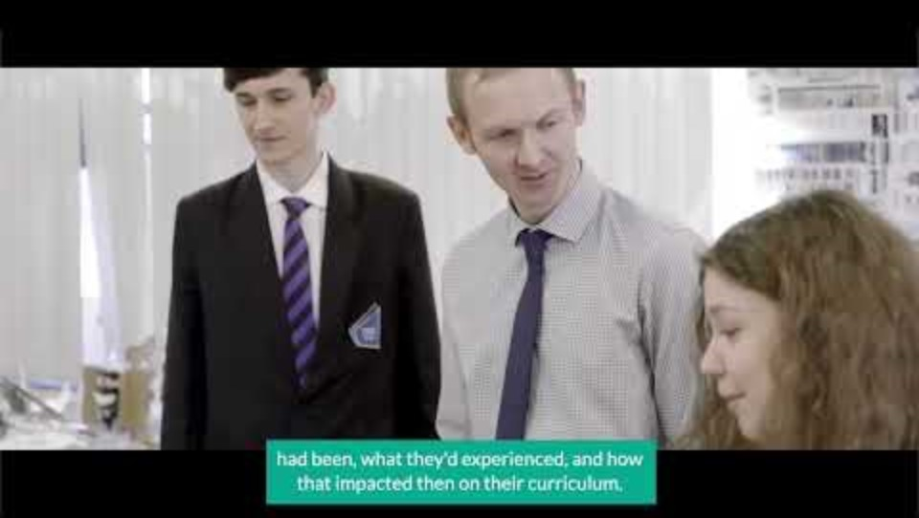

Slide 18
Our Evaluation Report concluded that Teacher Encounters within a MAT:
Drive trust-wide curriculum consistency Embed employer insight across schools to align teaching with real-world expectations and strengthen shared intent.
Maximise INSET and CPD impact Use trust-wide Teacher Encounters to deliver cost-effective, high-impact CPD with lasting benefits.
Turn employer engagement into a shared asset Build cross-trust partnerships with employers to support talent pipelines, projects, and collaboration.
Empower support staff as career influencers Involve all staff in career-connected learning to foster a whole-trust culture of workplace readiness

Slide 19
What the numbers say

Slide 20



of teachers reported improved confidence in having careers-related discussions with their learners. ​
of teachers felt that their engagement with employers made them better able to deliver their subject. ​
of employers reported that their engagement with Teacher Encounters helps them develop new talent pipelines.​

Slide 21


Schools with higher quality careers provision, have learners who are 8% less likely to become NEET
The measure of learners encountering employers through their education improves at twice the rate than schools that haven’t engaged in TE.
Schools participating in TE have increased their Gatsby Benchmark coverage by an average of 1.4 benchmarks — twice the rate of non-participant schools.

Slide 22
Don’t take our word for it… ​

Slide 23

Our school leaders got to see first-hand what employers want and understood what skills they are looking for
Nicky Henderson,
Devon, Plymouth and Torbay Careers Hub

Slide 24

Our staff took this learning back to
the classrooms, shaping their
teaching to incorporate that knowledge.
In turn ensuring our learners are equipped with experience-based insights into the world of work, and the skills and strengths they need to thrive in their careers and in life after school.
MAT Careers Lead at Aldridge Education Trust

Slide 25
The world of work is ever changing, there are many jobs around today that were not even imaginable during my
teacher training.
Now teachers can take tangible experiences back into the classroom.
Sarah Parker, Principal,
Trent View College, Scunthorpe

Slide 26
My schools strive to provide our students with a competitive advantage that makes them stand out from the crowd.
Teacher encounters are vital for our staff to know the skills employers require beyond qualifications.
Colin Grand, Executive Principal, Aldridge Education MAT

Slide 27
We have been a strong advocate for the
Teacher Encounters programme from
its inception; every teacher who attended has benefited directly: they return inspired and enthused, and are making more informed, explicit links between curriculum subjects and the wider world of careers to their students as a result. Teachers have seen this as valuable professional development, and an opportunity to forge useful links with other sectors Rich Peters, Headteacher, T The Misbourne

Slide 28
Let’s work together to make a difference

Slide 29

Thank you and next steps
Consider how you can embed Teacher Encounters across your School or Trust CPD offer – frameworks and resources for Educators
Contact your Careers Hub for support and guidance
Access free On-Line modules for Teachers, SENCOs and the Wider Education Workforce here
Explore CEC’s ‘My Learning, My Future’ to support embedding careers in subject delivery.

