Slide 1
Pitching and Presenting

Slide 2
01 | Why do communication skills matter?
02 | What makes a good speech?
03 | Finding your passion
04 | Making your pitch! You will need: Paper, Pen

Slide 3
Why do communication skills matter?

Slide 4
Why do communication skills matter?
Communication skills
Communication skills involve listening, speaking, observing and empathising.
There are different ways to communicate; through face-to-face interactions, phone conversations and digital communications, like email and social media.

Slide 5
Why do communication skills matter?
Employers are asking for them
Broader skills such as resilience, communication and problem-solving are also highly important when recruiting, with over half (60%) rating these skills as among their top three priorities. (CBI 2018)
For employers, formal qualifications are valuable indicators of application, achievement and ability. But businesses are clear that key drivers of success for young people in their working lives are attitudes and attributes such as resilience, enthusiasm, creativity and communication skills.
TASK: Thinking about the world of work , college or university;
On your piece of paper list five situations where you might need good verbal communication in the future.

Slide 6
Why do communication skills matter?
Interview Presentations Meetings

Slide 7
Why do communication skills matter?
What is a pitch?
A business pitch is a presentation by one or more people to an investor or group of investors. The goal of a business pitch is generally to secure the resources and funding necessary to move forward with a business plan.
They must be:
Succinct
Personalised
Appealing to the audience
Persuasive

Slide 8
Why do communication skills matter?
Pitch 1
Watch this and list 2 WWW (What went well) and 2 EBI (Even better if)

Slide 9
Why do communication skills matter?
Pitch 1
WWW
Professional pitch
Personal connection/ telling a story
Sets out a vision
EBI
Slower pace at times would land points better
More information on the market could help show research

Slide 10
Why do communication skills matter?
Pitch 2
Watch this and list 2 WWWs and 2 EBIs

Slide 11
Why do communication skills matter?
Pitch 2
WWW
Character and personality
Passionate - speaks with heart
Gives convincing data
EBI
Could speak more slowly
Less hand gesturing

Slide 12
What makes a good speech?

Slide 13
What makes a good speech?
The oral transmission of information or ideas
Step 9
I speak engagingly by using tone, expression and gesture to engage listeners
Characteristics of a good pitch
Engaging tone, expression and gesture
Responding to the listener
Clear structure to points
Appropriate examples and facts
Compelling and passionate
Step 10
I speak adaptively by changing my language, tone and expression depending on the response of listeners
Step 11
I speak adaptively by planning for different possible responses of listeners
Step 12
I speak adaptively by changing my content depending on the response of listeners
Step 13
I speak influentially by changing the structure of my points to best persuade the listeners
Step 14
I speak influentially by changing the examples and facts I use to best persuade the listeners
Step 15
I speak influentially by articulating a compelling vision that persuades the listeners

Slide 14
What makes a good speech?
Characteristics of effective speaking
Engaging tone, expression and gesture
Responding to the listener
Clear structure to points
Appropriate examples and facts
Compelling and passionate

Slide 15
What makes a good speech?
Create your score card
 | Present in speech | Evidence
Engaging tone, expression and gesture
Responding to the listener
Clear structure to points
Compelling and passionate
Appropriate examples and facts

Slide 16
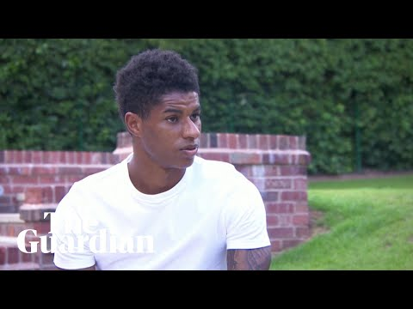
What makes a good speech?
Marcus Rashford

Slide 17
What makes a good speech?
Marcus Rashford
Engaging tone, expression and gesture |  | Appropriate expression for the topic Suitably serious
Responding to the listener
Clear structure to points |  | Makes a point and then refers to the question “That’s the main reason the letter was written”
Compelling and passionate |  | Paints picture/ tells story Speaks with authenticity “I once had to go through that” “We used to go to Poundworld” Shows emotion towards it “It is crazy that this is still going on”
Appropriate examples and facts |  | Uses own experiences as evidence to make his point

Slide 18
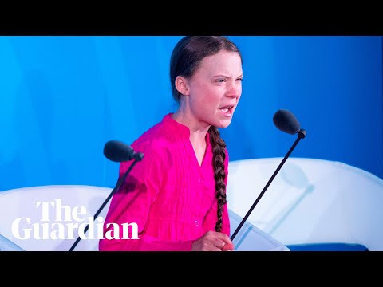
What makes a good speech?
Greta Thunberg

Slide 19
What makes a good speech?
Greta Thunberg
Engaging tone, expression and gesture |  | Pauses used to make effect Passionate tone throughout Points in an authoritative way
Responding to the listener |  | Directs speech to audience “How dare you?” “You’ve stolen my dreams”
Clear structure to points |  | Contrasts her experience with those of the adult audience
Compelling and passionate |  | Throughout
Appropriate examples and facts

Slide 20
Finding your passion

Slide 21
Finding your passion
What is Social Action?
Social action is when you take practical action in the service of others.
It involves activities carried out by individuals or groups that are not for profit and aim to bring about a change or benefit for communities.
This might involve giving time and/or money.
It includes volunteering and community involvement such as taking part in a programme like the National Citizen Service.
It is how citizens can influence decision-making through the democratic process.

Slide 22
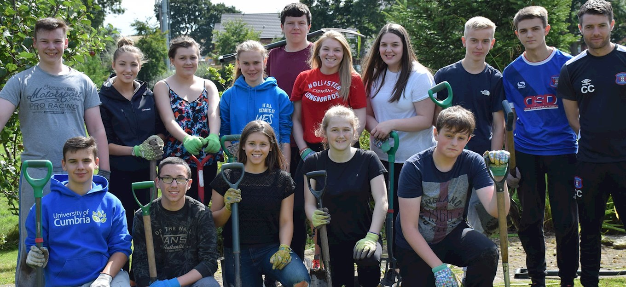
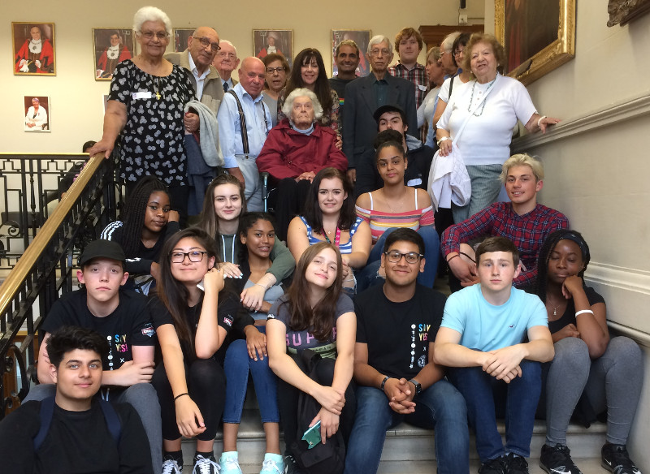
Young people in Exeter working with local supermarkets to make sure local food banks got the right donations to meet the needs of the community.
Finding your passion
Young people in Carlisle developing a patch of waste ground into a green space which will help the local environment.
Young people in Hendon teaming up with local care home residents to lobby the council to provide opportunities for the generations to work together.

Slide 23
Finding your passion
The ‘WHAT’
You have one minute to decide on a cause that you feel deserves social action
Choose a campaign that is local to your immediate community
If you're struggling, you might like to think about;
Your local food bank
Your local environment (e.g. protecting woodland, doing a beach clean, tackling graffiti or litter)
Your local care home

Slide 24
Finding your passion
The ‘HOW’
Now that you know what issue you care about, you need to decide how you are going to make a difference.
You now have time to write down
WHAT is the problem you are choosing?
WHY is it an issue?
who is impacted and how
what will happen if nothing is done?
SOLUTION what can you do about it?
STAKEHOLDERS who can help you?
IMPACT what do you hope to achieve?

Slide 25
Making your pitch!

Slide 26
Example problem: Litter in local park during lockdown
Making your pitch!
WHAT - what is the problem you are choosing?
Litter in the local park
WHY is it an issue?
who is impacted and how
Local residents - Unpleasant, e.g. smells, attracts mice/rats
Wildlife and the environment
what will happen if nothing is done?
The problem will continue and will have a negative impact on the local environment.
SOLUTION what can you do about it?
Request more bins from the council (or more regular collections)
Assemble a local committee of residents to arrange litter picks
Better signage to encourage people not to litter
STAKEHOLDERS who can help you?
Local residents/MP/local council/Environmental groups/Wildlife enthusiasts/people who have solved this issue elsewhere
IMPACT what do you hope to achieve?
More pleasant environment, which will encourage more people to use the park and be healthier

Slide 27
So how do we turn this into a pitch?
Making your pitch!
Introduce yourself
Explain your cause
Be snappy and succinct
Describe your campaign - what will you do and what do you hope the outcome is
AND REMEMBER THE CHARACTERISTICS
Engaging tone, expression and gesture
Responding to the listener
Clear structure to points
Compelling and passionate
Appropriate examples and facts

Slide 28
Example problem: Litter in local park during lockdown
Making your pitch!
Hi, my name is X and I am here today to talk about an issue that is affecting the community. As a local resident, I have become aware of the growing litter issue in the park.
This is an issue for residents because it is attracting mice and rats, it has an unpleasant smell and it will have negative impact on the local wildlife and environment. If this problem is not addressed it will only worsen and people will not respect the park.
I am here today to ask for your support with this. I have thought of a few suggestions that I hope you might be able to help me with:
more bins would reduce this problem as people have more opportunity to dispose of their litter responsibly
perhaps a sign to show the impact this can have on the local wildlife - it might make people think before dropping their litter.
I am coming to you as my MP because I know that you have the best interests of the residents at heart, and I know that you are the best-placed person to help with this, and that you have the power to make things happen.
I would hope that with these simple and low-cost measures that we would see vast improvements in the local community and more people would be able to enjoy the park.

Slide 29
Dragons’ Den

Slide 30
Your turn
Making your pitch!
Introduce yourself
Explain your cause
Be snappy and succinct
Describe your campaign - what will you do and what do you hope the outcome is
AND REMEMBER THE CHARACTERISTICS
Engaging tone, expression and gesture
Responding to the listener
Clear structure to points
Compelling and passionate
Appropriate examples and facts

Slide 31
Reviewing your performance
Making your pitch!
Reflect on your pitch
List 3 WWWs and 2 EBIs
How many of these characteristics did you include?
Engaging tone, expression and gesture
Responding to the listener
Clear structure to points
Compelling and passionate
Appropriate examples and facts

