Slide 1



Talking futures
Students’ careers
presentation
Supported by Gatsby

Slide 2

What we’re going to talk about today…
Education and careers options
Who can support you to make decisions
Where you can get more information
Notes:
Provide a brief overview of the plan for the session to help students understand what to expect.

Slide 3

Education and careers options
what are your choices?

Slide 4
Your options after Year 11
What’s next?
There are a range of options available from apprenticeships to A-levels and in some parts of the country, you do could a new T-level qualification.
There is a lot to consider when making this decision - here is an overview of the options and things to things to think about.
Notes:
Reassure students that they might find the options complicated and they might not have heard of them all but their school is there to help

Slide 5
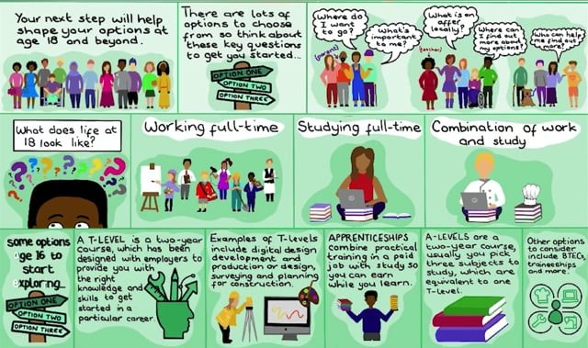
Your options after Year 11
Notes:
Share that this animation has been created by an artist to bring to life the options. It is just a very brief overview of the landscape but that more detail on each route is available [insert your school careers site, a paid for service you use or National Careers Service to show more information about the different options]
If you are working with a smaller group pause and ask students whether they have thought about where they want to be at age 18 and whether they have heard of all of the post-16 options mentioned.
This film should play when clicked, alternatively it can be watched here:
https://www.talkingfutures.org.uk/resource/options-at-age-16-animation/

Slide 6
Your options after Year 11
What we offer
[add in here if you offer post 16 options]
Notes:
[Remember it is important to share details of all options locally available to your students, not just the routes on offer at your institution, and emphasise that the different options are equally valuable but may suit different types of learning style or align with different career interests]

Slide 7
Your options after Year 11
Real-life insights
[add in here if you have case studies of alumni who have taken different post 16 routes or you could ask a range of local colleges, training providers or employers to speak about the options they offer]
Notes:
[If you are going to invite speakers to join ensure they represent a range of routes available and you may want to have some prompt questions to ask them all or just give them each a time slot to share their experiences/what they offer]

Slide 8
Post 18 options
What’s next?
In England, you don’t have to stay in education after the age of 18.
You can:
  Choose to go into employment.
  Do a short course of study to prepare you for a particular career.
  Go on to study a higher education qualification such as a Bachelor’s degree, HNC or foundation degree.
  Combine employment and training via an apprenticeship.
There is a lot to consider when making this decision - here is an overview of the options and things to things to think about.
Notes:
Reassure students that they might find the options complicated and they might not have heard of them all but their school/college is there to help
– what’s most important is that they are keen to explore the options further and engage with the support available.
Students may think they already have a plan in mind but making sure they have considered all the options is important and helping them think about the long term implications of their choices can help ensure their decisions are well informed.

Slide 9
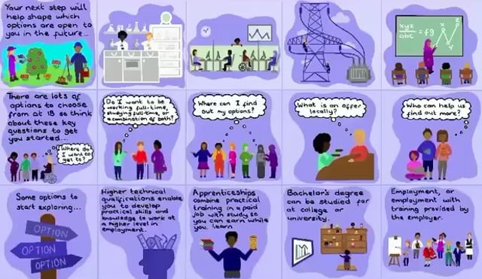
Post 18 options
Notes:
Share that this animation has been created by an artist to bring to life the options. It is just a very brief overview of the landscape but that more detail on each route is available [insert your school careers site, a paid for service you use or National Careers Service to show more information about the different options]
If you’re working with a smaller group pause and ask students if they have thought about where they would like to work in the future and whether they have heard of all the options mentioned in the animation.
This film should play when clicked, alternatively – you can watch the video here:
https://www.talkingfutures.org.uk/resource/options-at-age-18-animation/

Slide 10
Post 18 options
What we offer
[add in here if you offer post 18 options or there are particular local opportunities you want to highlight to students]
Notes:
[Remember it is important to share details of all options locally available to your students, not just the routes on offer at your institution]

Slide 11
Post 18 options
Real-life insights
[add in here if you have case studies of alumni who have taken different post 18 routes or you could ask a range of local HE providers, training providers or employers to speak about the options they offer]
Notes:
[If you are going to invite speakers to join ensure they represent a range of routes available and you may want to have some prompt questions to ask them all or just give them each a time slot to share their experiences/what they offer]

Slide 12

Careers decision-making,
how can your parents help?

Slide 13
Supporting your decision making
Parents, carers and your wider family
“You should follow in your dad’s footsteps”
“I can’t help you with anything to do with university as I didn’t go”
“You should aim for a high- paying job like your cousin”
“As long as you’re happy I don’t mind what you do”
Notes:
Do any of these quotes sound familiar? Parents, carers and wider family may offer lots of different advice and have strong opinions about your career decisions or they may not discuss it very much with you. It can be helpful to think about someone at home who you find easiest to talk to and try to find time to regularly speak to them about your options and what you think of different routes. They might have experiences that could inform your decisions and a different perspective that can help you see things more clearly. If you don’t have anyone at home at the moment who can help we have lots of people at school/college who you can chat to – we’ll share who they are later in this presentation.

Slide 14
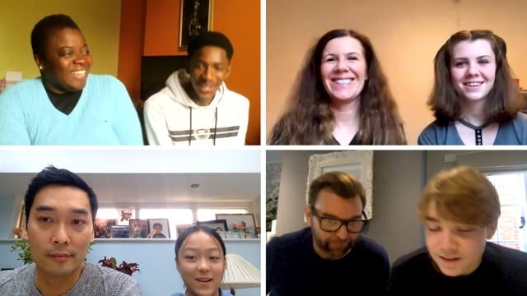
Supporting decision-making
Notes:
This film shows the important role parents can play and how conversations can be taken further to really explore their child’s interests and help shape their thinking about where that could lead next. It also shows how much a child can gain from learning more about their parent’s experiences.
If you’re working with a smaller group replay the film and pause after each family to discuss key points from their conversations.
The video should play when you click in the presentation. Alternatively it can be found here https://www.talkingfutures.org.uk/resource/family-conversations-film/

Slide 15

Careers decision-making
how can we help?

Slide 16
The support we offer
Our careers programme
Consider inserting here:
    The careers programme planned for the year group, plus a snapshot of the whole institution programme so students can see the long term support available (where applicable include your virtual offer)
    An explanation of/examples of your careers programme name or branding so students know what to look out for on leaflets, posters and presentations – particularly when you’re embedding careers across the curriculum so they can recognise that they are exploring careers within their subject lessons

Slide 17
The support we offer
Who can help you
Consider inserting here:
    An introduction to key staff that they can talk to about their options including the Careers Leader and Careers Advisor(s), plus the role form tutors and subject teachers play

Slide 18
The support we offer
Information we provide
Consider inserting here:
    What information is provided by the school/college and where to find it including website, careers page/portal, LMI tools, paid for services bought into by the institution that students can access, any information provided by partner organisations and employers
Talking Futures – These are resources to help your parents support you with your decision making – they include sessions you and your parents can attend at school/college to explore more about careers and activities you can try together at home.
www.talkingfutures.org.uk/parents/

Slide 19
What next
Upcoming careers events
Consider inserting here:
The next activity they can attend

Slide 20
Talking about your options
homework challenge

Slide 21
Part 1
Your top two
Using [website], research two options you could take after you finish Year 11
  E.g. apprenticeships, A-levels and T-levels
Create a short presentation to share with your parents about your two options
  There should be at least two slides on each option (a minimum of four slides)
  Include some key facts about each option and why you think it would be a good choice
Share it with [teacher] by [date] for them to check before you show it to your parents
Show your presentation to your parents and ask them:
  What they think of your top two choices?
  Would they pick different choices and why?
Create one more slide showing their preferences and reasons, plus whether you agree
Notes:
Signpost students to the main careers site you use in your careers activities.
If appropriate you can ask students to share back their presentations in class and hold a discussion about whether their parents agreed with their top two choices and their reasons. This could benefit students whose parents didn’t share very much with them/have very strong or outdated opinions as they all get to hear the opinions of a wider group of parents.

Slide 22
Part 2
Parent pathways
Carry out a short interview with your parent (or family member) to find out more about their choices and pathway
You could ask them:
  What did they want to do as a career when they were at school?
  What did they do straight after school?
  What do they do now? (it could be a job, training, looking for work or full-time parent)
  Have they ever had to change direction and try something new?
  Did anyone give them good careers advice and what did they say?
You can present your answers back as a presentation, an interview recording/podcast, a poster or newspaper interview
Share it with [teacher] by [date]
Notes:
This activity can be used to create a bank of case studies which could be shared amongst the class or put up on display to illustrate a range of pathways parents have taken – this helps students recognise the value of their parents’ experiences and also allows for sharing between students.

Slide 23
Thank you

