Slide 1
Where can studying Sociology take you?
Highlighting the relevance of Sociology to future careers and opportunities
Notes:
Purpose of slides:
To allow you to highlight the relevance of your subject to future careers and opportunities
To enable students to explore the full range of options available to them
Aims:
To engage students in your subject
To highlight pathways and opportunities from your subject
To encourage students to consider your subject at KS4/Post 16
To support work across the school towards Gatsby Benchmark 4
How to use these slides?
These slides can be used at any point during KS3/4 or post 16 to engage students in learning and to highlight the relevance of your subject to future careers and opportunities
They will be of most relevance within an option process and can support work you are doing to encourage students to consider their options for KS4/Post 16

Slide 2
What pathways can you take with this subject?
What do you think these roles involve (daily task, etc.)?
Why Sociology matters
What careers can you think of that use Sociology?
Have you ever considered where studying Sociology can take you?
Today, we’ll be exploring some of the career opportunities that are available to you, as well as the various pathways you can take to get there.
Why is Sociology an
important subject?
Why study Sociology?
School of Social Sciences - Birmingham City university
What skills do you think you might need for these roles?
Notes:
Refer also to the 5 reasons Sociology should be included in the curriculum from P5 of your subject guide:
Studying Sociology enriches students’ lives by being able to make better informed decisions about social issues and prepares them for careers in an increasingly diverse world
Sociology is a forward-thinking subject, always adapting to suit the society it is trying to study and helps you to understand a wide range of topics effecting people locally, nationally and internationally.
By studying Sociology and moving into a career within government, local community programmes or charities, youth worker, family support. In addition, Sociology supports careers in Law, Medicine and Public Health, Consulting, Finance, Non-profit and Public Administration, Social Network Research, Culture, and the Arts
Sociology provides a wide range of practical and transferable skills, including critical thinking, analysis, research and communication.
Sociology covers diverse topics (crime, culture, media, politics, identity) and is the perfect accompaniment to a range of other courses like International Relations, Anthropology, Political Science, History, Literature, Cultural Studies, etc

Slide 3
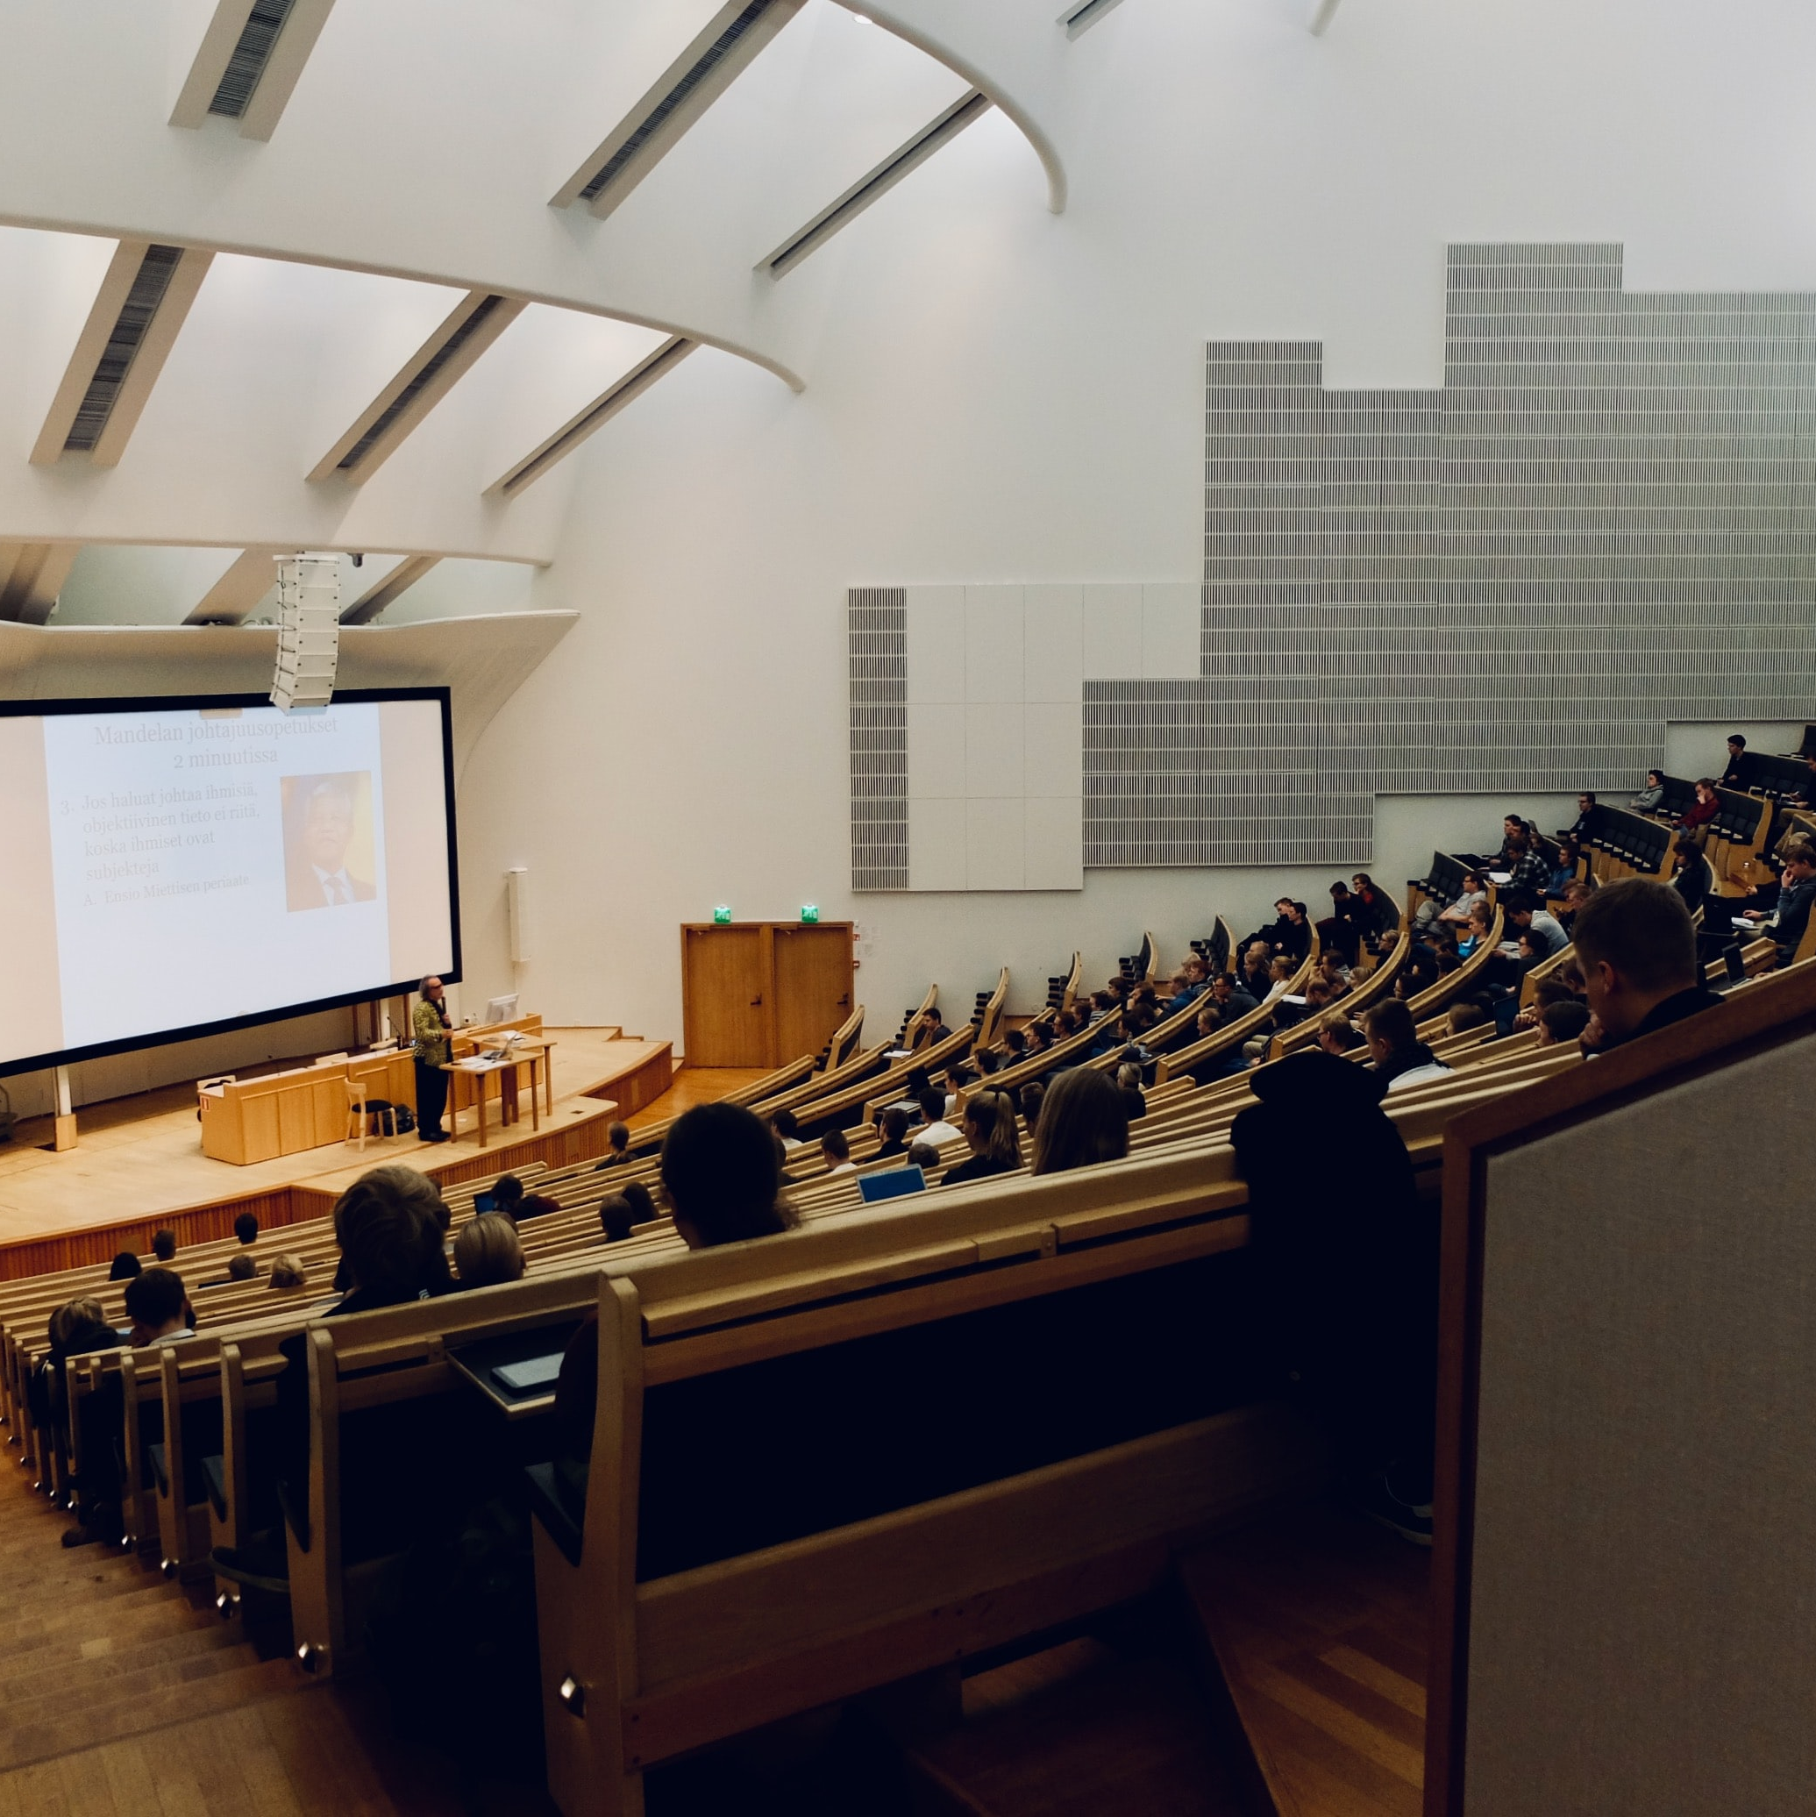
Social Policy Lecturer
icould case study
Explore a career as a…
BBC Bitesize case study
Here are some example roles and careers linked to
Sociology
Police Officer
BBC Bitesize case study
icould case study
Family Support Worker
icould case study
Notes:
Jobs that use Sociology iCould: https://icould.com/explore/categories/subject/sociology
Activity Ideas:
Ahead of revealing content of slide, encourage students to think about as many roles linked to your subject as they can in pairs/groups
Encourage students to engage with specific videos/profiles or direct students to specific roles/careers to predict, research and reflect on:
Pathways
Essential Skills
Wages/Work Conditions
Why they might like/not like in a particular role?

Slide 4
MP
Explore a career as a…
icould case study
icould case study
BBC Bitesize case study
Here are some example roles and careers linked to
Sociology
Coroner's Office
BBC Bitesize case study
Newspaper Journalist
BBC Bitesize case study
BBC Bitesize case study
Prospects case study
Notes:
Jobs that use Sociology iCould: https://icould.com/explore/categories/subject/sociology
Activity Ideas:
Ahead of revealing content of slide, encourage students to think about as many roles linked to your subject as they can in pairs/groups
Encourage students to engage with specific videos/profiles or direct students to specific roles/careers to predict, research and reflect on:
Pathways
Essential Skills
Wages/Work Conditions
Why they might like/not like in a particular role?

Slide 5
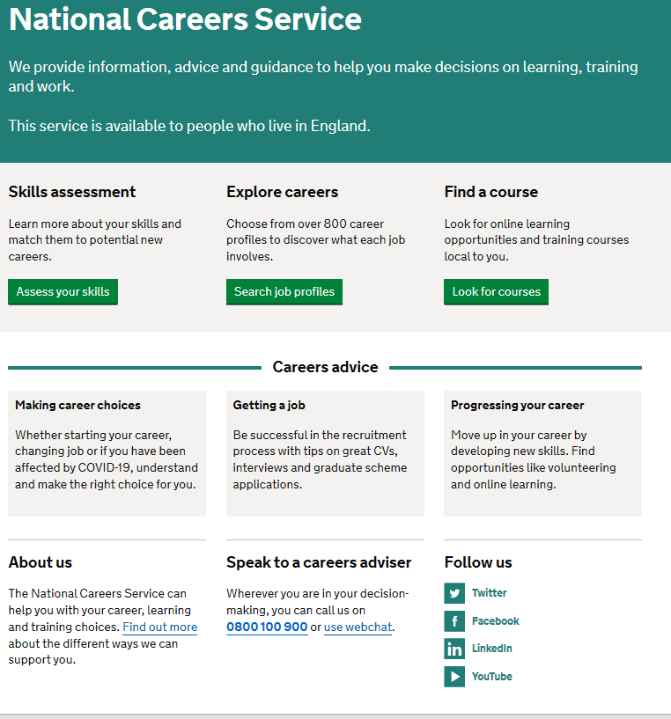
Discover more about the role
Explore careers using National Careers Service and find out about what jobs involve and how they are right for you
Includes:
Average salary
Typical hours
Work patterns
Pathways/How to become
Essential Skills
Daily tasks
Career path and progression
Current opportunities
Research Ideas:
Higher education Lecturer
Police Officer
Family Support Worker
MP
Coroner
Newspaper Journalist
Notes:
https://nationalcareers.service.gov.uk/explore-careers
How to use this slide:
Highlight the National Careers Service: Explore Careers Tool https://nationalcareers.service.gov.uk/explore-careers
Encourage students to access the tool and research general or specific roles linked to your subject
Set students comparative/reflective tasks about why students may/may not like jobs they research
Ask if your students have done the Buzz quiz (5mins to complete) – if they haven’t then consider setting this as a pre/post task to allow them to reflect on how these roles may suit them based n their profile. Take the test and find out which animal you are, too!
https://icould.com/buzz-embed/

Slide 6
Job
Why not teach Sociology?
Start in the classroom, where you go from there is up to you. Bring your passion for your subject, keep learning,
and pass your knowledge onto others
No two days are the same – and neither are the pupils
Once qualified you can teach throughout your life
You could teach abroad
Progress your career into leadership and management
Bring your outside interests into the classroom and your subject
Explore teaching
Jem’s Story
Shaniqua’s Story
What makes a great teacher?
The right skills to teach?
Work well in a team?
Love to keep learning?
Love to nurture imagination?
Notes:
Use the bullets on the slide to discuss benefits of teaching.
Bring through the reasons cited in your guide P5:
Re teaching:
2. Turn your passion into a career
3. The reward is always worth the challenge
4. More time for what you love
5. Start on at least £25k (£32k inner London)
‘Explore teaching’ is a great introduction for your students to consider what it is really like to be on the other side of the desk (you choose the best fit video for your students).
·Jem who always wanted to be a teacher from his time at university, teaches history and politics in an 11-18 secondary school. Filmed in his school, he shares his career progression, along with pupils sharing why they enjoy his lessons.
·Shaniqua is a primary teacher who shares her inspiring and personal journey from having to retake her GCSEs, to working as a Teaching Assistant, alongside studying for a degree. Filmed in her school, which she used to attend, Shaniqua shares her message that there are ‘other ways to become a teacher than doing A Levels and straight to university’.
The right skills to teach?
These three very short films show students those skills they have already gained like teamwork, imagination or a love of learning - could they be more of teacher than they think?
What makes a great teacher
A short video where secondary pupils share their responses to this question. Try asking your students first and then comparing their answers with the students on film.

Slide 7
GCSE
While there are different routes you can take to be a teacher there are a few essential things that you will need:
• A minimum GCSE Grade 4 or above in English and maths (plus science if you want to teach primary)
A degree or equivalent qualification
A level
T Level
Vocational/Technical Qualification
Apprenticeship
A levels are 2 years of study
T Levels are nationally recognised, technical qualifications for 16–19-year-olds. Designed by leading employers, one T Level is equivalent in size to 3 A levels
These include BTEC, Applied General Qualifications (AGQ) and Vocational Technical Qualifications (VTQ) – all at Level 3
Apprenticeships are jobs which combine practical work and study. Intermediate is Level 2, Advanced is Level 3
Degree
Level 4/5 qualifications
Higher apprenticeships
Complete a degree course
It is possible to get QTS as part of an undergraduate degree, for example:
• Bachelor of Arts (BA) with QTS
• Bachelor of Education (BEd) with QTS
• Bachelor of Science (BSc) with QTS
Complete a L4/5 course and top up to a degree – L4/5 includes Certificate of HE, Diploma of HE, Higher Technical Qualification (HTQ), HNC, HND and Foundation degrees
Top up to a degree (Level 6) in a year of full-time study
Higher level apprenticeship (foundation degree / Level 5)
Degree apprenticeships
Degree apprenticeship
(Level 6-7). There is a Level 6 Teaching apprenticeship programme
Initial Teacher Training (ITT) with qualified teacher status (QTS)
Teacher
Notes:
Here is the power point version of the infographic resource showing different options students could follow to get into teaching.
Go through this with your students and give examples of different staff in your school/college who followed these paths.

Slide 8
Why not teach activity?
Job
Pick a topic in Sociology you think you would like to try and teach
Agree your choice of topic with your teacher and the length of session (and with which group)
(It may be the perfect opportunity to try this with a younger class lower down the school, or as a transition activity for Y6)
Plan a short activity to cover the topic in a way you feel will be engaging and memorable for your peers as part of a lesson starter, main activity or plenary
Consider:
What are you trying to achieve (teach)? Be clear what information you intend to impart
How will you make it fun? How will you make it 'stick'? How long will this take?
What type of activity will you plan for? (written/practical)
How will you know others have learned it?
How will you make sure everyone is stretched and challenged?
What will the end-product be?
Once you have checked it with your teacher, try the lesson with a small group (as agreed by your teacher)
Try and get feedback during and after the session from those in the lessons and from the teacher
After, consider:​
What you enjoyed about the experience ​
Whether this is something, with training, you would enjoy
How you felt when others learned from you
Notes:
A great way to find out who might be suited to teaching is to give students an opportunity to teach an element of your subject.
This will require preparation from the students and you will need to consider which aspects of the course you might give over to them.
Alternatively, you might plan with older students an opportunity to teach one of your younger classes, an enrichment activity or as an experience of the workplace.
Give the students some planning time and support them in discussing possible ideas.
If they are teaching to another group, discuss conduct, dress code and how you might facilitate this with them. Make sure they make arrangements to take part (inform staff, know date, time, have resources ready etc)
As you go through this activity, talk to them about the process of lesson planning and evaluation so they have a greater understanding of the day to day work involved in planning for different groups of students
After, talk them through the transferrable skills they have used in their session and how useful these are to any job.
1. Problem-solving: Problem-solving skills enable teachers to look at situations and find the best solution. Teachers need to be resourceful, learn and react quickly to situations.
2. Instructing and presenting: Instructing and presenting skills support teachers in sharing information with others. Teachers need to be clear and concise and be able to read and engage with their students.
3. Management skills: Management skills enable professionals to lead projects and oversee groups of people. Teachers often have excellent management skills to lead their classrooms and motivate their students.
4. Communication skills: verbal and written communication enable people to share, receive, process and record information. Resources used in the classroom need to communicate to the young people effectively.
5. Emotional intelligence: understanding the feelings and needs of others. It is important for teachers to have excellent emotional intelligence so they're able to interpret how students may feel and adapt teaching to meet individual needs.
6. Time management: ability to prioritise tasks successfully and plan lessons so they can accomplish everything required and on time.
7. Ability to work under pressure: working to deadlines and responsibility for others.
8. Collaboration: skills people use to work together.
9. Self-motivation: the ability to work independently to complete work. Teachers are responsible for all aspects of their own lessons.
10. Adaptability: how well someone responds to change.
11. Interpersonal skills: skills required to understand others and build relationships.
12. Organisation: Organisational skills help you create and maintain order by arranging the space (e.g. for group work) or with the task (have everything you need)
13. Multi-tasking: This is the ability to complete many tasks at the same time.
14. Decision-making: This is deciding on the correct solution. This might be the best activity for a particular group, who needs more or less help.

Slide 9
5|
Non-obvious jobs using Sociology:
Ever thought about..?
https://www.bbc.co.uk/bitesize/articles/zhst2sg
How to become an Educational Wellbeing Specialist: Erin's story
Careers ideas and information - Sociology
Crown Prosecutor | Explore careers | National Careers Service
How to become a Community Education Coordinator: Annaleigh's story
Probation Officer | Explore careers | National Careers Service
How to get into law: Halimah's story
Registrar | Explore careers | National Careers Service
https://nationalcareers.service.gov.uk/explore-careers
Notes:
It’s important for students to understand the wide range of possibilities arising from your subject. Here’s some to explore…try and focus on less obvious choices
To select more yourself:
BBC Bitesize link:
https://www.bbc.co.uk/bitesize/tags/zjb8f4j/jobs-that-use-science/1
National Careers Service link:
https://nationalcareers.service.gov.uk/explore-careers

Slide 10
MYPATH Job of the week (Sociology)
Youth Worker
Charity Fundraiser
Life Coach
Notes:
MYPATH are a series of fabulous videos designed to inspire students in a variety of jobs
https://www.mypathcareersuk.com/other-careers-videos
Inspire students with these clips

Slide 11
Sustainability
means meeting our own needs without compromising the ability of future generations to meet their own needs.
(UN definition)
Sociology careers in a changing world:
How can I future-proof my career pathway?
The world will be changing drastically in the next few years to cope with the impacts of climate change and nature loss, and the need to lower greenhouse gas emissions and unsustainable practices. How might this steer your choice of career path using your Sociology skills?
Notes:
The planet provides our societies with all the things we need for free: clean air and water, food, soil, a stable and comfortable climate, productive seas. But greenhouse gas emissions and the global loss of nature is making the planet less stable and experts say we have to make drastic changes to avoid catastrophic changes to our planet.
The UK government has responded by committing to the UK becoming Net zero by 2050. That means that by then, the result of all activity in the UK should not be resulting in any increase in carbon in the atmosphere. This requires big changes to all aspects of life – the way food is produced and transported, the way we travel, the way we keep our energy footprint low.
Businesses will need to change the way they go about producing things, offering services, monitoring their impact, and even investing their money, to ensure they are sustainable. Those businesses that adapt to these new priorities earliest will find opportunities, while those businesses that cannot adapt because they are inherently unsustainable, or that are too slow to adopt sustainable practices, are unlikely to succeed.
Considering the importance of sustainability for the future of businesses can help us make career decisions that are good for us and for the planet.
This means understanding what sustainability means, being able to see the problems with practices that cause problems for the future, and being able to come up with new ways to do things that bring benefits to people without damaging the planet or the prospects of other people.
What is the role of business in bringing sustainability?
Short version of Our Planet: Our Business https://www.youtube.com/watch?v=YAkIsbrRKWU
For more resources and information on sustainable careers visit www.sustainable-futures.co.uk
Sustainable Futures is a free sustainable careers programme available to all schools across the UK. The programme is delivered in partnership by WWF-UK, Villiers Park Educational Trust and Founders4Schools. The Sustainable Futures Programme has been made possible by the generous support of the Evolution Education Trust.

Slide 12
Every career
can be sustainable
1. Use your skills and passion for sustainability to help businesses adapt
2. Work for a company with sustainable values
3. Innovate for a sustainable future
Sociology careers in a changing world
Youth Worker
Refugee Teacher (in Arabic with English subtitles)
Special Educational Needs and Disability Coordinator (SENDCO)
Notes:
The pressure on businesses to find ways to deliver their products or services in a sustainable way means that sustainable skills – the ability to apply sustainable thinking to identify and solve problems – will be increasingly valued by all businesses and organisations.
Already new jobs are emerging that are based on the need for sustainable thinking in Sociology eg Sustainability Managers that work to identify ways that businesses can improve their sustainable practices. However you don’t need to be a sustainability professional to be able to benefit from developing and applying sustainable skills. Or you can use your sustainability skills to identify companies that have a positive future because they are ahead of the game and already acting in a sustainable way. Finally, you can use business skills to set up a new company that meets the needs of people or companies in the Net Zero future by providing products and services in a way that does not impact the planet.
For more resources and information on sustainable careers visit www.sustainable-futures.co.uk
Sustainable Futures is a free sustainable careers programme available to all schools across the UK. The programme is delivered in partnership by WWF-UK, Villiers Park Educational Trust and Founders4Schools. The Sustainable Futures Programme has been made possible by the generous support of the Evolution Education Trust.

Slide 13
Sociology Pathways
7|
Combine Study and Work
Study
Work
Notes:
These are the three pathway choices all students have.

Slide 14
Combine Study and Work
7|
Apprenticeships
• Market Research Executive • Human Resource Operator
• Marketing Executive • Community Worker
• Youth Worker
T Levels T Levels | National Careers Service Education and Childcare
T Levels | Media, Broadcast and production
T Levels | Management and Administration
• Teaching Assistant
• Police Officer
VTQs Vocational Technical Qualifications (VTQs) | National Careers Service
• Learning Support • Supporting Adults and young
People in Essential Skills
• Education and Training
• Learning and Development
Find more >
Notes:
Apprenticeships can take between 1 and 5 years to complete, depending on the level. To start an apprenticeship you must be :
16 or over; Live in England; Not be in full-time education.
You can apply whilst you are still at school
T Levels are nationally recognised qualifications for 16-19 year olds that last for two years and an alternative to doing A levels
VTQs (Vocational technical qualifications) are practical qualifications for over 16s. They are designed to help students gets the skills they need to start a career or go on to higher levels of education. There are different types, including
BTECs What is a BTEC diploma? - Nationals, Firsts & Apprenticeships (ucas.com);
Cambridge Nationals Cambridge Nationals (ocr.org.uk)
Cambridge Technicals Cambridge Technicals (ocr.org.uk)
T Levels T Levels | National Careers Service

Slide 15
Study Pathways
7|
A levels A levels | National Careers Service
You might find courses in:
• Sociology
• Law
• Criminology
HTQs (Higher Technical Qualifications) Higher technical qualifications (HTQs) | National Careers Service
You might find courses in:
• Law and Practice • Social and Community Work • Policing • Public Services (Law, Criminology, Psychology and Sociology)
Higher education Higher education | National Careers Service You can explore undergraduate courses in Sociology
You might find courses in:
• Anthropology and Law • Sociology • Public Services • International Relations and Policy Study • Action on Poverty and hardship
• Associate degree – Psychology
and Sociology • Criminology and Sociology ​ • Business and Sociology ​ • Politics and Sociology​ • Ancient History, Archaeology and
Social Anthropology
• Social Science​​
• Sociology and Social Policy
Notes:
HTQs are technical qualifications that are approved by employers. There are many different types and are usually taught in the classroom at colleges, universities or independent training providers. To start a HQT you will need to be:
10 or over; live in England
Examples are:
Higher national diplomas Search – UCAS
Higher national certificates Search – UCAS
Foundation degrees Foundation Degree Information And Advice | UCAS
Higher education diplomas Search – UCAS
A levels are subject based qualifications usually assessed by exams and usually studied over two years. They can lead to further study, training or work
Higher education is the name for qualifications and courses young people can take after 18. there are many different types, such as:
Diplomas
Bachelor degrees
Foundation degrees and foundation years
HTQs (Higher technical qualifications) Higher technical qualifications (HTQs) | National Careers Service
Degree level apprenticeships Apprenticeships | National Careers Service

Slide 16
Work Pathways
7|
Supported internships with an education, health and care plan
Supported internships | National Careers Service
Watch Saul’s story
You might read about:
• Access to Work Funding (if you have a disability or health condition)
• Preparing for Adulthood
• Talking Futures (A parents' toolkit for career conversations)
School leaver schemes
School leaver schemes | National Careers Service
You might read about:
• How to fill in an application form
• How to write a CV
• Interview help
• Progressing your career (Careers Advice from NCS)
Notes:
Supported internship (with EHCP) is an unpaid work-based study programme that usually lasts for one year. It includes an extended work placement that lasts for at least 6
months. This will help young people take the first step from education into the workplace while gaining the skills they need to get a paid job.
School Leaver schemes. Some companies offer school leaver schemes to young people who have completed A levels. The scheme allows them to learn and train with a large company while earning a wage. You need to check each company’s website to see if they offer a school leaver scheme and how to apply.
You need to be 18 or over and not in full time education. Usually, the schemes require high A level grades or equivalent qualifications.

Slide 17
University League Tables
7|
See at a glance the university ranking for Sociology
Rankings Sociology Rankings (the completeuniversityguide.co.uk
Filter by:
• Overall score • Entry standards • Student satisfaction • Research quality • Research intensity • Graduate prospects
Notes:
Some students will aspire to go to the top university for their subject. However, this isn't the same for all subjects.
It also depends what aspect of university life young people consider the most important
Once you have had this discussion with students, follow the link and filter by different factors to help inform their choices.

Slide 18
Go to https://discoveruni.gov.uk/
2. Search for a course or subject
(You should get a page of search results, you can filter these by university or college, whether you want to study full or part time or perhaps you want to see that courses are near you)
Once you have had a look at a few different courses and subjects now it is time to compare some side by side
3. Check out this video which shows you how to use our comparison tool https://youtu.be/dBFzCQgTp8I - Pick 5 courses and add these as a saved course and then you can compare
4. Once you have your chosen five side by side, try to answer the following questions:
What kinds of qualifications do students on the course have when they start the course?
How many have a placement year?
How many courses let you study abroad?
Which has the highest student satisfaction rating? How do you know this?
What kinds of job do graduates from this course go on to?
Which course has the highest salary after three years? (higher/lower than national average)
Choose your favourite course and explain why you chose this course over the others?
Discover Uni
Have you ever considered if higher education is right for you?
discoveruni@officeforstudents.org.uk ​
Notes:
Activity (20 minutes approx.)- skills developed: numeracy, critical thinking skills, digital literacy. Equipment required- tablets, laptops or similar. Activity can be done individually or in small groups
Intro- Choosing a course at university or college can be a daunting prospect. There is a wealth of information available to help you make the right choice. This activity will show you how to shortlist and compare courses based on factual information on things like entry qualifications, location, how the course is taught, careers prospects as well as views of students who have studied that course.
Discover Uni includes official statistics about higher education courses taken from national surveys and data collected from universities and colleges about all their students.
Go to https://discoveruni.gov.uk/ [side box or similar ‘there’s lots of helpful advice and guidance on the site helping you understand if higher education is right for you’]
•Got a subject in mind? [alternatively, you could explore a certain subject here] search for a course or subject
•You should get a page of search results, you can filter these by university or college, whether you want to study full or part time or perhaps you want to see that courses are near you
•Once you have had a look at a few different courses and subjects now it time to compare some side by side
•Check out this video which shows you how to use our comparison tool https://youtu.be/dBFzCQgTp8I or you can read our Guide https://discoveruni.gov.uk/about-our-data/guidance-comparing-courses/
•Pick 5 courses and add these as a saved course (not sure how to do this, take a look at the guidance above), remember to also take a look at course page links at the bottom for even more information on things like accommodation and how the course is taught
•Once you have your chosen five side by side, try to answer the following questions [NOTE TO TEACHER, THESE CAN BE EDITED TO REFLECT YEAR GROUP]
Research and comprehension, numeric and basic statistical
•What kinds of qualifications do students on the course have when they start the course?
•How many have a placement year?
•How many courses let you study abroad?
•Which has the highest student satisfaction rating? How do you know this?
•What kinds of jobs do graduates from this course go on to?
•Which course has the highest salary after three years? Is this higher or lower than the national average?
•Choose your favourite course and explain why you chose this course over the others?
Notes to teachers
•Here are some key things for your students to consider when making their choices: These can be found on the course links at the bottom of the course page
•Do they know how the course will be taught? For example, in person, online or a mix of both?
•Do they know what the arrangements are for accommodation at each of their choices?
•If the student is interested in gaining specific skills, does the course they are interested in offer the opportunity to do so – perhaps by providing specialist equipment, laboratory or studio facilities, or opportunities such as field trips?
•Have they thought about opportunities they want to have outside of the course, such as societies, sports clubs, volunteering or study abroad opportunities? Are they available at the university they are interested in?
Acknowledgements – Discover Uni team – discoveruni@officeforstudents.org.uk

Slide 19
Discover Uni
Go to https://discoveruni.gov.uk/
2. Search for a course or subject
(You should get a page of search results, you can filter these by university or college, whether you want to study full or part time or perhaps you want to see that courses are near you)
Once you have had a look at a few different courses and subjects now it is time to compare some side by side
3. Check out this video which shows you how to use our comparison tool https://youtu.be/dBFzCQgTp8I - Pick 5 courses and add these as a saved course and then you can compare
4. Once you have your chosen five side by side, try to answer the following questions:
Is the data I am looking at for a course or a subject?
What year, or years, does the data relate to?
How many students or graduates is this data based on?
Does the data represent all the students on the course or subject area?
Does the data include people like me?
What factors might impact the data?
Have you ever considered if higher education is right for you?
discoveruni@officeforstudents.org.uk ​
Notes:
Activity (20 minutes approx.)- skills developed: numeracy, critical thinking skills, digital literacy. Equipment required- tablets, laptops or similar. Activity can be done individually or in small groups
Intro- Choosing a course at university or college can be a daunting prospect. There is a wealth of information available to help you make the right choice. This activity will show you how to shortlist and compare courses based on factual information on things like entry qualifications, location, how the course is taught, careers prospects as well as views of students who have studied that course.
Discover Uni includes official statistics about higher education courses taken from national surveys and data collected from universities and colleges about all their students.
Go to https://discoveruni.gov.uk/ [side box or similar ‘there’s lots of helpful advice and guidance on the site helping you understand if higher education is right for you’]
•Got a subject in mind? [alternatively, you could explore a certain subject here] search for a course or subject
•You should get a page of search results, you can filter these by university or college, whether you want to study full or part time or perhaps you want to see that courses are near you
•Once you have had a look at a few different courses and subjects now it time to compare some side by side
•Check out this video which shows you how to use our comparison tool https://youtu.be/dBFzCQgTp8I or you can read our Guide https://discoveruni.gov.uk/about-our-data/guidance-comparing-courses/
•Pick 5 courses and add these as a saved course (not sure how to do this, take a look at the guidance above), remember to also take a look at course page links at the bottom for even more information on things like accommodation and how the course is taught
•Once you have your chosen five side by side, try to answer the following questions [NOTE TO TEACHER, THESE CAN BE EDITED TO REFLECT YEAR GROUP]
Research and comprehension, numeric and basic statistical
•What kinds of qualifications do students on the course have when they start the course?
•How many have a placement year?
•How many courses let you study abroad?
•Which has the highest student satisfaction rating? How do you know this?
•What kinds of jobs do graduates from this course go on to?
•Which course has the highest salary after three years? Is this higher or lower than the national average?
•Choose your favourite course and explain why you chose this course over the others?
Notes to teachers
•Here are some key things for your students to consider when making their choices: These can be found on the course links at the bottom of the course page
•Do they know how the course will be taught? For example, in person, online or a mix of both?
•Do they know what the arrangements are for accommodation at each of their choices?
•If the student is interested in gaining specific skills, does the course they are interested in offer the opportunity to do so – perhaps by providing specialist equipment, laboratory or studio facilities, or opportunities such as field trips?
•Have they thought about opportunities they want to have outside of the course, such as societies, sports clubs, volunteering or study abroad opportunities? Are they available at the university they are interested in?
Acknowledgements – Discover Uni team – discoveruni@officeforstudents.org.uk

Slide 20
Job in 10 years time (related to Sociology):
________________________
1|
What GCSEs helped you get this job:
______ ______ ______ ______ ______ ______
In 10 years time…
What KS5 Pathways choice did you make and what did you study:
Apprenticeship T level A Level other L3 equivalent
___________________________________________________________________
Post 18 pathways choices did you make: explain:
Study & Work Study Work
_____________________________________________________________________
Essential skills used in the job:
________________________________________________
Progression route:
__________________________________________
Notes:
Encourage students to identify a job related to your subject that they will be doing in ten years’ time and ask them to present the pathway they took to that role
You may ask them to explore the options available for different pathways before deciding which they prefer

Slide 21
Subject chosen (related to Sociology):
_____________________________________________________________________________________
Local college options:
__________________________________________________________________
__________________________________________________________________
Local apprenticeships options:
__________________________________________________________________
__________________________________________________________________
Other options:
__________________________________________________________________
__________________________________________________________________
2|
The pros and cons of these options for me:
My local options…
Pros:
_____________________________
Cons:
_____________________________
Consider how these will apply and explain:
Cost _________________________________________________
Travel ________________________________________________
Convenience __________________________________________
Aspirations ____________________________________________
Personal circumstances __________________________________
Other ________________________________________________
Final choice – justify:
__________________________________________________________________________________________________
Next steps:
__________________________________________________________
Notes:
Encourage students to research local options at 16/18 in pathways related to your subject that interest them.
You may ask them to explore the range of options before deciding which they prefer

Slide 22
3|
Prepare a 3 - 5 minute talk to share with a small group on any role that interests you related to Sociology
Where do you need to go to carry out the role
What's the chances of getting this role
Who do you look up to in this role
What might a typical day look like
What's the role
Where has the interest come from
What do you need to do to become one
Where can you go to study and what level of study
Notes:
Encourage students to research and present on roles of interest
Differentiate the content or timings to suit individual needs
Encourage them each to add extra information that isn’t likely to be in any other presentation

Slide 23
4|
My career path….
Notes:
Share your own careers story
Perhaps add a few bullet points to mark stages of your career:
School; Next steps etc
Add a photo if you are willing to share!

Slide 24
8|
Essential Skills
 | Video | Skills Builder Resource KS3 | Skills Builder Resource KS4 | Skills Builder Resource Post 16
The oral transmission of information or ideas | Watch here | Short Lesson Speaking Step 6-8 | Short Lesson Speaking Step 8-10 | Short Lesson Speaking Step 10-12
The receiving, retaining and processing of information or ideas | Watch here | Short Lesson Listening Step 6-8 | Short Lesson Listening Step 8-10 | Short Lesson Listening Step 10-12
The ability to use tactics and strategies to overcome setbacks and achieve goals | Watch here | Short Lesson Staying Positive Step 6-8 | Short Lesson Staying Positive Step 8-10 | Short Lesson Staying Positive Step 10-12
Here are three key skills needed for a career that uses
Sociology
Notes:
How to develop Essential Skills in your subject:
A critical part of effective careers provision is building students’ essential skills. These are the skills that underpin success in the classroom and the world of work: skills like Creativity, Problem Solving, and Speaking. Students need to be able to recognise their skillset and talk about it confidently too. They will probably be using them already in your lessons but this can be a confusing space, with lots of overlapping terminology.
The Skills Builder Universal Framework has been developed by CEC, Skills Builder Partnership, Gatsby Foundation and others to address this problem. The Framework breaks down eight essential skills into 16 teachable steps. It outlines a roadmap for progress, giving educators and employers a common language for talking about the skills that are essential for employment. You can explore the Interactive Framework here: https://www.skillsbuilder.org/universal-framework/listening
How to use this slide:
Follow these links for quick 2min videos “What is this skill?”
Speaking
https://skillsbuilderpartnership.wistia.com/medias/wtx0nr7ju7
Listening
https://skillsbuilderpartnership.wistia.com/medias/nap68tblh1
Staying Positive
https://skillsbuilderpartnership.wistia.com/medias/dzwf6mz7k4
Problem Solving
https://skillsbuilderpartnership.wistia.com/medias/folu9nyiog
Creativity
https://skillsbuilderpartnership.wistia.com/medias/1ailu2bpod
Aiming High
https://skillsbuilderpartnership.wistia.com/medias/67f4qr5jod
Leadership
https://skillsbuilderpartnership.wistia.com/medias/ke09jw6nvi
Teamwork
https://skillsbuilderpartnership.wistia.com/medias/5crnmxtndt
Use the links on the slide to access Short Lessons for your subject/key stage. We have highlighted 3 essential skills that are likely to come up in your lessons, and included links to Short Lessons pitched appropriately for each Key Stage. These Short Lessons are perfect for pastoral time and starters/plenaries. You can register here to access these and many other resources: https://hub.skillsbuilder.org/account/login/
You can also access our inclusive learning resource pack, packed full of resources to support students with additional needs to develop their essential skills: https://hub.skillsbuilder.org/training-area/inclusive-learning-resource-pack/
Encourage students to reflect on and build their essential skills independently via the online reflection tool at Skills Builder Benchmark (https://www.skillsbuilder.org/benchmark) and through interactive, online modules at Skills Builder Launchpad (https://launchpad.skillsbuilder.org/).

Slide 25
8|
 | Speaking | Tick which apply
Step 6 | I speak effectively by using appropriate tone, expression and gesture
Step 7 | ​ I speak engagingly by using facts and examples to support my points
Step 8 | I speak engagingly by using visual aids to support my points
Step 9 | I speak engagingly by using tone, expression and gesture to engage listeners
Step 10 | ​​​​ I speak adaptively by changing my language, tone and expression depending on the response of listeners
Step 11 | ​ I speak adaptively by planning for different possible responses of listeners
Step 12 | ​​ I speak adaptively by changing my content depending on the response of listeners
My Strength (s)
My area (s) of Development
Notes:
Go to https://www.skillsbuilder.org/universal-framework
Speaking: https://www.skillsbuilder.org/universal-framework/speaking
Click on step 6 'build it' as a starting point.
Read the information provided
Read 'Building Blocks'
Try and answer the 'Reflective Questions'
You can also read the summary provided
If you feel you can do this then place a tick in the box
Repeat this until you have reached your limit.
Now you should be able to complete the two boxes: My Strength (s) and My area (s) of development

Slide 26
8|
 | Listening | Tick which apply
Step 6 | I show I am listening by how I use eye contact and body language
Step 7 | ​ I show I am listening by using open questions to deepen my understanding
Step 8 | I show I am listening by summarising and rephrasing what I have heard
Step 9 | I am aware of how a speaker is influencing me through their tone
Step 10 | ​​​​ I am aware of how a speaker is influencing me through their language
Step 11 | ​ I listen critically and compare different perspectives
Step 12 | ​​ I listen critically and think about where differences in perspectives come from
My Strength (s)
My area (s) of Development
Notes:
Go to https://www.skillsbuilder.org/universal-framework
Listening: https://www.skillsbuilder.org/universal-framework/listening
Click on step 6 'build it' as a starting point.
Read the information provided
Read 'Building Blocks'
Try and answer the 'Reflective Questions'
You can also read the summary provided
If you feel you can do this then place a tick in the box
Repeat this until you have reached your limit.
Now you should be able to complete the two boxes: My Strength (s) and My area (s) of development

Slide 27
8|
 | Staying Positive | I can do this
Step 6 | I keep trying when something goes wrong and encourage others to keep trying too​
Step 7 | ​ I look for opportunities in difficult situations
Step 8 | ​​ I look for opportunities in difficult situations, and share these with others
Step 9 | ​​​ I look for opportunities in difficult situations, and adapt plans to use the opportunities
Step 10 | ​​​​ I look for opportunities in difficult situations, and create new plans to use the opportunities
Step 11 | ​ I identify risks and gains in opportunities
Step 12 | ​​ I identify risks and gains in opportunities, and make plans to manage them
My Strength (s)
My area (s) of Development
Notes:
Go to https://www.skillsbuilder.org/universal-framework
Staying Positive: https://www.skillsbuilder.org/universal-framework/staying-positive
Click on step 6 'build it' as a starting point.
Read the information provided
Read 'Building Blocks'
Try and answer the 'Reflective Questions'
You can also read the summary provided
If you feel you can do this then place a tick in the box
Repeat this until you have reached your limit.
Now you should be able to complete the two boxes: My Strength (s) and My area (s) of development

