Slide 1
ON Y VA!
Organising a business trip, making travel arrangements, explaining travel itineraries

Slide 2
French: To use the theme of TRAVEL & TRANSPORT to develop grammar, vocabulary and linguistic competence.
Careers: To highlight the relevance of languages to future career paths
Essential Skills: Speaking, Listening, Problem Solving
Notes:
Resources for explicitly teaching these essential skills are available through the Skills Builder Hub here. Students use speaking skills at the end of this session to share their reflections.

Slide 3
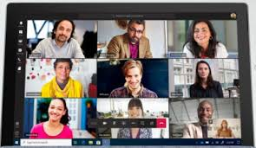
Why are you learning French?
Notes:
Highlight relevance of learning French in the working world. Knowledge of French will make you more employable. Emphasise importance of being able to communicate, listen, understand, join in with discussions, agree/disagree, in various contexts eg : on the phone, on Teams/GoogleMeet/Zoom meetings / face to face meetings, conferences.

Slide 4
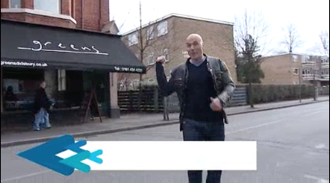
Introductory Clip
TV chef Simon Rimmer, talking about the benefits of learning languages
Notes:
Optional: What Can Languages Do For You
Watch this 20 minute programme, presented by TV chef Simon Rimmer, about the benefits of learning languages

Slide 5
Language Facts Quiz
How many languages are spoken throughout the world?
100+
200+
500+
1000+
4000+
7500+
7500+

Slide 6
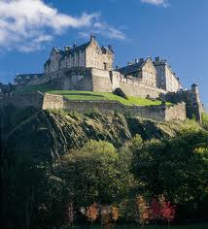
Language Facts Quiz
How many different languages are used at home as a FIRST language by people living in Edinburgh?
10
20
40
60
80
60

Slide 7
Language Facts Quiz
The proportion of the world which does not speak English as its first language is:
4%
24%
54%
74%
94%
94%

Slide 8
Language Facts Quiz
The proportion of the world which speaks
NO ENGLISH AT ALL is :
90%
75%
60%
45%
15%
75%

Slide 9
Language Facts Quiz
How many UK companies are losing business because of language barriers?
1 out of 2
1 out of 5
1 out of 20
1 out of 50
1 out of 5

Slide 10
Language Facts Quiz
How many £ worth of business does the UK LOSE EACH YEAR because of the lack of language skills in the workforce?
£50 million +
£100 million +
£1 billion +
£25 billion +
£25 billion+

Slide 11
Context
These resources were pulled together by Eiffage Genie Civil UK, part of the Eiffage Kier Ferrovial BAM (EKFB) joint venture building part of Britain’s new high speed railway. Eiffage is one of Europe’s leading operators in construction and concessions, with more than 100,000 projects in France and around the world in 2020. Eiffage’s 72,000 employees work in construction, real estate, urban development, civil engineering, metallic construction, roads, energy systems and concessions.

Slide 12
Language Facts Quiz
TRUE or FALSE:-
On average, someone with a second language will earn around 5% more salary than someone without a second language.
FALSE
The average is actually between
12% and 20%!

Slide 13
Language Facts Quiz
TRUE or FALSE:-
60% of UK employers say that they aren’t happy with the language abilities of young people today, and 30% say that they would specifically hire people for their language skills.
TRUE!!

Slide 14
Languages give you choices
In most careers nowadays language abilities are highly valued and there is a particular shortage of people with languages in Engineering and Finance. (At the moment many UK engineering companies are having to recruit from France and Germany!)
Languages are also valued in the areas of Media, Politics, Travel & Tourism, Hospitality, Export… and more!

Slide 15
WHY FRENCH?

Slide 16
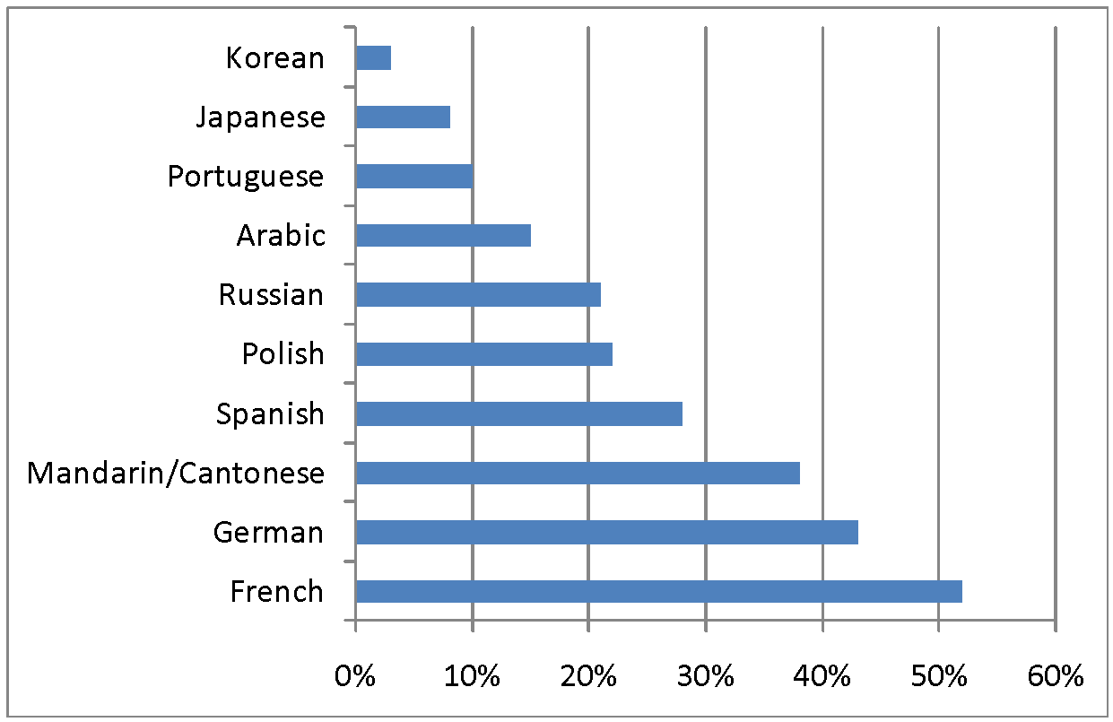
Which languages are most in demand?
Source: CBI, 2009

Slide 17
French is the only language other than English spoken on five continents. French and English are the only two global languages.

Slide 18
French, along with English, is the official working language of
The United Nations
The International Olympic Committee
The International Red Cross
The Council of Europe
The European Court of Justice

Slide 19
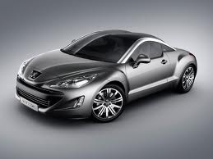
The French are world leaders in these industries:
Electronics
Medical Genetics
Car Production
Aerospace
High Energy Physics
Tourism (France is the most visited country in the world.)

Slide 20
Fit the figures into the summary paragraph:
________ of the world does not speak any English at all. __________ UK companies are losing business because of language barriers. Having a second language can rise your salary by around ________ as many employers really value the skill, even just on a conversational level. French is a good language to learn because it is the only other language spoken in all ______ continents and France are amongst the world leaders in many industries.
5 / 12% / 1 out of 5 / 75%

Slide 21
Context
These resources were pulled together by Eiffage Genie Civil UK, part of the Eiffage Kier Ferrovial BAM (EKFB) joint venture building part of Britain’s new high speed railway. Eiffage is one of Europe’s leading operators in construction and concessions, with more than 100,000 projects in France and around the world in 2020. Eiffage’s 72,000 employees work in construction, real estate, urban development, civil engineering, metallic construction, roads, energy systems and concessions.

Slide 22
Introduction to EKFB
Notes:
When, where and why might knowledge of French be useful?

Slide 23
EKFB en chiffres
330 hectares de plantations paysagères
80 km de ligne à grande vitesse
2 Unitary Councils
60 Parish Councils
75 ponts
22 km de déviations routière
5km de tunnels verts
6 County/ District Councils
17 viaducs
30 millions de mètres cubes de creusement

Slide 24
EKFB: What have you learned so far?
What is EKFB ?
What does this company do?
Why is having a knowledge of French important if you work for EKFB?
Describe EKFB ‘in numbers’

Slide 25
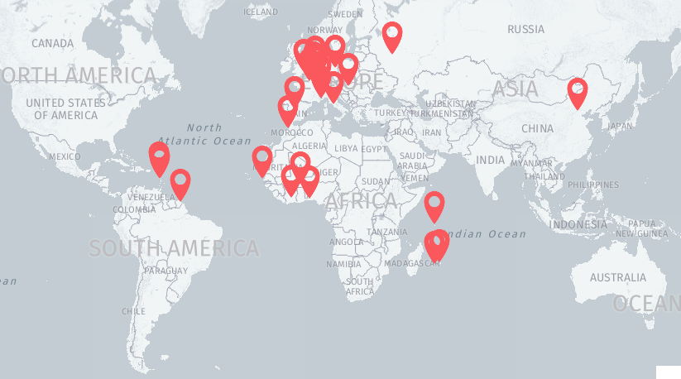
Eiffage: Locations
Explore the interactive map. In how many countries is EIFFAGE active? List 5 of them.
Notes:
Explore this interactive map.
Answer: 50 countries in five continents. Explain that if you work for a company like EKFB, the likelihood is that you may have to travel to those countries. Importance of knowledge of travel and transport vocabulary / phrases.

Slide 26
en Allemagne to Germany
en Argentine to Argentina
en Chine to China
à Cuba to Cuba
en Égypte to Egypt
en Écosse to Scotland
en Slovaquie to Slovakia
en Espagne to Spain
aux États Unis to the United States
en France to France
au Pays de Galles to Wales
en Grèce to Greece
en Inde to India
en Angleterre to England
en Irlande to Ireland
en Italie to Italy
au Canada to Canada
au Mexique to Mexico
au Portugal to Portugal
à pied on foot
en bus by bus
en avion by plane
en bateau by boat
à vélo by bike
en voiture by car
en skate(board) by skateboard
en train by train
Comment puis-je vous aider?
How can I help you?
j'aimerais I would like

Slide 28
READ AND UNDERSTAND THE TRAVEL POLICY

Slide 29
Eiffage
Campus Pierre Berger
3-7, place de l’Europe
78140 Vélizy-Villacoublay
www.eiffage.com
Politique Voyage
The Travel Policy for Eiffage is on the next 4 slides.
Read them through.
Discuss and answer the question on each slide.
Notes:
Travel Policy

Slide 30
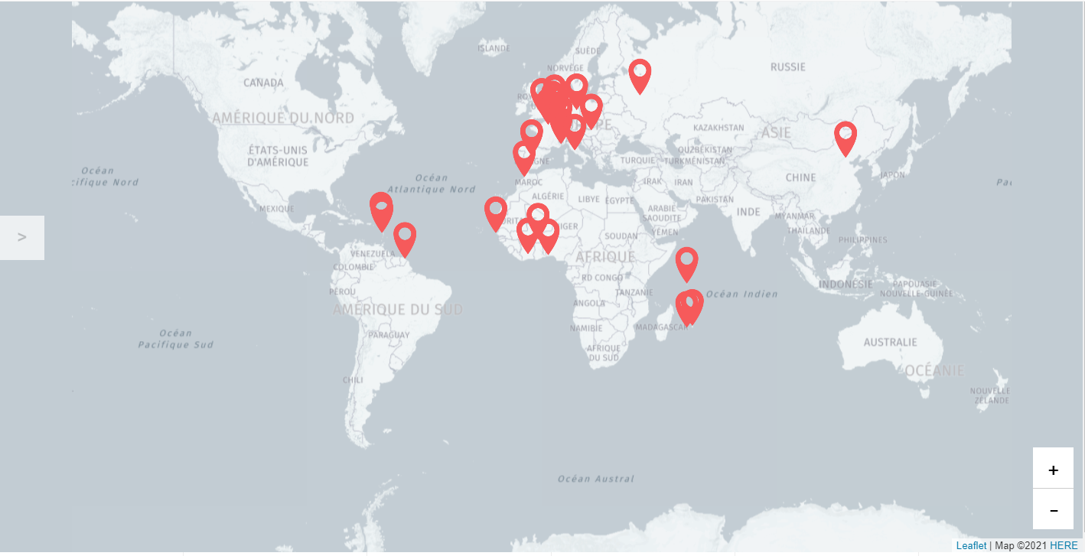
Eiffage / Politique voyages
Qui et qu’est ce que cela concerne ?
Champ d’application
A qui s’adresse cette politique voyages?
A l’ensemble des collaborateurs du Groupe, quels que soient la filiale, le pays, la branche ou le métier de rattachement.
50 pays sur les cinq continents
Le kit de survie
Quels papiers sont necessaires?
Vous devez vous munir de votre passeport, la carte d'identité ne suffira plus.
1
Quels types de voyages?
Congres/ Formations/ Séminaires
Partenariats
Team Building
What types of travels does the policy cover?
4
5

Slide 31
Eiffage / Déplacements en train et en avion
Déplacements en train et en avion
Eiffage / Déplacements en train et en avion
Critères
Pour une durée de trajet en train inférieure ou égale à 2h30: le train en classe économique est obligatoire.
L'avion ne pourra être utilisé que sur des critères d’urgence.
Critères
Pour une durée de trajet supérieure ou égale à 2h30: l’avion peut être considéré.
Les billets non flexibles (non modifiables et non remboursables) doivent être proposés et utilisés en priorité.
Classes de réservation
Economique: préconisée pour tous les vols et obligatoire pour tous les vols inférieurs à 4 heures.
Premium Eco: autorisée pour tous les vols de plus de 4 heures
Affaires: autorisée pour tous les vols de plus de 5 heures ou vol de nuit.
Choix de la compagnie
Le choix de la compagnie doit être fait en fonction du prix et de la sécurité.
2
When is Business Class possible when travelling by plane?
6
7

Slide 32
Eiffage / Location de voiture
Eiffage / Location de voiture
Location de voiture
La location de véhicule sera utilisée lorsque les autres moyens moins onéreux, comme les transports en commun, ne sont pas disponibles ou trop complexes.
Categories
Economique: pour les déplacements de moins de 3 personnes ou de moins de 400 km.
Compacte: Pour les déplacements de 3 personnes et plus, ou de plus de 400 km.
Le véhicule doit, sauf impossibilité être restitué avec le plein de carburant.
Assurances
La location doit inclure:
Les assurances vol, dommages, conducteur et personnes transportées.
Responsabilité civile
Assistance technique
Responsabilité
En cas d’accident? Le voyageur devra rapidement le signaler à son responsable hiérarchique.
Les règles soumises aux voyageurs :
Être détenteur d’un permis de conduire
Respecter le Code de la Route local
Toute condamnation pour conduite en l’état d’ivresse ou sous l’emprise de stupéfiants peut constituer une cause de licenciement.
3
Under which circumstances would you be allowed to hire a car for travel?
14
15

Slide 33
Eiffage / Logements
Eiffage / Logements
Logements
Critères
Où s’informer?
Sur la plateforme de réservation mise à disposition des voyageurs
Auprès des interlocuteurs locaux
Conditions
Tous les extras (TV, minibars, etc.) sont à la charge des voyageurs.
Les réservations doivent respecter les plafonds définis pour les destinations concernées en chambre single/standard.
4
Who is responsible for paying for additional extras such as TV?
14
15

Slide 34
Eiffage / Avant de partir
Eiffage / Avant de partir
Avant de partir
Documents obligatoires
Passeport et/ou pièce d’identité selon le pays de destination
Visa
Vaccins requis
Driving License
5
Which documents are required before travelling?
14
15

Slide 35
Watch and listen to a conversation between Travel Coordinator and 2 employees and answer the questions which follow.

Slide 36
Écoutez!
You are now going to watch a Teams discussion between Paddy, Laurie (employees at EKFB) and Fatima (the manager).
Fatima is offering Laurie & Paddy the opportunity to go on a business trip to Senegal. She wants them to meet careers advisers & teachers at a university, who are interested in offering placements to their students on EKFB’s rail project in the UK. They are talking about what to consider when planning a business trip. They call upon Rozenn, the travel coordinator, to help them out.
Read the Key Phrases and Vocabulary first before listening to the phone discussion.
Notes:
Students should read the Key Phrases and Vocabulary first before listening to the phone discussion (on next slide). It would be useful to have a handout of these available.

Slide 37
Notes:
Students should read the Key Phrases and Vocabulary first before listening to the phone discussion (on next slide). It would be useful to have a handout of these available.
Transcript Support for teachers.

Slide 38
Key Vocabulary
Un vol a flight
Un billet a ticket
Un siège fenêtre a window seat
Un siège couloir an aisle seat
Une chambre a room
Le logement the accommodation
La date d’aller outbound date
La date de retour return date
Classe affaire Business Class
Classe économique Economy Class
Arriver to arrive
Partir to leave
Réserver to reserve
Avez-vous….? Have you got …?
Il y a ….. There is…..

Slide 39
Écoutez encore une fois!
This time, listen out for the answers to these questions:
Does Paddy want a window or an aisle seat on the plane?
In which country has Laurie done a business trip before?
What's the outbound and return date?
Are Paddy and Laurie able to fly in business class?
What needs to be done before booking flights?
Notes:
ANSWERS:
1.Window 2. Canada 3. 12-16th July 4. Yes 5. Get a vaccination for yellow fever.

Slide 40
PREPARE A TRAVEL BRIEFING TO GIVE TO AN EMPLOYEE AHEAD OF THEIR BUSINESS TRIP.

Slide 41
You are now a Travel Coordinator for EKFB
One of your employees, Marianne, must travel to Québec for a 2 day conference.
You must brief her on the travel arrangements for this business trip.
In your briefing :
Ask if she has a passport.
Ask her which dates she is travelling.
Tell her there is a flight from Heathrow which leaves at 09.00h and the times of her return flight.
Explain that you have booked a room in the Holiday Inn for 3 nights.
Explain that she will have to take a bus from the airport to the hotel and give some brief details of this journey.
Wish her a safe and enjoyable journey.
Transcript Support
Notes:
The phrases here were all visited in the previous listening: a copy of the transcript will help students to construct their spoken briefing.

Slide 42
Sharing Outcomes

Slide 43
Present your briefing to the class or a group or a peer
Which new vocabulary have you learned and used?
How did you make your speaking have the right tone and style for work?
Are there any ideas or phrases you could take away from your peer’s work to use in yours to improve it?
How well did you explain things in French?
What more do you now know and what can you now do as a result of this lesson?
Notes:
Teacher to facilitate class discussion

