Slide 1
Organising Yourself

Slide 2
01 | Reflecting on your successes
02 | What’s your priority?
03 | Managing your time
04 | Setting yourself targets You will need: Paper, Pen, Highlighters

Slide 3
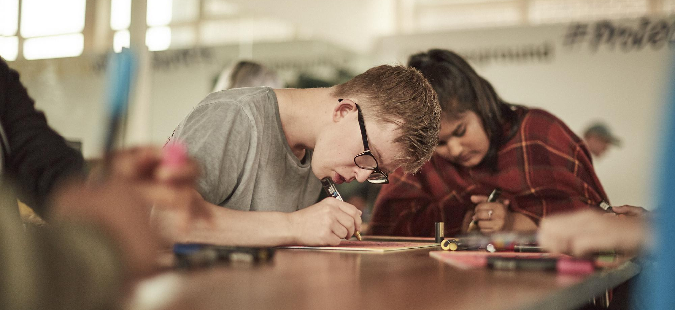
Reflecting on your successes

Slide 4
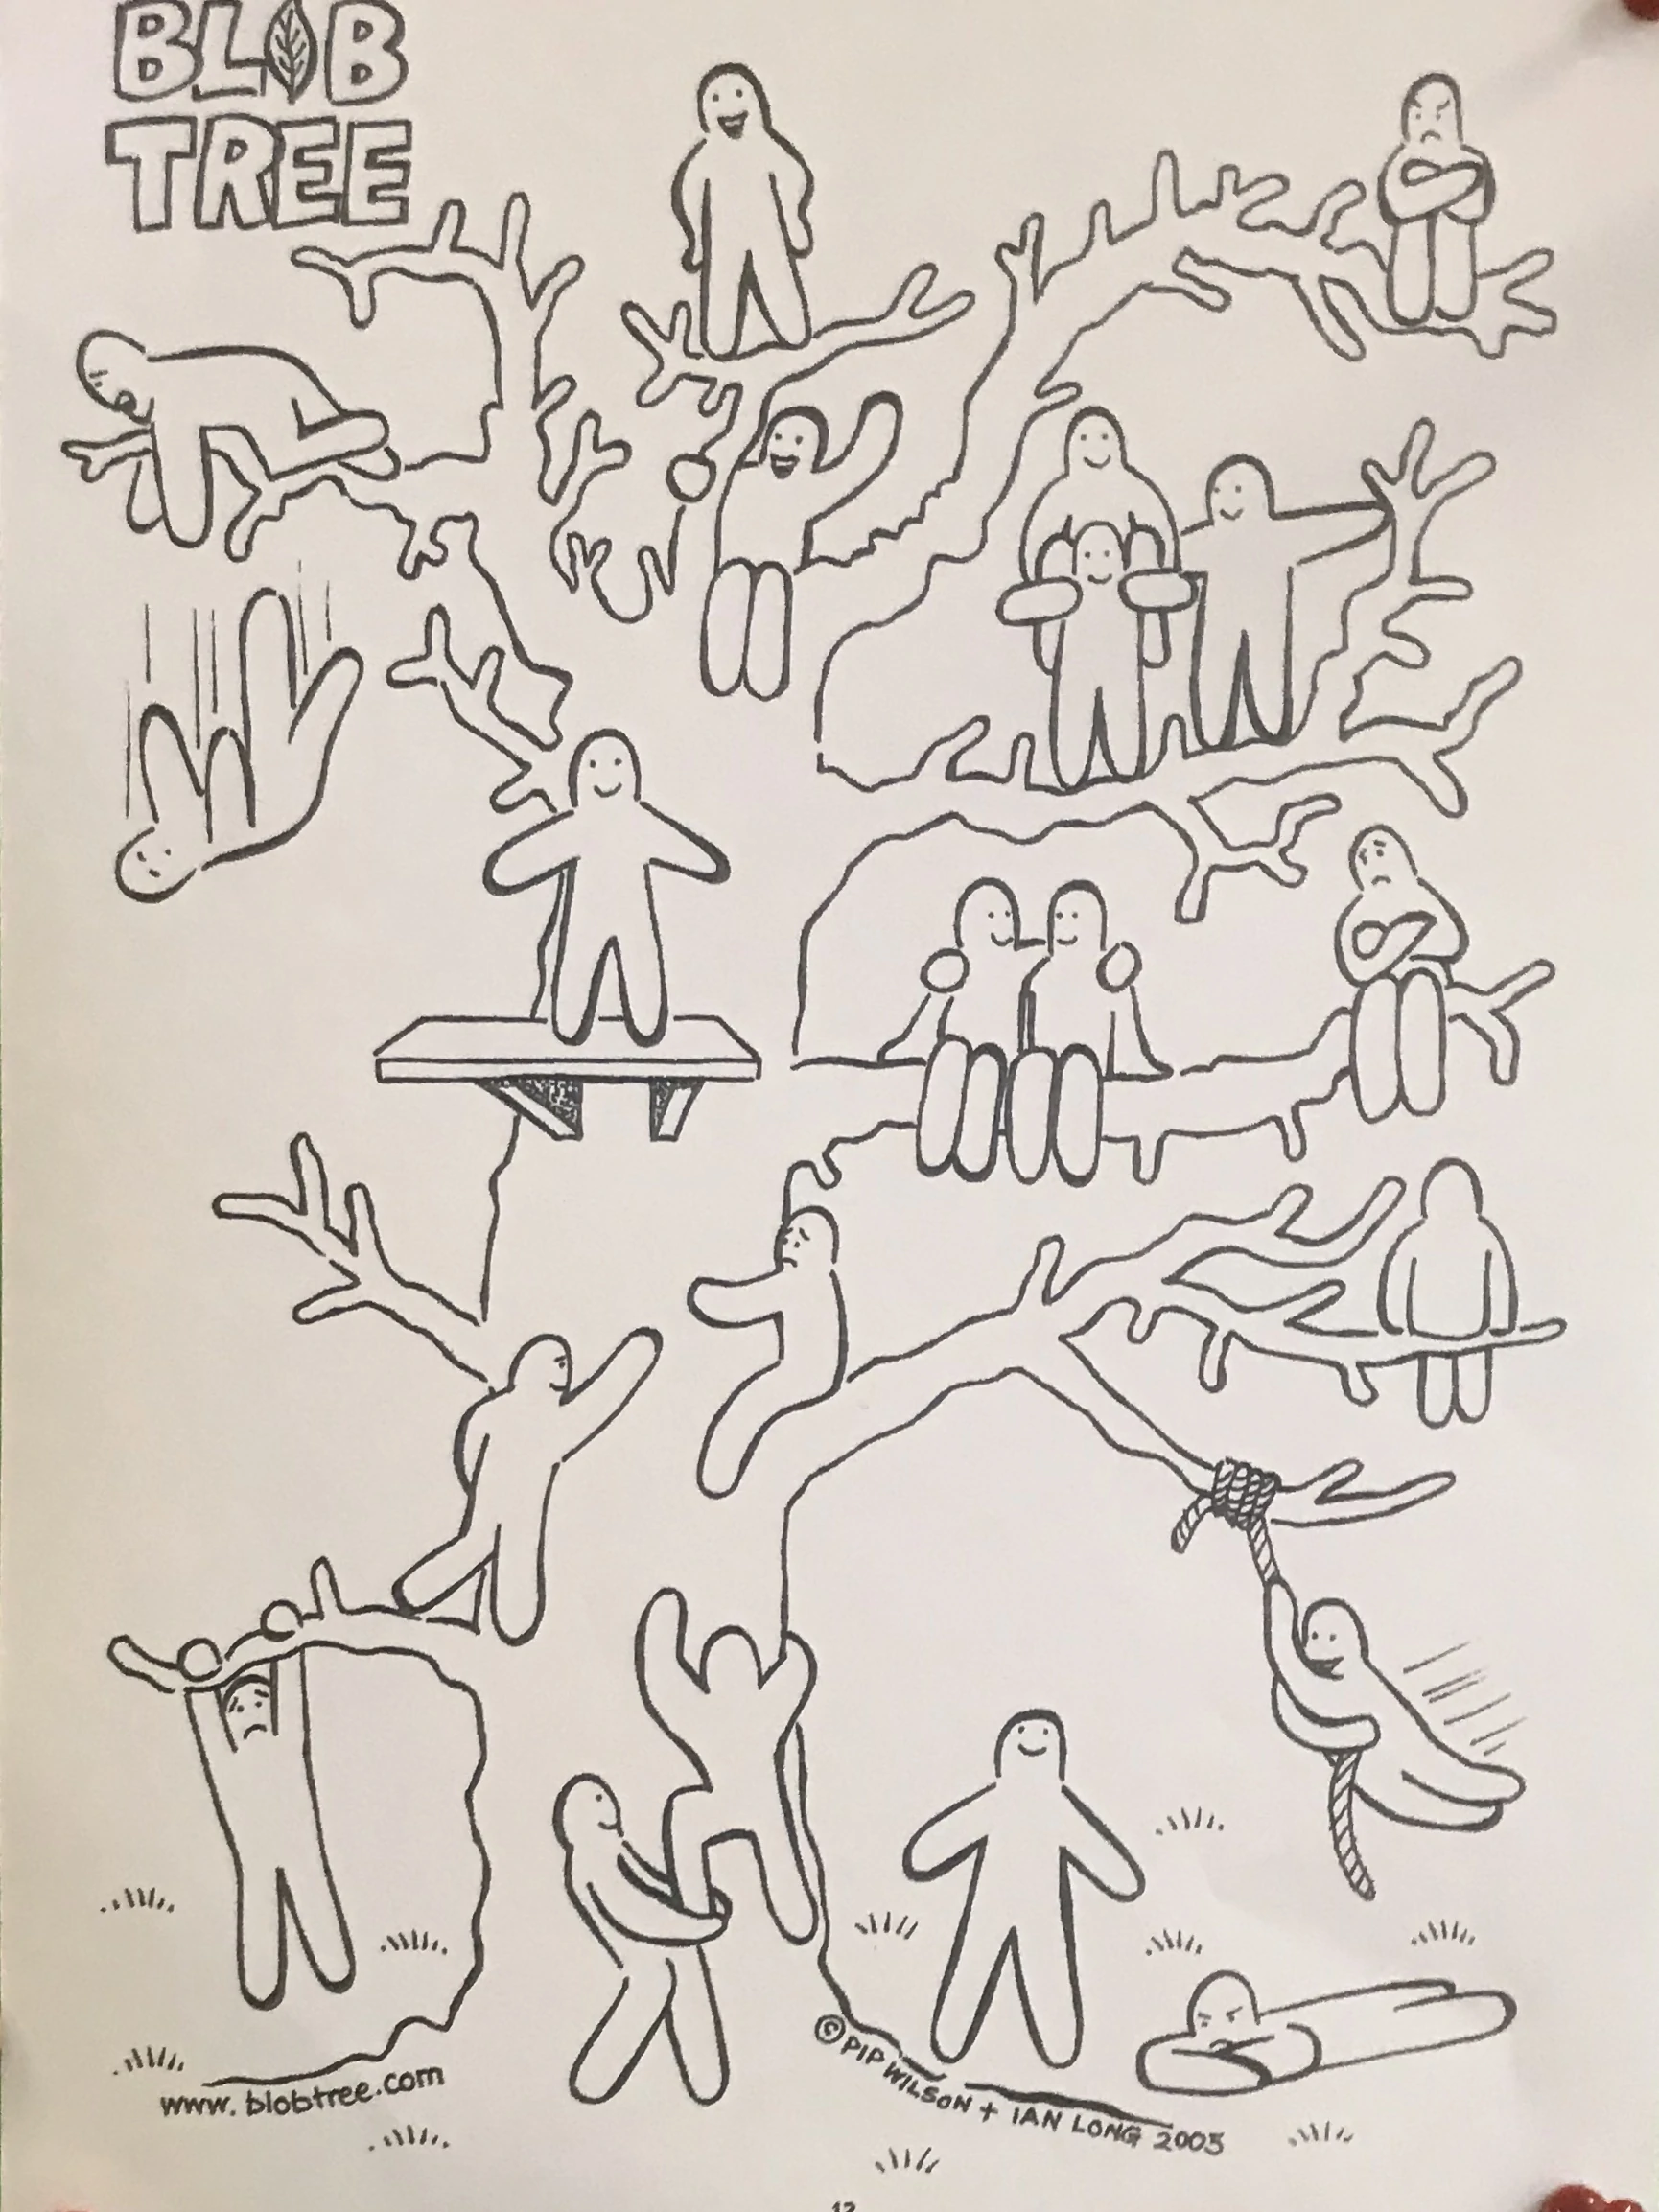
Reflecting on your successes

Slide 5
Reflecting on your successes
Choose three words that describe how you're feeling about the return to school
Excited
Scared
Happy
Anxious
Neutral
Stressed
Angry
Worried
Confident
Tired
Hopeful
Terrified
Worried
Elated
Impatient
Exhausted
Overwhelmed
Depressed
Fed up
Unsure
Content
Joyful
Impatient
Confused

Slide 6
Reflecting on your successes
Example
Excited
To see people
Get a sense of ‘normality’
Be more active
Anxious
The thought of travel
Lots of socialising
Enjoying working from home
Hopeful
Would mean we are coming out of coronavirus

Slide 7
Reflecting on your successes
At least three things you were really good at last year?
Being on time
Doing my homework early
Meeting deadlines
Revising
Keeping on top of commitments outside of school
Looking after my mental health and wellbeing
Keeping in touch with friends/family
Taking part in school activities
Attending events and careers fairs that will support my future
Having a good attitude in school
Spending my time wisely
Enjoying myself
Being organised
Eating healthy
Getting help and advice from my teachers
Trying harder work to push myself
Reading in my spare time
Challenging myself to try new things
Being a good friend
Relaxing
Learning new skills
Keeping active

Slide 8
Reflecting on your successes
At least three things that let you down last year?
Being on time
Doing my homework early
Meeting deadlines
Revising
Keeping on top of commitments outside school
Looking after my mental health and wellbeing
Keeping in touch with friends/family
Taking part in school activities
Attending events and careers fairs that will support my future
Having a good attitude in school
Spending my time wisely
Enjoying myself
Being organised
Eating healthy
Getting help and advice from my teachers
Trying harder work to push myself
Reading in my spare time
Challenging myself to try new things
Being a good friend
Relaxing
Learning new skills
Keeping active

Slide 9
What’s your priority?

Slide 10
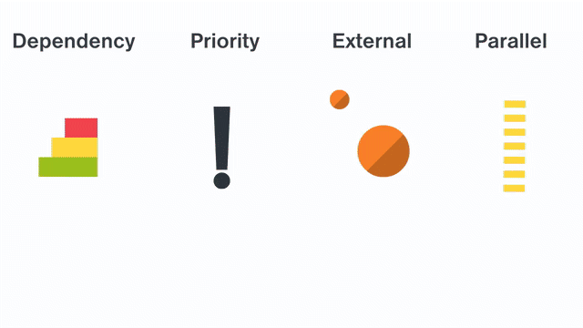
What’s your priority?
Dependency - does one activity depend on another? In what order do I need to do something?
Priority - Which things must be done soon, or by a particular time/date?
External - will this activity be affected by something outside the task, e.g. am I waiting for someone else to do something, or do I need to pass it to someone else?
Parallel - can more than one activity be done at the same time?
Notes:
Skills builder
thee order of tasks matters. There are several ways to think about how to order tasks:
Dependency: It might be that some tasks can only be completed in a particular order. For example, you can’t ice a cake before it has been baked, and you can’t bake a cake before all of the ingredients have been mixed together. If something needs to be done before you can do the next task, then this gives you a logical order.
Priority: In some cases, when there are lots of tasks to do and no dependency, then we will want to think about which tasks are most important. For example, we might have twenty ideas about how to get people to come to an event – if we’re not sure whether we might have time to do all twenty, then it makes sense to start with the ones we think will have the most significant effect.
External dependencies: It might be that some tasks rely on something or someone else out of your control to complete them. For example, you might need your oven to be fixed before you can bake a cake. In this case, you could organise tasks to get things ready and then wait until your oven is repaired to moving on to the baking stage. Alternatively, you might need someone to permit you to do something – there will be some tasks that you cannot do until that permission has received, so you should plan around that.
Parallel tasks: In some cases, it might be possible to work on more than one task at a time. For example, while the cake is baking, we might be making the icing in preparation for the cake coming out of the oven – or we might be making a cup of tea to have when the cake is ready. In organisations, individuals are often working on different tasks alongside each other.
We can use these principles to help us to arrange tasks into the order that makes it most efficient to complete them and so to achieve our goals.
We can also think about how long tasks are likely to take, so that we can put them on a timeline, and work out how long achieving a goal is expected to take as a result.

Slide 11
What’s your priority?
Task: Getting ready for a holiday abroad
Put the following activities in priority order:
Check in for flight (airport)
Buy tickets
Decide on dates
Check the weather
Pack a book and phone charger
Plan clothes to pack
Decide on dates - Step one, you can’t make any plans until you have checked dates
Buy tickets - Can’t book tickets without the dates
Check the weather - Would check this closer to the travel dates as the weather forecast can change
Plan clothes to pack - Once you know what the weather is going to be like, you can pack the right clothes
Pack a book and phone charger - Just before you travel
Check in for flight (at airport) - On day of travel

Slide 12
It’s a Wednesday night in November…
History coursework
(due Mon, haven’t started)
Maths homework
(due tomorrow, nearly finished- should take 20 mins)
Spanish revision
(exam in Jan)
Pack PE kit
(lesson tomorrow)
Apply for job
(deadline in 3 weeks)
Play Fortnite
What’s your priority?

Slide 13
History coursework
2 - important, but not immediately urgent
Maths homework
1 - short deadline and needs completing
Spanish revision
2 or 4 - not urgent, and depends on how important it is to you
Pack PE kit
3 - needs done for tomorrow but doesn’t take lots of time/effort
Apply for job
4 - only do if you have time
Play Fortnite
4 - only do if you have time
What’s your priority?
Do you agree?

Slide 14
What’s your priority?
Golden rules
Give yourself the time to think - you don't need to act straight away - this is time well spent
Trying to do everything quickly isn't the best solution, some tasks will take more time *assign time to tasks*
Get everything written down so you can see the whole picture and then break it down
Be realistic about how long things take

Slide 15
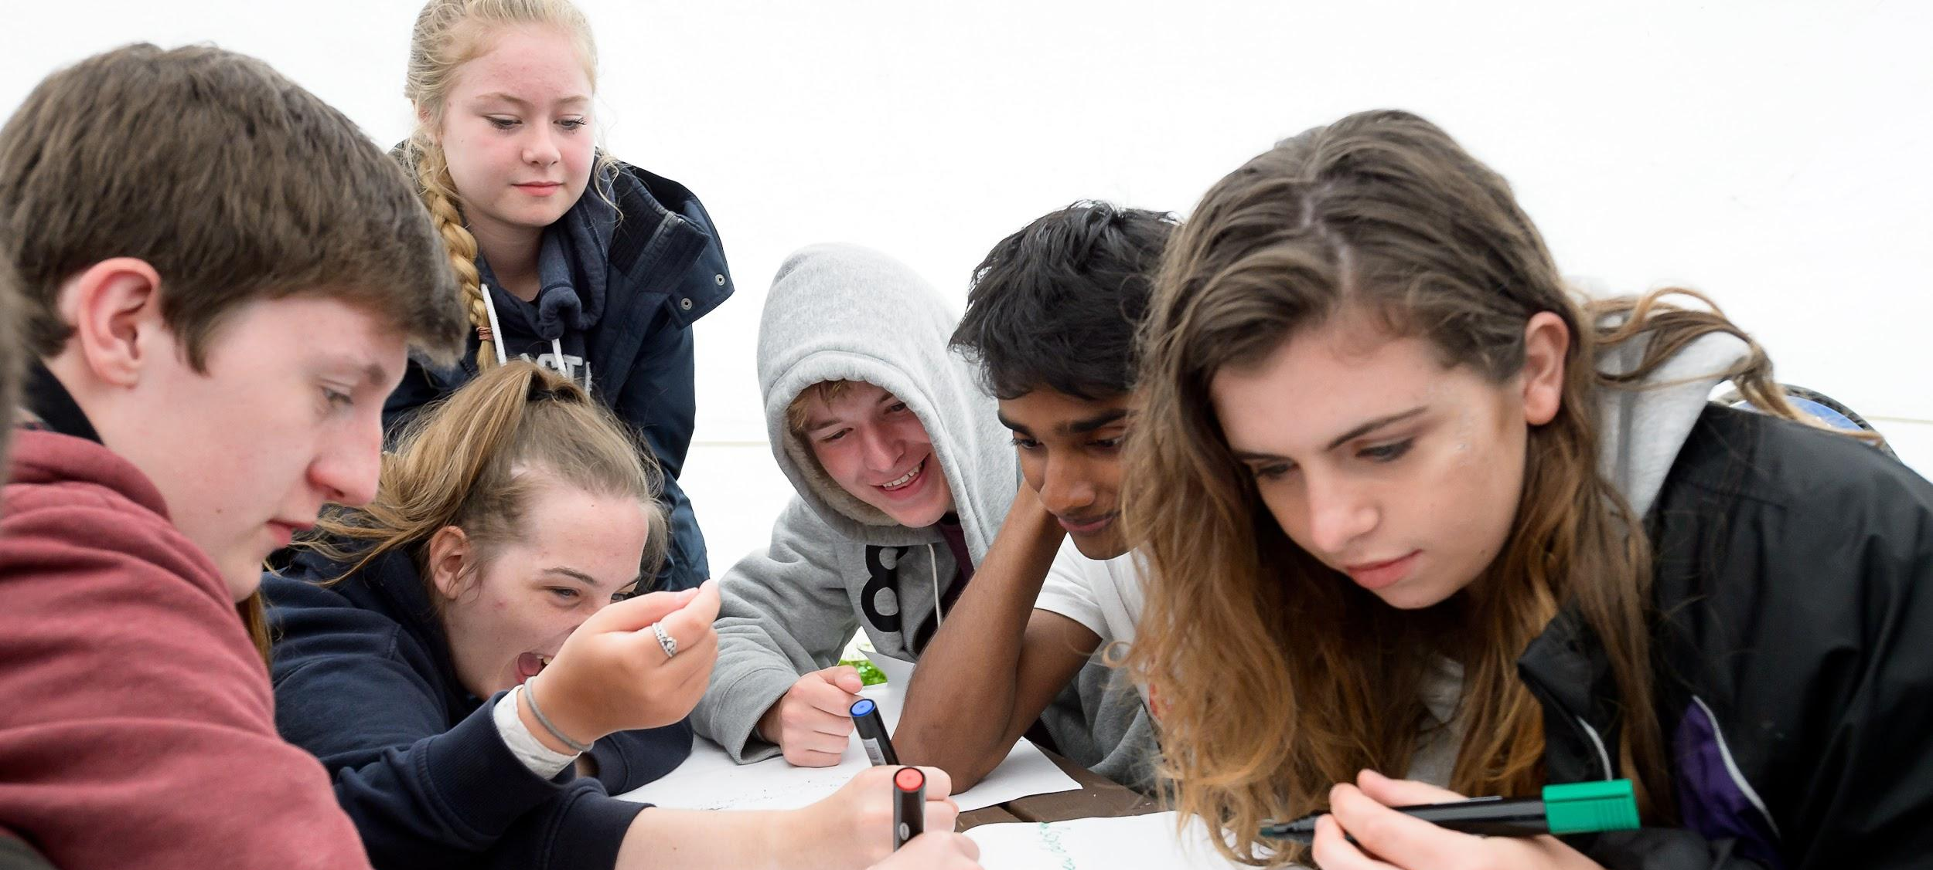
Managing your time

Slide 16
Step 1: List all the different things that you have to do during a week, e.g. lessons, appointments, family activities, etc.
Step 2: Now what time have you got left over - how much of that will be spent on other tasks (e.g. homework, study) and what can be used for free time?
Managing your time
Example activities:
Maths
English
Science
Geography
PE
Music
Business Studies
Tutor time
Appointments
Travel
Example activities:
Revision
Catch-up
Homework
Sport/Exercise
Meals
Family time
Friends
Fortnite

Slide 17
Making a ‘Life Timetable’
Day | 8:00 – 10:00 | 10:00 – 12:00 | 12:00 – 2:00 | 2:00 – 4:00 | 4:00 – 5:00 | 5:00 – 6:00 | 6:00 – 7:00 | 7:00 – 8:00 | 8:00 – 9:00 | 9:00 – 10:00
Monday
Tuesday
Wednesday
Thursday
Friday
Saturday
Sunday

Slide 18
Managing your time
Good habits to get into
Find a routine that works and stick to it
Write things down
Set yourself deadlines
Digital detox
Get enough sleep
Focus on one task at a time
Set time aside each day to plan your tasks for tomorrow
Stay active

Slide 19
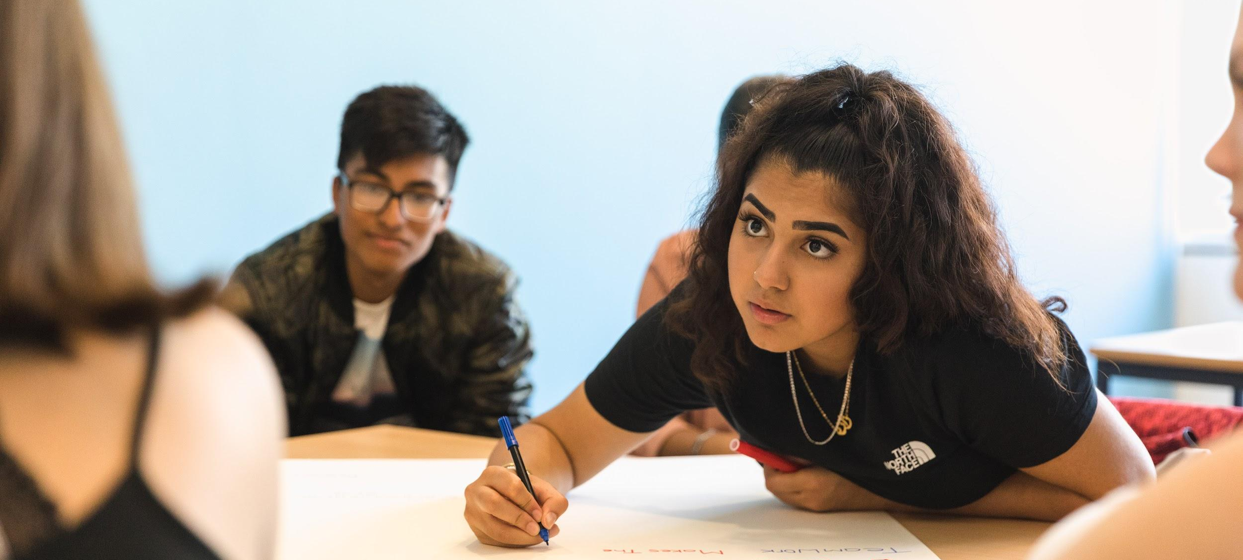
Setting yourself targets

Slide 20
Setting yourself targets
Making SMART Targets
The new year will bring many challenges, and getting back into a routine for success might be tricky.
You can use all the techniques we shared today to help you reach your goals, but another excellent method is to make a SMART target:
Specific (don’t be vague!)
Measurable (can you measure your progress?)
Achievable (will you know when you’ve reached it?)
Realistic (don’t pick the impossible!)
Timely (when will you finish?)

Slide 21
Setting yourself targets
Making SMART Targets
Example: Vague Target
“I want to learn to bake”
Example: SMART Target
“I want to be able to bake banana bread by 1st December”
Task: Make 3 SMART targets for the year ahead
One to continue a strength
One to fix a problem
One for outside school/college

Slide 22
Setting yourself targets
Reflection
Let's revisit those words in Slide 5
Have they moved at all?
What will it take to move any negatives to positive?
Can you use SMART targets to get you there?

