Slide 1
Maths and Careers Project

Slide 2
The brief:
‘To make at least 8 Maths lessons linking Maths with the world of work, and provide context in their education’
Suitable for KS3

Slide 3
These are the lessons:
Lesson 1 - Decorator
Lesson 3 - Landscape Gardener 1
Maths skills:
Area of compound shapes
Rounding
% increase and decrease
+ × ÷ −
Problem solving
Maths skills:
Loci
Scale
Circles
Problem solving
Lesson 2 – Personal finances
Lesson 4 - Landscape Gardener 2
Maths skills:
% of quantities
+ × ÷ −
One number as a percentage of another
Maths skills:
Circumference of a circle
Volume of a cylinder
Surface Area
Conversions
Division
Problem solving

Slide 4
These are the lessons:
Lesson 5 – Music Promoter 1
Lesson 7 - Ecologist part 1
Maths skills:
% of amounts
Sharing in ratio
rounding
+ × ÷ −
Problem solving
Money
Maths skills:
Sampling
Handling data
Finding the mean
Testing a hypothesis
Interpreting results
Lesson 6 – Music Promoter 2
Lesson 8 - Ecologist part 2
Maths skills:
Problem solving
% change
+ × ÷ −
Spreadsheets
sequencing
Maths skills:
Plotting a scatter graph
Interpreting a scatter graph
Testing a hypothesis

Slide 5
These are the lessons:
Lesson 9 – Swimming coach
Lesson 11 - Catering Manager
Maths skills:
Speed, distance, time
Converting between units
Rounding
Permutations
Problem solving
Maths skills:
Proportion
% increase
Rounding
Converting units
Problem solving
Lesson 10 – Architect
Lesson 12 - Vet
Maths skills:
Problem solving
Pythagoras
Converting units metric to imperial
Ratio
Maths skills:
Creating formulae
Substituting into formulae
Converting between units
Rounding

Slide 6
These are the lessons:
Lesson 13 – Market research Analyst
Lesson 15 - Cost of living
Maths skills:
Pie charts
Bar charts
Frequency Polygons
Data analysis
Suitability of different charts
Maths skills:
+ × ÷ −
% change
Plotting graphs
Interpreting real life graphs
Problem solving
All lessons have:
Starter activities linked to the main learning
Detailed lesson plan
Any blank grids/diagrams needed
Links to careers
Answers
Lesson 14 – Going to university
Maths skills:
% of amounts
Sequencing of events
+ × ÷ −
Problem solving

Slide 7
Let’s look at one in depth
Lesson 2 – Personal finances
Maths skills:
% of quantities
+ × ÷ −
One number as a percentage of another

Slide 8
Personal Finances -1
Personal Tax and National Insurance

Slide 9
What do you already know about personal finances?
You are going to see 6 multiple choice questions.
You just have to choose A, B, C or D
A
B
C
D

Slide 10
A single person is allowed to earn a certain amount per year before it is taxed – how much is this?
A
B
C
D
£8,870
£10,270
£12,570
£15,170
1 of 6

Slide 11
APR stands for…
A
B
C
D
Annual Print Run
Average Pay rate
April
Annual Percentage Rate
2 of 6

Slide 12
Approximately what percentage of your salary do you lose in tax and national insurance?
A
B
C
D
50%
33%
25%
20%
3 of 6

Slide 13
A person aged under 24 claiming jobseekers allowance gets a maximum of how much per week?
A
B
C
D
£59.20
£84.12
£102.11
£126.18
4 of 6

Slide 14
Approximately how much do you think a hairdresser earns per year, starting salary?
A
B
C
D
£9,000
£14,000
£22,000
£28,000
5 of 6

Slide 15
What does VAT stand for?
A
B
C
D
Various additional taxes
Veteran associationtax
Value added tax
Vote against tax
6 of 6

Slide 16
We are going to calculate how much you would actually get from a job
First we need to choose a career:
On the next slide are a selection of starting salaries per year for some careers
All will need various amounts of training or qualifications, but those with a blue star require a university degree or better.

Slide 17
Hairdresser
£14,000
Beauty Therapist
£16,000
Police officer
£19,164
Nurse
£20,329
Veterinary nurse
£18,000
Teacher
£25,714
Sales Assistant
£13,000
Events Manager
£21,000
Personal Trainer
£14,000
Pilot
£24,000
HGV driver
£19,000
Army - soldier
£15,985
Electrician
£18,000
Computer games developer
£25,000
Vet
£30,000
Doctor
£60,455
https://nationalcareers.service.gov.uk/explore-careers

Slide 18
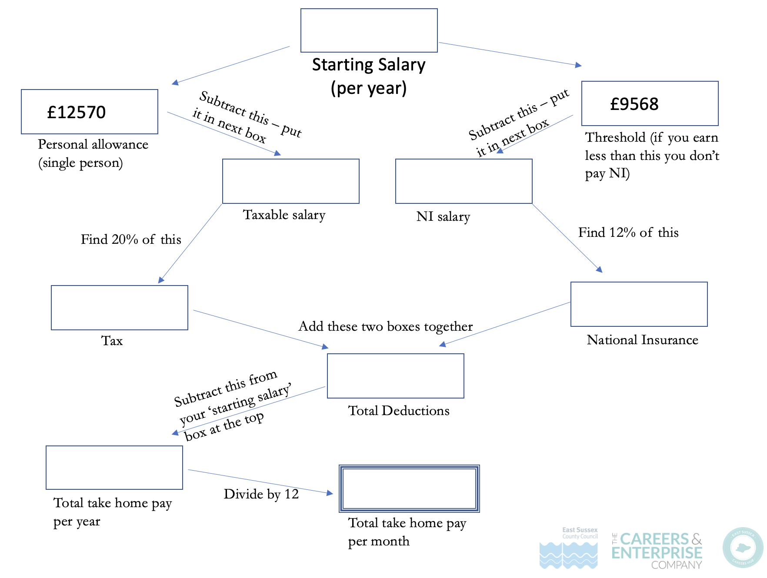
OK so you have chosen your Career..
We are now going to calculate your Tax and National insurance
…and see how much you would take home per month

Slide 19
example
£14,000
Starting Salary (per year)
£12570
£9568
Subtract this – put it in next box
Subtract this – put it in next box
Personal allowance (single person)
Threshold (if you earn less than this you don’t pay NI)
£1430
£4432
Taxable salary
NI salary
Find 20% of this
Find 12% of this
£286
£531.84
Add these two boxes together
Tax
National Insurance
Subtract this from your ‘starting salary’ box at the top
£817.84
Total Deductions
£13182.16
Divide by 12
£1098.51
Total take home pay per year
Total take home pay per month

Slide 20
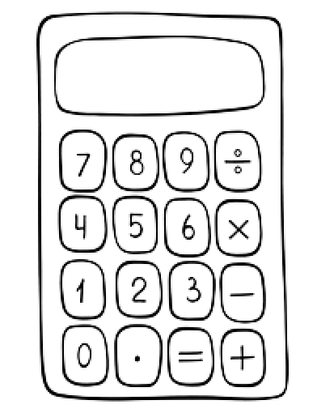
For starting salaries below £50,000
Starting Salary (per year)
£12570
£9568
Subtract this – put it in next box
Subtract this – put it in next box
Personal allowance (single person)
Threshold (if you earn less than this you don’t pay NI)
Taxable salary
NI salary
Find 20% of this
Find 12% of this
Add these two boxes together
Tax
National Insurance
Subtract this from your ‘starting salary’ box at the top
Total Deductions
Total take home pay per year
Divide by 12
Total take home pay per month

Slide 21
Starting Salary (per year)
For starting salaries above £50,270
Income Tax
National Insurance
Threshold (if you earn less than this you don’t pay N.I.)
£9568
Personal allowance No tax (single person)
Standard rate tax
Deduct £50270 from starting salary
£12570
£37700
£40702
Higher rate tax and NI
Find 20% of this
Find 12% of this
Find 40% of this
Find 2% of this
Add these two boxes together
N.I. higher rate
N.I. standard rate
Add these two together, put in here
Total tax
Total N.I.
Subtract this from your ‘starting salary’ box at the top
Total Deductions
Total take home pay per year
Divide by 12
Total take home pay per month

Slide 22
Did you know…?
There is an even higher rate of tax for people who earn more than £150,000 a year.
What percentage do you think that is?

Slide 23
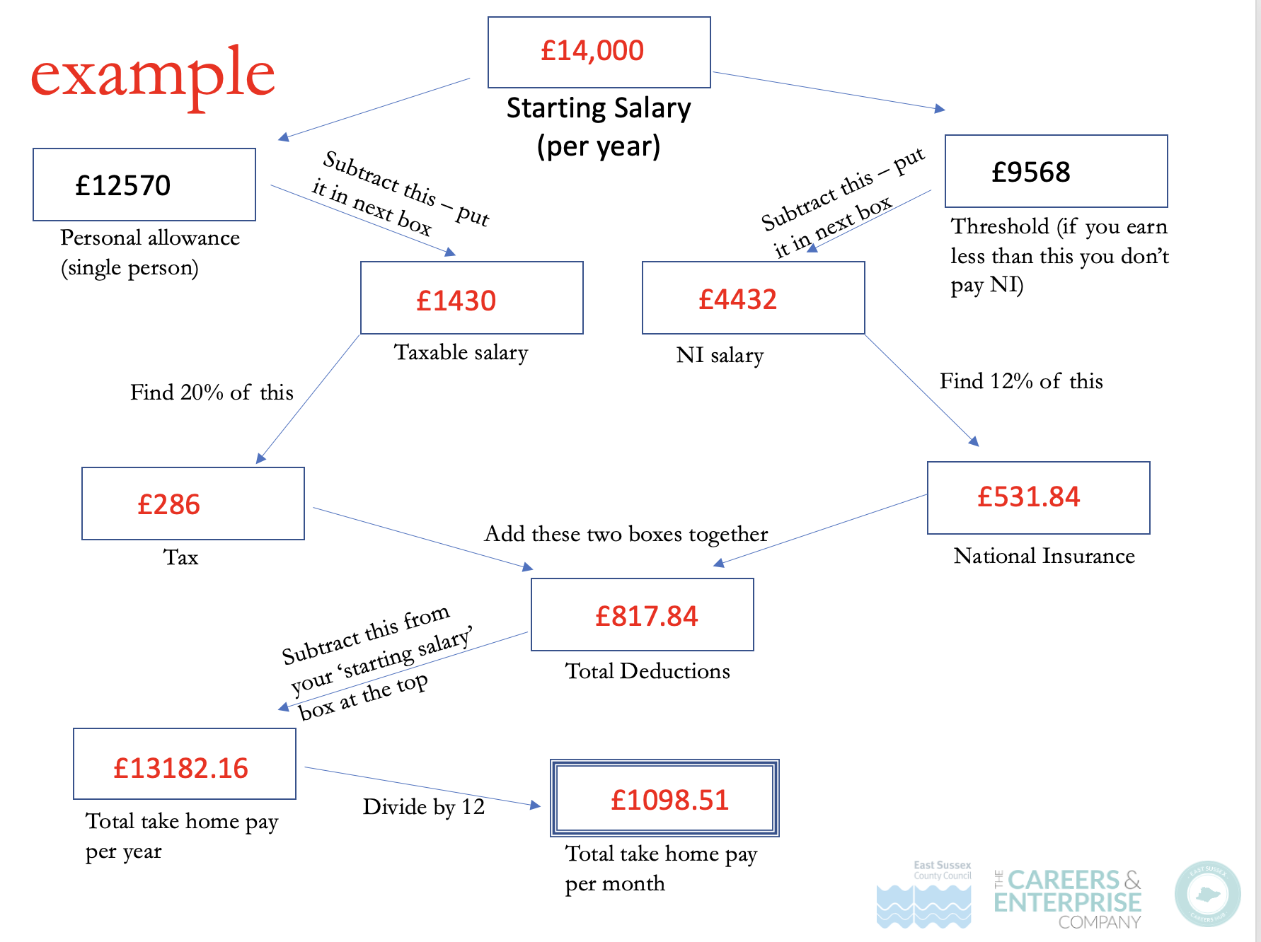
Using your calculations from this lesson. What percentage of your total salary would you actually get?
How do I do that?
Total take home pay
X 100
Starting salary

Slide 24
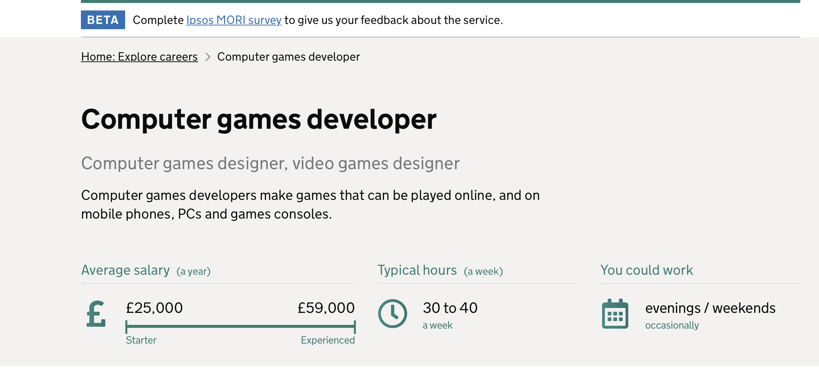
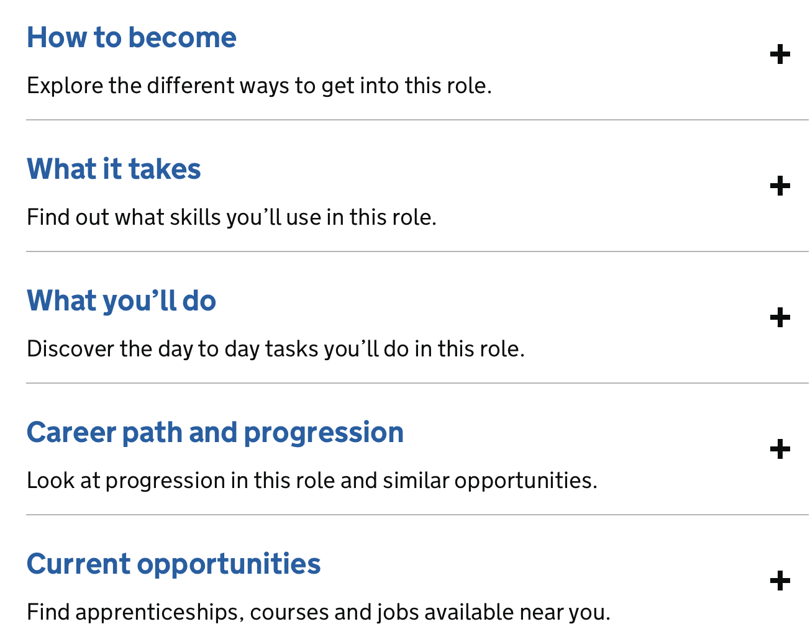
You can explore loads of different careers on this website.
https://nationalcareers.service.gov.uk/explore-careers
You can see the salaries
What qualifications you will need
What skills you will need
What you would do

Slide 25
Feedback from the schools that trialled them
One school used it from year 7 through to yr 12 in their global Finance week – picking suitable lessons for each year group
They found them enjoyable
They particularly liked the personal finance one as they were all surprised – they called it an eye-opener
They adapted the cost of living one, to using flats for sale in their local area
They liked that they could pick and choose from the selection for the ability of their class
One school is writing them into their scheme of work
Overall they went really well and rated them ‘very effective’

Slide 26
Any Questions?

Slide 27
Lesson 1 – Decorator
Paint a room, + ceiling
Work out costs of materials, and how much paint
The cost of their labour, and give customer a price
Lesson 6 – Music promoter 2
Calculate how much money they will make from the sale of the merchandise. They can decide their own design for their band, they have £1000 to spend on buying in the items, they then have to wrk out how many of each they want to buy with that money and then work out how much they make on the sale of it. Each item has a different % sold, and profit margin which is given later. –the idea is to see which team makes the most money
Lesson 2 – Personal Finances 1
Work out their tax, NI, etc from their wages and how much they will have left
Lesson 7 – Ecologist 1
Given a huge amount of real data (over 1000) on a fish called the Goby, to see if it’s body shape changes between rivers and lakes. They have to sample the data and organise it , calculate the mean, ready for part 2.
Lesson 3 – Landscape Gardener 1
Use loci to see where a pond could be dug
Harder scenario with a swimming pool
Lesson 8 – Ecologist 2
Using the data sample they collected from last lesson, they produce 2 scatter graphs, and interpret their results to see if they do change their body shape according to their environment.
Lesson 4. -Landscape Gardener 2
Dig a pond and put fish in it – the area of the pond liner, the volume of water needed, and how many fish they can put in
Lesson 9 – Swimming coach
They have to decide who is going to make the team from their swimmers, by calculating their speeds, they must also consider if it would be best for them to choose the fastest or the more consistent. They look at the possible combinations, and each group choose their swimmers. The times of all swimmers are revealed and they can see which team in the room won.
Lesson 5 - Music promoter 1
Calculate the amount of money the band will make, and how much they will make – they know the ticket prices, and concession prices, the % of seats sold, sitting and standing. Cost of hiring the venue, and the split of the proceeds

Slide 28
Lesson 10 – Architect
They have to calculate the length of the run on a roof, and the common rafter length, and the stringer length of stairs using Pythagoras, which is taught a bit in the starter. They also have to convert the units, and see how to use pythagoras to square a wall.
Lesson 14 – Going to university
They have 4 student scenarios, different courses with different backgrounds at different universities, and one living at home. They have to work out how much they will get in student loans, and how much it will cost to live at uni. And how much they will oew in student loans by the end of their courses.
Lesson 11 – Catering Manager
They have to cater a wedding, guests have chosen 3 courses, they have the recipes, (all are not metric) and need to calculate how many of each dish they will need and the amount of ingredients they will need– rather than all doing them all, they work in groups to share out the task.
Lesson 15 – Cost of living
Using the job they decided on in lesson 2 (personal finance ). Or they can use one of the ones given to them, they take the money they had left after tax and NI, and see how much it costs to run a home. Task 1 - They choose between a 1 or 2 bedroom flat and calculate the costs. See how much they have left for ‘fun’.
Task 2 they have the prices of food items from 2010, 2020, and 2022, so they can calculate the % increase. They then graph the percentage increase or decrease.
Lesson 12 - Vet
They are given various animals and their weights in various units, they have to calculate the correct amount of medicine for each animal given the dosage per kg etc.
Answers to starter activity on lesson 2
Q1 – C -this is for a single person
Q2 – D
Q3 - B
Q4 – A – this is a maximum for a single person
Q5 – B. -this is a starting salary
Q6 – C
Lesson 13 – Data research Analyst
They are given data on products from customers feedback and have to create a suitable chart to show the data to their clients, different data in each set so some numerical, some categorical

