Slide 1
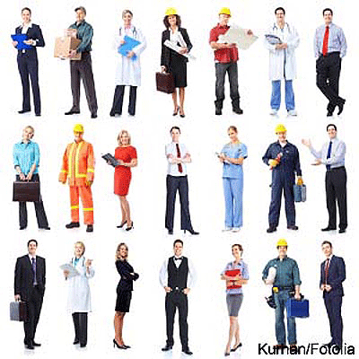
Career Stereotypes

Slide 2
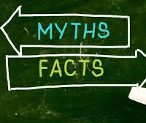
Purpose
To dispel some of the myths concerning careers suitable for particular groups of people.
By the end of the workshop, you will understand:
The meaning of prejudice and stereotype
How stereotyping might influence your career choices
  Be able to recognise your own and others stereotypical and prejudicial attitudes.
  Be aware of the negative consequences of prejudice and stereotypes.
Ways to challenge these stereotypes

Slide 3

Agenda
Introduction & agenda
What are stereotypes
Employee introductions
Guess the job of each employee
Reveal of employee jobs
Results and review of learnings

Slide 4
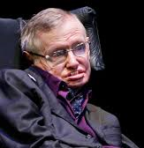

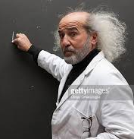
Who is a Professor?
Notes:
If I asked you to think of a professor, a farmer or a footballer, a visual image is likely to come into your mind. You might think that the professor is eccentric and the footballer rich and famous. These are stereotypes – images that pop into our heads when we think of a particular type of person or group of people. We could call stereotypes ‘effortless brain reference points’.
We all have these images and ideas that come to mind, and this does not necessarily need to be a problem – as long as these stereotypes do not affect our attitude and behaviour towards individuals. For example, it’s not good if we make assumptions about an individual based on a stereotype (e.g. all old people are weak and need help) or if we tease somebody because they do not conform to a stereotype (e.g. a boy that hates football). To prevent these assumptions and negative behaviours, we have to be aware of and be able to challenge the stereotypes we hold.
Stereotypes, of course, play their part in the development of prejudice. Prejudice or deciding something about a person before you even know them as an individual, can be fuelled by stereotypes. We might decide that a scruffy person is not to be trusted based not on the merits of the individual but on our preconditioned idea about all scruffy people.

Slide 5
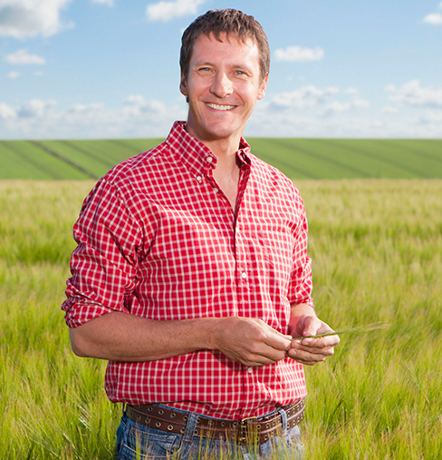
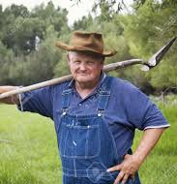
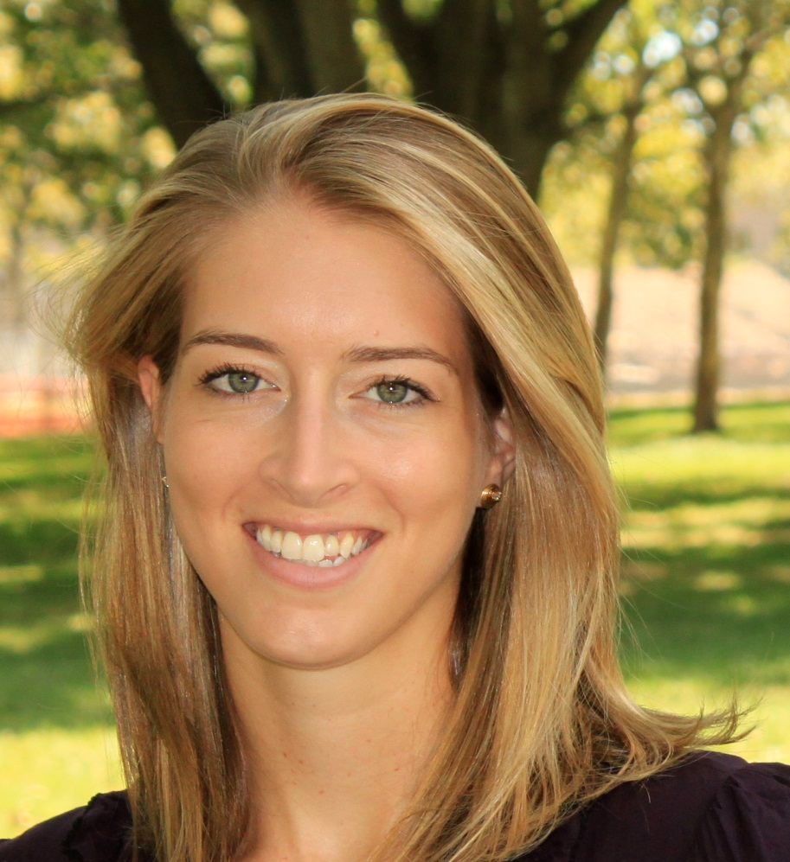
Who is a Farmer?

Slide 6
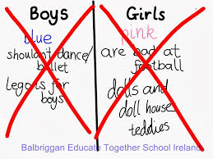
Gender stereotypes exercise
Look at the following ‘rules’ and sort them into what you think is expected more of teenage girls and what is expected more of teenage boys. Make sure you put each rule in either boys or girls – not both.
• Be sensible
• Don’t cry
• Be good at fixing things
• Be neat and organised
• Don’t be affectionate
• Be gentle
• Take risks and be daring
• Love sport
Notes:
Ask if pupils think it’s fair that there can be different rules for girls and boys, what happens if these rules are broken and which rules they think should be challenged.

Slide 7
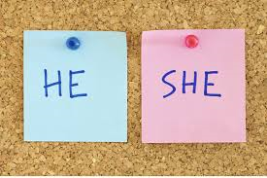
Gender stereotypes
Which ‘rules’ did you match to boys?
Which ‘rules’ did you match to girls?
How easy was it?
How do you feel being labelled in this way?
What could be the problem with being labelled in this way?
Notes:
class discussion where students feel comfortable to share their thoughts

Slide 8
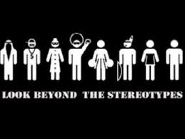
Stereotypes and prejudice
Stereotypes: thinking all people who belong to a certain group are the same and labelling them, for example all young people who wear hoodies are thugs.
Prejudice: judging someone without knowing them, on the basis of what they look like or what group they belong to, for example all black people are good dancers.

Slide 9
Employee Introductions
Notes:
Invite some local employees to be quizzed by the students – try and include people from roles that the students may not associate them with i.e – girl engineers etc

Slide 10
Quiz the employees
Notes:
Use the attached questions to support and scaffold the learning for the students to try and identify the roles of the people. For differentiation purposes roles could be given and have to be matched or students could be left to decide on the role themselves depending on ability

Slide 11
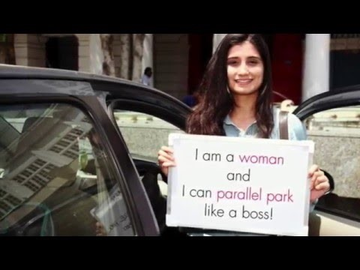
Notes:
PSA breaking gender stereotypes
https://www.youtube.com/watch?v=72p4Hg8ok8U
gender stereotypes

Slide 12
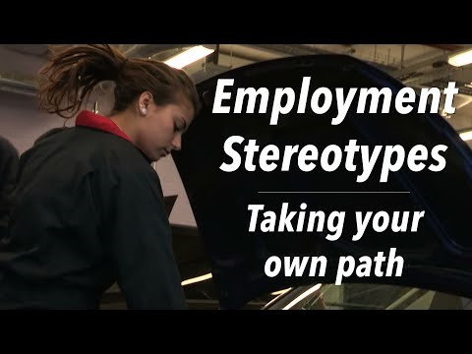

Slide 13
Employees reveal their jobs

Slide 14
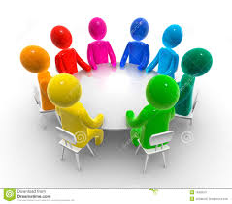
Table group discussion - reviewing your choices?
How many did you guess correctly?
What helped you guess the correct job?
What hindered you guessing the correct job?
What do you think influenced your decisions?
Do you think people often judge people like this in our everyday life?
What could be the consequences of pre-judging people?
Notes:
Encourage effective discussions thinking about what they learnt earlier regarding steroeptyping

Slide 15
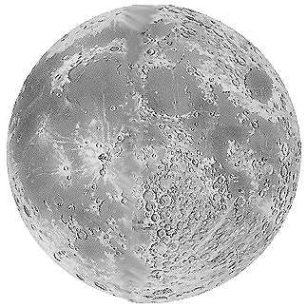
Choose your apprentice
You are an entrepreneur, like Alan Sugar on The Apprentice.
You need to ‘hire’ an engineer to set up life on the moon!
It’s a big, challenging job that will make history.
It needs the right apprentice - someone with resilience, determination, engineering expertise and great people skills!

Slide 16
Choose your apprentice
You have 7 applicants (write these names down):
  Ali
  Patrick
  Jamie
  David
  Adriana
  Hannah
  Delroy
Each time I reveal a layer of information about each applicant, you need to ‘fire’ one person by crossing out their name.
Who will you ‘fire’ and ‘hire’?
Notes:
Encourage discussion in groups around why they have crossed out that person at each stage what is informing their decisions?

Slide 17
Choose your apprentice
Ali | Patrick | Jamie | David | Adriana | Hannah | Delroy
The apprentices…
Fire one now so you have six remaining

Slide 18
Choose your apprentice
Fire one now so you have five remaining
Ali Abdul
Patrick Murphy
Jamie Small
David Campbell
Adriana Carboni
Hannah Mann
Delroy
Bailey

Slide 19
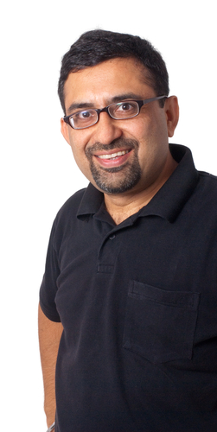
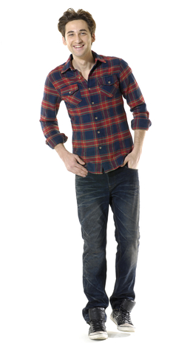

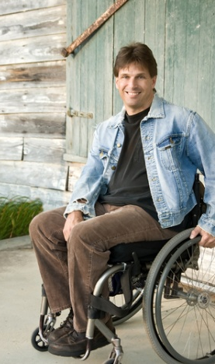
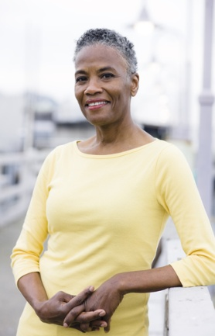

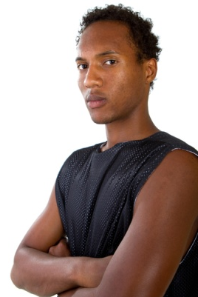
Choose your apprentice
Ali Abdul
Patrick Murphy
Jamie Small
David Campbell
Adriana Carboni
Hannah Mann
Delroy
Bailey
Fire one now so you have four remaining

Slide 20
Choose your apprentice
Fire one now so you have three remaining
Ali Abdul
Patrick Murphy
Jamie Small
David Campbell
Adriana Carboni
Hannah Mann
Delroy
Bailey
Muslim
Atheist
Christian
Mormon
Buddist
Spiritualist
Jewish

Slide 21
Choose your apprentice
Ali Abdul
Patrick Murphy
Jamie Small
David Campbell
Adriana Carboni
Hannah Mann
Delroy
Bailey
Physically fit but wears glasses
Physically and mentally fit
Physically fit and mentally fit
Physically disabled, mentally fit
Physically and mentally fit
Pregnant, physically & mentally fit
Physically fit but suffers anxiety
Fire one now so you have two remaining

Slide 22
Choose your apprentice
Ali Abdul
Patrick Murphy
Jamie Small
David Campbell
Adriana Carboni
Hannah Mann
Delroy
Bailey
Ex-Army
Entrepren-eur / business man
Firewoman
Doctor of engineering
Engineer and project manager
Army engineering officer
Engineer graduate
Fire one now so you have one remaining

Slide 23
Who was your choice?
What choice did you make?
Are you pleased with your hired apprentice?
Would you have made a different decision if you had the qualifications information first?
What is wrong with judging people with such little information?
What do you think influenced your decisions?
Do you think people often judge people like this in our everyday life?
What could be the consequences of pre-judging people?

Slide 24

Riddle
Listen as I read out a riddle.
You will need to answer some questions that follow.

Slide 25
Riddle
A van driver whistles to a nurse on the street then swerves to miss a parked car and crashes into a young boy and his father who are driving to school. The father dies at the scene. The boy is transported to the hospital, taken immediately into surgery... but the surgeon steps out of the operating room and says, "I can't operate on this boy - he is my son”!

Slide 26
Riddle - questions
How can the boy be the surgeon’s son?
Is the van driver a man or woman?

Slide 27
Riddle - answers
How can the boy be the surgeon’s son?
  The surgeon could be a woman and it is her son.
  Or the surgeon could be a man and they are a gay couple with a son.
Is the van driver a man or woman?
  Unknown – it could be man or woman. He or she could be whistling at a male or female nurse.

Slide 28

What have we learnt?
That people have negative attitudes and what is meant by prejudice and stereotypes.
To be able to recognise my own and others stereotypical and prejudicial attitudes.
To be aware of prejudice and stereotypes when thinking about my future career
Notes:
Reflection and verbal feedback from students encourage them to be honest about their thoughts before and after

Slide 29
