Slide 1
Career Ambassador training

Slide 2
Timetable for today
12.30pm | Introduction & Questionnaire
12.40pm | Ice Breaker
12.50pm | Leadership Training part 1
1.30pm | BREAK
2pm | Leadership Training part 2
2.45pm | Kahoot! Quiz
3pm | Finish

Slide 3
Thank you
For taking part in your schools’ career ambassador programme. By the end of the programme you will have gained knowledge and experience of leadership & careers which you can use on your CV, applications to sixth form, college, apprenticeships ect.
You are also helping to build the careers programme in your school which impacts every student including you!

Slide 4
Questionnaire

Slide 5
Teams of 2-4 with a named spokesperson

Slide 6
Ice breaker! Moon Landing NASA task
Read through the Moon Landing brief and list of items.
Rank the items individually under ‘my score’ then in teams, discuss your decisions and collectively rank the items under ‘team score’.
Items should be ranked 1-15 with 1 being the most important
Notes:
https://insight.typepad.co.uk/moon_landing.pdf

Slide 7
Ice breaker! Moon Landing NASA task
10 minutes to complete
We’re here if you need to ask a question
Notes:
https://insight.typepad.co.uk/moon_landing.pdf

Slide 8
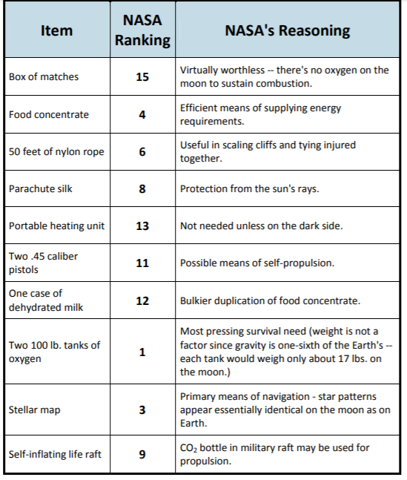
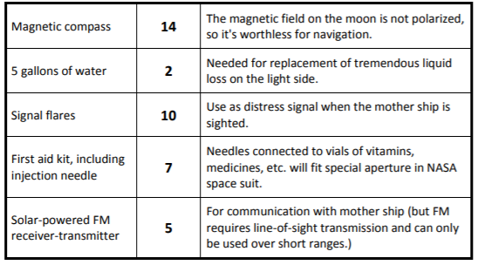
NASA answers
Notes:
Students to mark answers - points are scored through the difference between their own ranking and NASA ranking. For example, if students ranked matches as 5th most important then score is 10.

Slide 9
Ice breaker! Moon Landing NASA task
For each item, mark the number of points that your score differs from the NASA ranking and then add up all the points. Disregard plus or minus differences. The lower the total, the better your score.
0-25 You and your crew demonstrate great survival skills! 26-32 Above average - well done, you made it! 33-45 It was a struggle - but you made it in the end! 46-55 At least you’re still alive, but only just 56-70 Sadly, not everyone made it back to the mothership 71+ Oh dear, no one made it back to the mothership
Notes:
Students should recognise how important it is to work together, share ideas and make decisions as a team.

Slide 10
Aims of the training:
By the end of this training you should:
Be able to identify key leadership traits & skills
Assess yourself as a leader
Action plan to improve your own leadership skills
Be familiar with the careers ambassador booklet and comfortable to start working through the tasks

Slide 11
Leadership Activity 1; What is a leader?
What do you think a leader is? Why are leaders important?
Definition: The person who leads a group of people, especially the head of a country, an organization Oxford Dictionary
Notes:
Ask the room, give students a minute to talk on their tables first if they do not have ideas straight away.

Slide 12
Leadership Activity 2; What makes a good leader?
In your booklets write down as many skills/traits which you think make a good leader: Examples: organised & efficient

Slide 13
Leadership; What skills/traits make a good leader?
Enthusiasm
Integrity
Communication skills
Loyalty
Decisive
Empowers others
Charismatic
Hard working
To motivate a team To encourage honesty To work well with the team To be trusted To be productive So people are happy to come to work To build good relationships To set an example
Notes:
Ask students to think about each word on the list and why they think these traits would be important to good leaders. Write on a flipchart all the other words that the students come up with and then come back to these later on.

Slide 14
Leadership Activity 3; Assess yourself!
Using the skills you listed in your booklet and those on the presentation; tick all of the skills you think you have.
Don’t worry if there are lots you need to work on, we will be putting together a plan to achieve them later on!

Slide 15
Leadership Activity 4; SWOT Analysis
What is a SWOT analysis?
Notes:
Give students a minute to think Strengths, Weaknesses, Opportunities, Threats

Slide 16
Leadership Activity 8; Buzz Quiz
Take the Buzz Quiz
icould.com/buzz-quiz
Complete Activity 8 before the next session

