Slide 1
How can you maximise revenue through occupancy?
Filling a Film Studio
Year 9
Notes:
More catchy title?

Slide 2
Maths: To solve problems involving percentages
Careers: To highlight the relevance of Maths to future career paths
Essential Skills: Staying Positive, Leadership, Speaking, Problem Solving
Notes:
Resources for explicitly teaching these essential skills are available through the Skills Builder Hub here.
This lesson has really strong problem solving links, students will research and evaluate different solutions to quite complex problems. But there also opportunities to highlight speaking and leadership skills along the way. Call these out so students know they are developing other skills along the way, and that these skills are crucial in the workplace.

Slide 4
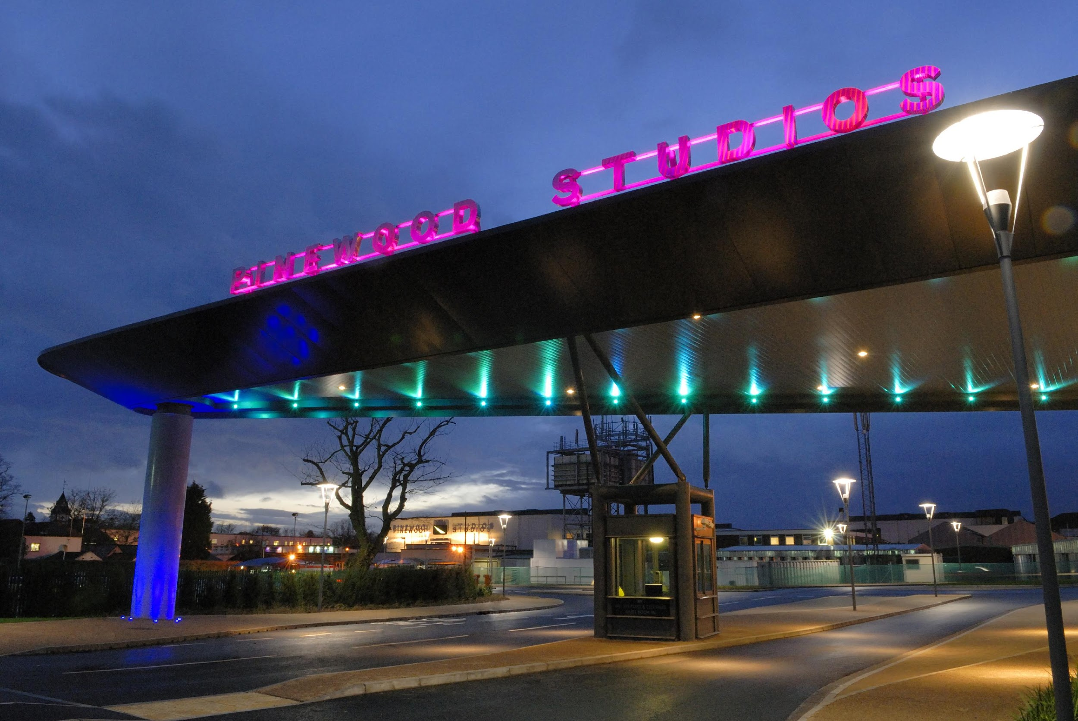
What do you know about Pinewood Studios?
What industry is this company related to?
What sort of job roles do you think there are?
© Pinewood Studios Limited
Notes:
Facilitate class discussion

Slide 5
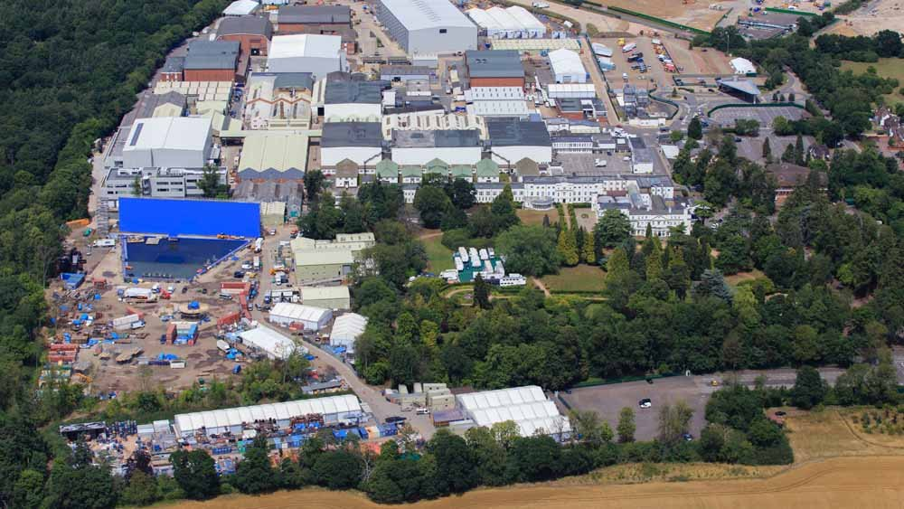
© Pinewood Studios Limited
Notes:
Play video: Meet commercial Director

Slide 6
Notes:
Play video: Meet commercial Director

Slide 7
Production
A film or TV show, when being made
Notes:
Definitions of keywords used in video. Check student understanding of these before moving on.

Slide 8
Footprint
The number and size of sound stages that a production uses, and the length of time they need them for
Notes:
Definitions of keywords used in video. Check student understanding of these before moving on.

Slide 9
Occupancy
The proportion or percentage of the
stages booked or occupied
Notes:
Definitions of keywords used in video. Check student understanding of these before moving on.

Slide 10
Revenue
The total amount of money Pinewood receives from customers for stage hire and services
Notes:
Definitions of keywords used in video. Check student understanding of these before moving on.

Slide 11
Context

Slide 12
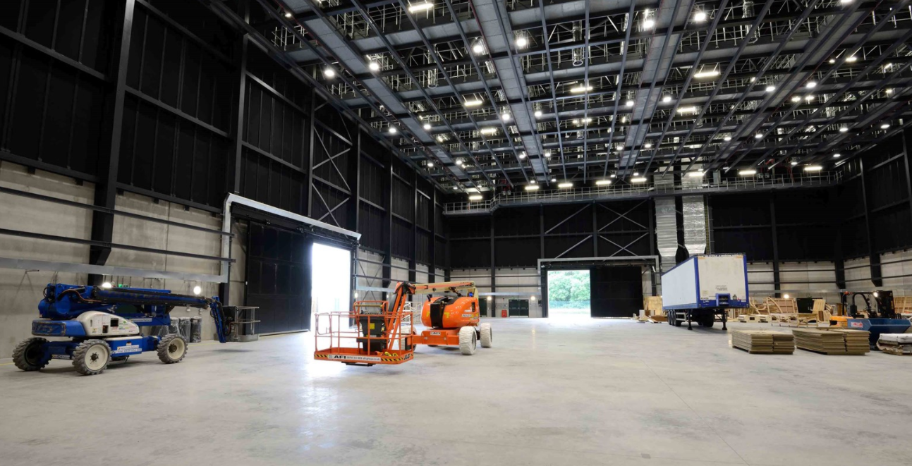
© Pinewood Studios Limited
Notes:
Play video

Slide 13
Notes:
Play video

Slide 15
Congratulations!
You’ve got the job!
You are the newest commercial manager at Pinewood Studios
Notes:
Introduce task to students - they become the commercial manager!

Slide 16
Commercial Manager
As a commercial manager you will need to look back at occupancy for January to decide how successful the company was, and calculate their total revenue for the month.
You will also need to look forward to ensure you are going to create good revenue for the rest of the year.
It is your job to make sure Pinewood have maximum occupancy to create maximum revenue!
%
?
£
Notes:
Teacher led - talk through their new role again and emphasis importance of it!
Discuss how problem solving required research and looking at pros and cons of something, which commercial managers do all the time to weigh up options.
Click here https://www.skillsbuilder.org/homelearning for Short Lessons and resources to explicitly build Problem Solving skills beyond this lesson

Slide 17
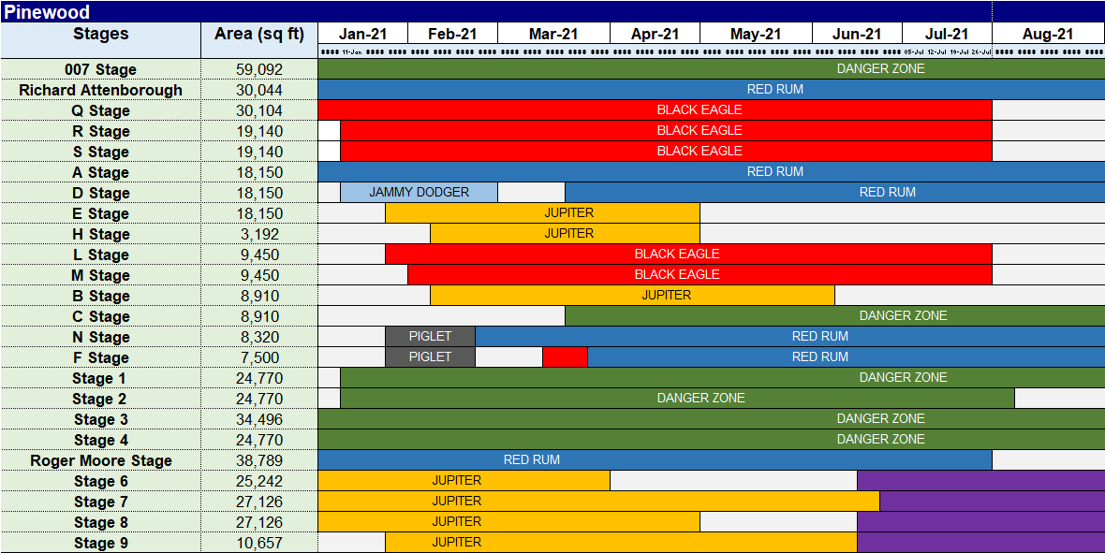
Stage bookings & availability
Chart shows which stages are booked and used by which production
Coloured bars are film or TV shows
White area is empty or available stages
Today
Notes:
Teacher led: This is the chart that a commercial manager will use to look at the bookings. Talk through the dates at the top; the stages on the left & the bars indicating the different films already booked in
Print this overview for students (in excel sheet)

Slide 18
Task 1 | How did we do in January?
What was the occupancy and revenue of the stages in January 2021?
As in any Industry, you have targets you need to meet.
The occupancy target in January was 80%. Was this target met?
There are two ways to calculate the occupancy:
Method 1: The percentage of stages booked
or
Method 2: The percentage of stage square footage booked
Notes:
First Task | Teacher to explain task and talk through the two methods (available on next slides)
Students will need the Task 1 Bookings printed and the Task 1 (Part1) worksheet printed. The answers are available and a teacher can decide how much of the completed table to provide students with - for lower ability students this task can be scaffolded by providing more values in the tables meaning students only need to calculate the totals and percentages. For lower ability students the methods can be modelled by the teacher for the first stage.
Students should be split into groups and within each group delegate the two methods. Method 1 is quicker than method 2 so should have less students involved.

Slide 19
Task 1 | How did we do in January?
What was the occupancy of the stages in January 2021?
Method 1
Step 1: Find the total number of days that stages were booked
Step 2: Find the total possible days available for stages to be booked (total days in January)
Step 3: Calculate the percentage of stages booked
Use the table to fill in your values
Notes:
Print for students using method 1 - provides a step-by-step guide to the process
Students will need the Task 1 Bookings printed and the Task 1 (Part1) worksheet printed.

Slide 20
Task 1 | How did we do in January?
What was the occupancy of the stages in January 2021?
Method 2
Step 1: Find the area (square foot) of each stage booked in January
(Square ft stage x days occupied)
Step 2: Find the total area (square foot) available for stages to be booked
(Square ft stage x total days in January)
Step 3: Calculate the percentage of stages booked
Use the table to fill in your values
Notes:
Print for students using method 2 - provides a step-by-step guide to the process
Students will need the Task 1 Bookings printed and the Task 1 (Part1) worksheet printed.

Slide 21
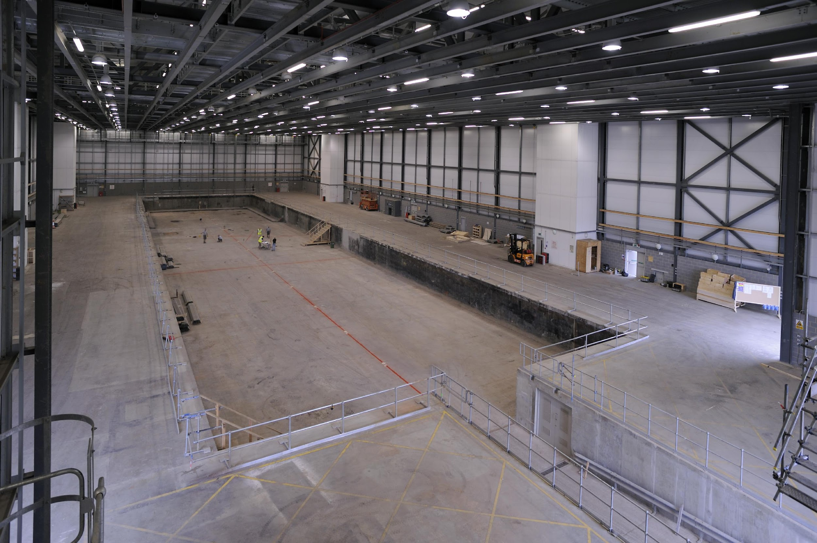
Task 1 | How did we do in January?
Do both methods tell us the same answer?
Why might one method be better than the other?
© Pinewood Studios Limited
Hint: Use problem solving skills to identify pros and cons of the different solutions
Notes:
Facilitate class discussion. Answers are provided on excel sheet to support.
The better method is method 2 as this takes into account the different sizes of each stage which is relevant as stages are priced based on their sq footage.
Method 1 = 66% occupancy but Method 2 = 81% occupancy, so yes the January target has been met!
Click here https://www.skillsbuilder.org/homelearning for Short Lessons and resources to explicitly build Problem Solving skills beyond this lesson

Slide 22
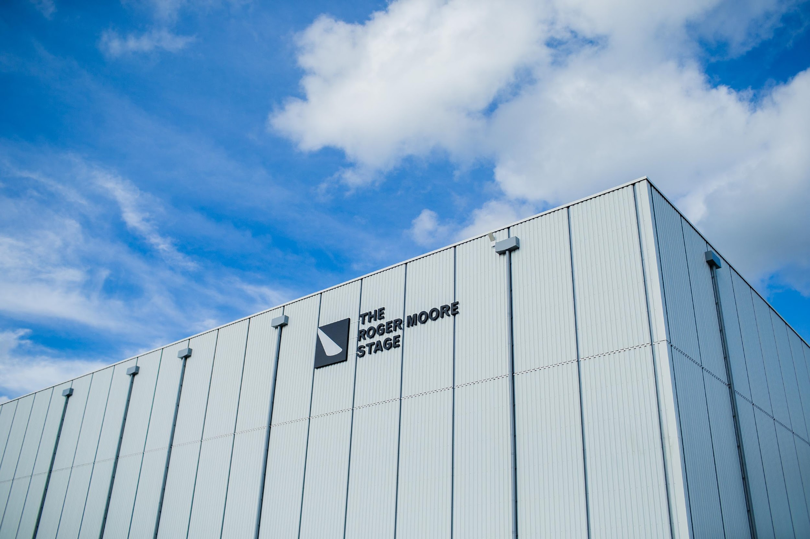
Task 1 | How did we do in January?
Do these methods give us enough information to evaluate our success?
If each stage costs a different amount to hire, can we use this information to calculate the revenue?
© Pinewood Studios Limited
Notes:
Facilitate class discussion. Answers are provided on excel sheet to support.
The better method is method 2 as this takes into account the different sizes of each stage which is relevant as stages are priced based on their sq footage.
Method 1 = 66% occupancy but Method 2 = 81% occupancy, so yes the January target has been met!
Click here https://www.skillsbuilder.org/homelearning for Short Lessons and resources to explicitly build Problem Solving skills beyond this lesson

Slide 23
Task 1 | How did we do in January?
What was the percentage occupancy of each stage in January 2021?
Split into two groups:
Group 1: calculate this using method 1 (by number of stages),
Group 2: calculate this using method 2 (by square footage of stages)
Notes:
Students to swap methods; so those working previously with method 1 will now use method 2; and vice versa.
Swap method sheets (slides 17 & 18) or print additional copies for students.
Students will need the Task 1 Bookings printed and the Task 1 (Part2) worksheet printed.

Slide 24
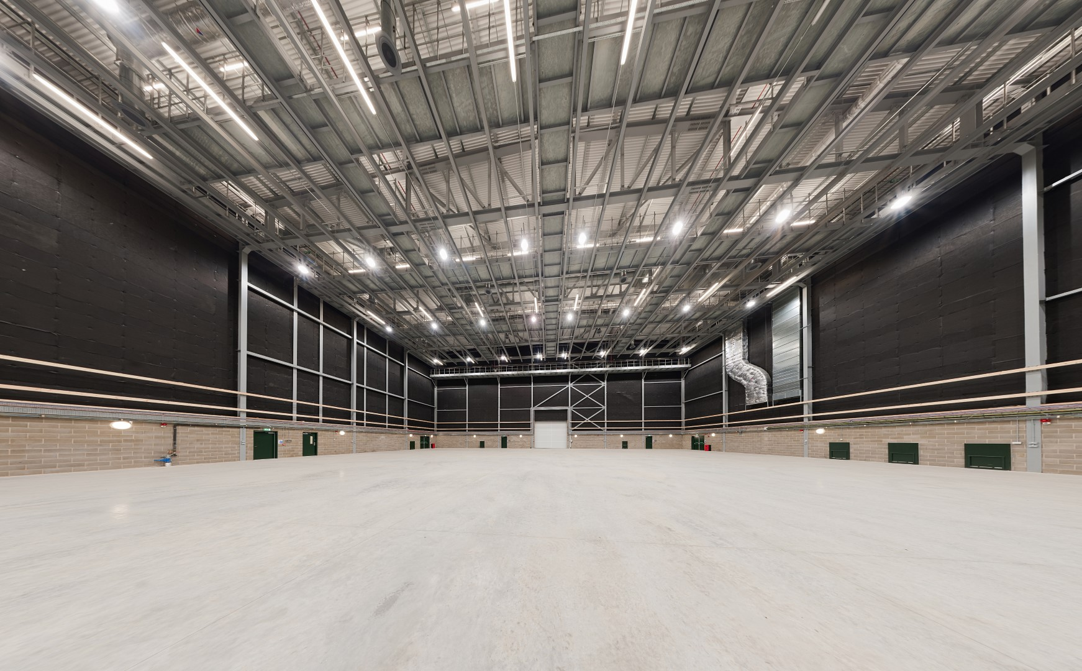
Task 1 | How did we do in January?
Compare the two methods, what do you notice about your answers?
Why has this happened?
© Pinewood Studios Limited
Hint: Use problem solving skills to identify pros and cons of the different solutions
Notes:
Facilitate class discussion. Answers are provided on excel sheet to support.
It doesn’t matter here which method is used; explore the maths here with students and get them to explain why it doesn’t matter.
Click here https://www.skillsbuilder.org/homelearning for Short Lessons and resources to explicitly build Problem Solving skills beyond this lesson

Slide 25
Task 1 | How did we do in January?
Complete a short report to summarise your findings.
Key Points:
Did you reach the target?
How did you complete your calculations? How can you show these are accurate?
Use the sentence starters and key word bank to support you.
Sentence Starters
In January 2021 we did/did not achieve our target occupancy.
Our target occupancy was 80% and we achieved an occupancy of …
To calculate the occupancy I…
This method gave me a more accurate answer because...
The total revenue in January was …
The stage with the greatest revenue in January was…
Key Words
Target
Footprint
Occupancy
Percentage
Revenue
Notes:
Print/display sentence starters and key words to support students.
Can be completed as a written task or a verbal speaking activity in pairs.

Slide 26
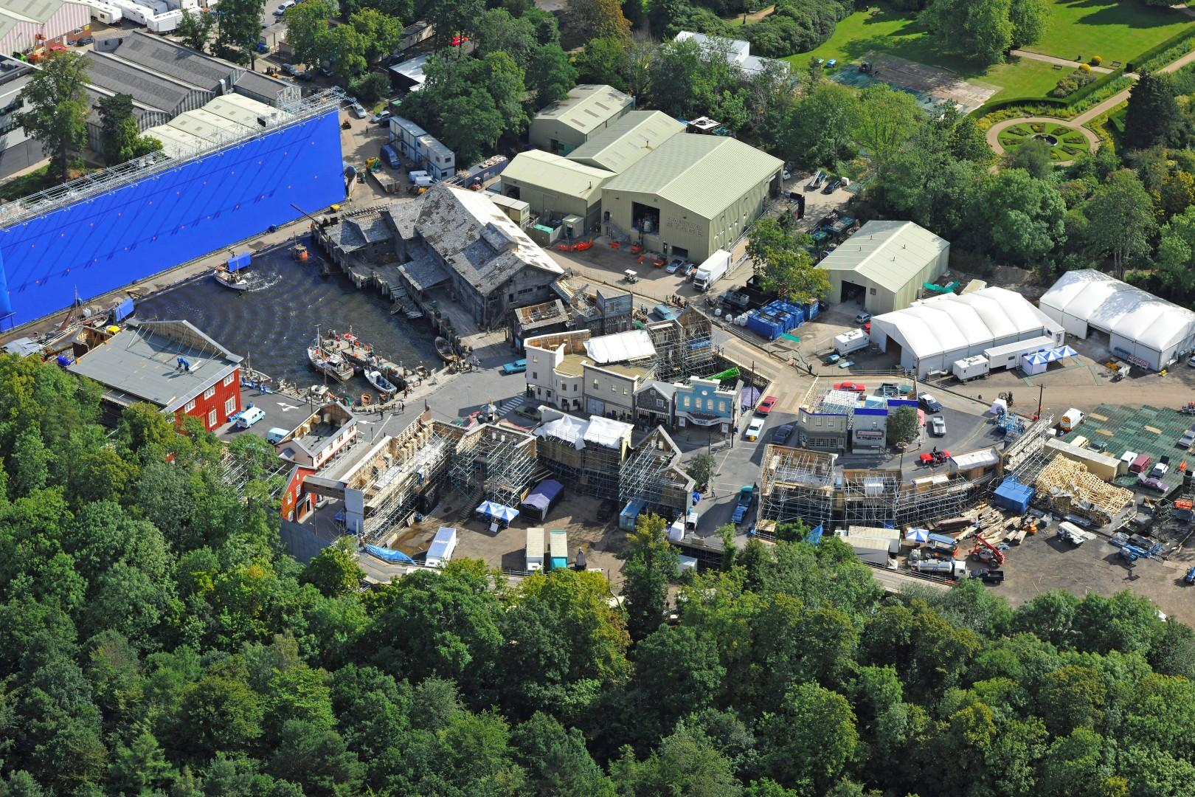
© Pinewood Studios Limited
Notes:
Play video

Slide 28
Task 2 | Planning for the future
You now need to look ahead to see how our bookings are looking for August.
Calculate the total percentage occupancy for August - use Method 2 as this gives us a more accurate indication of how successful we are.
Our target occupancy for August is 85%.
What occupancy percentage do we have?
By what percentage do we need to increase this to reach target?
Notes:
Introduction for task 2.
Students will need task 2 current bookings sheet printed. They will need copies of the task 2 worksheet a to complete these calculations. The answers are available and a teacher can decide how much of the completed table to provide students with - for lower ability students this task can be scaffolded by providing more values in the tables meaning students only need to calculate the totals and percentages. For lower ability students the methods can be modelled by the teacher for the first stage.
Current occupancy using method 2 is 65%
We need to increase by 20% to hit 85%- this is a percentage increase of 30.8%

Slide 29
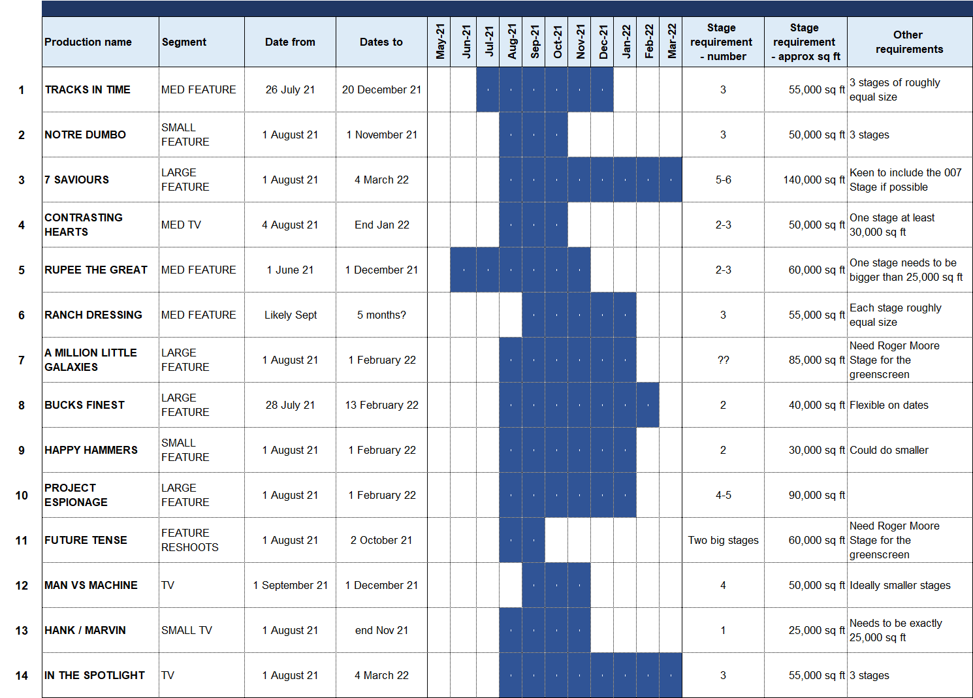
Production Pipeline
List of future productions who are interesting in booking space at Pinewood
Each production needs different footprint of stages, and some have other requirements
They are not yet all green lit!
Notes:
Print for students (in excel sheet)
Teacher to talk through the information provided here

Slide 30
Task 2 | Planning for the future
What productions from the pipeline, and what combination should we target to best use the available space?
What occupancy would each of these scenarios deliver in August?
How much extra revenue in 2021 will each scenario deliver?
You will need to present some possible scenarios and your best scenario:
the August occupancy potential; the revenue for each scenario; the percentage difference in revenue between your scenarios; any complications or practical advantages to each scenario
Notes:
Main task. Split students into small groups with the task of choosing which productions to pick from the pipeline to maximise the occupancy.
Each time students think they’ve found a good solution; they will need to complete the process (used in task 1; method 2 - to calculate occupancy) before moving on and trying a different variation. Students should aim to have calculations to support between 3 - 5 different combinations.
Students will need multiple copies of the August task 2 worksheet b to complete these calculations.
Click here https://www.skillsbuilder.org/homelearning for Short Lessons and resources to explicitly build Problem Solving and Speaking skills beyond this lesson

Slide 31
Task 2 | Planning for the future
Step 1
Step 2
Step 3
Rule out any pipeline projects which definitely cannot happen.
This might be because the start date is too early (by a considerable length of time); or the total footprint of stages required is too large; or because an individual stage size required is too large!
Evaluate the likelihood of each project happening and rule out any projects which are unlikely to happen.
Things to look out for are if the show hasn’t been green lit; or if there is not a confirmed start date for filming.
Time to play tetris!
You will need to trial different combinations to see which combination will work best.
If you think you’ve got a good fit, do some calculations to work out the percentage occupancy! You will need to try with a number of different combinations to find the best way!
Notes:
Teacher to read through these steps with students - they can immediately rule out some of the productions which will leave them with a smaller pipeline selection which will make the task more manageable.
This part can be completed together as a class; or independently. By Step 3 students should then be working in their small groups.
Click here https://www.skillsbuilder.org/homelearning for Short Lessons and resources to explicitly build Problem Solving skills beyond this lesson

Slide 32
Sharing Outcomes

Slide 33
Task 2 | Planning for the future
You will now need to select one or two members from your group to present your proposal to the rest of the class.
You have 5 minutes to prepare, and 2 minutes to present.
Remember the aim is to have the highest possible occupancy and therefore create the highest revenue!
Hint: use your leadership skills to choose the best person to present based on their strengths
Notes:
Students to present their best option from the 3 - 5 combinations. Encourage students to recognise how they are using Leadership skills to assign roles / choode who presents. This is an easily missed opportunity to highlight to students that leadership is not just about “being in charge” but about recognising others strengths and using them.
The aim is to maximise occupancy (by method 2 calculations) so the winning team will be the team with the highest occupancy.
Best option (model answer) is available on excel sheet for teachers.
Click here https://www.skillsbuilder.org/homelearning for Short Lessons and resources to explicitly build Leadership and Speaking skills beyond this lesson

Slide 34
Video 4
Notes:
Play video
Click here https://www.skillsbuilder.org/homelearning for resources that focus on Staying Positive skills.

Slide 35
Task 2 | Change of plan!
One of the actresses on Black Eagle has broken her ankle in a stunt and filming has been pushed back 2 months. This will delay Black Eagle’s finish by 2 months on either R Stage or L & M Stages
– it’s not yet clear which.
Notes:
Highlight to students that staying positive isn’t just about putting on a happy face but about responding to change in a constructive way. As a manager in the workplace this can have lots of impact on colleagues and the project outcome. If time, ask students why they think this is an important skill. Click here https://www.skillsbuilder.org/homelearning for resources that focus on Staying Positive skills.

Slide 36
Task 2 | Change of plan!
Given this latest update you now need to work together as a class.
Taking the proposed solution for maximising occupancy, can you work together to come up with a solution?
Notes:
Complete as a class using the groups plan with the highest occupancy.
Depth of this task may vary; students can consider possible ideas verbally; or return to the planning process and work out the calculations for different outcomes.
Click here https://www.skillsbuilder.org/homelearning for resources that focus on Staying Positive skills.

Slide 37
CAST
James Rider Commercial Director, Pinewood Group
CREW
Ben Orr Production Manager, Shepperton Studios
Enda Brignull Production Manager, Pinewood Studios
Erika McCormick Production Manager, Pinewood Group
Ben Palmer Commercial Analyst, Pinewood Group
Nick Long Head of Production, Turtle Canyon Media
Al Clayton Camera Operator, Turtle Canyon Media

