Slide 1
How big is the table, how small is the White Rabbit’s house?
How can we use ratio & proportion when building sets & props?
Year 8
Notes:
More catchy title?

Slide 2
Maths: To solve ratio and proportion problems to find missing values using scaling and multipliers
Careers: To highlight the relevance of Maths to future career paths
Essential skills: Listening, Speaking, Teamwork, Creativity
Notes:
Resources for explicitly teaching these essential skills are available through the Skills Builder Hub here.
There are simple speaking and listening activities throughout the lesson.
Highlight to students that Creativity is not just about being artistic, but about generating ideas and combining learning to develop ideas. Maths supports idea generation and therefore creativity.

Slide 4
The role of a Prop Master!
Notes:
Play video
Click here https://www.skillsbuilder.org/homelearning for lots of resources that will help students build listening skills, beyond this lesson

Slide 5
Context

Slide 6
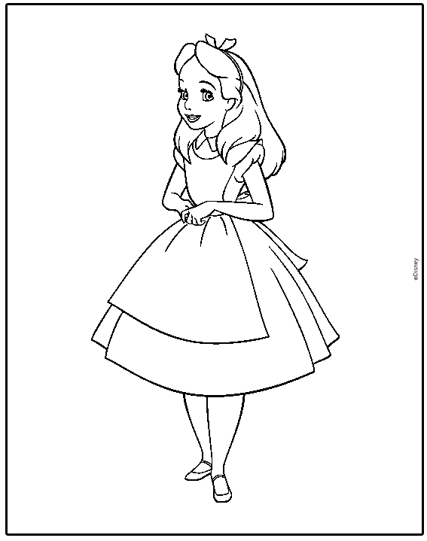
TV Adaptation | Alice in Wonderland
A new TV adaptation of Alice in Wonderland is being filmed at Pinewood Studios this summer.
In Alice in Wonderland, Alice drinks a bottle of liquid which makes her shrink; she later eats wild mushrooms which make her grow enormous! In this magical world, we need to make the actress playing Alice look really small, and then really big.
Notes:
Teacher led: talk through slide

Slide 7
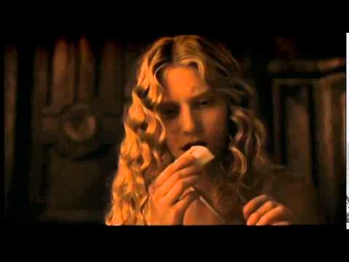
Film Clip: Alice in Wonderland
Notes:
Play video to set the scene

Slide 8
How did they make her miniature?
Did they shrink the actress?
How did they make it seem realistic?
What’s happening to the props and set around her?
Notes:
Facilitate class discussion
Encourage students to apply Teamwork skills by including everyone in the discussion - how did they make sure that they gained a diverse set of opinions in this discussion. Value the discussion not just the answer they come to.
Click here https://www.skillsbuilder.org/homelearning for Short 15min Lessons and resources to explicitly build Teamwork skills beyond this lesson. There’s also lots of resources on speaking and listening too.

Slide 9
Why do we need to use props?
We cannot make the actress actually shrink really small or grow really big so we need to use props to help create an illusion of this magical world where Alice becomes really big and really small.
Notes:
Teacher led: emphasis the importance of props to create this illusion

Slide 11
The process
As a prop master you will be given a design brief and essential items which will need to be included.
You will also have creative freedom to add in different elements to bring your set to life and add to the director’s vision for the scene!
Hint: use your creativity skills to combine ideas and innovate
Notes:
Teacher led: talk through slide
Highlight to students that creativity skills are not just about being artistic, but creativity is the ability to generate and develop ideas.
Click here https://www.skillsbuilder.org/homelearning for Short Lessons and resources to explicitly build Creativity skills beyond this lesson

Slide 12
You are the prop master!
Notes:
Play video
Click here https://www.skillsbuilder.org/homelearning for Short Lessons and resources to explicitly build Listening skills beyond this lesson

Slide 13
You are the prop master!
For the new TV adaptation of Alice in Wonderland, being filmed at Pinewood Studios this summer, you are in charge of creating and designing all the props.
In Alice in Wonderland, Alice drinks a bottle of liquid which makes her shrink; she later eats wild mushrooms which make her grow enormous! In this magical world, we need to make the actress playing Alice look really small, and then really big.
Notes:
Teacher led: talk through slide

Slide 14
The Mad Hatter’s Tea Party!
Scene: A table is set out under a tree in front of a house. The March Hare is sat at the table. A Dormouse is sitting on the floor, fast asleep. The table is a large one with a huge tea party with lots of different food laid out across it. Alice drinks some liquid and is miniature and walking along the table through the cups and saucers
Prop Brief:
Contents of Table (all the tea party items);
Notes:
Model example to work through with students. As a prop master you would be given a scene & a prop brief

Slide 15
The Mad Hatter’s Tea Party | Normal Size
Essential Props | “Normal” Dimensions
Table | L: 244cm W:80cm H:100cm
Plates | D:26cm
Tea Cups | D:5cm H:5.5cm
Tea Pot | D:10 cm H:11cm
Cake | D:20 cm H:12cm
Candles | D:2.5 cm H:18cm
160cm
“Normal” Alice
Key: L(Length) W(Width) H(Height) D(Diameter)
Notes:
Dimensions to support task

Slide 16
The Mad Hatter’s Tea Party | In miniature
Remember, the actress isn’t actually changing size!
Instead, the props around her will need to become larger.
Notes:
Teacher led: reminder to students of what’s happening when Alice shrinks

Slide 17
The Mad Hatter’s Tea Party | In miniature
Everytime Alice has 1 sip of the liquid, she shrinks to half her size.
If she has 1 sip, how tall will she be?
160cm
If she has another sip, how tall will she be now?
“Normal” Alice
How much smaller is she now? What is the ratio of her ‘normal’ to ‘miniature’ height?
Notes:
Pose the question to students and work together as a class: model the maths clearly so students have steps they can follow for independent task

Slide 18
The Mad Hatter’s Tea Party | In miniature
Everytime Alice has 1 sip of the liquid, she shrinks to half her size.
If she has 1 sip, how tall will she be?
160cm
If she has another sip, how tall will she be now?
“Normal” Alice
How much smaller is she now? What is the ratio of her ‘normal’ to ‘miniature’ height? 160: 40 or 4 : 1
Notes:
Answers

Slide 19
The Mad Hatter’s Tea Party | In miniature
If the ratio is 4 : 1
How many times smaller has she become?
So, how many times bigger will all the props need to become around her?
“Normal” Alice
Notes:
Teacher led:Facilitate class discussion.
Emphasis she has becomes 4 times smaller, so the props will need to become 4 times bigger.

Slide 20
The Mad Hatter’s Tea Party | In miniature
Essential Props | “Normal” Dimensions | Dimensions when Alice is in miniature (scene 1)
Table | L: 244cm W:80cm H:100cm
Plates | D:26cm
Tea Cups | D:5cm H:5.5cm
Tea Pot | D:10 cm H:11cm
Cake | D:20 cm H:12cm
Candles | D:2.5 cm H:18cm
Key: L(Length) W(Width) H(Height) D(Diameter)
Notes:
Print for students to complete. Model the first prop and then ask students to complete the rest of the table.
Extend students by researching what other props they might want to include at their tea party.

Slide 21
The Mad Hatter’s Tea Party | In miniature
In the next scene, Alice has another sip!
How tall will she be now?
How many times bigger will the props need to be now?
160cm
“Normal” Alice
How much smaller is she now? What is the ratio of her ‘normal’ to scene 2 ‘miniature’ height? What is the ratio of scene 1 to scene 2?
Notes:
Teacher Led: Model for students that she is now 8 times smaller so the ratio from her ‘normal’ to scene 2 ‘miniature’ height is 160: 20 which simplifies to to 8:1. The ratio of scene 1 to 2 is 40: 20 which simplifies to 2:1.

Slide 22
The Mad Hatter’s Tea Party | In miniature
Essential Props | “Normal” Dimensions | Dimensions when Alice is in miniature (scene 2)
Table | L: 244cm W:80cm H:100cm
Plates | D:26cm
Tea Cups | D:5cm H:5.5cm
Tea Pot | D:10 cm H:11cm
Cake | D:20 cm H:12cm
Candles | D:2.5 cm H:18cm
Key: L(Length) W(Width) H(Height) D(Diameter)
Notes:
Print for students to complete. Model the first prop and then ask students to complete the rest of the table.
Extend students by researching what other props they might want to include at their tea party.

Slide 23
The White Rabbit’s House!
Scene: Alice is in the White Rabbit’s House looking for her gloves, she eats some mushrooms and grows to an enormous size with her arms and legs protruding out of windows and doors. The White Rabbit and his friends come to shoo her out of his house. They throw rocks at her and she throws furniture back at them.
Prop Brief:
Her gloves, rocks and furniture from the White Rabbit’s house.
Furniture examples: chairs, a sofa and a fridge.
Notes:
Independent task: students now have a new scene to complete independently or in small groups.
Talk through the scene & prop brief

Slide 24
The White Rabbit’s House | Gigantic Alice | Task 1
Everytime Alice has 1 mushroom she grows three times bigger.
For ‘gigantic Alice’ scene 1 she has 1 mushroom.
For ‘gigantic Alice’ scene 2 she has 2 more mushrooms (3 in total).
How tall is she for scene 1?
What’s the ratio of ‘normal’ to ‘gigantic scene 1’?
How tall is she for scene 2?
What’s the ratio of ‘normal’ to ‘gigantic scene 2’?
By how many times smaller will each prop need to be for scene 1 and scene 2?
160cm
“Normal” Alice
Your Task: Calculate the prop sizes needed to gigantic Alice scene 1 & 2
Notes:
Display on the board for students and check understanding of the main task

Slide 25
The White Rabbit’s House | Gigantic Alice | Task 1
Essential Props | “Normal” Dimensions | Props for Gigantic Alice (scene 1) | Props for Gigantic Alice (scene 2)
Gloves | L:18cm W:9cm
Rocks | W:330cm H:270cm
Sofa | W:135cm L:390cm H: 90cm
Arm Chair | W:135cm L:100cm H: 90cm
Fridge | W:60cm L:90cm H:180cm
Key: L(Length) W(Width) H(Height) D(Diameter)
Notes:
Print for students to complete.
Extend students by researching what other props they might want to include at their tea party.

Slide 26
The White Rabbit’s House | Gigantic Alice | Task 1
Essential Props | “Normal” Dimensions | Props for Gigantic Alice (scene 1) | Props for Gigantic Alice (scene 2)
Gloves | L:18cm W:9cm | L:6cm W:3cm | L:0.7cm W:0.3cm
Rocks | W:330cm H:270cm | W:110cm H:90cm | W:12.2cm H:10cm
Sofa | W:135cm L:390cm H: 90cm | W:45cm L:130cm H: 30cm | W:5cm L:14.4cm H: 3.3cm
Arm Chair | W:135cm L:100cm H: 90cm | W:45cm L:90cm H: 30cm | W:5cm L:10cm H: 3.3cm
Fridge | W:60cm L:90cm H:180cm | W:20cm L:30cm H:60cm | W:2.2cm L:3.3cm H:6.7cm
Key: L(Length) W(Width) H(Height) D(Diameter)
Notes:
Answers

Slide 27
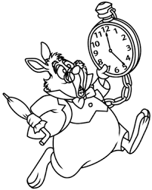
The White Rabbit’s House | Gigantic Alice
Remember, the actress isn’t actually changing size!
Instead, the props around her will need to become smaller, but there also needs to be ‘normal’ size props for the Rabbit to interact with.
The Rabbit is not human size so would his furniture be?
What information would we need to be able to calculate the size of the props needed for the rabbits furniture?
Notes:
Teacher led:
Can go into different level of depth for these questions: for lower ability groups - just get them to think about what would need to happen. For higher ability groups, could give a height for the rabbit and ask them to complete these calculations

Slide 28
Sharing Outcomes

Slide 29
The White Rabbit’s House | Gigantic Alice | Task 1
What dimensions did you need to use for the new props in scene 1 and 2 at White Rabbit’s House?
When calculating these for scene 2 what methods did you use? Did you calculate this from the “normal” dimensions or from scene 1 dimensions?
What additional props did you decide to add in?
What dimensions would you need to use to create these new props?
Notes:
Teacher led; Facilitate class discussion.
Focus on the different methods students used and which ones were more efficient
Explore students creativity here - what different props did they chose to add in?

Slide 30
The White Rabbit’s House | Gigantic Alice | Task 1
!Change of Plan!
Due to the detail and intricate nature of building the miniature fridge for Gigantic Alice; and the contents of the food inside to look good on camera the designers have come back to us!
They’ve said the smallest they want to make the width of the fridge is 6.67cm.
Notes:
Explore how this is an example of what might happen in the workplace. Why might staying positive be an important skill for a manager in this scenario? Highlight that it is not just about putting on a happy face, but recognising when and how people can be frustrated by change and how this affects the outcome of the task
If your students struggled with this last minute change, consider using the resources here https://www.skillsbuilder.org/homelearning to explicitly build Staying Positive skills beyond this lesson

Slide 31
The White Rabbit’s House | Gigantic Alice | Task 1
!Change of Plan!
If the width of the fridge can only be 6.67cm, how will this affect the other dimensions of the fridge?
How will this affect the sizes of the other props?
How will this affect the size of Alice? How many mushrooms would she eat?
Notes:
The level of detail in this final task may vary depending on the ability of the group. A more able group should be able to do the calculations and see the change in the ratio and answer these questions precisely; a less able group may just acknowledge that this would mean all the dimensions would need to change and that Alice wouldn’t appear as many times bigger as we originally wanted her to.
If your students struggled with this last minute change, consider using the resources here https://www.skillsbuilder.org/homelearning to explicitly build Staying Positive skills beyond this lesson

Slide 32
CAST
Sarah McGettigan Head of TV, Pinewood Group
CREW
Nick Long Head of Production, Turtle Canyon Media
Al Clayton Camera Operator, Turtle Canyon Media
WITH THANKS TO
All at National Geographic

