Slide 1

Will there be a second series?
Using audience figures and social media data to evaluate success
Year 7
Notes:
More catchy title?

Slide 2




Maths: To interpret data in a variety of forms for a specific purpose, understanding the limitations of such interpretation
Careers: To highlight the relevance of Maths to future career paths
Essential Skills: Speaking, Listening, Problem Solving
Notes:
Resources for explicitly teaching these essential skills are available through the Skills Builder Hub here. Students use speaking skills at the end of this session to share their reflections.
Highlight to students that Problem Solving includes researching a problem to learn more about it, students might not know this is important in “Maths” so there is an opportunity here to address misconceptions

Slide 4
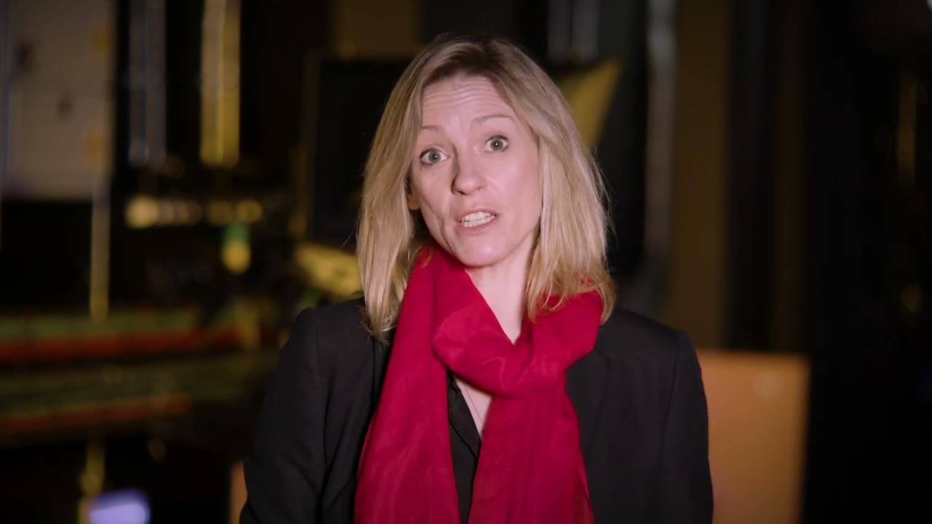

Slide 5
Re-commission
To commission something again
A ‘commission’ is a piece of work that someone is asked to do and is paid for, for example creating a TV show
Notes:
Definitions of keywords used in video. Check student understanding of these before moving on.

Slide 6
Context

Slide 7
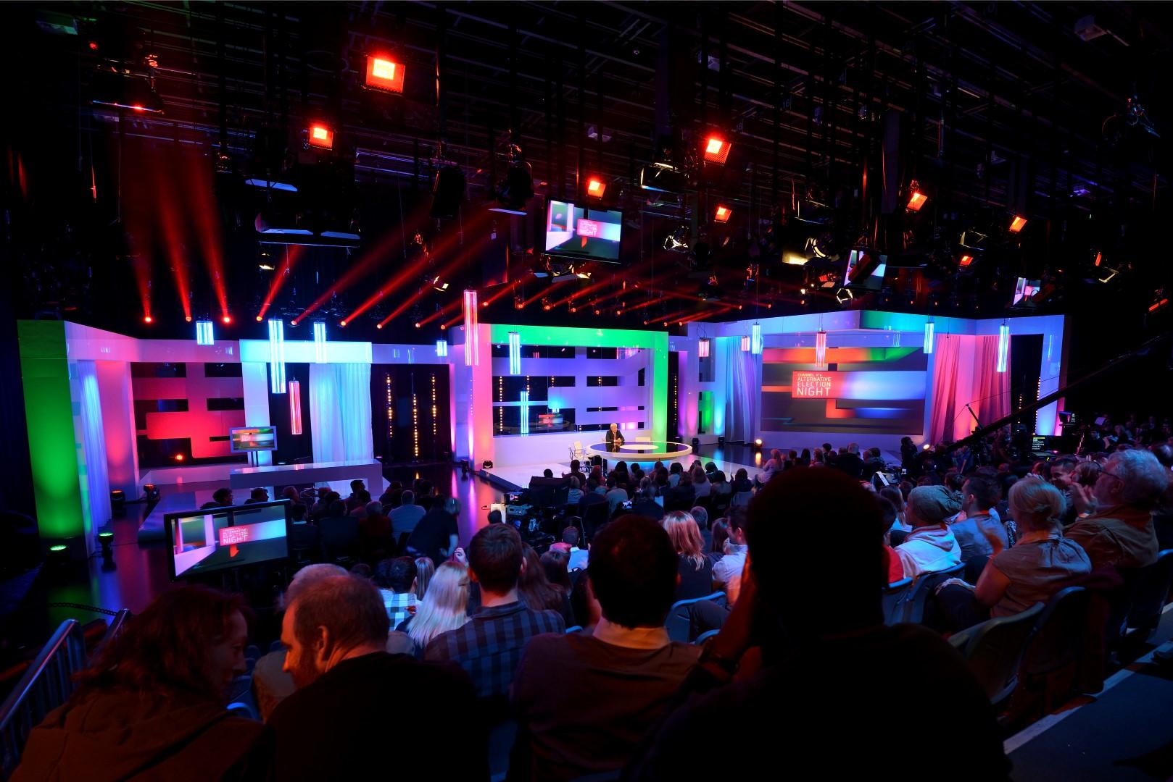
Audience Share Analysis
What is it?
Why’s it important?
Notes:
Class discussion (this could be facilitated through a think.pair.share)

Slide 8
Audience Share Analysis
TV programme share of audience, based on the size of the total viewing audience over the week.
Notes:
Key definition to support class discussion

Slide 9

Social Media Platforms & Metrics
Top social media platforms include: twitter, facebook and instagram
Metrics to assess success of campaign can include:
Follows
Fans
Reach
Engagement
Social media engagement is a metric by which we measure the popularity and therefore success of a TV or film production
Notes:
Teacher led slide: talk through the different social media platforms and the different metrics which are used to assess the success of a campaign

Slide 10
Reach vs Engagement
Reach: how many people does our social media content reach?
Reach matters only if your audience listens to or reads what you’re saying.
Engagement: how many people liked/shared/commented on our social media content?
Engagement is a better metric to ensure your audience has seen that piece of content and engaged with it.
Notes:
Teacher slide: Explore differences between reach and engagement. Pose question to students: which is more important?

Slide 11



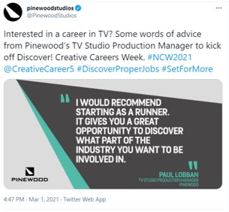
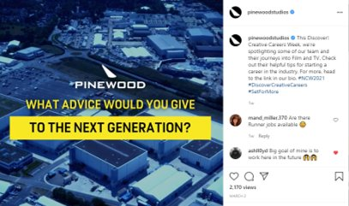

Example of a current campaign
Pinewood Studios takes part in #CreativeCareersWeek. Top posts were:
Impressions: 7,705
Engagement: 186
Reach: 8,892
Views: 2,170
Reach: 5,886
Engagement: 333
Notes:
Teacher led slides: some examples of current campaigns run by Pinewood Studios - look at the difference between the reach and the engagement.
Would we always expect reach to be higher than engagement?
This doesn’t necessarily mean a campaign wasn’t successful, but important to consider

Slide 12

© Pinewood Studios Limited

Slide 14

Welcome to the Research & Insights team
Notes:
Teacher led slide: Intro to task

Slide 15
Welcome to the Research & Insights team
We have just come to the end of the first series of a new Saturday night talent show called ‘Way to the Stage’, recorded at Pinewood Studios.
We think the show has been a great success but we now need to provide support as to whether or not to recommission series 2 and we need some evidence to present to the Commissioning and Programming teams.
It’s your job to review the data and prepare a report to explain whether or not to recommission the show for a second series.
Hint: you’ll use problem solving skills to research the problem and suggest a solution
Notes:
Teacher led slide: Intro to task
Click here https://www.skillsbuilder.org/homelearning for Short Lessons and resources to explicitly build Problem Solving skills beyond this lesson

Slide 16
Talent Availability
Audience data trends
Audience data trends
Budgets and Funding
Should we recommission the show?
Studio & Crew Availability
Hint: problem solving skills includes using information from lots of sources to find a solution
Social Media data trends
Social Media Engagement Trends
Revenue and profitability
Notes:
Pose the question to students: What factors might be considered when deciding whether to recomission a show? Here are 6 possible factors to consider (not there are more!), but here we are going to focus in on two - the Audience data trends and the Social Media Engagement Trends
Click here https://www.skillsbuilder.org/homelearning for Short Lessons and resources to explicitly build Problem Solving skills beyond this lesson

Slide 17
Audience Data Trends
By using data collected on the UK’s weekly top programmes, analyse whether the audience data trends suggest if the show was a success.
Key Questions to consider and explore:
For how many weeks was the programme at number 1?
Did the viewing numbers increase or decrease throughout the series What does this tell us about whether people liked the programme or not?
Were there any viewing highs or lows throughout the series? If so, when? What might be the explanations for this?
What were the average viewing figures for the series? What average will you use to calculate this, could you compare the difference between the different averages?
Notes:
Task 1: Teacher to read through task; consider key questions and display them on the board for students whilst working. Students to work in pairs or small groups.
Provide students with the audience data trend graphs from the excel sheet.

Slide 18
Audience Data Trends
What conclusions can we make about the audience data trends?
Looking at the audience data trends we can see that across the series the audience figures … from … to …
This tells us that …
The highest viewing figures was for episode … and the lowest viewing figures was for episode…
This might have been because...
The average viewing figures for the series was … The average I used was … because ...
In conclusion based on this data I would recommend that there should/should not be a second series because...
Notes:
Print this slide for students to act as a writing frame for their final answer.
(Option to complete as a verbal speaking task if preferred)

Slide 19
Social Media Data Trends | Facebook
By using data collected from the social media channels, we can analyse whether there was engagement with this show and if the audience was engaged with our content.
Let’s look at the data trends from Facebook as a class.
Notes:
Task 2: Teacher to lead and model how to analyse engagement from social media using data from Facebook

Slide 20
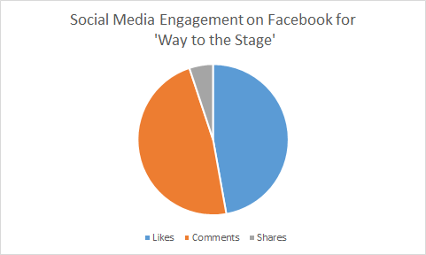
Social Media Data Trends | Facebook
What does this data tell us about reach vs engagement?
What are the limitations of this data?
(What does it not tell us)
Notes:
Teacher led - pose question to students and facilitate discussion
The data shows us that comments where the highest form of engagement was comments, however what it doesn’t tell us is how many likes; comments or shares there were - this could be a total of 10 people; or 10,000 - so we need to look at more data.
Key Learning point: This is a limitation of data being represented by a pie chart; if you do not know the total of the data set.

Slide 21
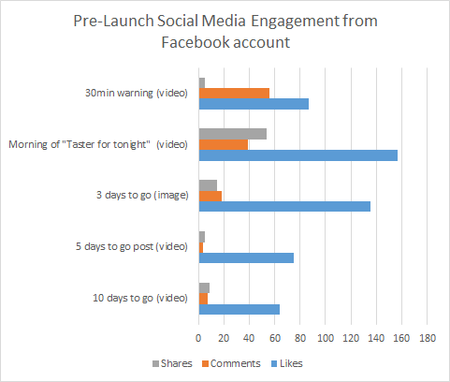
Social Media Data Trends | Facebook
What was the most popular type of interaction? Does this engagement increase reach? What does it tell us about reach vs engagement?
Which post had the most engagement?
What does this data tell us about the number of people that engaged with the content pre-launch?
Notes:
Teacher led - pose question to students and facilitate discussion
The most popular type of interaction was ‘likes’. Whilst ‘shares’ are low which might have increased reach; we can see engagement by people liking the posts; but not as much engagement as when people comment on the posts.
The one with the most engagement was the morning of ‘taster for tonight’ video.
Videos had a higher engagement than images.
In total just over 700 people engaged with the social media on Facebook.

Slide 22
Social Media Data Trends | Facebook
In pairs, you will be assigned the data for one of the episodes; and you will need to answer the same 3 questions.
We will then compare the findings across the series.
What was the most popular type of interaction? Does this engagement increase reach? What does it tell us about reach vs engagement?
Which post had the most engagement?
What does this data tell us about the number of people that engaged with the content pre-launch?
Notes:
Give each student one of the graphs for one of the weeks (found in the excel sheet under social media facebook)
Pose the 3 questions in the box for students to answer.
Facilitate a class discussion to share answers (following slides to support)

Slide 23
Social Media Data Trends | Facebook
Episode | 1 | 2 | 3 | 4 | 5 | 6 | 7 | 8
Most popular interaction
Most engagement
Total numbers
Notes:
Share as a class the findings from each graph - the next slide has the answers but elicit responses from students.
Student observations can extend beyond this table - prompt students to think about anything else they noticed from their graph?
Now lead a discussion about how this changes across the series and what conclusions we can draw from this.
What do you notice about how the time of highest engagement tells us? What might this mean?
Importantly as well - what does this not tell us?

Slide 24
Social Media Data Trends | Facebook
Episode | 1 | 2 | 3 | 4 | 5 | 6 | 7 | 8
Most popular interaction | C (942) | C (1275) | C (796) | C (1248) | C (1873) | L (1570) | L (2260) | C (2516)
Most engagement | Morning of | Morning of | Morning of | 3 Days ‘pre’ | During Ep | During Ep | During Ep | Morning of
Total numbers | 1687 | 2007 | 1611 | 2212 | 3045 | 3170 | 3892 | 5064
Notes:
Share as a class the findings from each graph.
Now lead a discussion about how this changes across the series and what conclusions we can draw from this.
What do you notice about how the time of highest engagement tells us? What might this mean?
What else did groups notice about the data from their chosen episode?
Importantly as well - what does this not tell us?

Slide 25
Social Media Data Trends | Facebook
What conclusions can we make about the social media engagement on Facebook?
Looking at the data from the social media content on facebook we can see that the engagement … across the series. In the pre-launch week total engagement was . and for the final episode it was … This shows us that…
The most popular type of engagement across the series was … In total there were … (number of) … This shows … but would not …
The most popular time for engagement throughout the show was … and … This suggests that…
In conclusion we think this data tells supports the decision to have/not have a second series because...
Notes:
Writing frame for students. This version could be a verbal or a written task.

Slide 26
Social Media Data Trends | Facebook
What conclusions can we make about the social media engagement on Facebook?
Looking at the data from the social media content on facebook we can see that the engagement increased across the series. In the pre-launch week total engagement was approximately 700 and for the final episode it was approximately 5000. This shows us that the series became more popular.
The most popular type of engagement across the series was comments. In total there were approximately 11,500 comments. This shows engagement but would not increase reach.
The most popular time for engagement throughout the show was the morning of the episode and during the episode. This suggests that people were excited about the show and were engaging whilst they were watching it.
In conclusion we think this data supports the decision to have a second series because there were high levels of engagement that increased showing that it became more popular throughout the series.
Notes:
Possible example answer

Slide 27
Social Media Data Trends | Twitter & Instagram
Now we’ve looked at Facebook together, you need to look
at the social media data trends on twitter & instagram
Key Questions to consider and explore:
How many likes/comments/shares did posts related to each episode get? What was the split between likes/comments/shares? Does this show engagement? Would this increase reach?
How did the number of likes/comments/shares change throughout the series?
Was one platform more successful than another? Why might this have been?
What are the limitations of this data? What does the data tell us, and what does it not tell us?
Notes:
Intro of independent task.
Students now repeat this process for twitter & instagram.
Can work independently or in pairs/small groups. Display or print prompt questions for students to answer. Print data (graphs) from excel sheet on social media data (twitter & instagram)
Click here https://www.skillsbuilder.org/homelearning for Short Lessons and resources to explicitly build Problem Solving skills beyond this lesson

Slide 28
Social Media Data Trends | Twitter & Instagram
What conclusions can we make about the social media engagement?
Looking at the data from the social media content on twitter/instagram we can see that the engagement … across the series. In the pre-launch week total engagement was . and for the final episode it was … This shows us that…
The most popular type of engagement across the series was … In total there were … number of … This shows … but would not …
The most popular time for engagement throughout the show was … and … This tells us that…
In conclusion we think this data tells supports the decision to have/not have a second series because...
Notes:
Writing frame - can be printed to support students.
Again can be used to support a written or verbal task at teacher discretion

Slide 29
Sharing Outcomes

Slide 30
Should there be a second series?
How many of you think there should be a second series?
How many of you think there should not be a second series?
Can we reach a class consensus?
Notes:
Teacher to facilitate class discussion

Slide 31
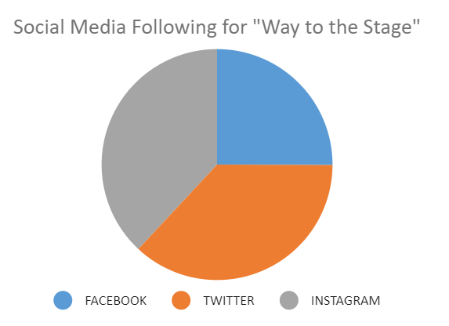
What can this data tell us about our social media for the second series?
Which social media platform had the highest following for series 1?
If there is a series 2, what recommendations would you make to the social media ‘content’ team?
Having looked through the data, what data do you think would be best for this team to review?
Notes:
Lead a class discussion: if we wanted to pass some of knowledge and insight we’ve gained onto the social media content team what would be useful to pass on?
The depth of this task can vary; could be a short verbal task highlighting some ideas; or a more detailed analysis of the data could be completed by students.
Possible prompt questions:
What platform had the highest following? Remind students about the difference between reach vs engagement. Would data would you recommend the social media team look at when deciding about what content to produce next time?
What platform had highest engagement? What time was the most successful? Were videos/polls/images most successful?
Click here https://www.skillsbuilder.org/homelearning for Short Lessons and resources to explicitly build communication skills beyond this lesson

Slide 32

CAST
Rosie Moutrie Senior Communications & Social Media Manager, Pinewood Group
CREW
Fern Colao Senior Brand & Marketing Manager, Pinewood Group
Nick Long Head of Production, Turtle Canyon Media
Al Clayton Camera Operator, Turtle Canyon Media

