Slide 1
3D Sets from 2D Drawings
Using plans and elevations to design film sets at Pinewood Studios
Year 10
Notes:
More catchy title?

Slide 2
Maths: To construct and interpret plans and elevations of 3D shapes
Careers: To highlight the relevance of Maths to future career paths
Essential Skills: Creativity, Leadership, Teamwork, Speaking
Notes:
Resources for explicitly teaching these essential skills are available through the Skills Builder Hub here.

Slide 4
Meet Duncan, a Set Designer!
Notes:
Play video

Slide 5
3D Sets from 2D drawings
Using 3 dimensional shapes (or objects) to alter a space is part of a
set designers job.
The 3 dimensional shapes can be in the form of walls and ceilings as
well as furniture and smaller decorative objects such as vases, boxes,
even a ball next to a sports kit bag.
All of these shapes can be used in many different ways
and can be shown both 2 dimensionally and 3 dimensionally.
Notes:
Teacher to talk through slide

Slide 6
3D Sets from 2D drawings
Before any set is built, a set designer would create 2D dimensional drawings of both the plan, side elevation and front elevation.
Let’s have a look at some examples…
Notes:
Teacher to talk through slide

Slide 7
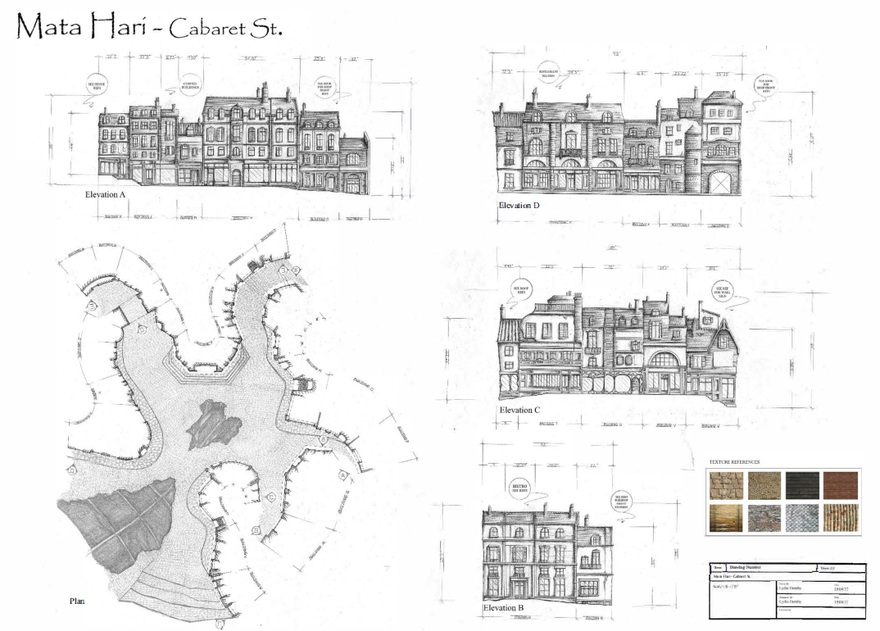
3D Sets from 2D drawings
Work by Lydia Hornby – Nottingham Trent University
Notes:
Examples of plan and elevation drawings of sets

Slide 8
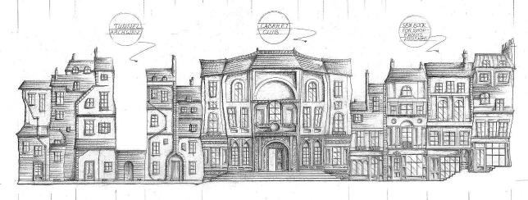
3D Sets from 2D drawings
Work by Lydia Hornby – Nottingham Trent University
Notes:
Elevation view

Slide 9
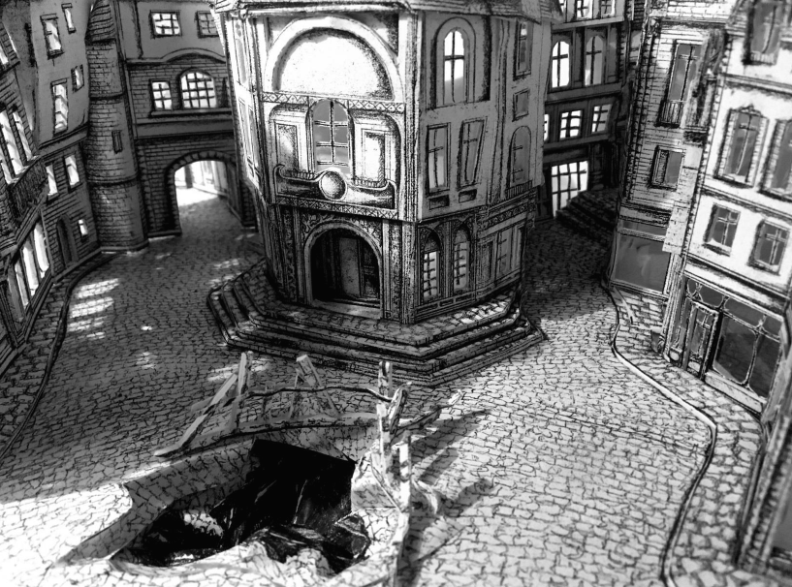
3D Sets from 2D drawings
Work by Lydia Hornby – Nottingham Trent University
Notes:
The model set

Slide 10
3D Sets from 2D drawings
Banished, BBC
Notes:
Teacher notes: play trailer for the BBC drama ‘Banished’

Slide 11
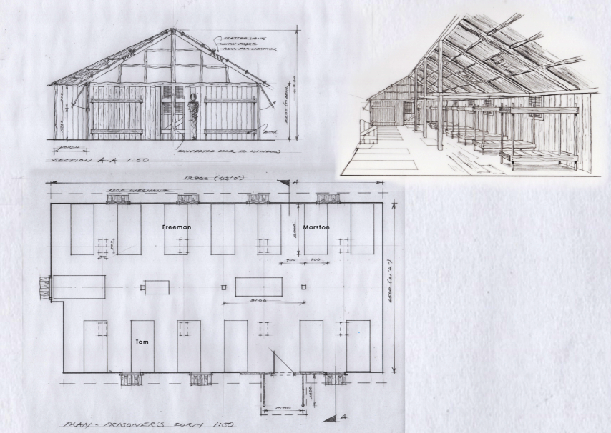
3D Sets from 2D drawings
Banished – BBC, Prison dormitory 1788
Drawings by Duncan Howell
Notes:
Teacher notes: These are the plan and elevation drawings for the prison dormitories on the TV programme

Slide 12
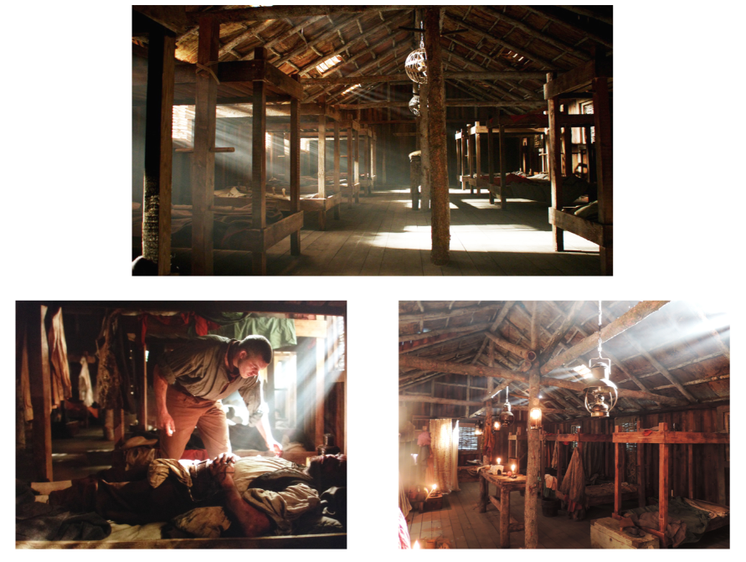
3D Sets from 2D drawings
Banished – BBC, Prison dormitory 1788
Courtesy of RSJ Productions
Notes:
Teacher notes: These are scenes from the programme in the 3D dormitory set which was built from these plans

Slide 13
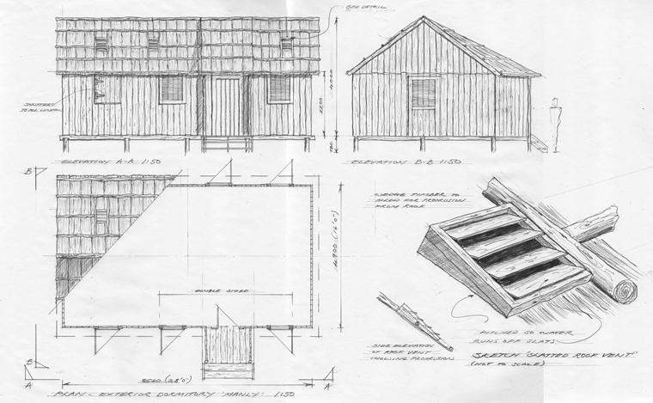
3D Sets from 2D drawings
Banished – BBC, Prison dormitory 1788
Drawings by Duncan Howell
Notes:
Teacher notes:

Slide 14
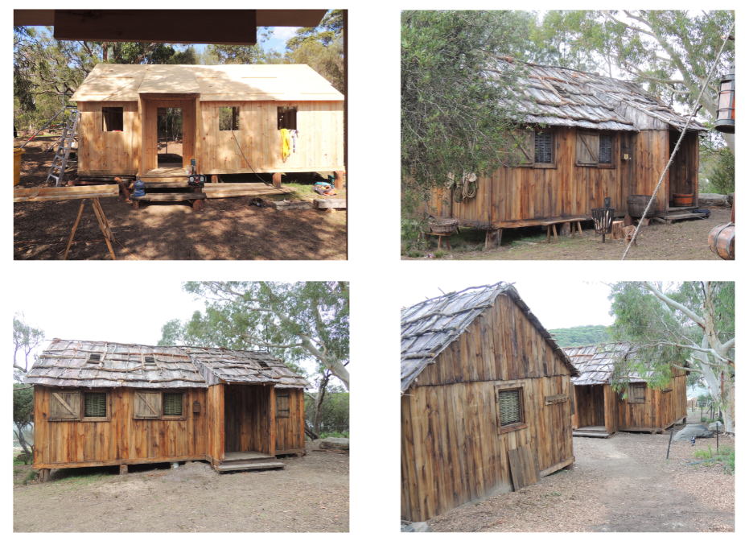
3D Sets from 2D drawings
Banished – BBC, Prison dormitory 1788
Courtesy of RSJ Productions
Notes:
Teacher notes:

Slide 15
Context

Slide 16
3D Sets from 2D drawings
Let’s think about the process of how we go from a 2D drawing to a 3D set.
As a set designer we will get a design brief and a little context of the film or programme this will be used for including the script.
We will be given the stage dimensions and we will need to start by creating a plan view to map out the key items and where these will be located.
Notes:
Teacher notes:

Slide 17
3D Sets from 2D drawings
Here’s a project we’ve been working on.
Our brief: A kitchen in a family home in London for a new soap opera. The soap is set in our current time period (2021). There is creative freedom for the design of the kitchen but there must be space for the family of four to all sit for certain scenes to be filmed. The family also has a small dog which will live in the kitchen.
Notes:
Teacher notes:

Slide 18
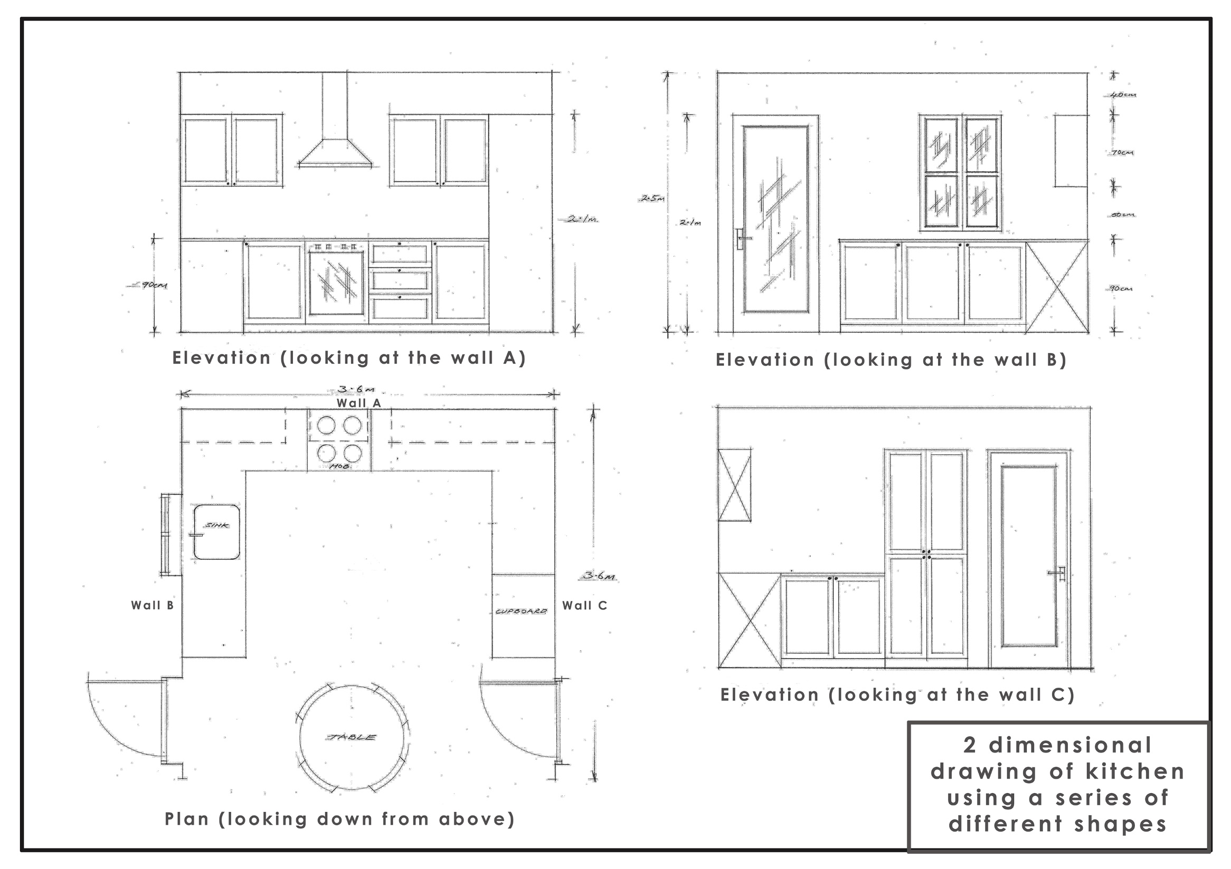
3D Sets from 2D drawings
Notes:
Teacher notes: Stage 1: As designers they started with the plan and then elevation views

Slide 19
3D Sets from 2D drawings
The plan view and elevations are the first step when designing a set.
The kitchen looks very flat at the moment, so let’s change that by building a model…
Notes:
Teacher notes: here we have the front elevations and plan view of the kitchen

Slide 20
3D Sets from 2D drawings
Notes:
Teacher notes: Watch students build this model (Note - this could be referred back to if you chose to do the extension task during the independent task)
Click here https://www.skillsbuilder.org/homelearning for resources to explicitly teach listening skills, resources are not subject specific!

Slide 21
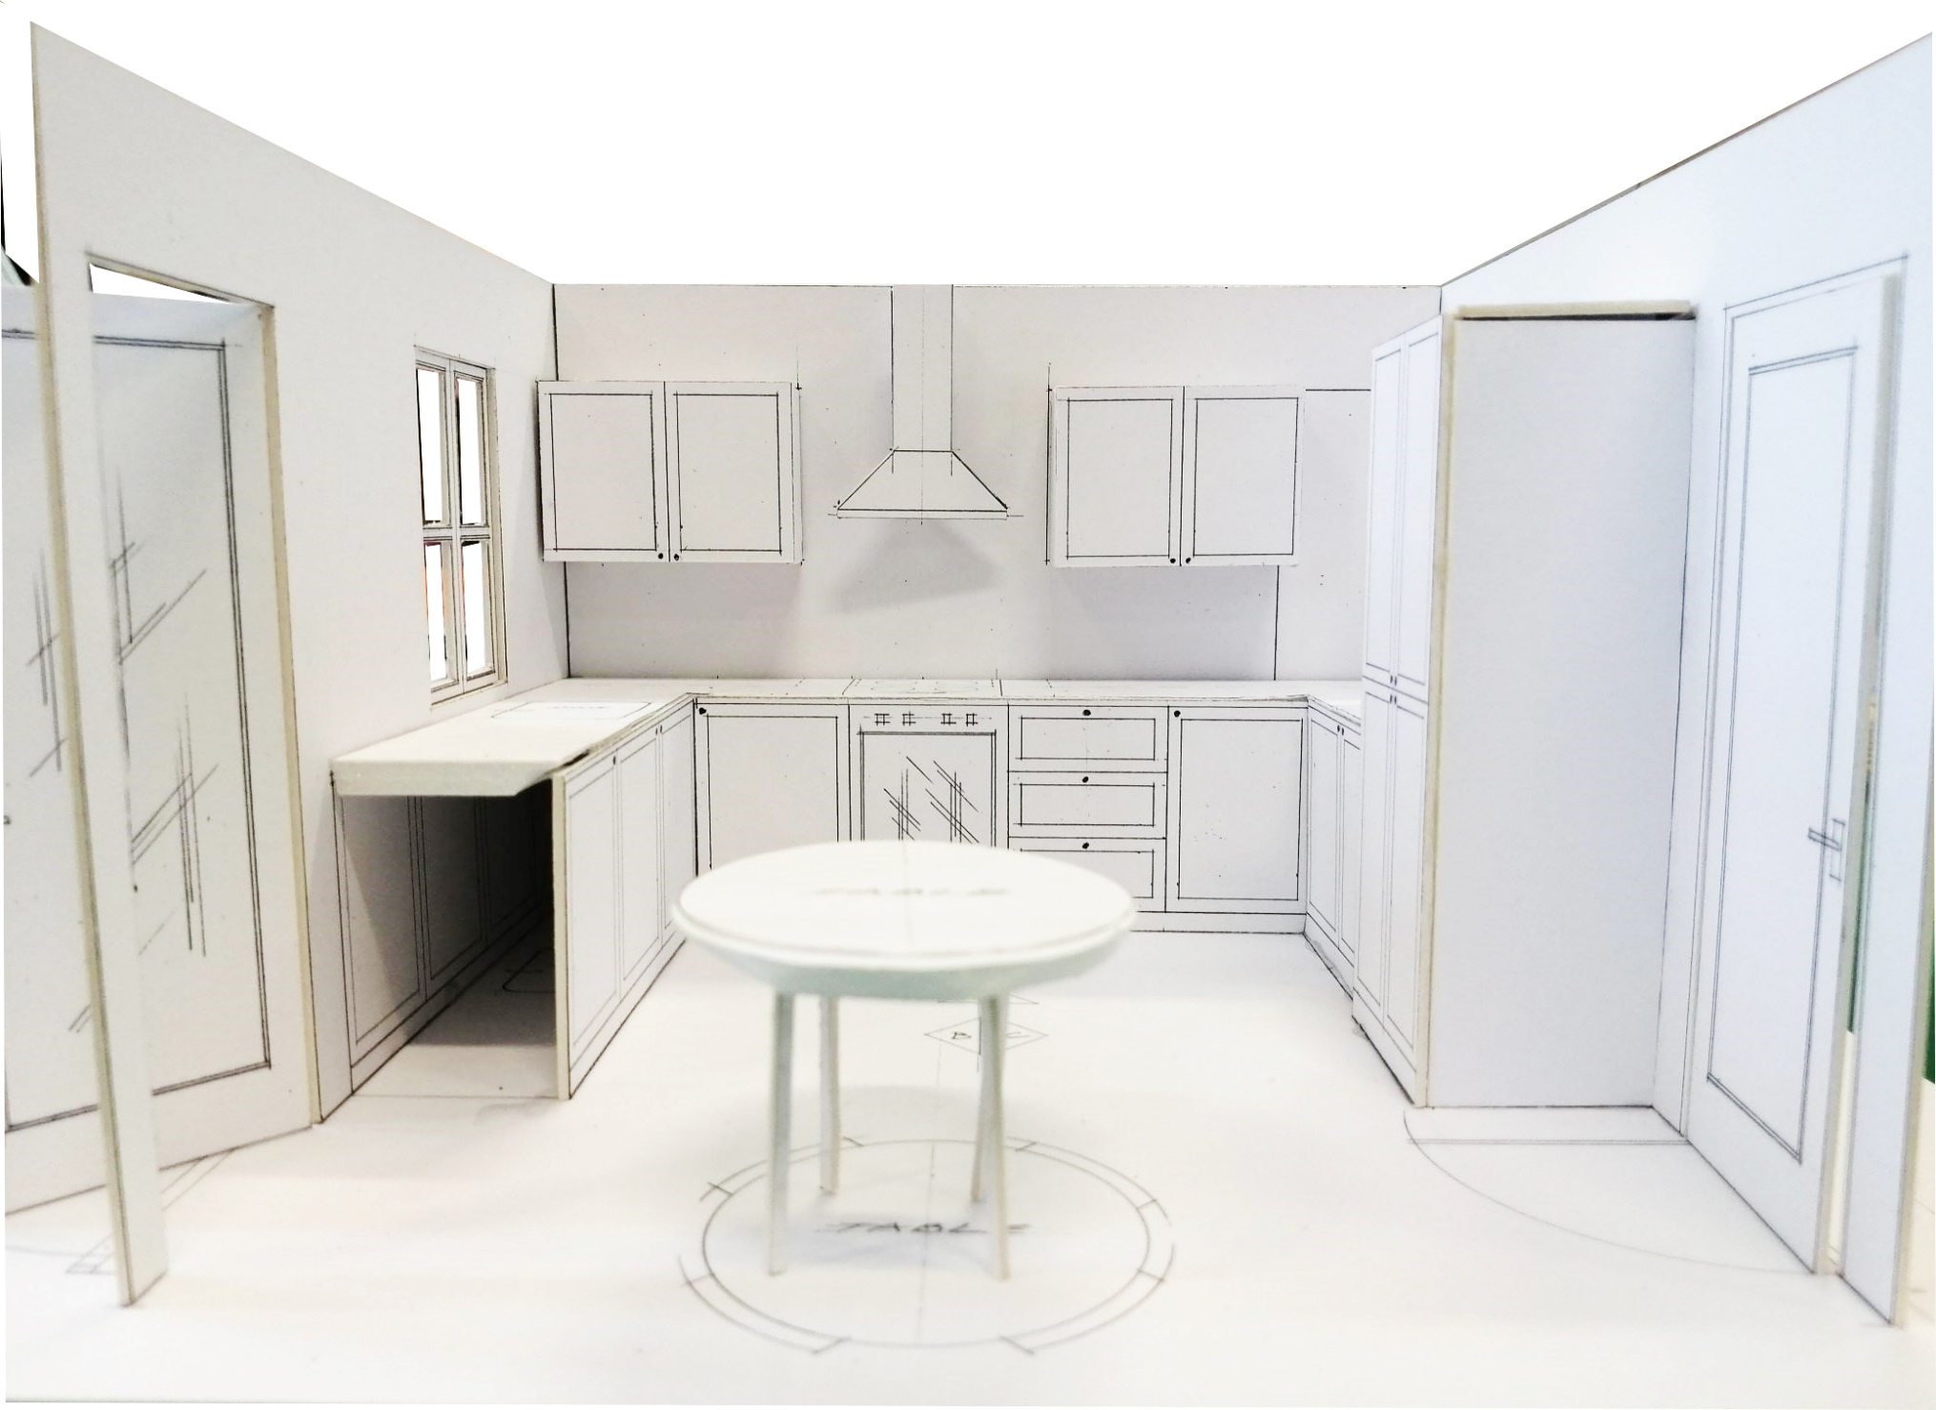
3D Sets from 2D drawings
We can use this 3D model to take photos to help decide camera angles; if the set looks realistic and if it meets the brief!
Notes:
Teacher notes: here we have the front elevations and plan view of the kitchen

Slide 22
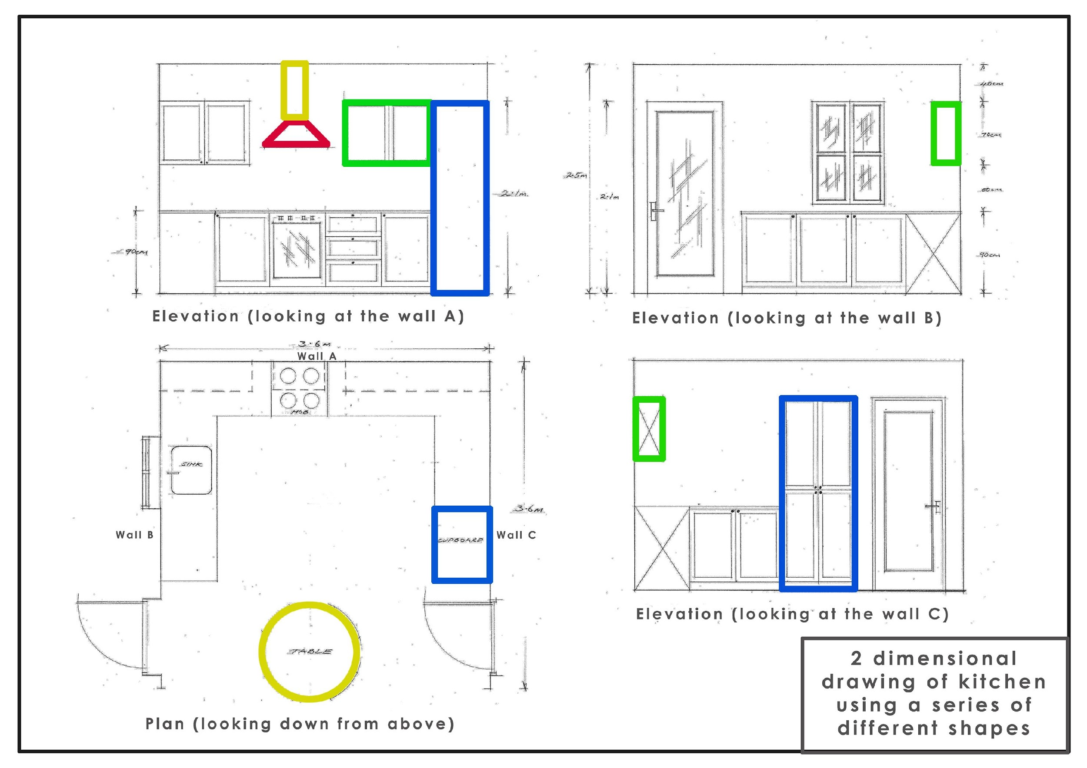
3D Sets from 2D drawings
Let’s think back to our 2D drawings of the plan and elevation.
What shapes are highlighted here?
What 3D shapes will these now be in our model?
Notes:
Teacher notes: here we have the front elevations and plan view of the kitchen

Slide 23
3D Sets from 2D drawings
Notes:
Teacher notes: this model can then be created digitally - so we can now see these shapes in 3D

Slide 24
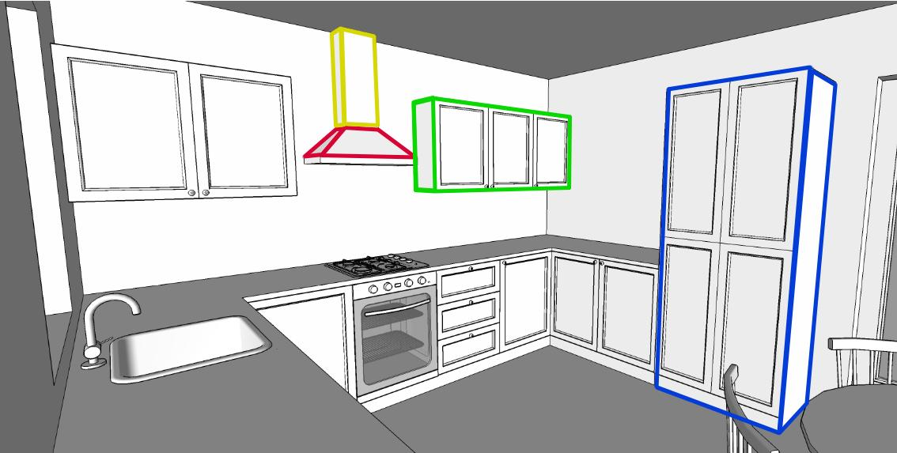
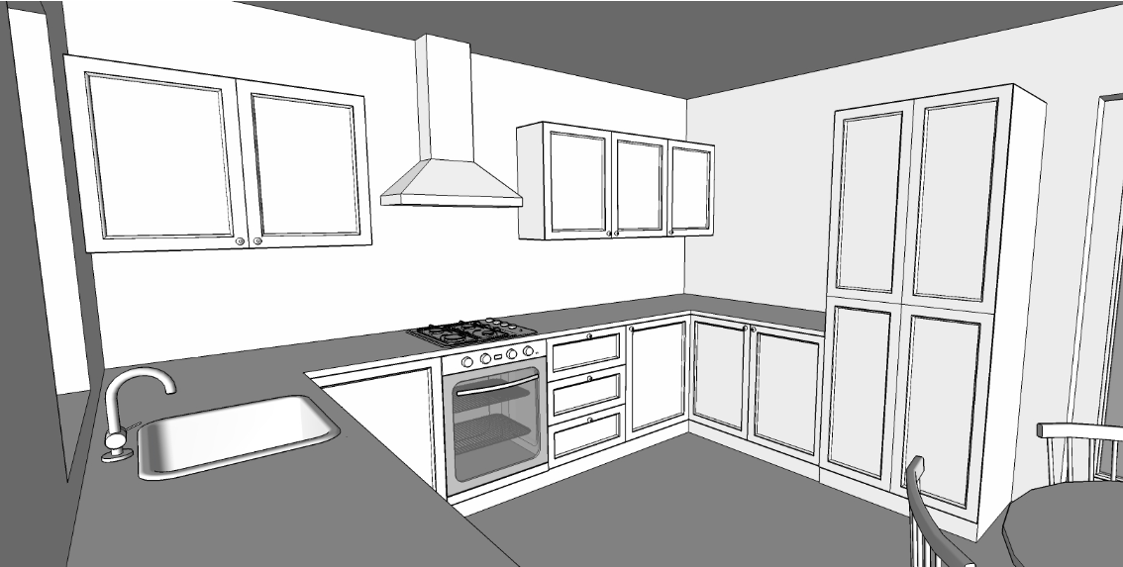
3D Sets from 2D drawings

Slide 25
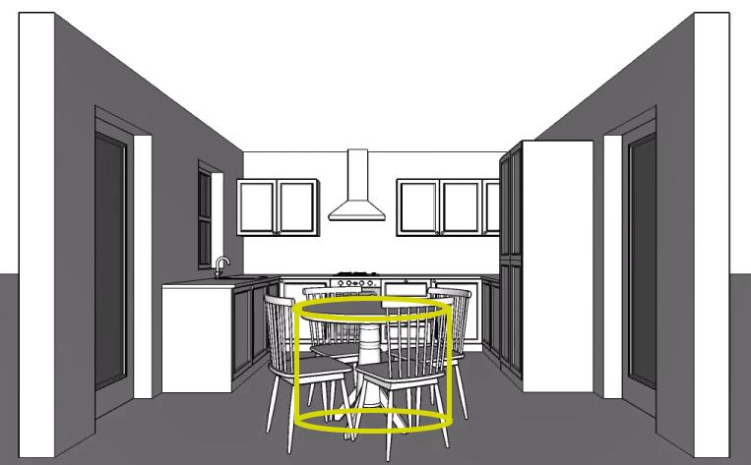
3D Sets from 2D drawings

Slide 26
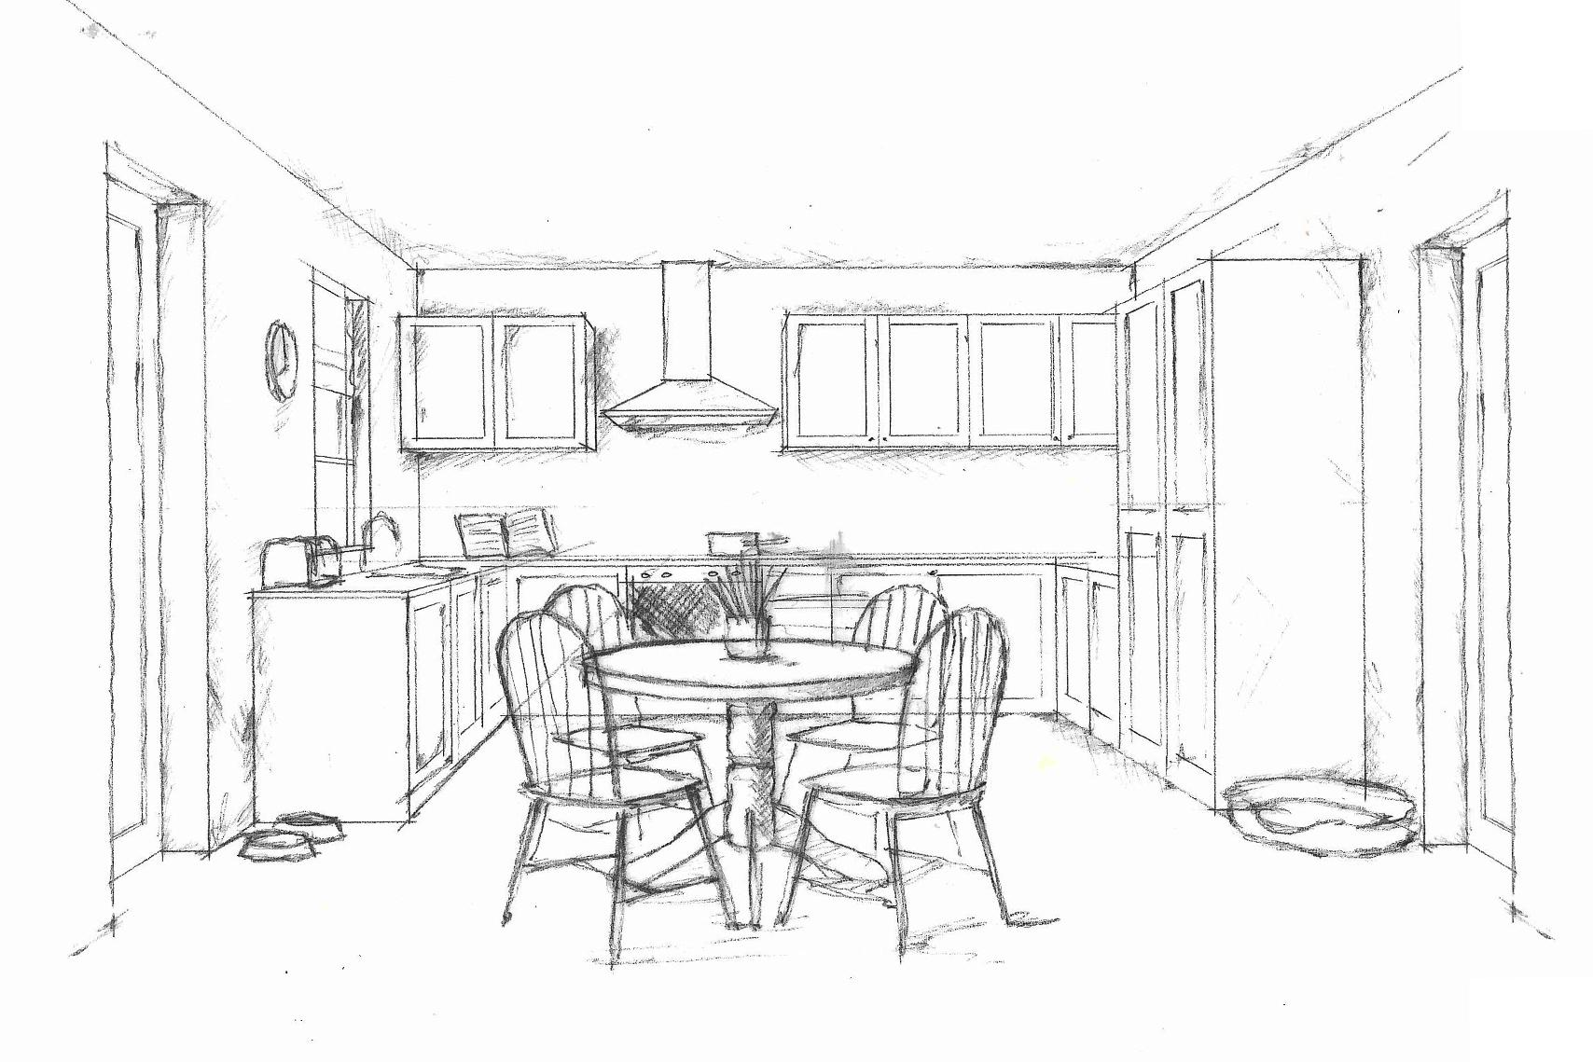
3D Sets from 2D drawings
A set designer would then draw in some objects to make the set look even more realistic.
What has been added in here to ensure the set meets the brief?
Notes:
Teacher notes: here we have the front elevations and plan view of the kitchen

Slide 28
Welcome to the design team!

Slide 29
Welcome to the design team!
We’ve just received a new design brief for a new film being filmed at Pinewood Studios!
You will be working together in small groups to design three different sets which will all be built in one of the stages in Pinewood Studios.
Notes:
Highlight how working together isn’t just something for sports activities. If time, pose a question about the value of working in a team for this activity over working alone. Why do people work in teams in the workplace? Click here https://www.skillsbuilder.org/homelearning for Short Lessons and resources to explicitly build Teamwork skills beyond this lesson

Slide 30
The design brief
A new sci-fi film has been commissioned and we need you to build 3 of the sets. You will work in a larger groups: and split into 3 sub-groups (A, B & C)
A hexagonal space-ship control room with a entrance hatch; a central control panel and computers built into the walls.
A walled garden in a family house with a trampoline; outdoor furniture; grass and flowerbeds. There needs to be space for the spaceship to land.
A games room in the family house that has a pool table, table tennis table and games/TV area

Slide 31
The design brief | Stage 1
In your groups of six you will work in pairs.
Pair A: Using the brief, create the plan view of set 1
Pair B: Using the brief, create the plan view of set 2
Pair C: Using the brief, create the plan view of set 3
Hint: Use your leadership skills to choose pairs based on your strengths
Notes:
Click here https://www.skillsbuilder.org/homelearning for Short Lessons and resources to explicitly build Leadership skills beyond this lesson

Slide 32
The design brief | Stage 2
In your groups of six you will work in pairs.
Pair A: Using the brief, and the plan view; draw the elevations for set 3
Pair B: Using the brief, and the plan view; draw the elevations for set 1
Pair C: Using the brief, and the plan view; draw the elevations for set 2
Hint: Use your leadership skills to choose pairs based on your strengths
Notes:
Click here https://www.skillsbuilder.org/homelearning for Short Lessons and resources to explicitly build Leadership skills beyond this lesson

Slide 33
The design brief | Stage 3
In your groups of six you will work in pairs.
Pair A: Using the brief; the plan view; and the elevations draw a 3D sketch of set 2
Pair B: Using the brief; the plan view; and the elevations draw a 3D sketch of set 3
Pair C: Using the brief; the plan view; and the elevations draw a 3D sketch of set 1
What additional objects do you need to add in to make sure the set is realistic and meets the brief?
Notes:
Possible Extension task: Students build a 3D model using nets
Highlight that creativity skills are about combining ideas, it’s about the art here but the idea generation. Click here https://www.skillsbuilder.org/homelearning for Short Lessons and resources to explicitly build Creativity skills beyond this lesson

Slide 34
Sharing Outcomes

Slide 35
Gallery Walk
Present your 3 drawings for each of your sets.
Walk around the classroom and look at the other sets from your own group and other groups.
Was the final 3D drawing within your own group what you had imagined during stage 1 (plan view) and stage 2 (elevation view)?
You all had the same 3 briefs, but what do you notice is the same about each design? What do you notice is different?
Notes:
Possible Extension task: Students build a 3D model using nets Click here https://www.skillsbuilder.org/homelearning for Short Lessons and resources to explicitly build Speaking skills beyond this lesson

Slide 36
Gallery Walk
By completing a gallery walk you will be able to see lots of similarities across the different set designs but also the different interpretations of the same brief which have led to sets which will all be individual!
A set designers role is to add to the brief and help enhance the director's vision by making it even better!
Notes:
Possible Extension task: Students build a 3D model using nets

Slide 37
What happens next?
The next stage of the design process would be passing your drawings to the building team who would make your creations a reality!
Why are your drawings so important in this next stage?
Notes:
Possible Extension task: Students build a 3D model using nets

Slide 38
Challenge Task | You write the brief
You will now be presented with the plan view of a set.
You have 3 minutes to consider this and create the brief that could go with this set!
You will need to think carefully about the different 3D objects which could be represented on the plan.
Be as creative as you can!

Slide 39
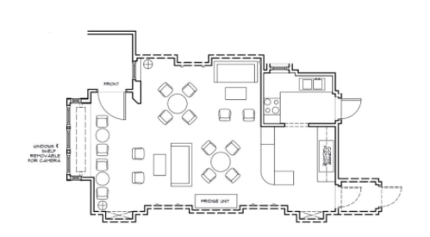
Challenge Task | You write the brief

Slide 40
CAST
Duncan Howell Lecturer/Production Designer, Nottingham Trent University
CREW
Kathryn Maidment Senior Community and Education Outreach Manager, Pinewood Group
Talia Cartmel
Ewan Coates
Phoebe Howard
Daisy Jackson
Francis Martin
Tom Merchant-Smith
Connie Ruding
Students of Design for Film & Television, Nottingham Trent University
Students of Design for Film & Television, Nottingham Trent University
Students of Design for Film & Television, Nottingham Trent University
Students of Design for Film & Television, Nottingham Trent University
Students of Design for Film & Television, Nottingham Trent University
Students of Design for Film & Television, Nottingham Trent University
Students of Design for Film & Television, Nottingham Trent University

