Slide 1


Slide 2


The system of technical education in England is complicated, and the options its presents are not always as easy to find or as clear as they could be.
AELP/CEC, with the technical expertise of LearnBox, have created this resource to help you as a careers professional to give young people accurate and impartial advice on the fullest possible range of technical training options.

Slide 3
It will help you:
Plan the best options for young people, using easy to follow graphics
Show how qualifications work together to provide progression
Show real-life video case studies to young people
Inform young people of what an occupation involves and how to work towards it
Find all the information you need with a comprehensive collection of links

Slide 4
The resource forms part of a range of linked materials that you can use::
A free interactive document designed for careers advisers and careers leaders in a range of settings giving a full overview of the technical FE and skills system
An accompanying downloadable booklet for young people mapped to its contents
Graphics and posters
Slide deck to aid introduction to its use
All will be freely available from CEC Resource Directory and from AELP SectorShare

Slide 5
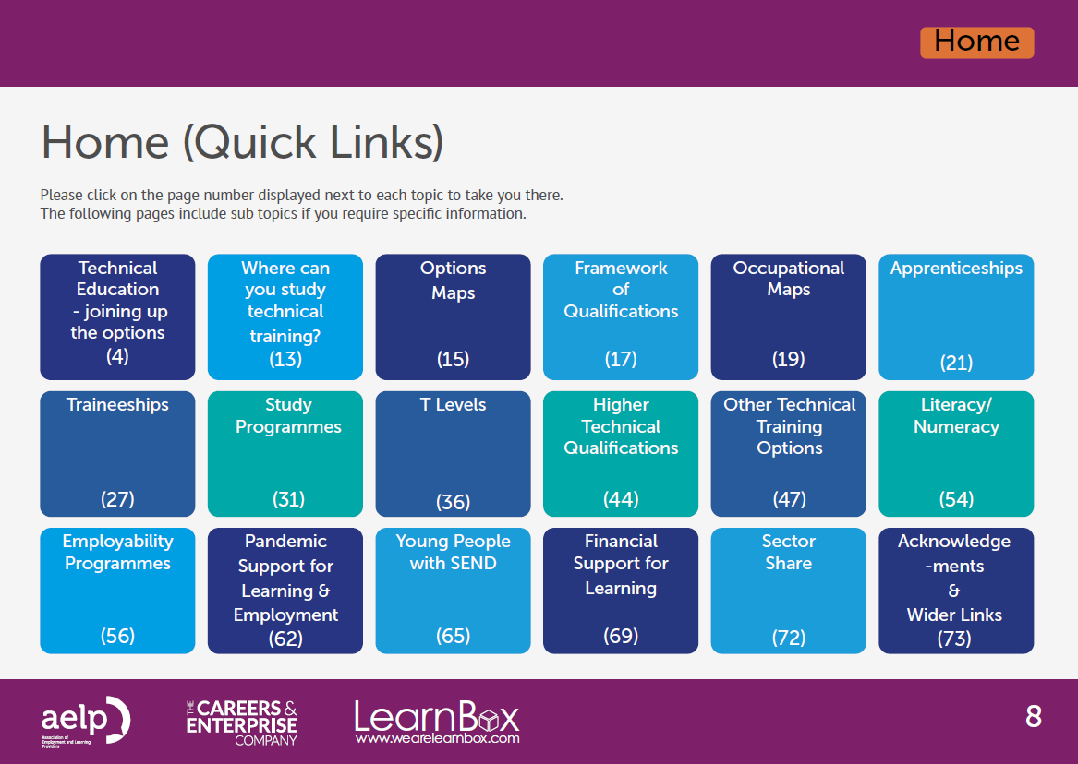
It’s an interactive on-screen resource – you just go straight to the topic you want at the click of a link…..
Notes:
We started with the premise that you are sitting with a young person opposite you – perhaps only aware in the broadest sense of what occupation they might like to follow, or the type of learning they may wish to undertake in order to launch them on that career. They need accurate and impartial guidance and the fullest possible range of options, but until now the information to do this has been made available only in a very dispersed fashion, making it difficult for you to find the information they may want if you do not happen to already know it.

Slide 6
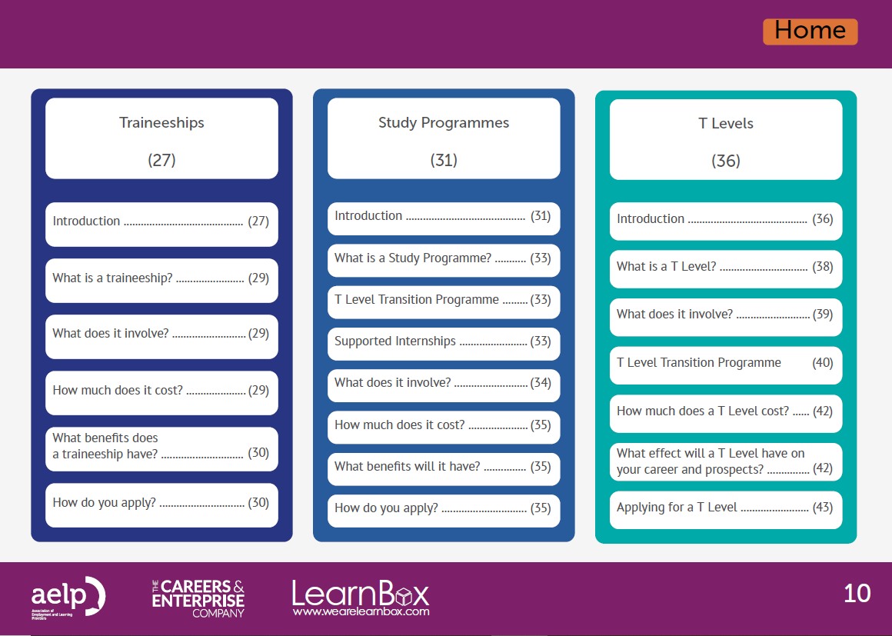
….or if you have a very specific question, you can go straight there too!
Notes:
We started with the premise that you are sitting with a young person opposite you – perhaps only aware in the broadest sense of what occupation they might like to follow, or the type of learning they may wish to undertake in order to launch them on that career. They need accurate and impartial guidance and the fullest possible range of options, but until now the information to do this has been made available only in a very dispersed fashion, making it difficult for you to find the information they may want if you do not happen to already know it.

Slide 7
There is detailed information to help you to better understand the sector as a professional……
Notes:
We started with the premise that you are sitting with a young person opposite you – perhaps only aware in the broadest sense of what occupation they might like to follow, or the type of learning they may wish to undertake in order to launch them on that career. They need accurate and impartial guidance and the fullest possible range of options, but until now the information to do this has been made available only in a very dispersed fashion, making it difficult for you to find the information they may want if you do not happen to already know it.

Slide 8
…. and simple graphics to help you explain technical training options to the young person sitting in front of you…..
…which you’ll also be able to download as stand-alone posters!
Notes:
We started with the premise that you are sitting with a young person opposite you – perhaps only aware in the broadest sense of what occupation they might like to follow, or the type of learning they may wish to undertake in order to launch them on that career. They need accurate and impartial guidance and the fullest possible range of options, but until now the information to do this has been made available only in a very dispersed fashion, making it difficult for you to find the information they may want if you do not happen to already know it.

Slide 9
A simple interactive navigation bar at the beginning of each section means you can go anywhere you want in the resource, at any time….
Notes:
We started with the premise that you are sitting with a young person opposite you – perhaps only aware in the broadest sense of what occupation they might like to follow, or the type of learning they may wish to undertake in order to launch them on that career. They need accurate and impartial guidance and the fullest possible range of options, but until now the information to do this has been made available only in a very dispersed fashion, making it difficult for you to find the information they may want if you do not happen to already know it.

Slide 10
…… or alternatively go straight back to the contents page!
Notes:
We started with the premise that you are sitting with a young person opposite you – perhaps only aware in the broadest sense of what occupation they might like to follow, or the type of learning they may wish to undertake in order to launch them on that career. They need accurate and impartial guidance and the fullest possible range of options, but until now the information to do this has been made available only in a very dispersed fashion, making it difficult for you to find the information they may want if you do not happen to already know it.

Slide 11
Each section clearly explains the information it will give you…….
….along with video case studies which can be accessed online or using the integrated QR codes!
Notes:
We started with the premise that you are sitting with a young person opposite you – perhaps only aware in the broadest sense of what occupation they might like to follow, or the type of learning they may wish to undertake in order to launch them on that career. They need accurate and impartial guidance and the fullest possible range of options, but until now the information to do this has been made available only in a very dispersed fashion, making it difficult for you to find the information they may want if you do not happen to already know it.

Slide 12
FULL LIST OF CONTENTS:
Options Maps – routes through technical training, relative qualifications
Occupational Maps – what they are and how to use them
Apprenticeships
Traineeships
Study Programmes
T Levels
Higher Technical Qualifications
Other technical training (Applied Generals, BTEC, HNC/HND, professional qualifications)
Literacy/Numeracy (including Condition of Funding flow chart)
Employability programmes
Pandemic incentives
Support for young people with SEND
Financial Support for Learning
Notes:
We started with the premise that you are sitting with a young person opposite you – perhaps only aware in the broadest sense of what occupation they might like to follow, or the type of learning they may wish to undertake in order to launch them on that career. They need accurate and impartial guidance and the fullest possible range of options, but until now the information to do this has been made available only in a very dispersed fashion, making it difficult for you to find the information they may want if you do not happen to already know it.

Slide 13
To make life even easier for you, there is a section of easy-to-access URLs for further information should you need it…
Notes:
We started with the premise that you are sitting with a young person opposite you – perhaps only aware in the broadest sense of what occupation they might like to follow, or the type of learning they may wish to undertake in order to launch them on that career. They need accurate and impartial guidance and the fullest possible range of options, but until now the information to do this has been made available only in a very dispersed fashion, making it difficult for you to find the information they may want if you do not happen to already know it.

Slide 14
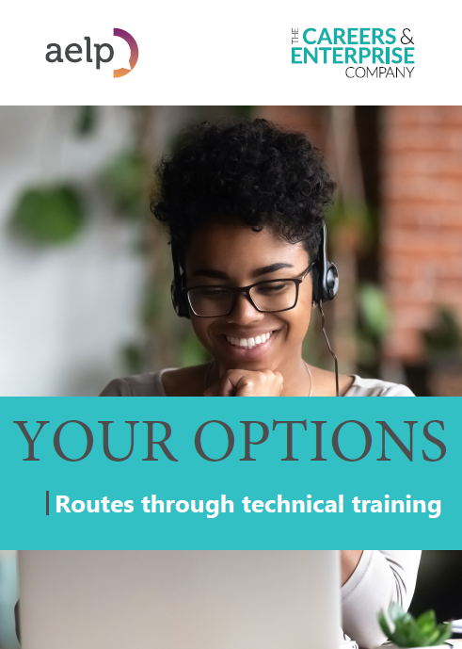
    “Your Options: Routes through technical training ”
A resource for young people, parents and carers
Downloadable booklet with content mapping directly to the main document
Coming soon…
Notes:
We started with the premise that you are sitting with a young person opposite you – perhaps only aware in the broadest sense of what occupation they might like to follow, or the type of learning they may wish to undertake in order to launch them on that career. They need accurate and impartial guidance and the fullest possible range of options, but until now the information to do this has been made available only in a very dispersed fashion, making it difficult for you to find the information they may want if you do not happen to already know it.

Slide 15
All content available for free download from
Careers and Enterprise Company – Resource Directory
https://resources.careersandenterprise.co.uk
Or via
AELP SectorShare
www.sectorshare.org.uk
Notes:
We started with the premise that you are sitting with a young person opposite you – perhaps only aware in the broadest sense of what occupation they might like to follow, or the type of learning they may wish to undertake in order to launch them on that career. They need accurate and impartial guidance and the fullest possible range of options, but until now the information to do this has been made available only in a very dispersed fashion, making it difficult for you to find the information they may want if you do not happen to already know it.

