Slide 1
CoP (Community of Practice) PROJECT
Careers in
Transport

Slide 2
Task 1
Career 1​
………………………………………………………………
Career 2
………………………………………………………………

Slide 3
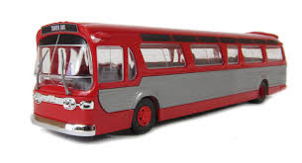

Slide 6
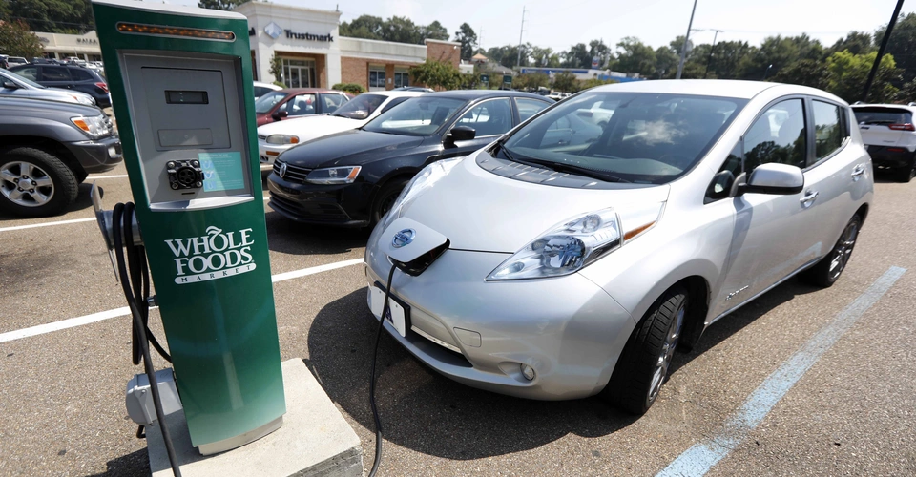

Slide 8
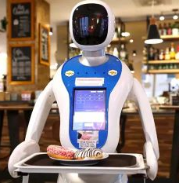
!
.

Slide 15
GRACE HAYWARD
MIDLAND METRO ALLIANCE

Slide 16
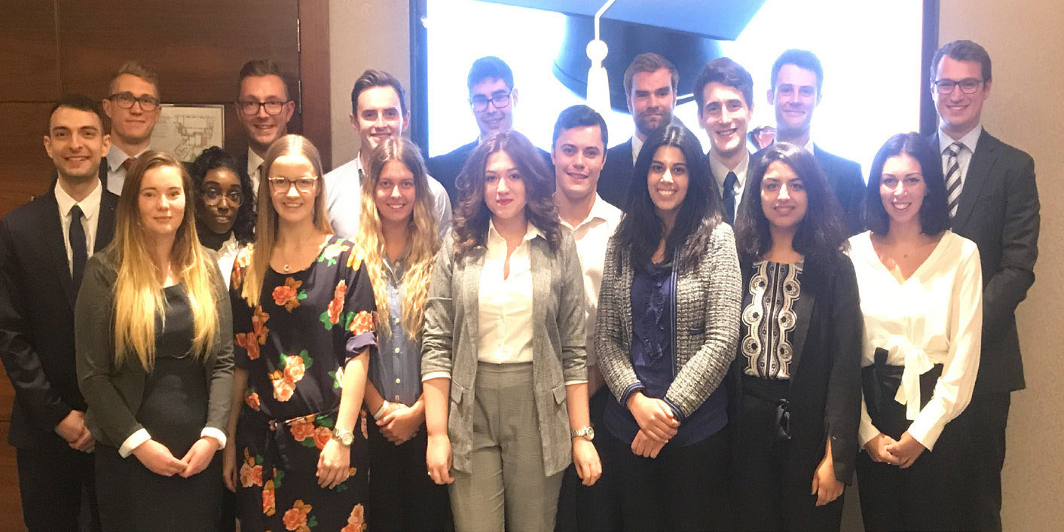
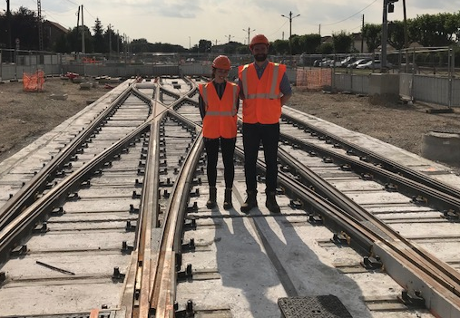
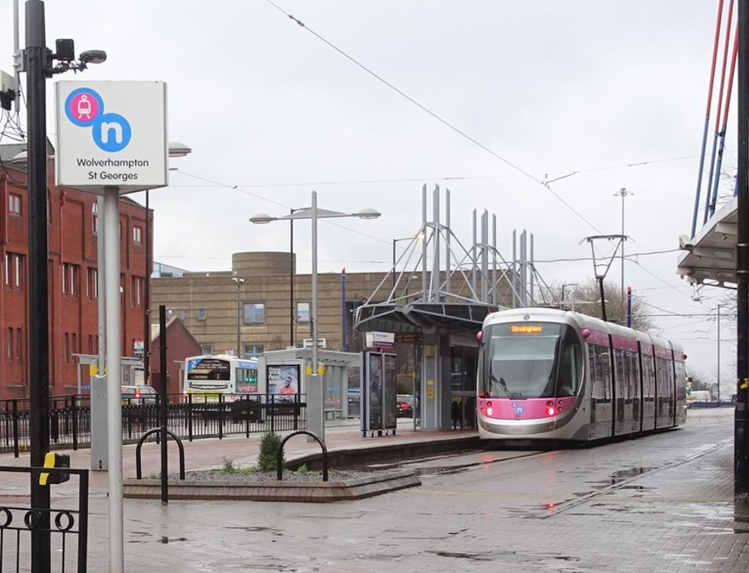
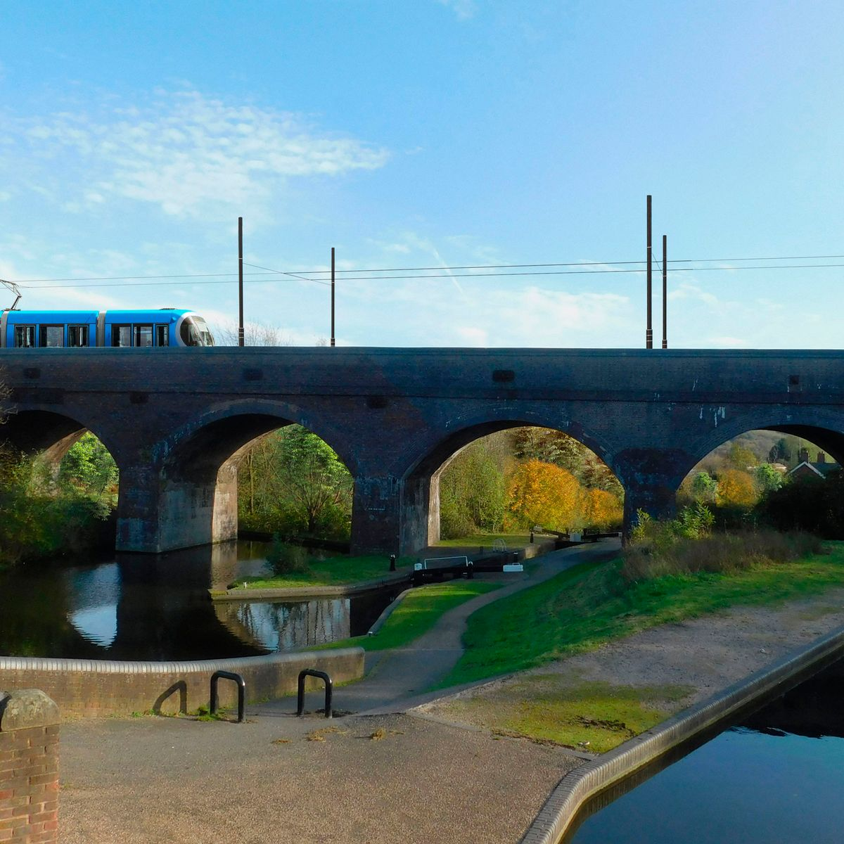

Slide 17
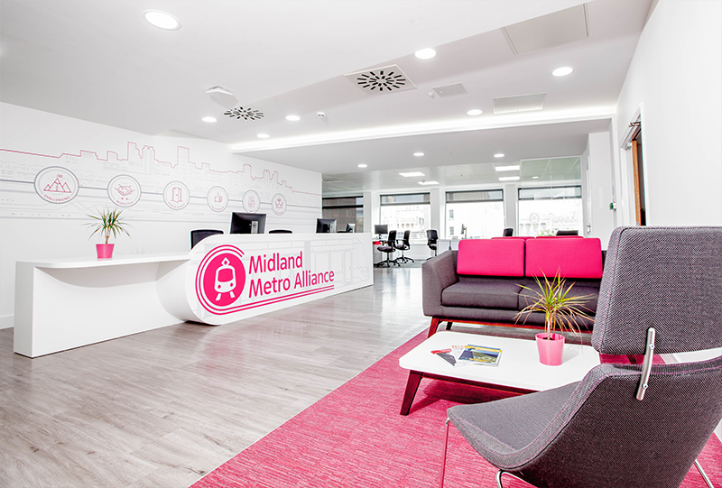
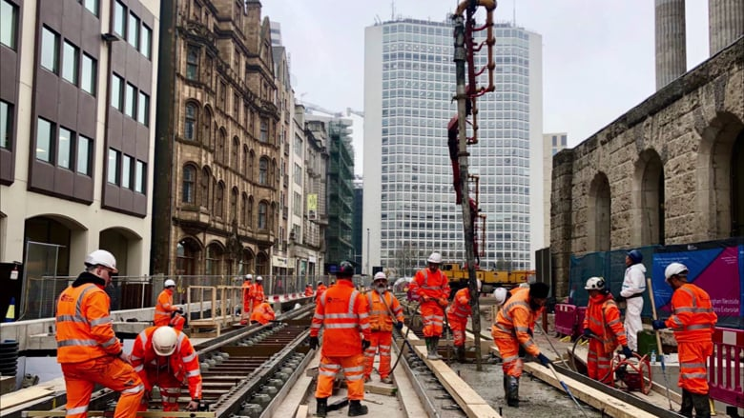
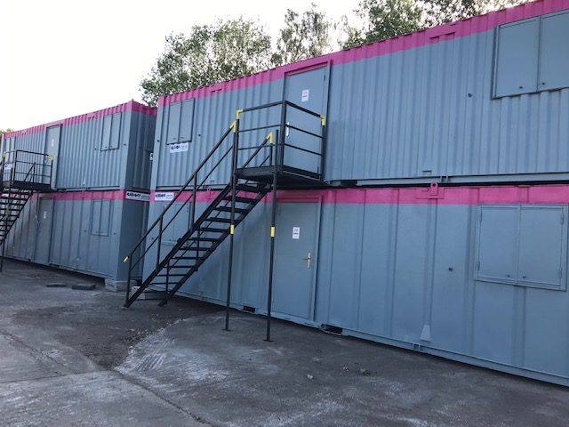

Slide 19
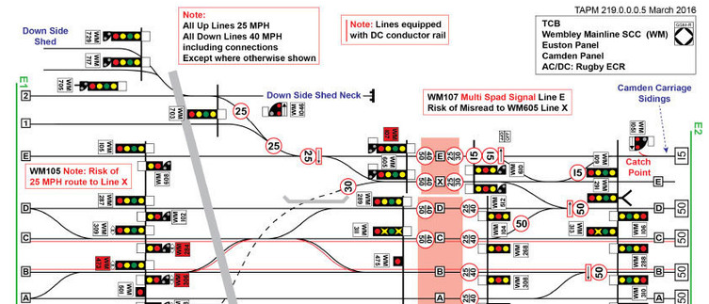
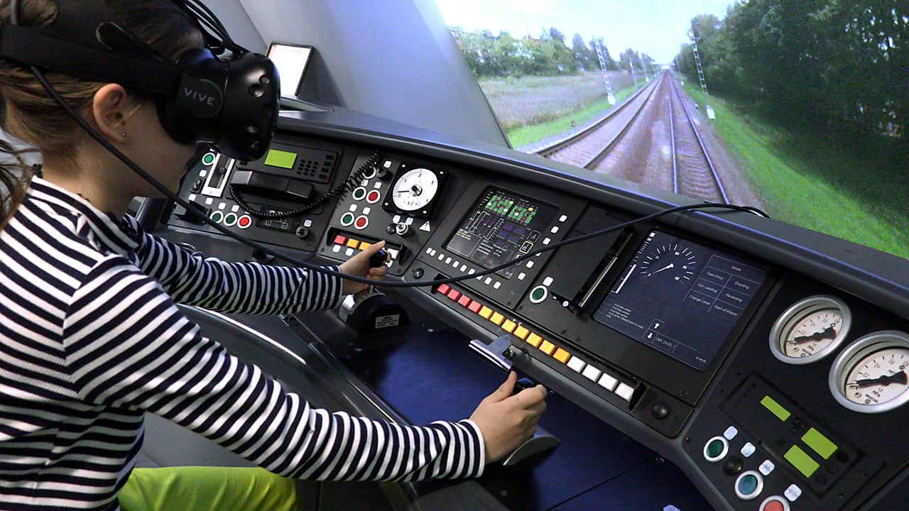

Slide 21
CHRIS
WEST MIDLANDS METRO

Slide 23
Check tram before leaving the Depo.
Drive customers from point A to Point B.
Check that everyone has a valid ticket and pass

Slide 24
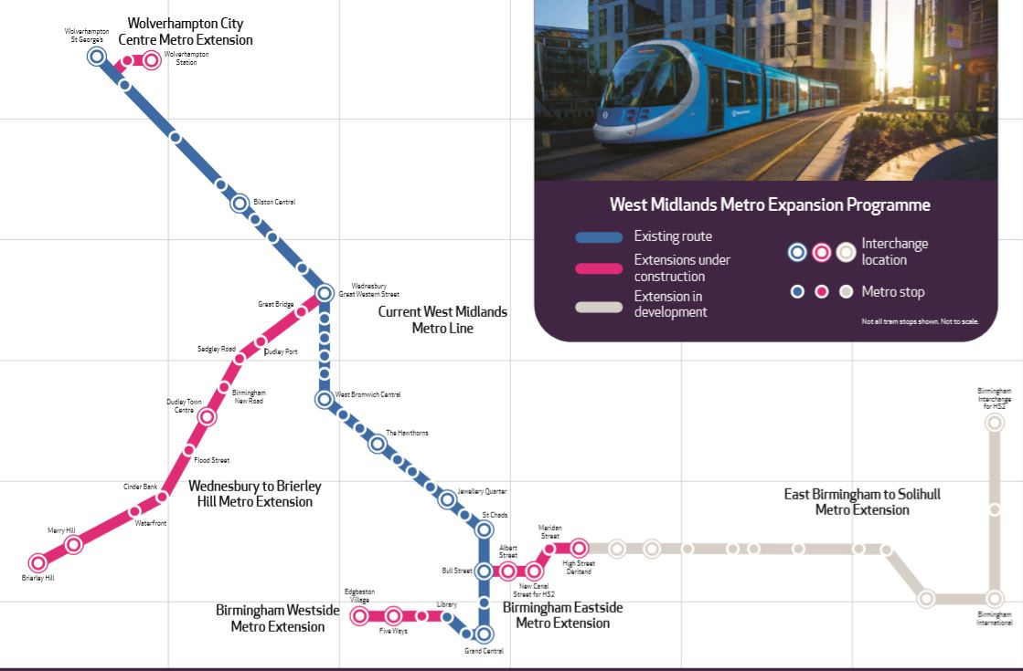
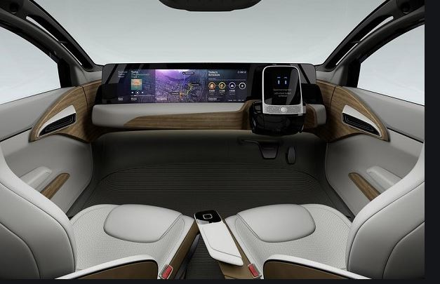
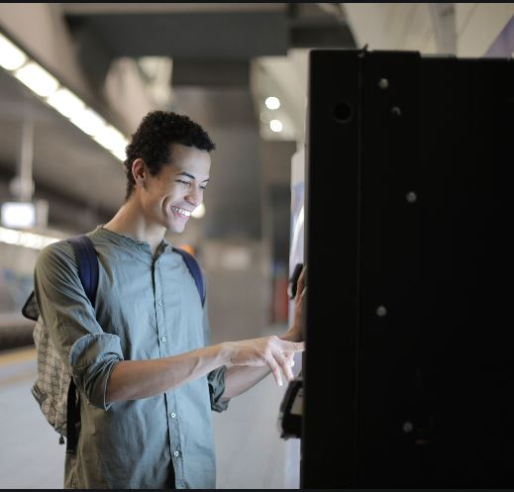

Slide 25
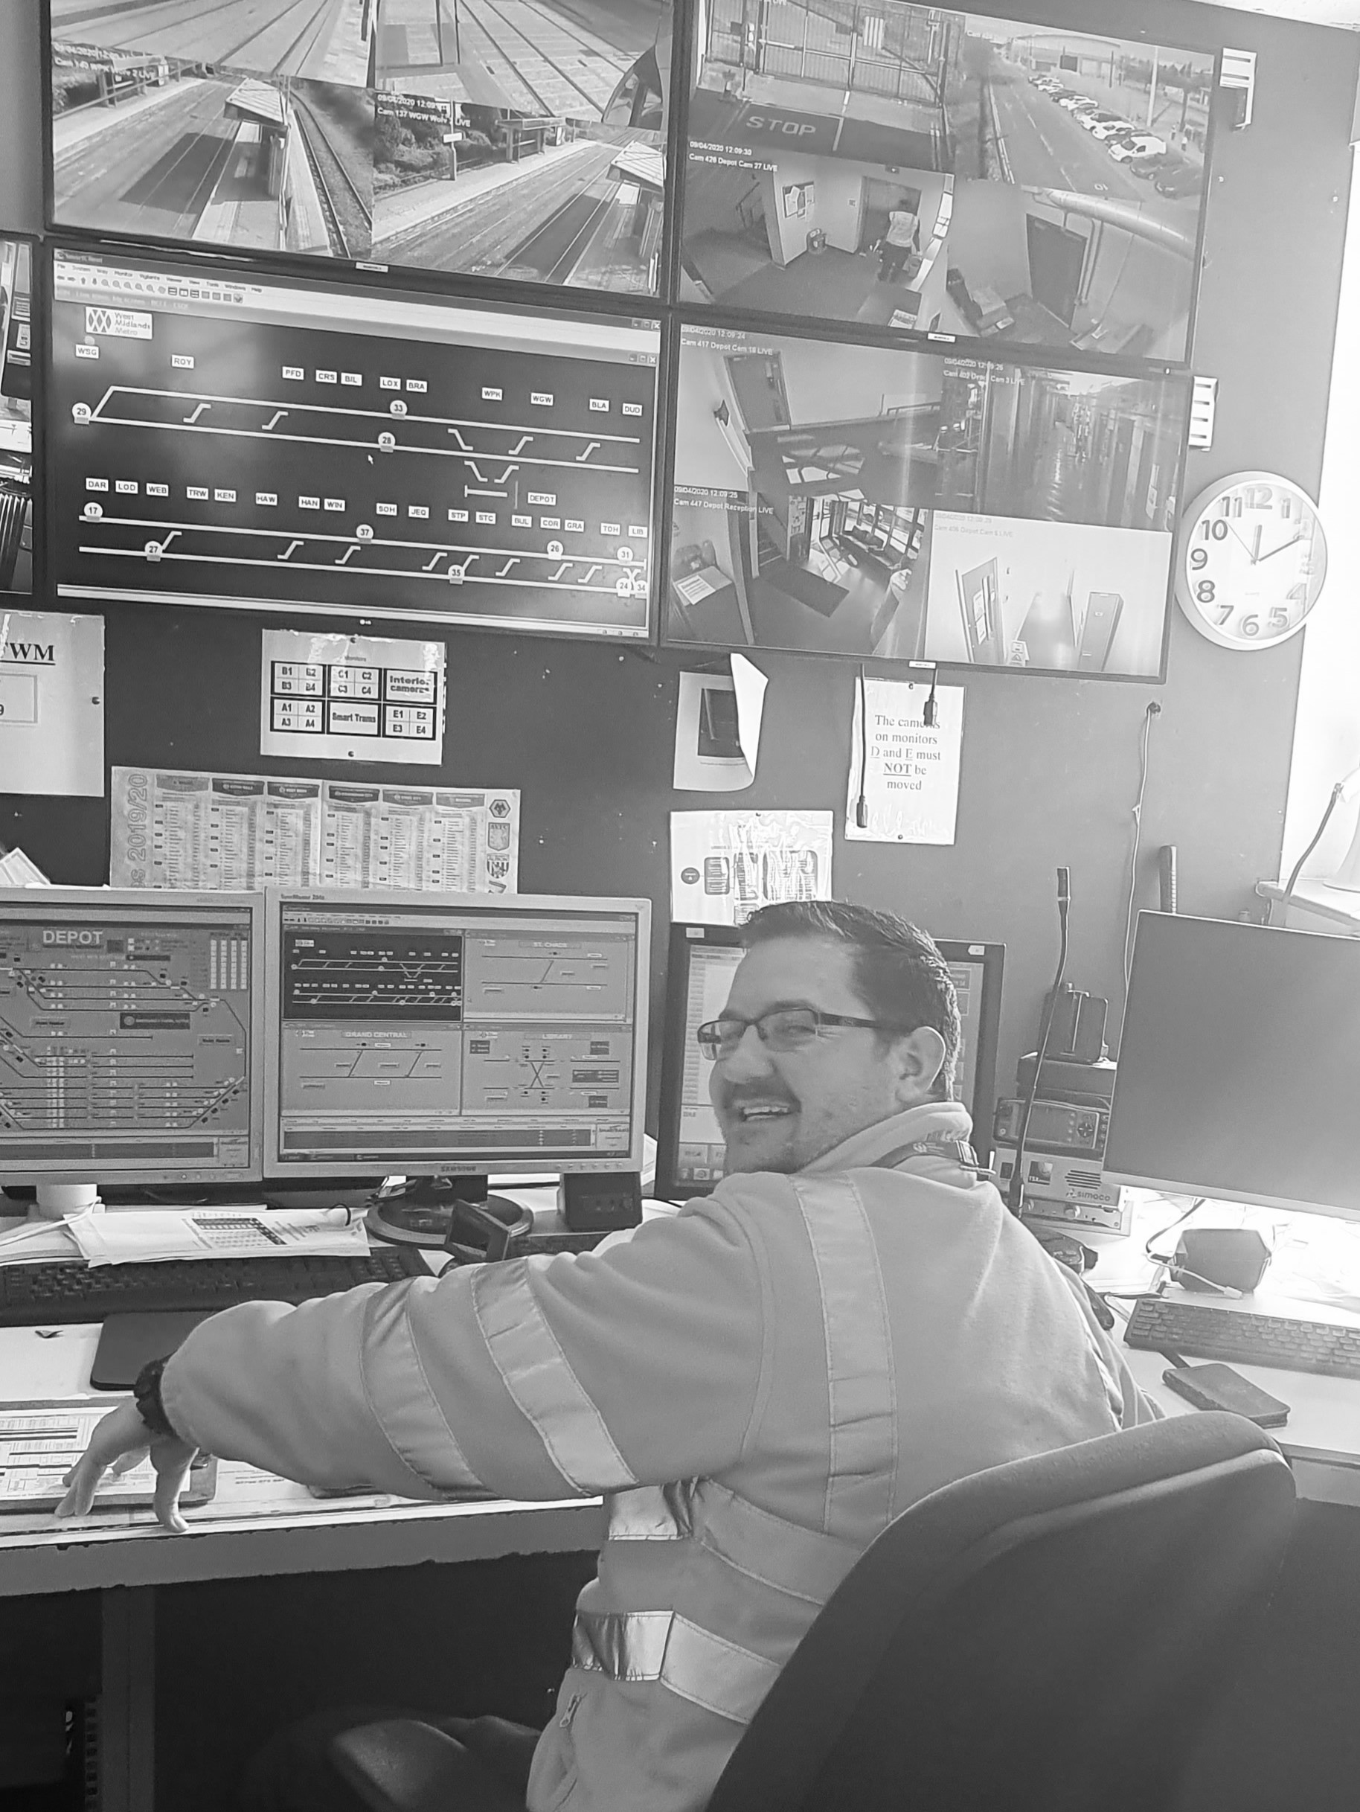

Slide 26
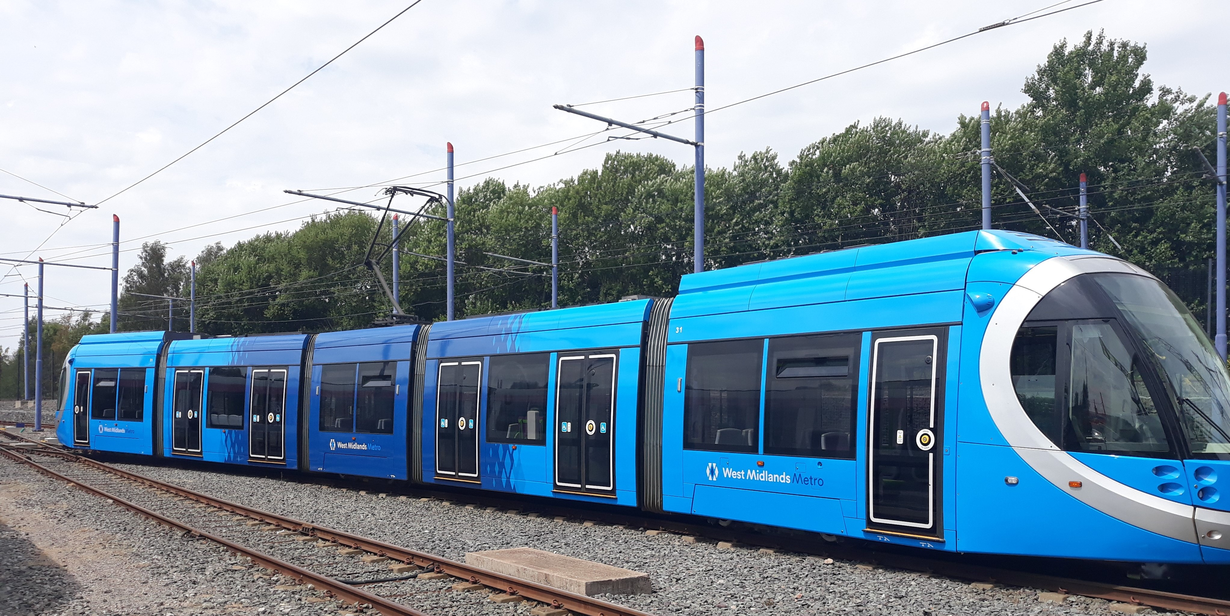
Closing Comments

Slide 27
OLLY CRAUGHAN
DPD GROUP UK LTD

Slide 29
What does a typical day look like for me?

Slide 30
How will my role change?

Slide 32
JACQUI MILLER
TRANSPORT FOR WEST MIDLANDS

Slide 33
My Career
Jacqui Miller

Slide 35
How will my role change?

Slide 37
Closing Comments

Slide 38
Task 2

Slide 39
Task 3

