Slide 1
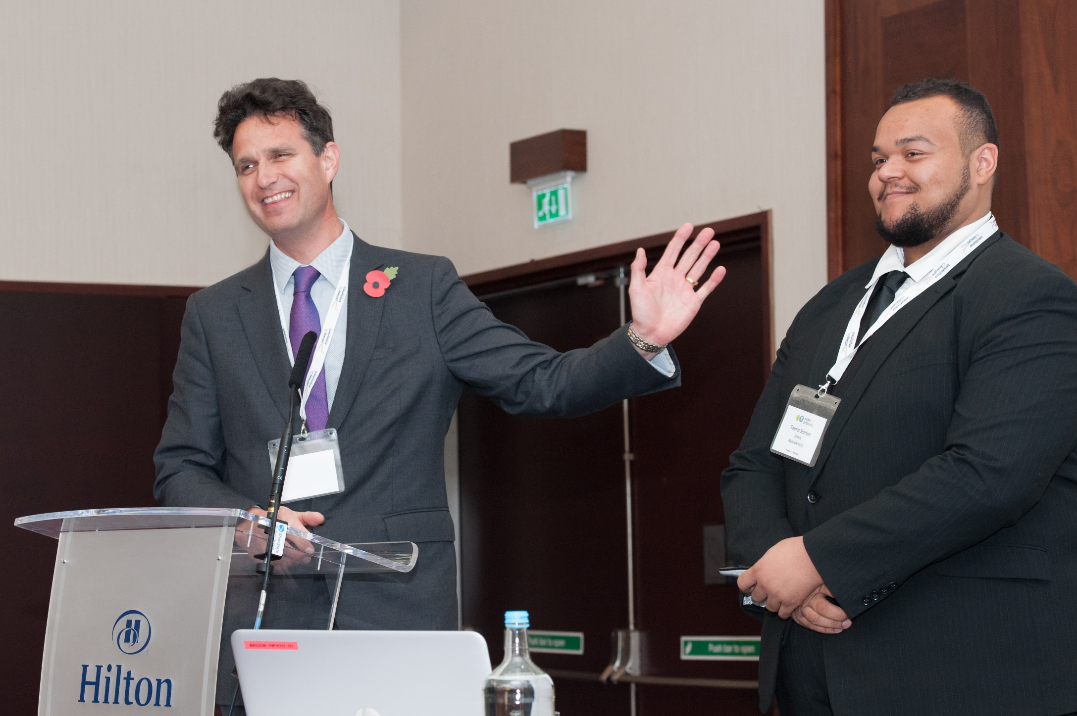
Partnering to improve career outcomes for young people with SEND – Careers Leaders and SENCOs

Slide 2
Welcome
Facilitators
  Jenny Connick, Founder Talentino, strategic partner for SEND for the Careers and Enterprise Company
  Kelly Dillon - leading on SEND for Careers and Enterprise Company
  We will work together and in smaller groups in breakout rooms sharing our thoughts and ideas
  Today our group consists of:
    Careers Leaders from schools, special schools and Colleges
    SENCOs from schools, special schools and Colleges
    Parent, Carer and Family Forum
    Enterprise Coordinators and Enterprise Advisers

Slide 3



Introductions
Introduce ourselves –what you would like from this session and pop it in the chat thanks

Slide 4
What are we aiming to cover today and how will we work together?
1 |
Reach a common understanding of the roles of the SENCO and Careers Leader and develop ideas about creating partnership working
5 |
Challenge our thinking around what a good destination might look like…
2 |
Start from a core narrative around who young people with SEND are and what positive career outcomes look like
6 |
Consider the role that Parents, Carers and families can play and what they might need to fulfil it
3 |
Explore the barriers to optimum outcomes for young people with SEND in mainstream using two case studies
7 |
Think about the role of the employer and what they might need to fully support the career development of a young person with SEND
4 |
Gain further clarity on what Careers support looks like for young people with SEND in mainstream
8 |
Highlight the resources and support available from the Careers and Enterprise Company (Kelly)

Slide 5
Who are young people with SEND in mainstream?

Slide 6
Who are young people with SEND?
  SEND is an abbreviation for Special Educational Needs / Disabilities, sometimes written as SEN or SEN(D) as not everyone with SEN has a disability
  Young people with SEND face huge barriers to achieving optimum career outcomes
  Young people with SEND / disabilities or who are vulnerable are:
    Less likely to achieve qualifications
    More likely to be NEET
    More likely to suffer from mental health problems
    More likely to be homeless
    More likely to be represented in the criminal justice system

Slide 7
Who are young people with SEND?
1.37 million
Many millions more disadvantaged eg 80,000 Looked after Children, 800,000 young carers from age 5, 4 million in Food Poverty
15% students in mainstream have SEND
@280,000 have EHC plans
  138,630 in mainstream
  136,630 in Special School
Experience poorer career outcomes
Fewer employer-driven career opportunities available
Deep, subtle,systemic barriers to career success

Slide 8
Legal Framework SEND Code of Practice 2015
Very common for a young person with SEND ( Special Educational Needs / Disabilities) to have multiple barriers
from more than one grouping
Complex picture for individual and their families/carers
However broad SEND groupings can be defined as:
Communication and interaction - Speech, language and communication needs, Autistic Spectrum Disorder
Cognition and learning - Specific learning difficulty, moderate
or severe learning difficulty or profound and multiple learning difficulty (PMLD)*
Social, emotional, and mental health difficulties (SEMH) /behaviour sensory
Physical needs, including visual impairment, hearing impairment, multi-sensory impairment, physical disability

Slide 9


SEND groupings for the purposes of planning for careers:
Bring the four groups as defined in the Code back together
Divide into
  Career SEND (Inclusion) group One
  Career SEND (Inclusion) group Two:
1
Students with communication/ interaction or cognition and learning difficulties who typically do not take GCSEs (or exams that employers recognise) and who should expect to achieve positive career outcomes but often don’t
2
Students with Social, emotional, and mental health difficulties (SEMH) /Behaviour Sensory and/or Physical needs who typically are able to take GCSEs and can enjoy the same opportunities as their peers but face significant barriers

Slide 10
Where are young people with SEND educated?
Mainstream schools
6th Form/FE College
Home Educated
Specialist Schools or Colleges
Special Schools
Virtual Schools
SEMH schools
Hospital Schools
PRUs
AP
Young Offender Institutes

Slide 11
Let’s think about the group of young people who take /could take GCSEs or L2 Qualifications who we want to include:
Defined in the SEND Code of Practice
  Communication and interaction
  Cognition and learning
  Social, emotional, and mental health difficulties (SEMH) /behaviour sensory
  Physical needs
Disadvantaged
Vulnerable
Looked After Children
Eligible Free School Meals, Pupil Premium, Child in Need
Any young person living through the last two years of education
Inclusion is about getting our arms around this group, aiming for the optimum career outcomes together and respecting the individual needs and enablers

Slide 12
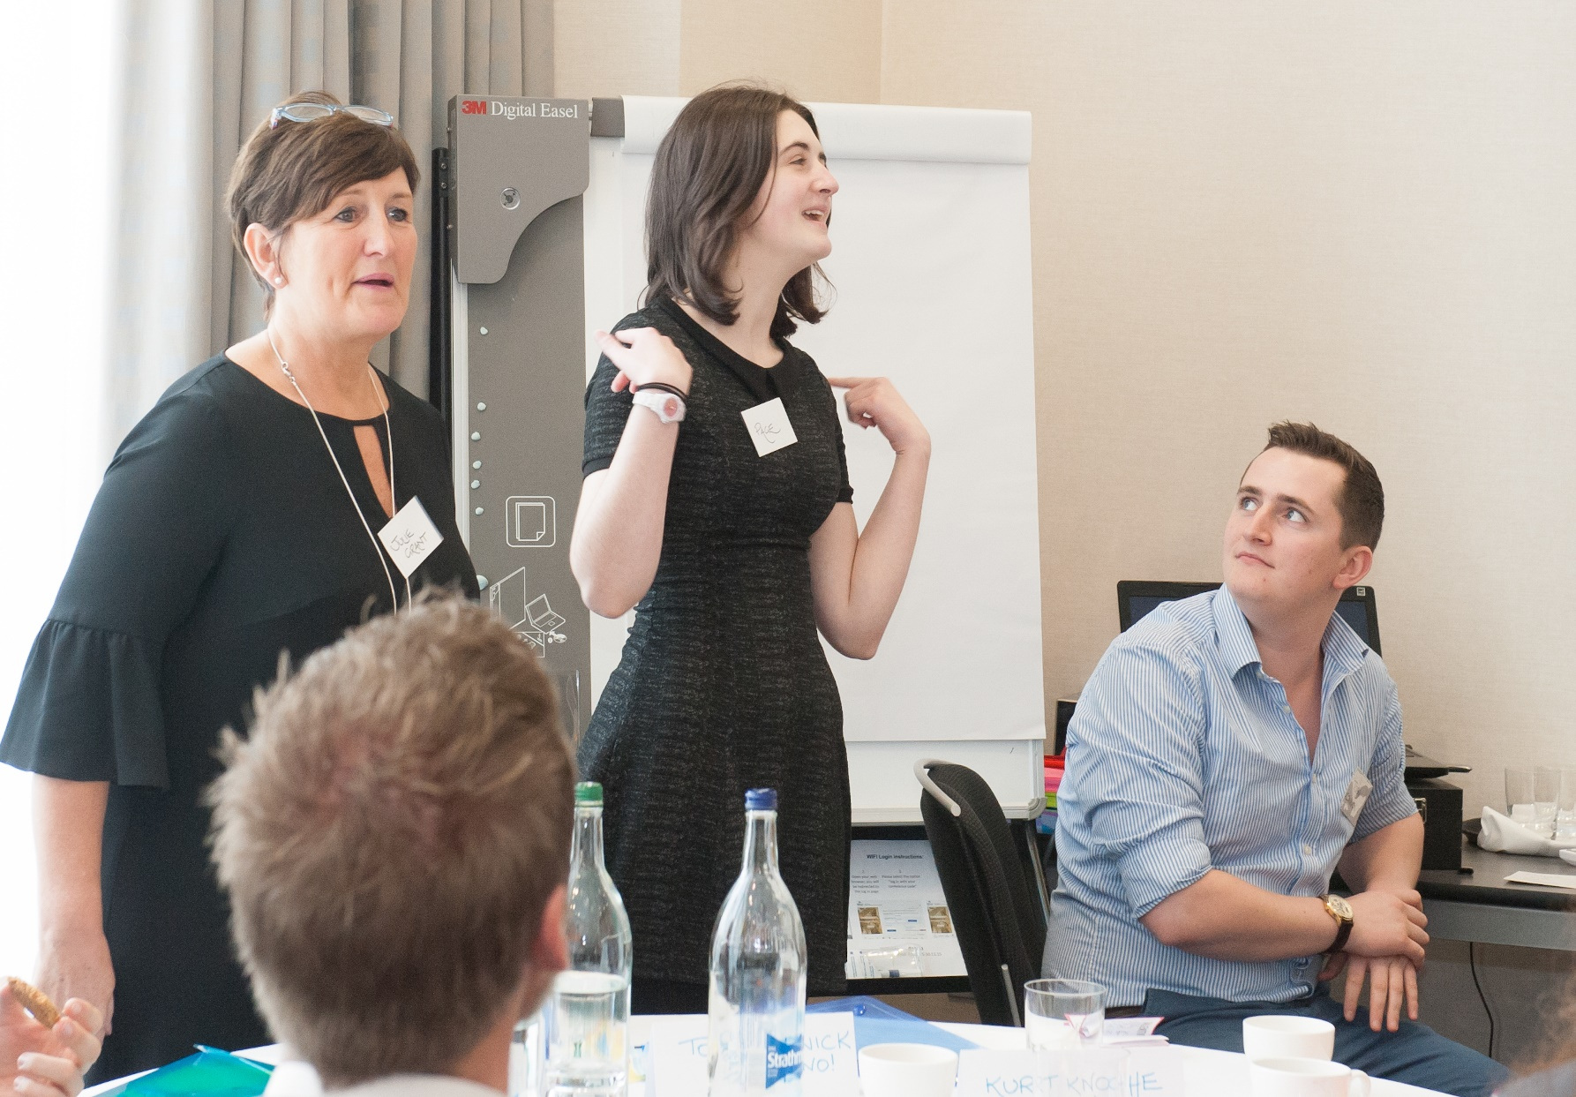
Positive career outcomes for
young people with SEND (Inclusion) Group 2
Apprenticeships
Further Education
Higher Education including University
Employment
Enterprise
T Levels
Those young people with EHC plans can access supported training and employment opportunities

Slide 13
Careers support for young people in the Career Inclusion / SEND Group Two
Early career development for this group needs to:
Start early
Raise aspirations of everyone involved
Extend over a long period of time
Be unbroken
Include extensive support
Factor in time for preparation of everyone involved
Bring families/ corporate parent into the process early, sustain and support them
Enable employers to appreciate the starting points of these young people and the journey they need to travel
Be badged with the word ‘more’

Slide 14
Careers support for young people in the Career Inclusion / SEND Group Two
More…
more time
more support and encouragement
more preparation including of employers
Adaptations
support raising aspirations
more support for families/carers
more time to build trust

Slide 15
Breakout Room
Who are the young people with SEND belonging to Career Inclusion/ SEND Group 2 in your school, special school or College, how could you organise for the purposes of raising career aspirations and achieving the optimum career outcomes?
10 minutes discussion
5 minutes feedback on your top 3 ideas

Slide 16
Reaching a common understanding of the roles of SENCOs and Careers Leaders – developing ideas around partnership

Slide 17
Introduction
SENCOs are vital to improving career outcomes for young people with SEND
No mechanistic link between SENCOs and Careers Leaders necessarily
No mechanistic link between Careers Leaders and SENCOs necessarily
Professional training does not seem to include Careers development in detail
We are going to explore:
  how to create the link between these two key roles
  what both SENCOs and Careers Leaders need to collaborate successfully
  a template to bring these two vital roles together through sharing expertise, delivery and knowledge together

Slide 18
Who is who? Careers Leaders
Careers Leaders
  New (relatively) appointment in school
  Subject Matter expert Careers
  Responsible for the strategic direction and delivery of career development within school
  Member of or closely aligned to SLT
  ‘Discretionary’ qualification – Careers Leader training, accredited/non-accredited
  Management of other Careers Team members – Careers Adviser, Work Experience, other

Slide 19
Who is who? SENCOs
SENCOs
  Statutory appointment
  Subject Matter expert SEND
  Responsible for the strategic direction and implementation including statutory requirements for young people with SEND
  Member of SLT
  Trained and qualified Teacher
  Mandatory qualification within 3 years of appointment – L7 NASEN
Both role-holders will be VERY busy!

Slide 20
Thinking about the locus of expertise and knowledge
SENCO
Careers Leader
SEND expertise and knowledge – expert level including who young people with SEND are
SEND expertise in managing behaviours – expert level
SEND expertise and knowledge – expert level and relationships with external agencies
Academic knowledge – qualified teacher
Statutory planning processes and legal requirements
Funding possibilities and career opportunities eg Supported Internships
Relationships with young people with SEND
Relationships with Parents/Carers/Families of young people with SEND
SEND expertise and knowledge – expert level including who young people with SEND are
SEND expertise in managing behaviours – expert level
SEND expertise and knowledge – expert level and relationships with external agencies
Academic knowledge – qualified teacher
Statutory planning processes
Funding possibilities and career opportunities eg Supported Internships
Relationships with young people with SEND
Relationships with Parents/Carers/Families of young people with SEND

Slide 21
Thinking about the locus of expertise and knowledge
Careers Leader
SENCO
Careers Landscape and ‘how careers work in schools’
Delivery requirements National Careers Strategy
Gatsby Benchmarks and their application
  School Careers strategy and plan – architect
  Supply of local labour market data
  Personalised career development plans pupils
  Integration of careers in the curriculum
  Successful engagement with employers
  Relationships with employers for the purposes of employer encounters and work experience
  Interface with post school destination providers
  Facilitation of Careers Advice and Guidance
Infrastructure – external relationships with ECs, EAs, Careers Hub, SEND COP
Careers Landscape and ‘how careers work in schools’
Delivery requirements National Careers Strategy
Gatsby Benchmarks and their application
  School Careers strategy and plan – architect
  Supply of local labour market data
  Personalised career development plans pupils
  Integration of careers in the curriculum
  Successful engagement with employers
  Relationships with employers for the purposes of employer encounters and work experience
  Interface with post school destination providers
  Facilitation of Careers Advice and Guidance
Infrastructure – external relationships with ECs, EAs, Careers Hub, SEND COP

Slide 22
Improving Outcomes
Careers Leaders and SENCOs will be organised differently in different schools
As a minimum, Careers Leaders and SENCOs will need to join forces and focus on how the career development needed to improve the career outcomes for young people with SEND in school can be facilitated
Careers Leaders and SENCOs will need to share their knowledge at different levels :
  Expert
  Delivery
  Information and knowledge

Slide 23
Expert Level SENCO | Delivery level - needed by SENCO and Careers Leader | Information basis – needed by SENCO and Careers Leader | Expert Level Careers Leader
SEND expertise and knowledge – expert level including who young people with SEND are SEND expertise in managing behaviours – expert level SEND expertise and knowledge – expert level and relationships with external agencies Academic knowledge – qualified teacher Statutory planning processes and legal requirements Funding possibilities and career opportunities eg Supported Internships Relationships with young people with SEND Relationships with Parents/Carers/Families of young people with SEND | SEND expertise and knowledge including who young people with SEND are SEND expertise in managing behaviours Statutory planning processes and legal requirements Funding possibilities and career opportunities e.g. Supported Internships Relationships with young people with SEND Relationships with Parents/Carers/Families of young people with SEND Successful engagement with employers Relationships with employers for the purposes of employer encounters and work experience Interface with post school destination providers | SEND expertise and knowledge –relationships with external agencies Careers Landscape and ‘how careers work in schools’ Delivery requirements National Careers Strategy Gatsby Benchmarks and their application School Careers strategy and plan – architect Supply of local labour market data Personalised career development plans pupils Integration of careers in the curriculum Facilitation of Careers Advice and Guidance Infrastructure – external relationships with ECs, EAs, Careers Hub, SEND COP | Careers Landscape and ‘how careers work in schools’ Delivery requirements National Careers Strategy Gatsby Benchmarks and their application School Careers strategy and plan – architect Supply of local labour market data Personalised career development plans pupils Integration of careers in the curriculum Successful engagement with employers Relationships with employers for the purposes of employer encounters and work experience Interface with post school destination providers Facilitation of Careers Advice and Guidance Infrastructure – external relationships with ECs, EAs, Careers Hub, SEND COP

Slide 24
Breakout Room
Careers Leaders and SENCOs discuss what are the top three things they need from each other and how they could organise to work together, what would a successful model look like that would contribute to improved career outcomes?
10 minutes discussion
5 minutes feedback on your top 3 ideas

Slide 25
Barriers to Optimum Career Outcomes for young people with SEND in mainstream – case studies
Looked after children – VSLAC Oxfordshire
Billy – Realising Potential AP

Slide 26
Why might children come into care?
Homelessness
Abuse- physical, sexual, emotional
Death of parents
Neglect
Parents lack capacity- through illness, substance misuse or other reasons
Family under severe stress, relationships breakdown
Parent(s) in prison, parental abandonment
Child has severe disability or other needs that parents cannot meet
Unaccompanied asylum seeking child
Child at risk of sexual exploitation, criminality etc and parents unable to safeguard adequately
Notes:
Activity- list reasons and guess figures

Slide 27
How might traumatised children present in school?
May experience flashbacks and intrusive thoughts
Anxious
May have panic attacks
Depressed, low self esteem
Self harming behaviour Inc. eating disorders
May lie or make up stories, or deny behaviour
Can be aggressive, both physically and verbally
May abuse substances
Some may overshare personal information
Might run off when fearful or under stress
May find it difficult to form relationships
Sudden mood changes
Acting childlike or ‘babyish’
When a traumatised child senses a threat (real or perceived) their brain initiates a ‘fight, flight or freeze’ response. During this, the child is not able to access more complex areas of their brain, such as speech, cognition or memory
Think about your observations, how would you react, changes …

Slide 28
What support can be provided in the classroom during careers activities ?
Aim to form positive, warm relationships that traumatised children feel they can predict and rely on. They must feel safe within your classroom if they are to learn.
Be consistent and therefore predictable as this is non threatening
Be aware that traumatised children may have ‘triggers’ e.g. certain smells, sounds, topics such as sex education. Talk to your Designated Teacher for more advice on an individual child
Avoid situations that ‘shame’ children at all costs
Take extra care to praise the efforts of these children, be mindful that concentrating might be really difficult for them. Instructions may need to be short and sweet, and written down.
Some children may be given time out cards, fiddle toys etc to help them manage their behaviour and feel grounded, this will be communicated to you by pastoral staff.
Hypervigilant children often prefer to sit where they can see everyone in the classroom at once, so they can monitor for danger- try to subtly accommodate this if you can.
Model self-regulation e.g. “take a deep breath with me…’
Be discreet about the child’s past or status
Notes:
What can I do in the classroom?

Slide 29
Recommendations and top careers related actions
Be aspirational for your students
Recognise students as individuals, build relationships with them
Encourage them to explore as many career related activities as possible
Think about what tools and resources you have to help students identify their key interests and start planning their career
Think about how to build an aspirational and careers focussed culture in your setting
What businesses and HE institutions could you reach out to and build links with
Help students to think about the story they want their CV to tell
Develop your understanding of Attachment and Trauma – plan how you can spread this understanding and ethos

Slide 30

Billy
Young man 22, told his story for the first time to the Talentino / CEC conference
Background at home included domestic violence, parent’s dependency issues, sibling death through addiction Some support early on from Grandmother Challenges started in Primary School Permanently excluded from Primary School, from a mainstream school and a PRU Arrived in AP – Realising Potential at 14 Sustained support from a small number of staff Started to achieve at College Domestic violence and bereavement interrupted progress Opportunity extended with continued support | Work experience taught me lots of things some positive some not so positive!

Slide 31

How could you help other young people like Billy, here is what he suggests…
Schools could…
The challenges Billy had to face from a very young child were ( and still are) enormous
Single people throughout his life have seen his potential, Head Teachers, teachers, employers, his Grandma
Take time to understand our backgrounds and its impact
Build our confidence
Identify someone who can support us long term
Don’t judge us, look beyond our behaviours
Facilitate secure and lasting attachments that generate emerging independence
Prepare employers sensitively and effectively to engage with us as soon as possible
Be creative around delivering careers activities
Find out what interests us, then encourage/help us to progress in it.

Slide 32

Employers could think about…
Come with an open mind
Don’t judge, look at our life from our perspective to better understand
Help us find things we enjoy
Provide access
Organise flexibly, short sessions building up to longer engagement activities
Be prepared for set-backs
Work with us longer term – Mentor, Coach
Be our role model, help us aspire
Believe in us, we need to feel you actually care

Slide 33
Breakout Room
Consider the needs of young people with SEND in mainstream, what Careers Support do you or could you put in place?
10 minutes discussion
5 minutes feedback on your top 3 ideas

Slide 34
Challenging what ‘good’ destinations look like…

Slide 35


Destinations
It’s what it’s all about – isn’t it? Everything we do…
What is a ‘good destination’?
We know the range of possible destinations
We measure them, report on them
Feels like an end point, should it be a beginning / continuation?
Judgements are made but
  how do we know what good looks like?
  when do we know it is a good destination?
  what if there is little choice?
  who decides what good looks like?

Slide 36
Destinations – and the Gatsby Benchmarks
  GBM1 – Do you start with the outcomes?
  GBM 2- Do you include information on the widest range of possibilities…
  GBM 3 – Do EHC plan outcomes reinforce individual career plans, does everyone know
  GBM 4 – Does the curriculum inspire aspirations?
  GBM 5 – Do employers understand this group, do they really appreciate their starting points and the life changing impact they could have ( and the alternative…)
  GBM 6 – ditto
  GBM 7 – Do you showcase the full range of possibilities early, make the career pathways obvious and navigable
  GBM 8 – Do your Careers Advisers inspire, aspire, take the path of least resistance , venture out for success

Slide 37
What role do Parents, Carers Families play and how Can SENCOs and Careers Leaders work together?

Slide 38
Impact of Parents, Carers, Families on Career Outcomes – key influences
Level of their own education
Personal experience of education
Value placed on education
Employment status
Beliefs and attitude to employment, knowledge of different careers
Their own values and those they show to family, friends and society
The opportunities they provide for their children
The nature of the parent / child relationship
Basic needs met
Consider the influence of parents, carers and families, engage with the SENCO who will have a deeper understanding and relationship

Slide 39
Breakout Room
Choose either- Discuss how you think you could approach the development of what good destinations are and how can SENCOs and Careers Leaders work together to ensure the optimum destinations are achieved
Or – Discuss what you can do / or share how to engage Parents, Carers and Families further to support the career aspirations of their children
10 minutes discussion
5 minutes feedback on your top 3 ideas

Slide 40
Support and resources from the Careers and Enterprise Company - Kelly

Slide 41

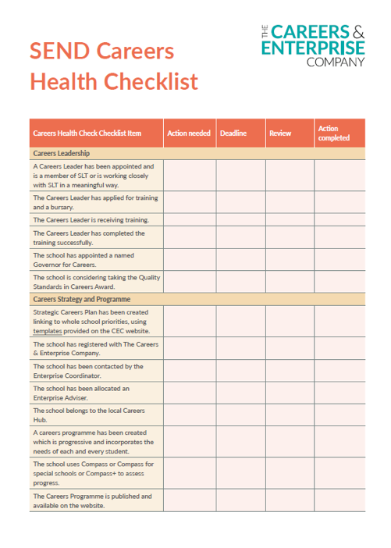

Resources
Examples from across the network to support all benchmarks can also be found in the Resource Directory on the CEC website.
Notes:
Revised toolkit live now alongside Careers Health checklist. Plant nurture grow will be September

Slide 42
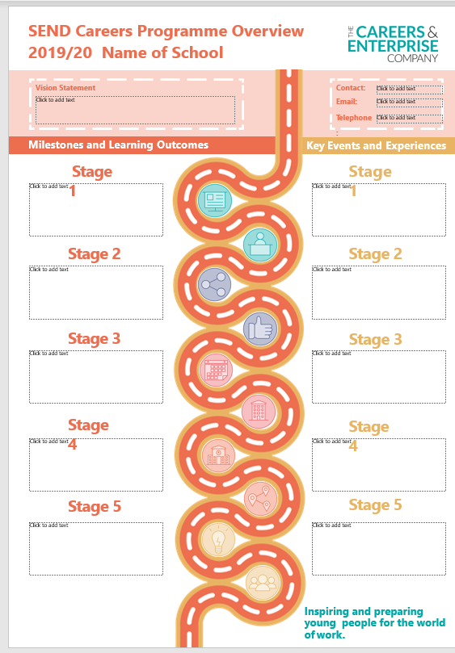
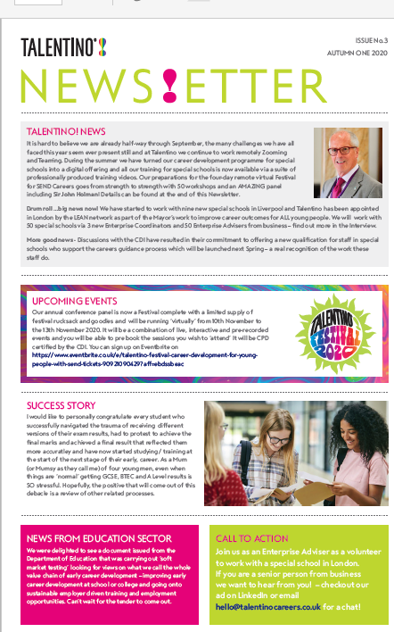
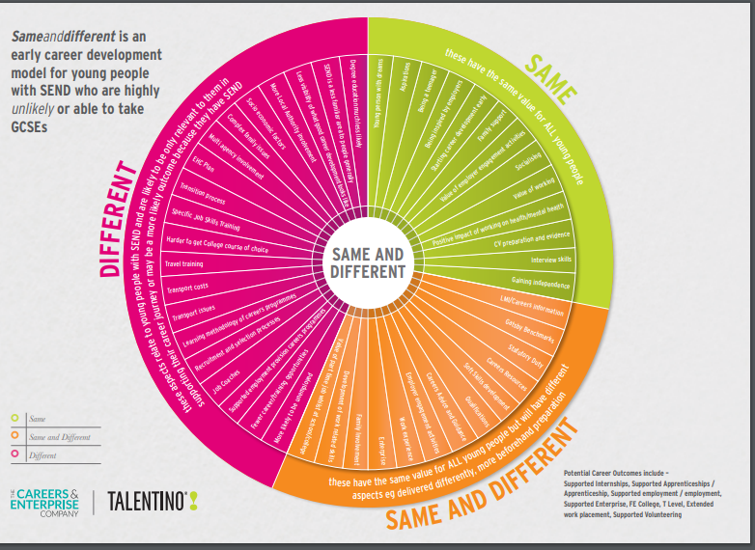
SEND specific resources
CEC developed in partnership with Talentino!

Slide 43

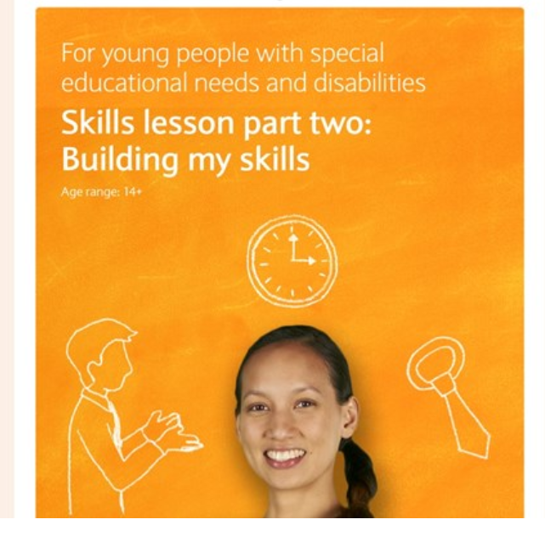
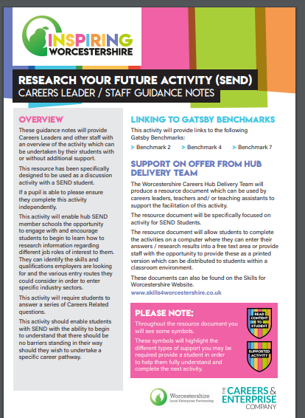
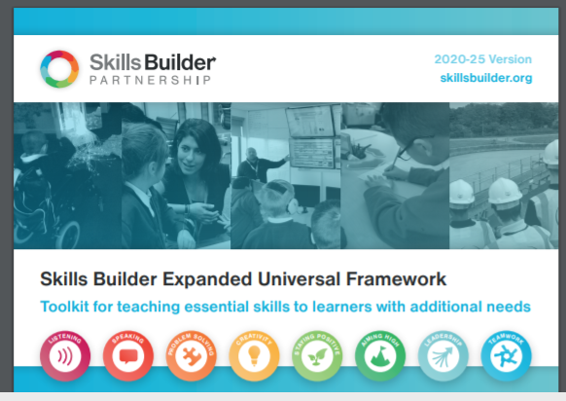
SEND specific resources
Network, Employer and Provider resources

Slide 44

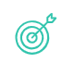




What can you find in the Resource Directory?
Training and development
Gatsby Benchmarks
SEND
Deliver your school, special school or college’s careers provision.
Confidently meet the eight Gatsby Benchmarks.
Support settings that include young people
with SEND.
Employer engagement
Key stages
Campaigns
Engage employers and establish your employer networks.
Open the possibilities with key stage-specific resources.
Resources from campaigns including My Choices, My Week of Work and Work It

Slide 45
Summary

Slide 46
We covered today:
1 |
Reach a common understanding of the roles of the SENCO and Careers Leader and develop ideas about creating partnership working
5 |
Challenge our thinking around what a good destination might look like…
2 |
Start from a core narrative around who young people with SEND are and what positive career outcomes look like
6 |
Consider the role that Parents, Carers and families can play and what they might need to fulfil it
3 |
Explore the barriers to optimum outcomes for young people with SEND in mainstream and how SENCOs and Careers Leaders can work together
7 |
Think about the role of the employer and what they might need to fully support the career development of a young person with SEND
4 |
Gain further clarity on what Careers support looks like for young people with SEND in mainstream
8 |
Highlight the resources and support available from the Careers and Enterprise Company (Kelly)

