Slide 1
Learning objectives
I will identify skills and qualities employers are looking for.
I will match my own skills and qualities to this.
I will identify which skills and qualities I need to develop.

Slide 2
What employers want?

Slide 3
Employers are people who give people work.
My employer is Mr Preece.
Employees are people who work.
I am an employee.
I work for the school.

Slide 4
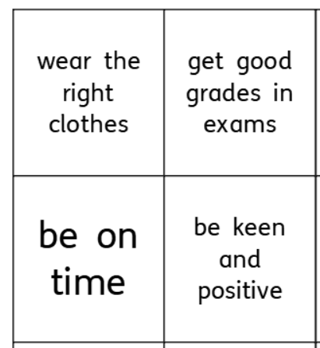
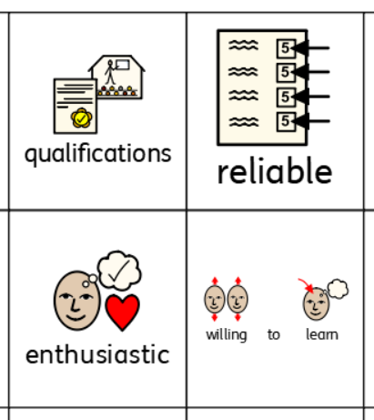
Starter Activity
Match the words to the definitions.
Cover the pictures and words with the explanation cards.

Slide 5
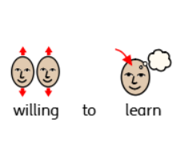
I always tell the truth.
I know my strengths and weaknesses.
I know what is right and wrong.
I am positive about my lessons.
I see the good things.
I like to please people.
I like to learn new things.
I ask question.
I find things out for myself.

Slide 6
I always wear school uniform.
I wear smart clothes to special occasions.
I am on time for school.
I am on time for my lessons.
I am on time for my sports club.
I help do jobs for teachers.
I am always in the right place.
I always do my homework.

Slide 7
I can work with other people.
I know what my job is.
I can help others.

Slide 8
What do employers want?
Choose 8 things employers think are important.
Put them in order
Top is most important
Bottom less important
Example
Punctual
Live near
Smart
……..
……..
……...
………
………

Slide 9
Answers
Reliability and Honesty – 91%
Punctuality – 91%
Willing to learn – 88%
Teamwork – 85%
Enthusiastic – 82%
Smart – 78%
Number and literacy – 54%
Good exam grades – 30%
Is this a surprise?
Why/Why not?
What should you show employers?

Slide 10
What should I write
Step 1: Give an example
I like to learn new things.
Step 2: Give a real example saying where and when
In Art last year I liked learning about mixing different colour paints.
Step 3: Give a real example and explain what you did
In Art last year I liked learning about different colour paints. I looked for information in books and on the internet. I asked the teacher for more information. I talked about what I had learned with my parents.

Slide 11
Questions to think about
How can we improve?
Be honest about ourselves
Find out what we need to be better at
Make a plan
What can we do this year?
Join after school clubs
Do some jobs at home
Ask teachers to help

