Slide 1
Mindfulness & Stress

Slide 2
01 | Understanding stress
02 | How to relax
03 | Diet and stress
04 | Your own personal “Relaxation Plan” You will need: Pen, Paper

Slide 3
Understanding stress

Slide 4
Under-
standing stress
Definitions
Stress is what you feel when you are worried or uncomfortable about something. This worry in your mind can have physical effects too.
Tension is similar to stress; it is a state of worry or nervousness.
Mindfulness is taking notice of how your body feels and what your mind is doing.
We all feel stressed at times. Stress is not necessarily a bad thing; it gives us energy and mobilises us to do things. However, too much stress can lead to a range of health problems, including upset stomach, headaches and even heart disease.

Slide 5
Under-
standing stress
Knowing ourselves
Since mindfulness is taking notice of how your body feels and what your mind is doing, it is often very useful to reflect on experiences that have made us stressful in the past.
Task:
Make a list of things / situations that cause you stress and / or tension, together with how this makes you feel e.g. sick / worried.
With a partner, compare your lists and identify any that you might have in common. Why might this be?

Slide 6
How to relax

Slide 7
How to relax
Reflecting on your own way
Learning how to relax properly is key to coping well with stress and tension.
However, everyone has slightly different strategies for doing this.
Task:
How do you best relax?
How have you seen others relax?
List as many different activities that people do to combat stress and tension.

Slide 8
How to relax
Learning a new technique
Breathing exercises are an important part of practising mindfulness.
One technique is called deep breathing. We will show you how to do this on the next slide.
It will be tricky to do it properly in a classroom, but try not to be too distracted by what’s around you, and instead focus only on your breathing .

Slide 9
Inhale slowly and deeply, filling your chest with air.
Count five seconds to yourself
“one and two and three and four and five”
Imagine your chest slowly filling with air.
Your stomach should expand.
When you have inhaled fully, hold your breath for another five seconds, again counting to yourself
“one and two and three and four and five”
This should be just a comfortable pause.
Let the air out through your mouth slowly for a final five seconds
“one and two and three and four and five”
Let as much air as you can out of your lungs.
Feel yourself relaxing as you do.
Feel your shoulders, chest and diaphragm letting go and imagine releasing all the tension.
How to Relax

Slide 10
How to Relax

Slide 11
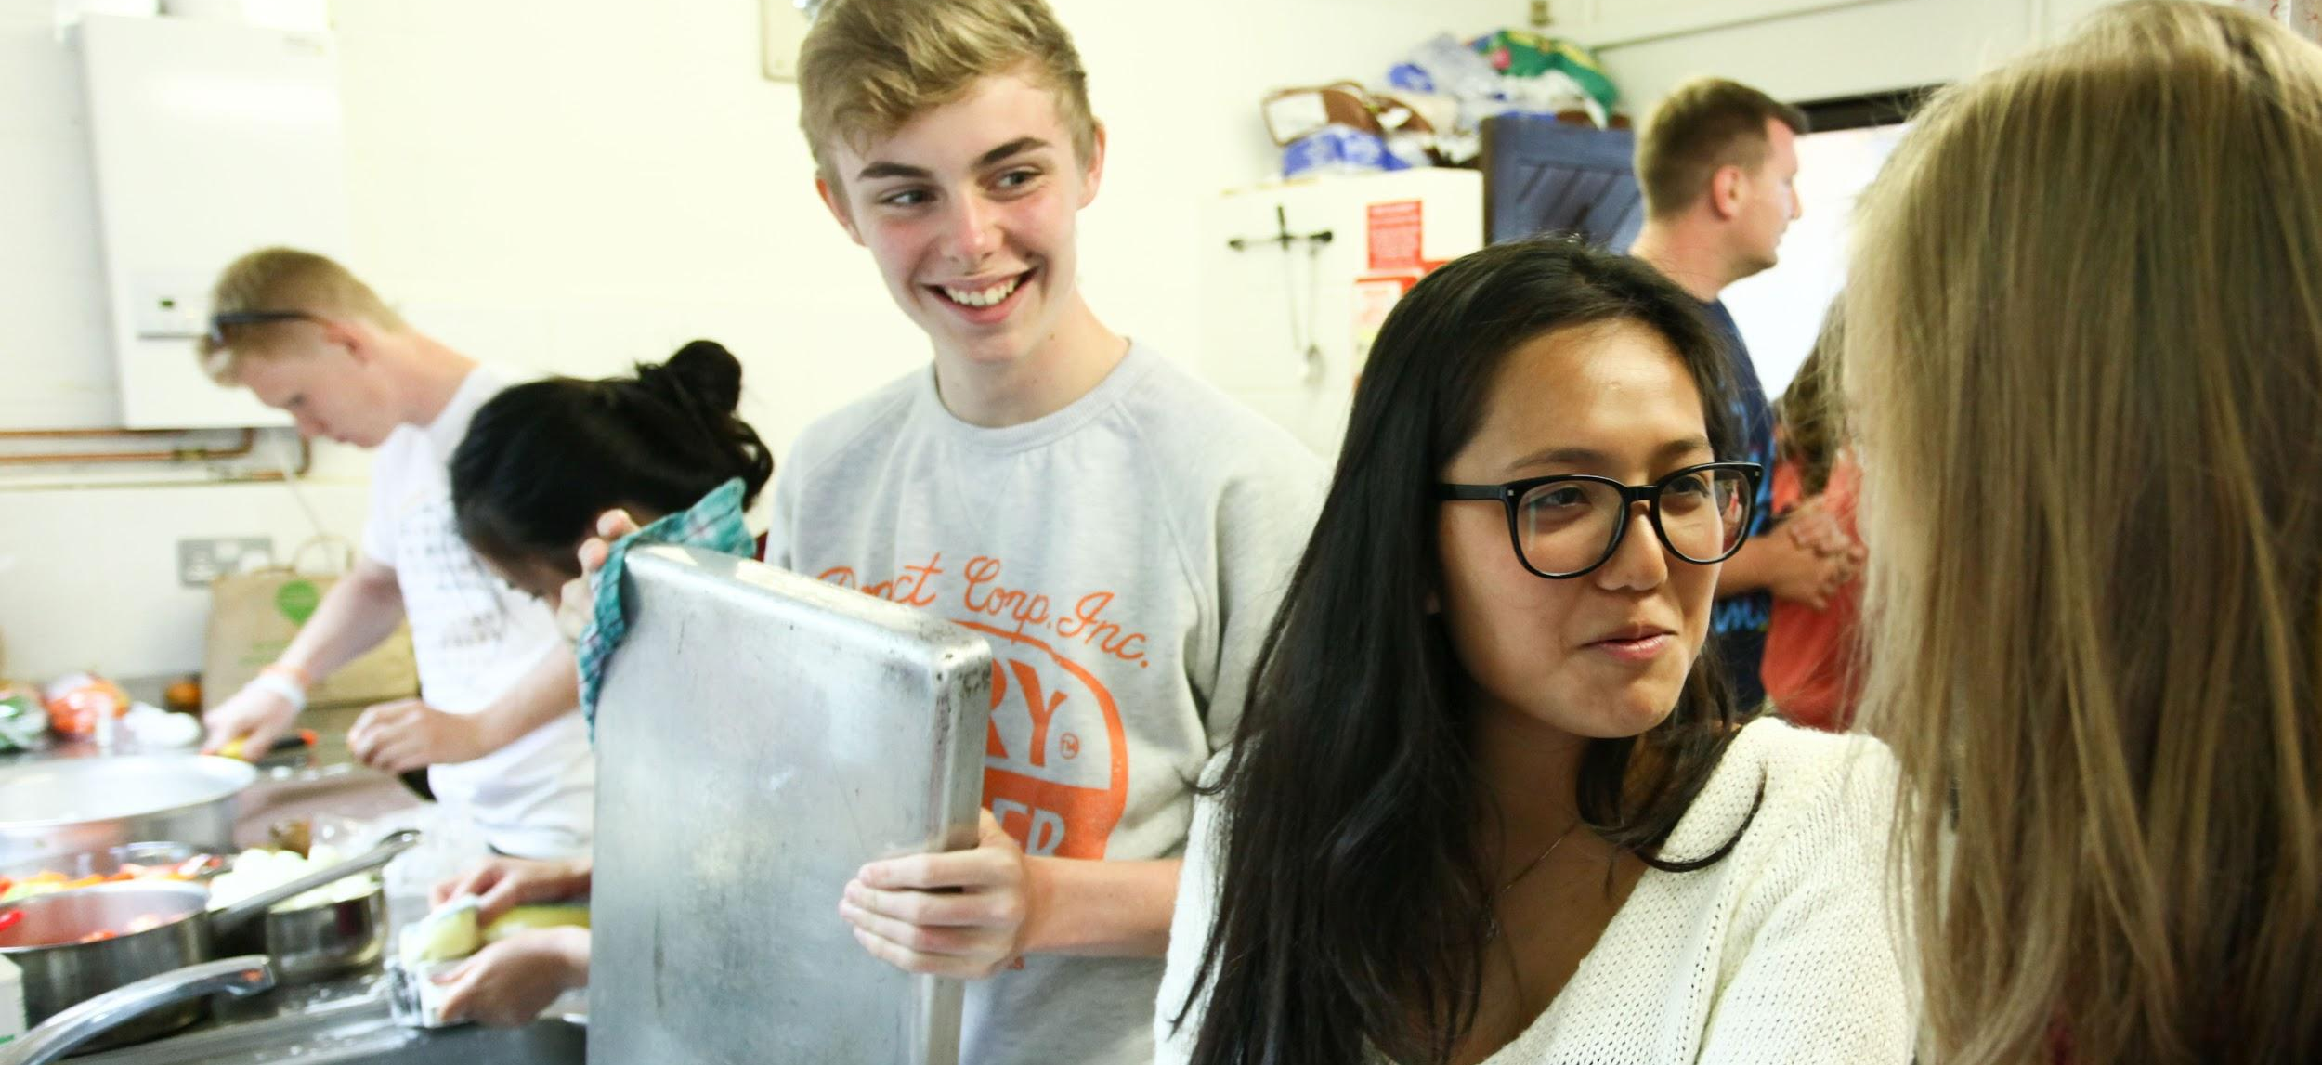
Diet and stress

Slide 12
Diet and stress
Eating your way to relaxation
Stress triggers a set of biological responses including:
The release of stress hormones from your adrenal glands – adrenaline and cortisol
An increase in blood sugar
Rising blood pressure
Rapid heart beat
So how can our diet help?
Eating a balanced and healthy diet is key to helping our bodies manage the physiological changes caused by stress.
Since the hormonal response is significantly influenced by blood sugar levels, we can change our diet to help stabilise the levels of sugar in our blood.

Slide 13
Top tips:
Ensure a minimum of five portions of vegetables per day
Start the day with a balanced breakfast. Avoid sugary cereals, pastries and too much caffeine.
Protein helps to slow the release of sugar into the bloodstream, so eat lean meat, chicken, fish, eggs, beans, lentils, nuts or seeds in each meal.
Don’t skip meals. Small, regular meals will help to maintain energy levels and mood, while decreasing tiredness and irritability.
Avoid highly refined foods such as white bread, pasta, chocolate, biscuits, sweets or foods with added sugars.
Watch the caffeine, and aim to drink at least 1-1.5 litres of water throughout the day.
Try not to reach for food when you are in a stressed state. Stress diverts blood flow away from your digestive system, so you may experience bloating, gas and discomfort.
Diet and stress

Slide 14
Diet and stress
Eating your way to relaxation
Task:
How many of the top tips apply to you?
Five portions of fruit/vegetables per day
Balanced breakfast
Protein in each meal
Don’t skip meals
Avoid added sugars
Watch the caffeine
Drink 1-1.5 litres of water throughout the day
Avoid reaching for food in a stressed state
How could you change one thing for the better?

Slide 15
Your own personal “Relaxation Plan”

Slide 16
Your own personal “Relaxation Plan”
Your Personal Relaxation Plan
Based on all the above information, you can now create a Personal Relaxation Plan that you can follow easily, and that will help you deal with stress and tension without it taking you over.
Task: Create your own guide to dealing with stress (make it personal to you).
You should include the following:
Identifying your own stress ‘triggers’ and their effects
Diet
Exercise
Sleep time
Relaxation techniques
Writing a journal - keep an eye on how these changes are helping.

