Slide 1
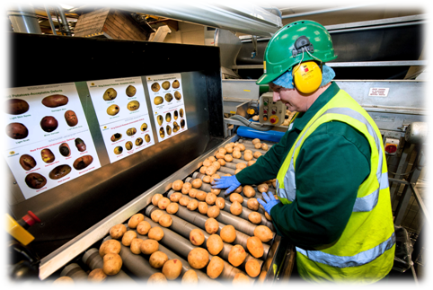
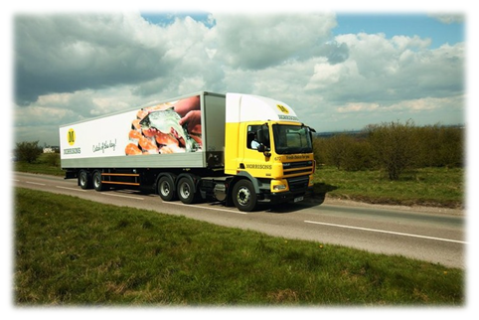
Jjjj
j
Welcome to Morrisons
Notes:
Introduce ourselves.
Try to get rid of the stereotype of working at morrisons – More than till work an stocking shelves
Ask: What jobs do you think are available at Morrisons.
1

Slide 2
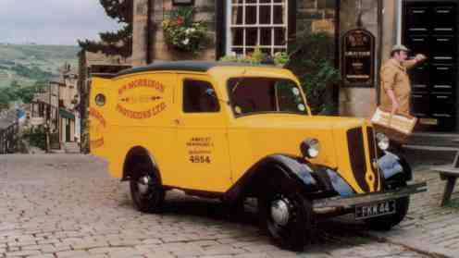
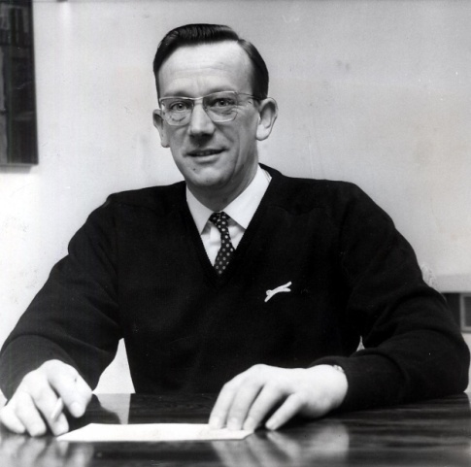
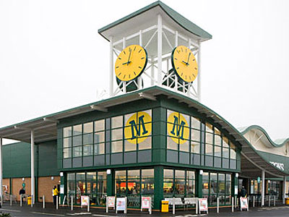
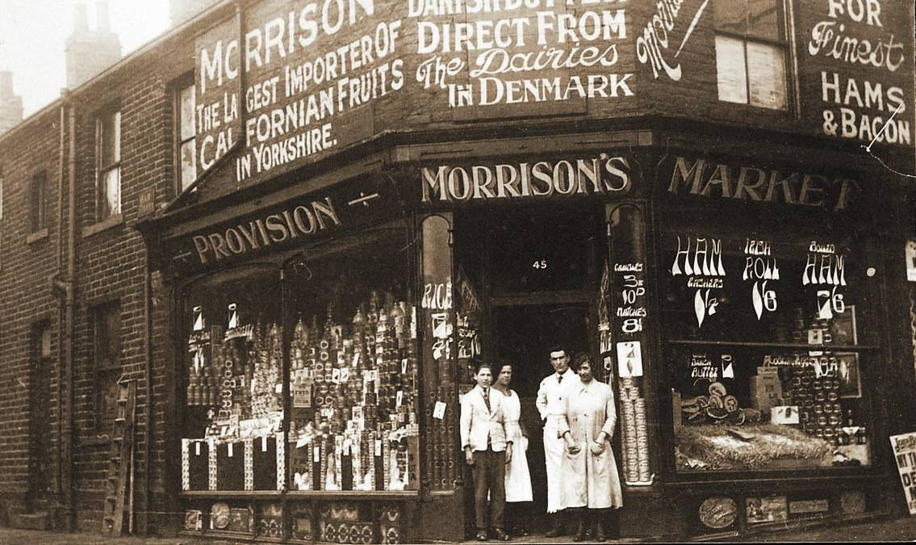
Morrison’s Heritage
Notes:
Ask: How old is Morrisons?
William Morrisons founded Morrisons in 1899 with a market stall selling eggs and butter in Bradford.
In 1952 Ken Morrison took over
In 1958 the first self service supermarket opened – with only 3 checkouts
In 1999 Morrison opened its 100th shop
In 2004 they bought Safeway who already had 479 stores.
We are now the 4th largest supermarket with 498 stores

Slide 3
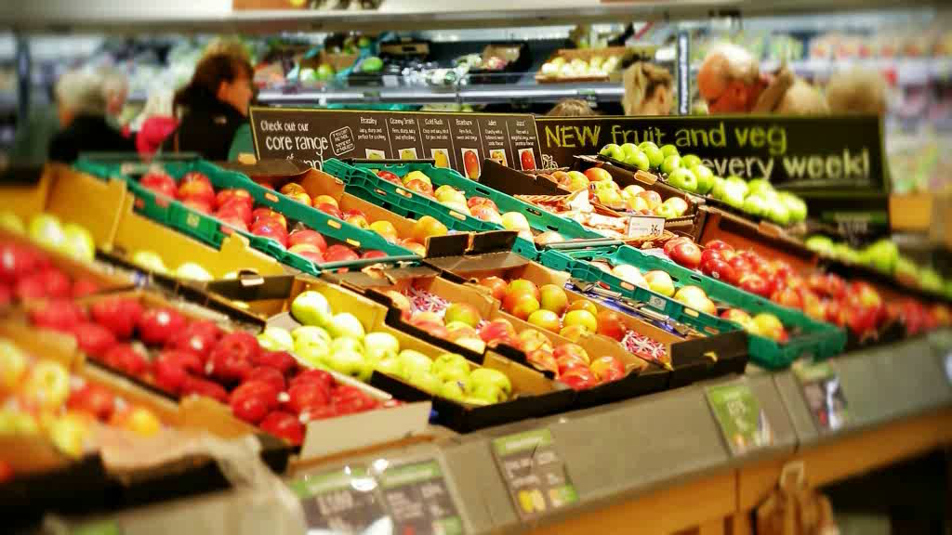
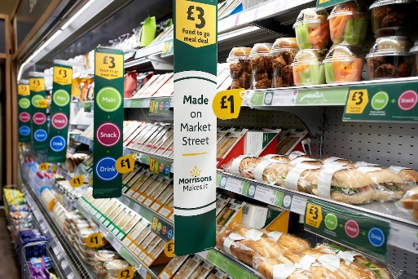
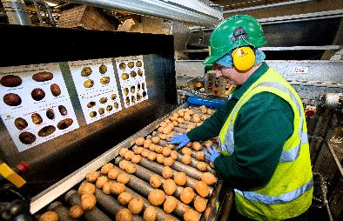
Core Purpose – Why we do what we do?
Notes:
Purpose:
Making food is at the our heart of what we do. Providing food suggests we care more about its enjoyment than simply selling it.
Food that’s consistently good quality, so we can rely on it.
We all have a part to play no matter our role.
We make Morrisons accessible to everyone through our different ways of selling and going to market.
Eating well means being completely satisfied, savouring flavours, appreciating quality, enjoying a healthy balance, feeling good.
3

Slide 4
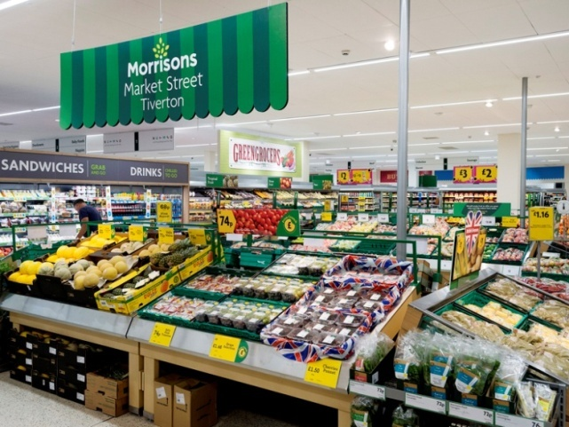
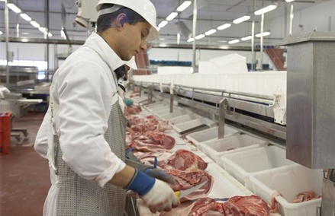
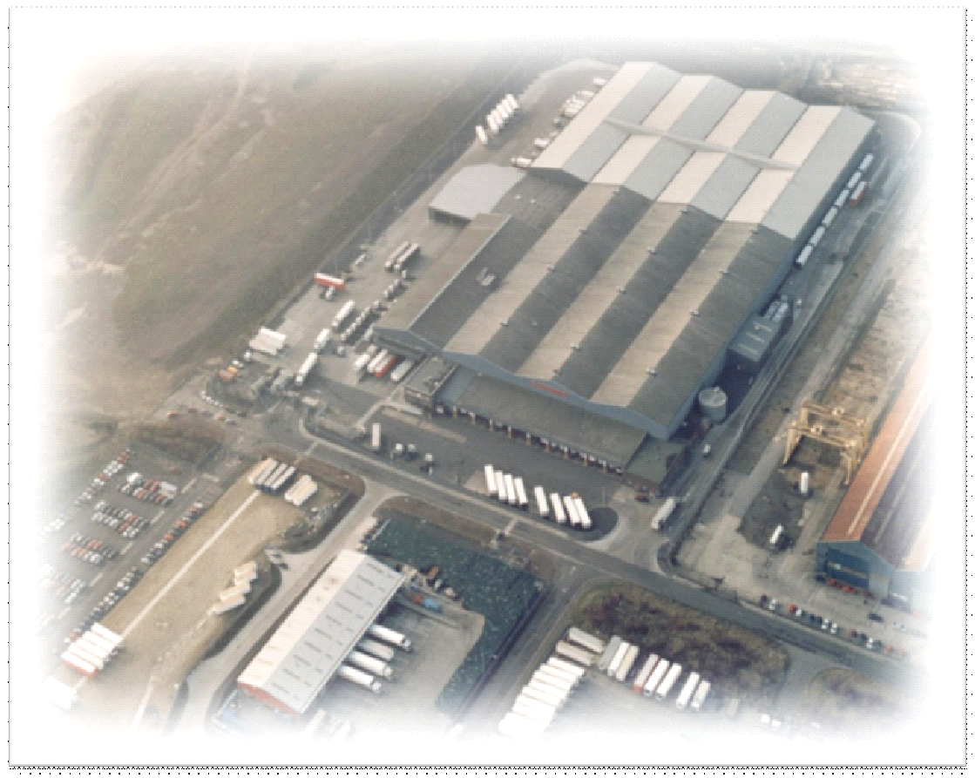
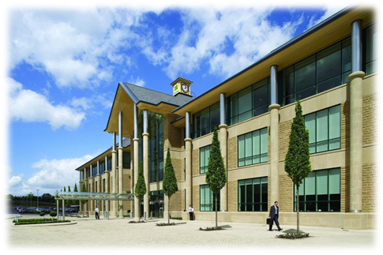
Divisions of Morrisons
Retail
Manufacturing
Logistics
Head Office
Notes:
4 divisions of morrisons
Retail – the shops which you will all know.
Manufacturing – We have 18 manufacturing plants which include farms, abbortoires, bananas plant, seafood port, flowerworld, Chippendale eggs, Rathbones bakery
Not just Morrisons that sell our products. Did you Know? We provide all of Macdonalds beef burgers? We provide the sausage meat for Greggs?
We the UK’s largest fresh food manufacturer
Head office – Everything comes together centrally. Board of directors, buyers, marketing, budgets,
Logistics – Ask: Does anybody know what Logistics is?
Getting a product from one place to another. This may be China – or locally. Modes of transport – Road, rail, ship and plane
7 RDC’s throughout the UK
4

Slide 5
Our Supply Chain
“Field to Fork” Process
Notes:
We are unique. We are different to other retailers in the UK, as we own our whole supply chain. This allows us to control product from source to consumer, ensuring the best quality and control.
5

Slide 6
Notes:
Morrisons makes it advert – what we makes makes us who we are
This advert demonstrates out supply chain from raw materials to the customer
6

Slide 7
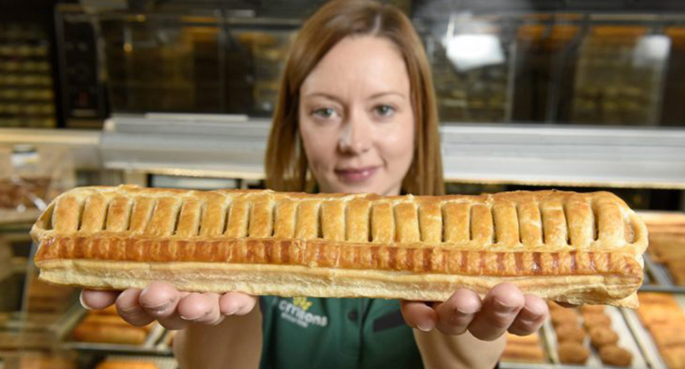
Manufacturing facts
How many sausages do we produce a year?
What weight of cheese do we manufacture per year?
How many pies do we produce a year?
Notes:
●How many sausages do we produce a year? 345 million sausages per year
●What weight of cheese do we manufacture per year? 17,160 tonnes of cheese per year
●How many pies do we produce a year? 44.4 million pies per year (excludes sausage rolls)
7

Slide 8
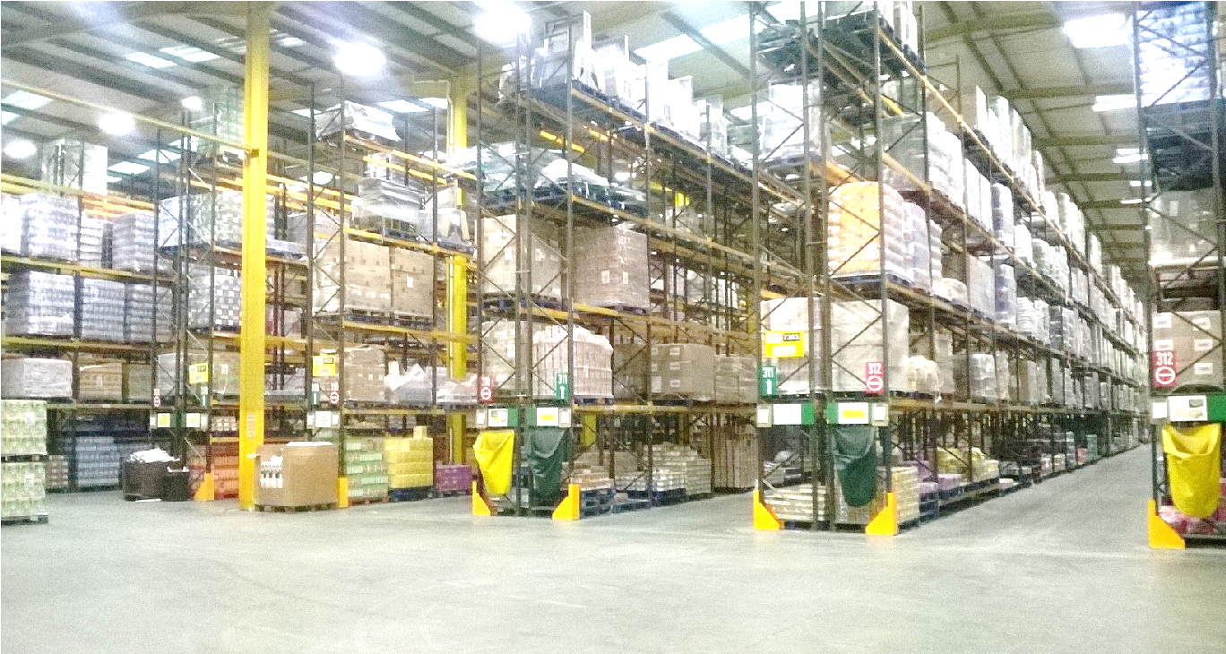
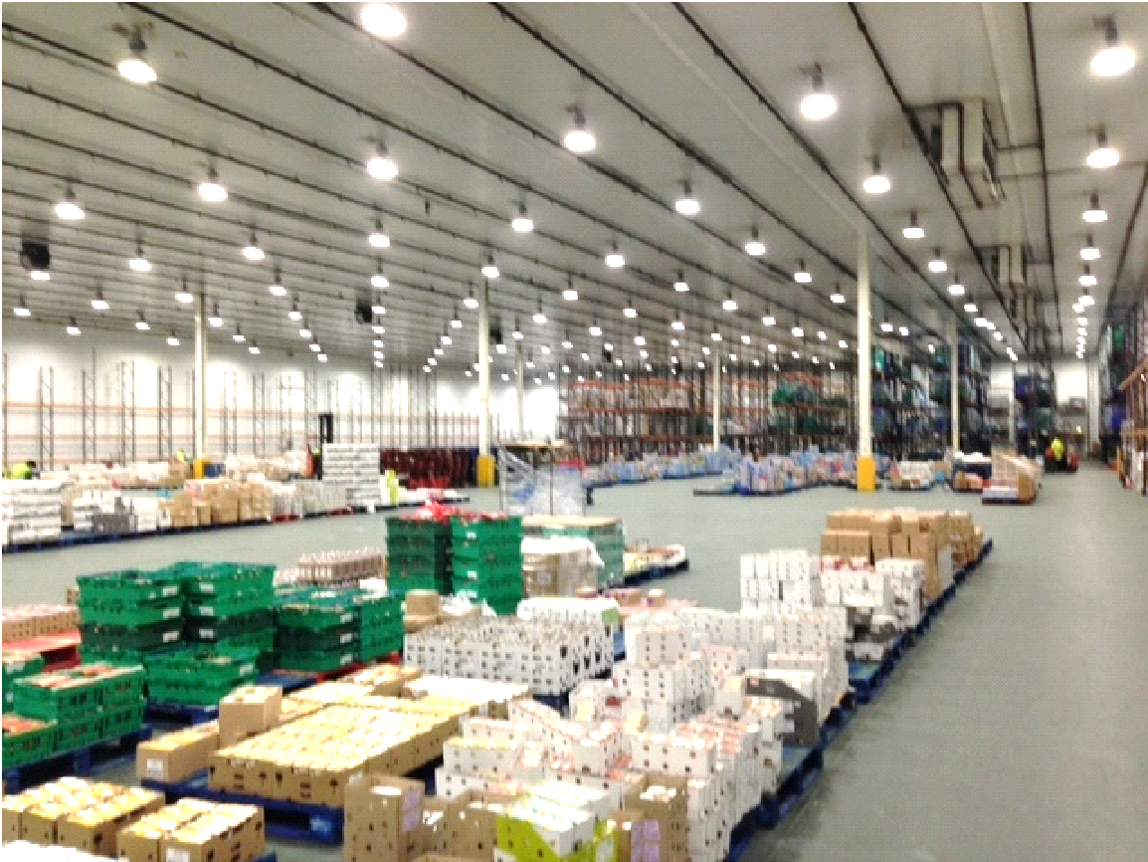
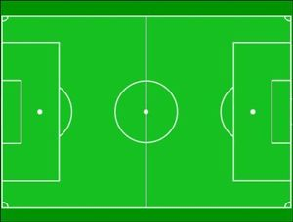
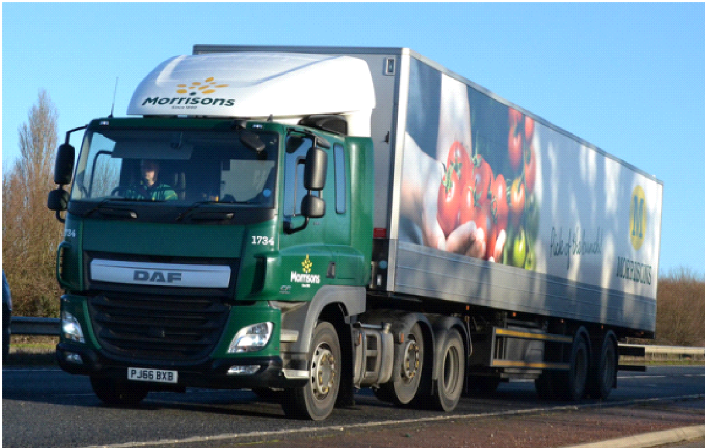
Stockton RDC
Notes:
Stockton RDC is about as big as 11 football pitches
Was built in 1975 – over 40 years old. Started as Hintons – Prestos – Safeway - Morrisons
Ambient Warehouse 3311 different lines - process 400,000 cases a week
What products would you find in an Ambient Warehouse?
Chill Warehouse 3740 different line – process 540,000 cases a week
What products would you find in a Chill Warehouse?
Transport department 32 units and 95 trailers
VMU workshops Maintain our fleet and MHE – 156 picking trucks/FLTS
Recycling unit
All stock comes into our depot. This is then picked into store orders.
8

Slide 9
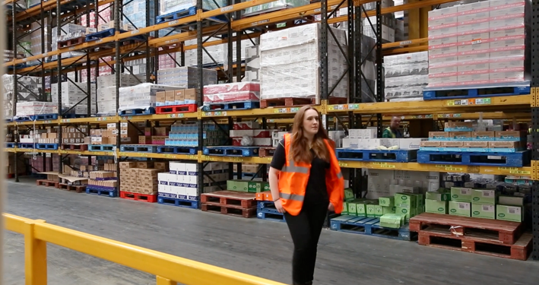
What jobs are available in Logistics?
Notes:
9

Slide 10
What jobs are available in Logistics?
Warehouse Operative
HGV Driver
Fitters (HGV, MHE & Fridges)
Canteen Assistant
Cleaners
Administrators
Managerial roles
Notes:
Warehouse Operative – the colleagues who pick the goods ready to out to store. Muti skilled. Can include FLT’s, picking trucks or on foot.
HGV driver – Class 1 delivery drivers
Fitters – They are RGV (truck and trailer), MHE (picking trucks and FLTS), and fridge engineers
Canteen Assistants
Cleaners
Administrators – every departments has their own administrators. They are responsible for data entry, paperwork, and other office based tasks.
Managerial roles – all departments have their own managerial structures. This varies for each department. There are managers who manage the colleagues. Managers who manage the shift. And managers who oversee the who department.
There is one manager in charge of the whole site.
10

Slide 11
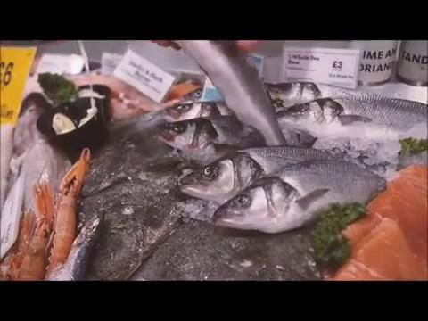
A wide range of jobs available within the whole of Morrisons?
Notes:
This video demonstrates all the different roles available throughout the Morrisons network
11

