Slide 1
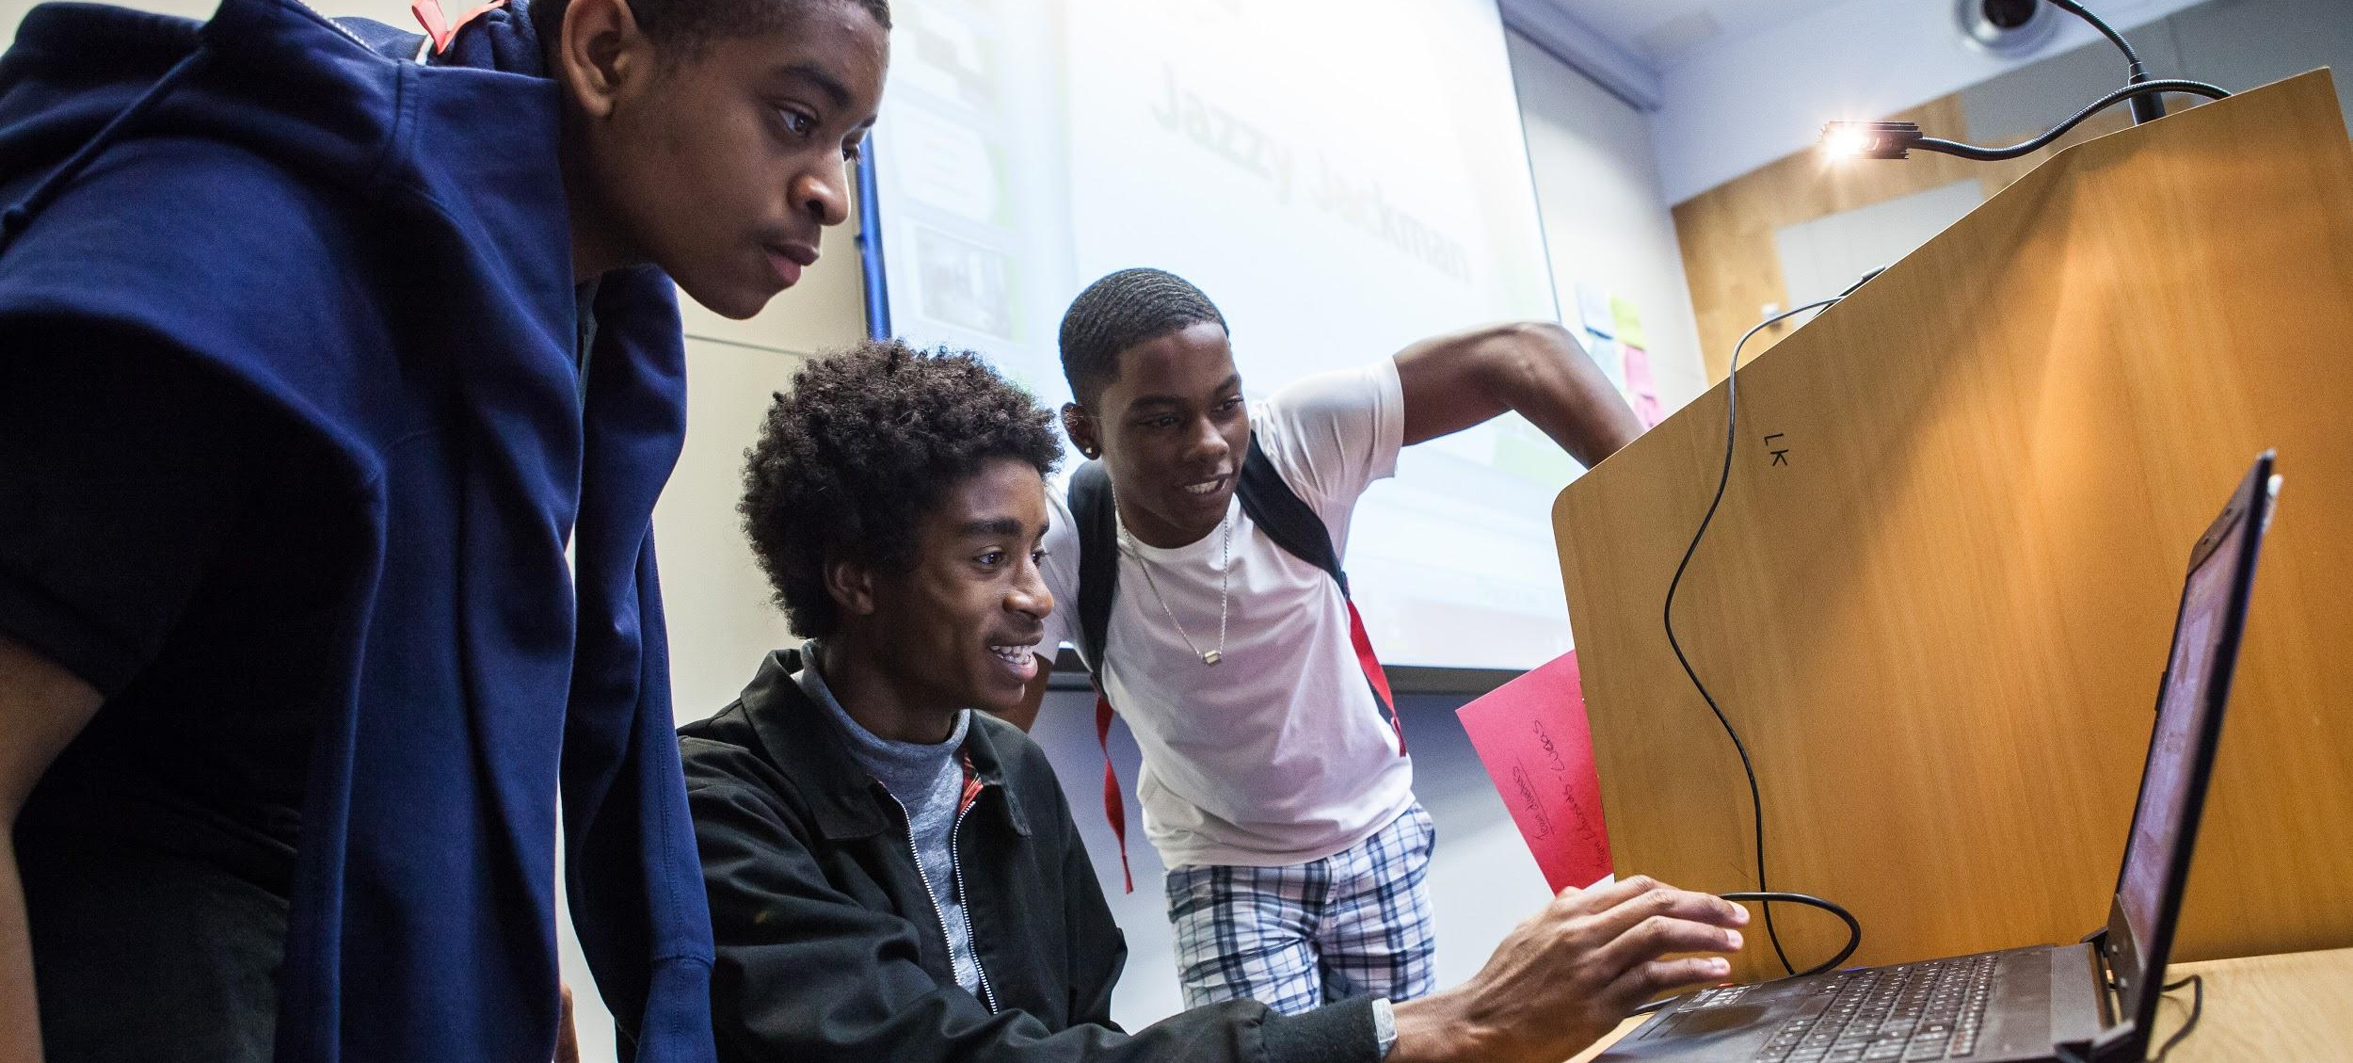
CV Workshop

Slide 2
01 | Identifying your strengths
02 | Using professional language
03 | Making a CV
04 | Making your CV shine You will need: Paper, 2 Pens (different colours)

Slide 3
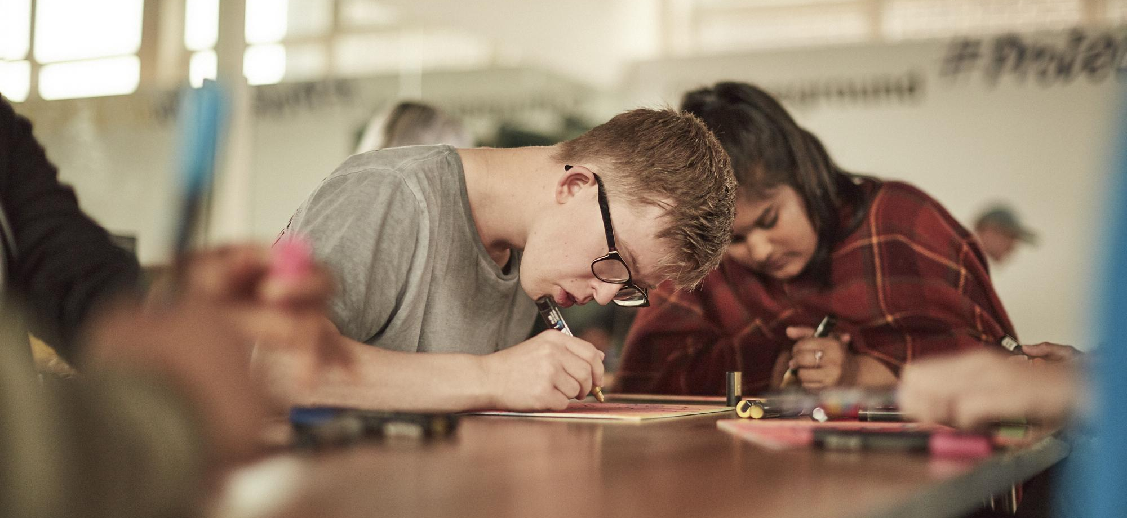
Identifying your strengths

Slide 4
Identifying your strengths
What is a CV, and why do you need one?
A CV, which stands for curriculum vitae, is a document used when applying for jobs. It summarises your education, skills and experiences so that you can successfully sell your abilities to potential employers.
It gives you an opportunity to demonstrate how your skill set matches the job you are applying for.

Slide 5
Identifying your strengths
First step in the journey
See a job advert
CV
Cover letter
Application form
Interview

Slide 6
Identifying your strengths
What to include in a CV
Contact details
Profile
Education
Work experience
Skills
Achievements
Reference

Slide 7
Identifying your strengths
Let's make a start!
What am I good at?
Where do I excel?
What do I enjoy doing?
How do I like to spend my time?
What am I passionate about?
What would my teacher say I am good at?
What would my friends say I am good at?
How have I spent my summer break?
When am I at my best?
What is my proudest achievement?
Task: Answer the above questions as honestly and positively as you can

Slide 8
Using professional language

Slide 9
Using professional language
What is a skill?
A skill is the ability to repeatedly do something well
Skills that help with specific jobs or industries:
Coding, woodwork, plumbing, nursing, animation, web design, painting, accounting, customer service etc
Technical
Skills
Skills that are essential whatever the job:
Listening, Speaking, Problem Solving, Creativity, Staying Positive, Aiming High, Leadership, Teamwork
Essential Skills
Skills that underpin everything:
Literacy, numeracy, digital
Foundation / Basic Skills

Slide 10
Using professional language
The “essential” skills
The receiving, retaining and processing of information or ideas
The oral transmission of information or ideas
The ability to find a solution to a situation or challenge
The use of imagination and the generation of new ideas
The ability to use tactics and strategies to overcome setbacks and achieve goals
The ability to set clear, tangible goals and devise a robust route to achieving them
Supporting, encouraging and developing others to achieve a shared goal
Working cooperatively with others towards achieving a shared goal

Slide 11
Using professional language
Examples of activities/experiences that can be used for each skill:
Creativity Planned an event to raise money for a local charity
Problem Solving NCS social action project
Aiming High GCSE grade 4 in Maths and English Gaining a qualification in a musical instrument Improvement in e.g attendance
Listening Worked with a team on a school project, shared ideas and came to an agreement Attended a careers talk/TED talk
Leadership Coaching/reading mentor for younger students; young carer.
Staying Positive Volunteering at a local primary school and kept morale high
Speaking Gave speech at school event During work experience spoke with customers Fluent in second language
Teamwork Part of school orchestra Play in football team Part of school production

Slide 12
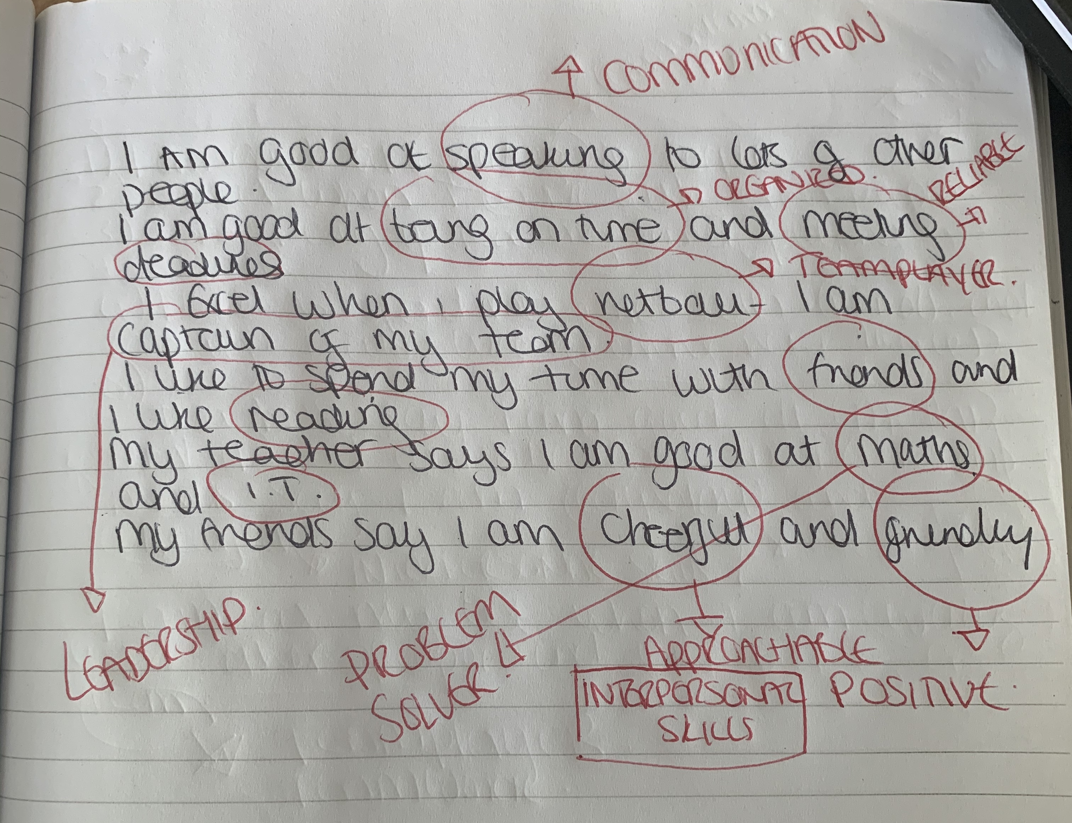
Using professional language

Slide 13
Using professional language
Strengths and experiences | Skill/ attribute
Speaking to lots of different people | Communication skills
Good at getting my homework in on time | Reliable Organised
Good at maths | Problem solving
Good at IT | IT literate
Cheerful and friendly | Interpersonal skills Positive
Captain of my netball team | Leadership Teamwork/ Team Player

Slide 14
Step 1: Using Student A as an example, re read over your notes from part one and with a different colour pen circle;
Anything that you are particularly proud of
Anything that you would want an employer to know
Any keywords that need to be translated into professional language
Using professional language
Step 2:
Think about the words you might replace your words with, for example:
Leadership
Staying positive Positive attitude
Speaking
Communication skills
Teamwork
Hard working
Committed
Reliable
Customer service
Creativity
Problem solving
Aiming high
Listening
Driven
Passionate
Motivated
Trustworthy

Slide 15
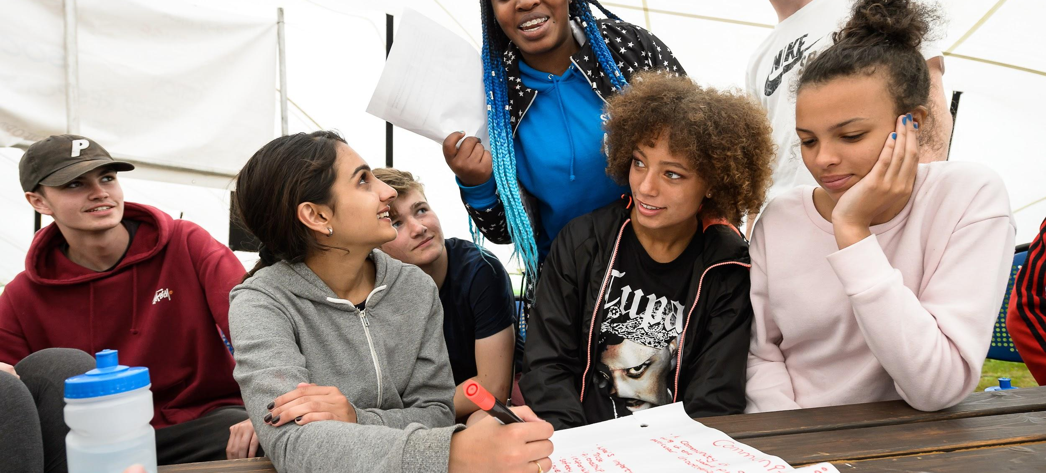
Making a CV

Slide 16
Making a CV
Reminder: What goes on a CV?
Contact details
Profile
Education
Work experience
Skills
Achievements
Reference

Slide 17
Match the CV sections to the responses
Contact details |  | Analytical thinking Communication skills Good problem solver | Teamwork Reliable Organised
Profile |  | Oak Hill School, 2008-2016 8 GCSEs (including English and Maths), 3 A Levels (Drama, English, Maths)
Education |  | Two weeks work experience at local paper, The Daily Echo. Carried out key administrative tasks and worked with a team.
Work experience |  | Extended project qualification (EPQ) Grade 4 Violin Grade 9 in Maths GCSE
Skills |  | A problem solver with excellent communication skills. Confident at speaking with different people and would be suited to a customer service role. Punctual and reliable and works with a positive attitude.
Achievements |  | Available upon request
Reference |  | Student A, 21C Millbrook Court, SW18 9LA , HC1@hotmail.com 07888888888

Slide 18
That’s better
Contact details | Student A, 21C Millbrook Court, SW18 9LA , HC1@hotmail.com 07888888888
Profile | A problem solver with excellent communication skills. Confident at speaking with different people and would be suited to a customer service role. Punctual and reliable and works with a positive attitude.
Work experience | Two weeks work experience at local paper, The Daily Echo. Carried out key administrative tasks and worked with a team.
Education | Oak Hill School, 2008-2016 8 GCSEs (including English and Maths), 3 A Levels (Drama, English, Maths)
Skills | Analytical thinking Communication skills Good problem solver | Teamwork Reliable Organised
Achievements | Extended project qualification (EPQ) Grade 4 Violin Grade 9 in Maths GCSE
References | Available upon request

Slide 19
Making a CV
Your Turn!
Contact details
Profile
Education
Work experience
Skills
Achievements
Reference

Slide 20
Student A - Skills
Making a CV
Communication skills
Reliable
Organised
Problem solving
IT literate
Interpersonal skills
Positive
Leadership
Teamwork/ Team player
Outstanding communication skills
Reliable
Highly organised
Excellent problem solver
IT literate
Exceptional interpersonal skills
Positive approach to tasks
Demonstrable leadership
Team player
Expert, outstanding, excellent, demonstrable, confident, skilled, inspiring, passionate, highly, experienced

Slide 21
Student A - Profile
Making a CV
Outstanding communication skills
Reliable
Highly organised
Excellent problem solver
IT literate
Exceptional interpersonal skills
Positive approach to tasks
Demonstrable leadership
Team player
“A confident communicator who enjoys working as part of a team. Also comfortable taking on a leadership role.
Highly organised and works with a positive approach to tasks.”

Slide 22
Making a CV
Your turn!
Hint: use “Action” verbs

Slide 23
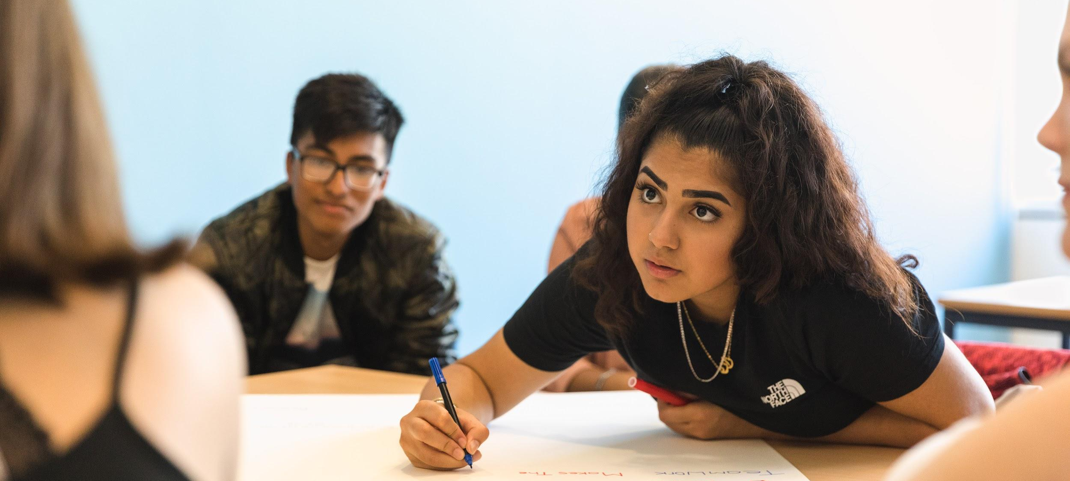
Making your CV shine

Slide 24
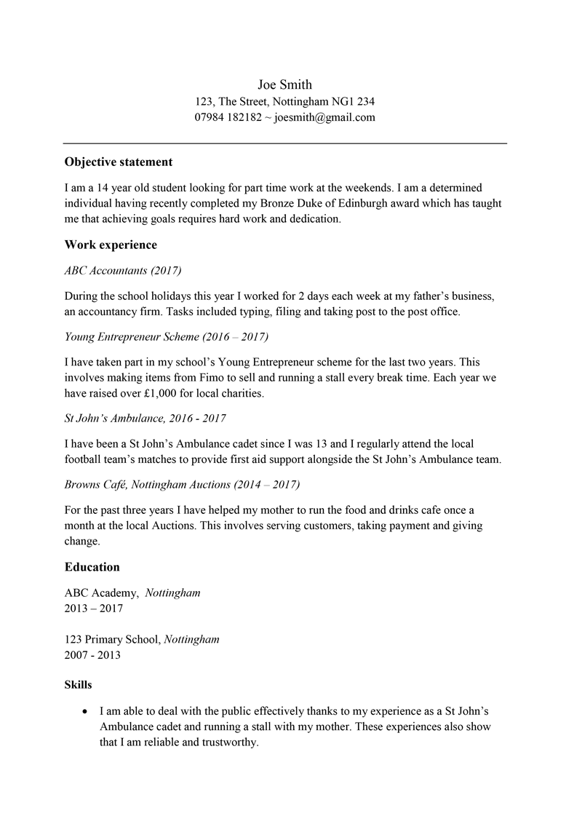
Making your CV shine

Slide 25
Making your CV shine

Slide 26
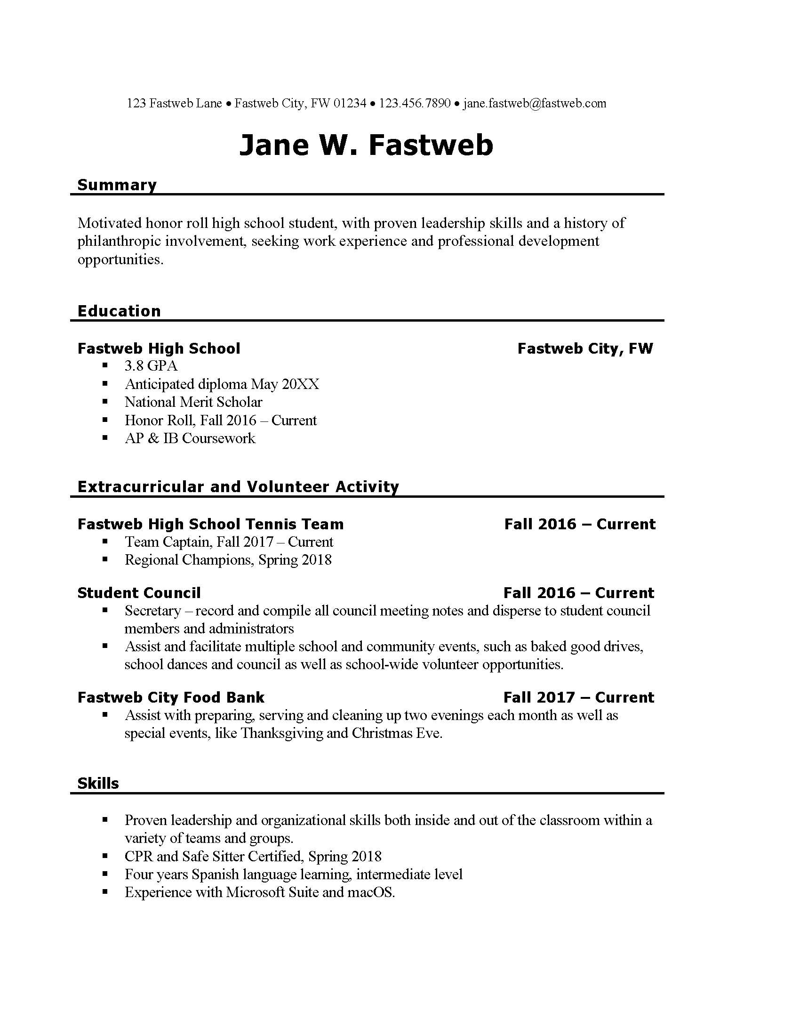
Making your CV shine

Slide 27
Making your CV shine

Slide 28
Choose five ideas that you are going to steal

Slide 29
Making your CV shine
Must, should, could
3 “must haves”
Contact details
All relevant experience and skills
Dates
2 “should haves”
Consistent formatting
Clear sections
1 “could have”
An interesting design

Slide 30
Making your CV shine
Top tips and ideas!
Keep a record of activities you take part in
Seek out opportunities
Keep your CV up to date
No longer than two pages
Imagine being the reader - the employer will scan your CV so make it stand out
Cross reference your CV with the job description before sending

